Slide 1
Signals and Systems Lecture 4 Zero-state response
DR TANIA STATHAKI
READER (ASSOCIATE PROFFESOR) IN SIGNAL PROCESSING IMPERIAL COLLEGE LONDON

Slide 2
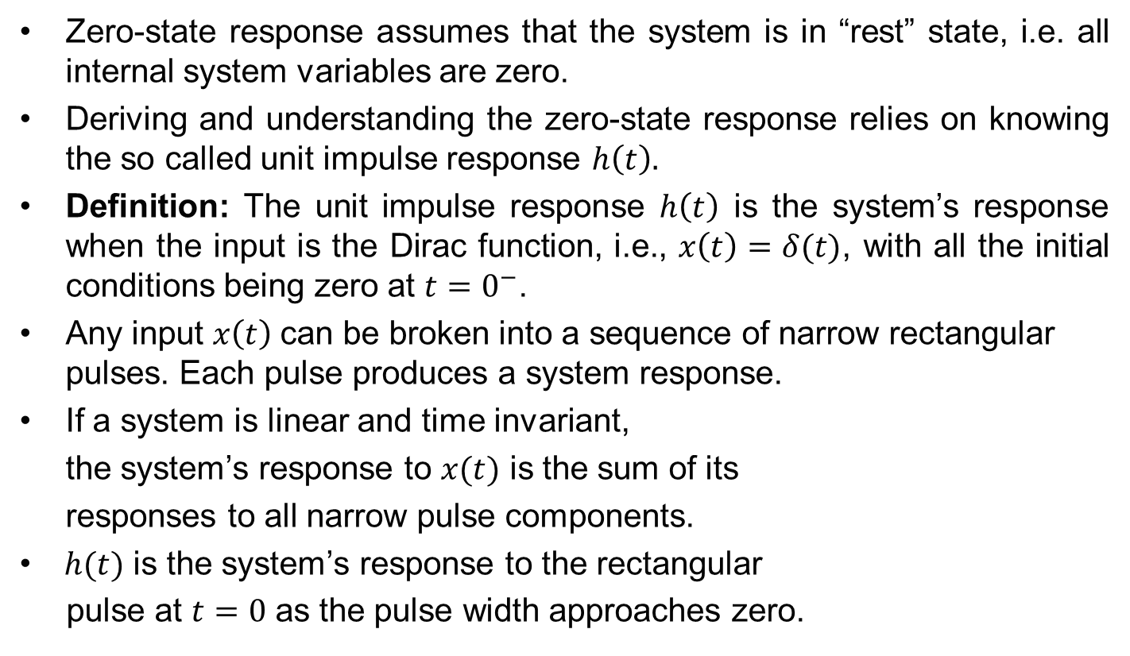
The importance of impulse response
Zero-state response assumes that the system is in “rest” state, i.e. all internal system variables are zero.
Deriving and understanding the zero-state response relies on knowing the so called unit impulse response $h\left(t\right).$
Definition: The unit impulse response $h\left(t\right)$ is the system’s response when the input is the Dirac function, i.e., $x\left(t\right)=δ(t)$, with all the initial conditions being zero at ${t=0}^{−}$.
Any input $x\left(t\right)$can be broken into a sequence of narrow rectangular pulses. Each pulse produces a system response.
If a system is linear and time invariant,
the system’s response to $x(t)$ is the sum of its
responses to all narrow pulse components.
$h(t)$ is the system’s response to the rectangular
pulse at $t=0$ as the pulse width approaches zero.

Slide 3
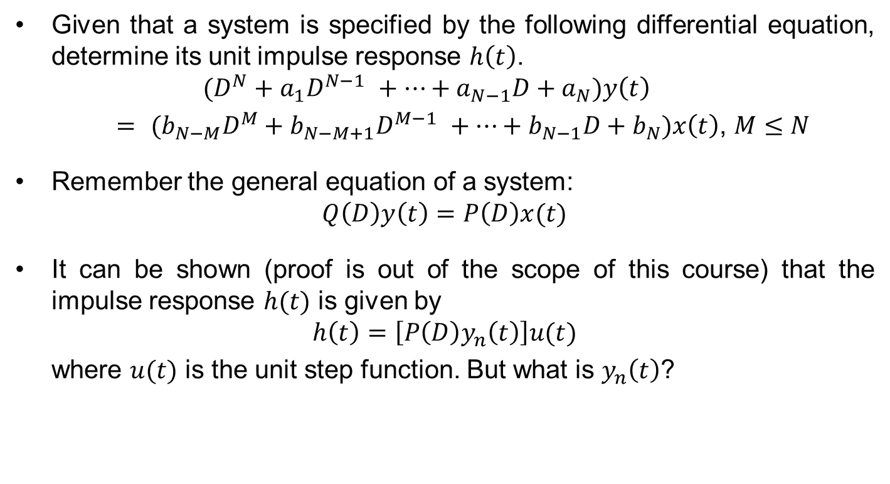
How to determine the unit impulse response $h(t)$ ?
Given that a system is specified by the following differential equation, determine its unit impulse response $h\left(t\right)$.
$$(D^{N}+a_{1}D^{N−1} +…+a_{N−1}D+a_{N})y\left(t\right)$$
$= {(b}_{N−M}D^{M}+b_{N−M+1}D^{M−1} +…+b_{N−1}D+b_{N})x\left(t\right)$, $M≤N$
Remember the general equation of a system:
$$Q\left(D\right)y\left(t\right)=P\left(D\right)x(t)$$
It can be shown (proof is out of the scope of this course) that the impulse response $h(t)$ is given by
$$h\left(t\right)=\left[P\left(D\right)y_{n}\left(t\right)\right]u(t)$$
where $u(t)$ is the unit step function. But what is $y_{n}\left(t\right)$?

Slide 4
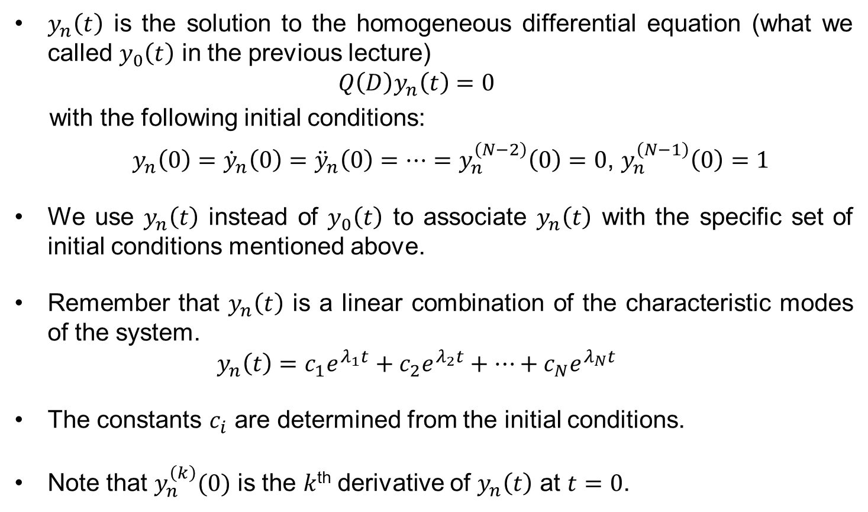
How to determine the unit impulse response $h(t)$ ?
$y_{n}\left(t\right)$ is the solution to the homogeneous differential equation (what we called $y_{0}\left(t\right)$ in the previous lecture)
$$Q\left(D\right)y_{n}\left(t\right)=0$$
with the following initial conditions:
$y_{n}\left(0\right)={\dot{y}}_{n}\left(0\right)={\ddot{y}}_{n}\left(0\right)=…=y_{n}^{\left(N−2\right)}\left(0\right)=0$, $y_{n}^{\left(N−1\right)}\left(0\right)=1$
We use $y_{n}\left(t\right)$ instead of $y_{0}\left(t\right)$ to associate $y_{n}\left(t\right)$ with the specific set of initial conditions mentioned above.
Remember that $y_{n}\left(t\right)$ is a linear combination of the characteristic modes of the system.
$$y_{n}\left(t\right)=c_{1}e^{λ_{1}t}+c_{2}e^{λ_{2}t}+…+c_{N}e^{λ_{N}t}$$
The constants $c_{i}$ are determined from the initial conditions.
Note that $y_{n}^{\left(k\right)}(0)$ is the $k$^{th} derivative of $y_{n}\left(t\right)$ at $t=0$.

Slide 5
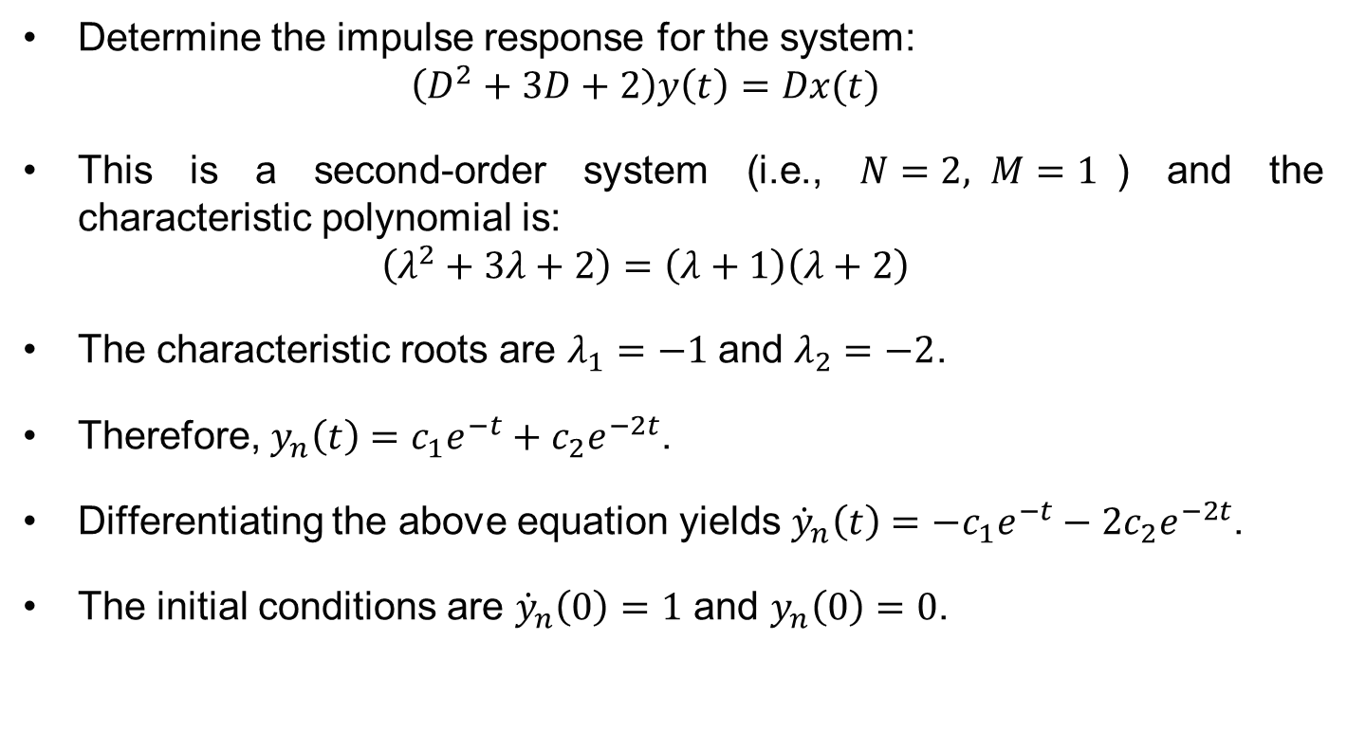
Example
Determine the impulse response for the system:
$$\left(D^{2}+3D+2\right)y\left(t\right)=Dx(t)$$
This is a second-order system (i.e., $N=2, M=1$) and the characteristic polynomial is:
$$\left(λ^{2}+3λ+2\right)=\left(λ+1\right)\left(λ+2\right)$$
The characteristic roots are $λ_{1}=−1$ and $λ_{2}=−2$.
Therefore, $y_{n}\left(t\right)=c_{1}e^{−t}+c_{2}e^{−2t}$.
Differentiating the above equation yields ${\dot{y}}_{n}\left(t\right)={−c}_{1}e^{−t}−2c_{2}e^{−2t}$.
The initial conditions are ${\dot{y}}_{n}\left(0\right)=1$ and $y_{n}\left(0\right)=0$.

Slide 6
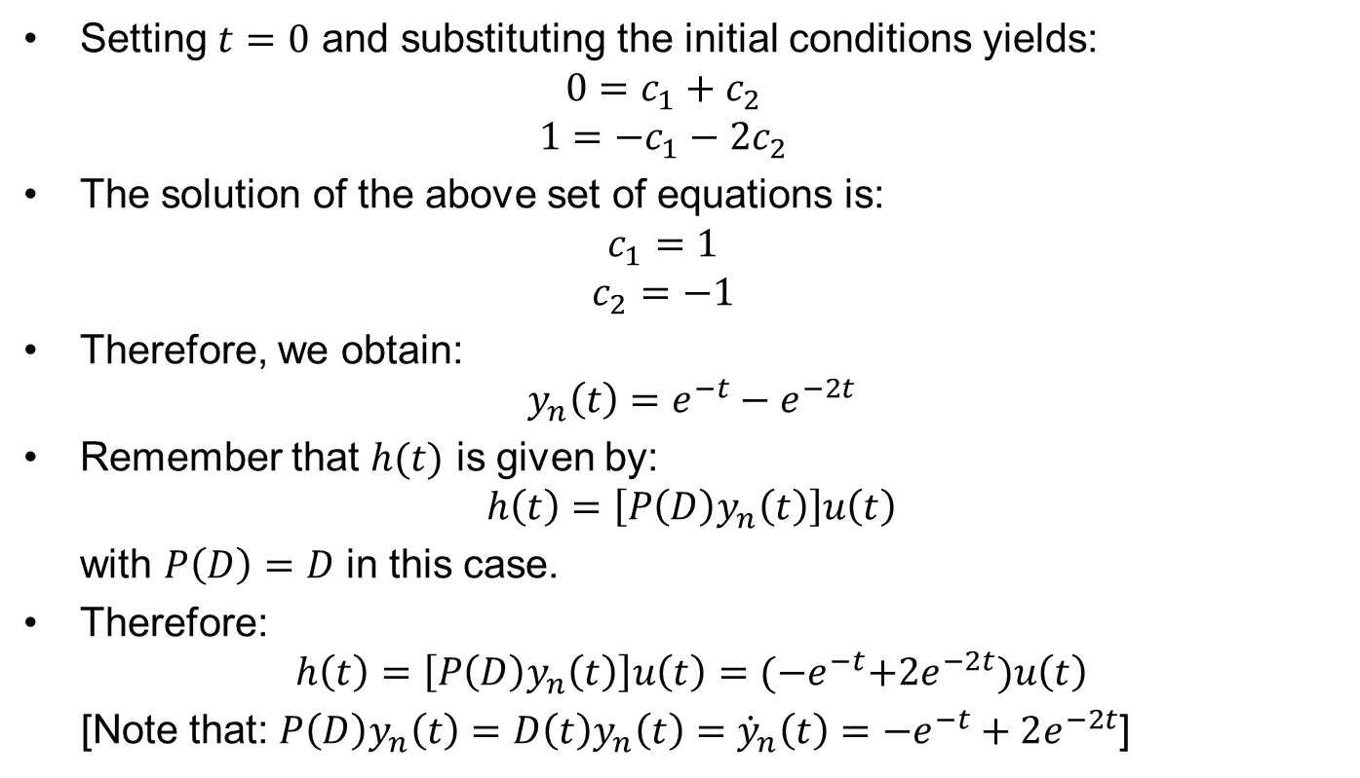
Example cont.
Setting $t=0$ and substituting the initial conditions yields:
$$0=c_{1}+c_{2}$$
$$1={−c}_{1}−2c_{2}$$
The solution of the above set of equations is:
$$c_{1}=1$$
$$c_{2}=−1$$
Therefore, we obtain:
$$y_{n}\left(t\right)=e^{−t}−e^{−2t}$$
Remember that $h(t)$ is given by:
$$h\left(t\right)=\left[P\left(D\right)y_{n}\left(t\right)\right]u\left(t\right)$$
with $P\left(D\right)=D$ in this case.
Therefore:
$$h\left(t\right)=\left[P\left(D\right)y_{n}\left(t\right)\right]u\left(t\right)={(−e}^{−t}+{2e}^{−2t})u\left(t\right)$$
[Note that: $P\left(D\right)y_{n}\left(t\right)=D\left(t\right)y_{n}\left(t\right)={\dot{y}}_{n}\left(t\right)={−e}^{−t}+2e^{−2t}$]

Slide 7

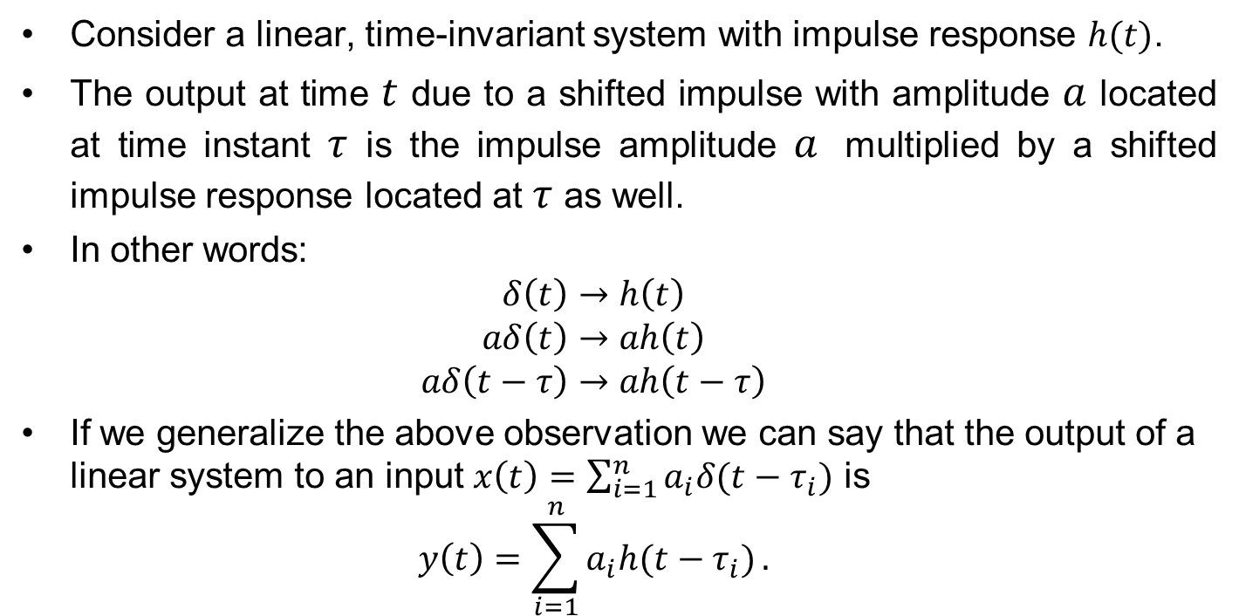

Zero-state response
$$x(t)$$
Linear System
$$y(t)$$
Consider a linear, time-invariant system with impulse response $h(t)$.
The output at time $t$ due to a shifted impulse with amplitude $a$ located at time instant $τ$ is the impulse amplitude $a$ multiplied by a shifted impulse response located at $τ$ as well.
In other words:
$$δ\left(t\right)→h\left(t\right)$$
$$aδ\left(t\right)→ah\left(t\right)$$
$$aδ\left(t−τ\right)→ah\left(t−τ\right)$$
If we generalize the above observation we can say that the output of a linear system to an input $x\left(t\right)=\sum_{i=1}^{n}{a_{i}δ(t−τ_{i})}$ is
$$y\left(t\right)=\sum_{i=1}^{n}{a_{i}h(t−τ_{i})}.$$

Slide 8
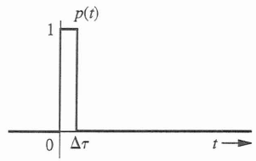
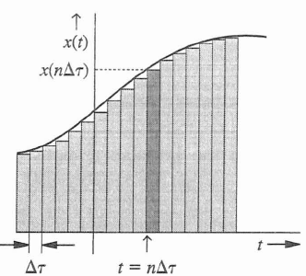
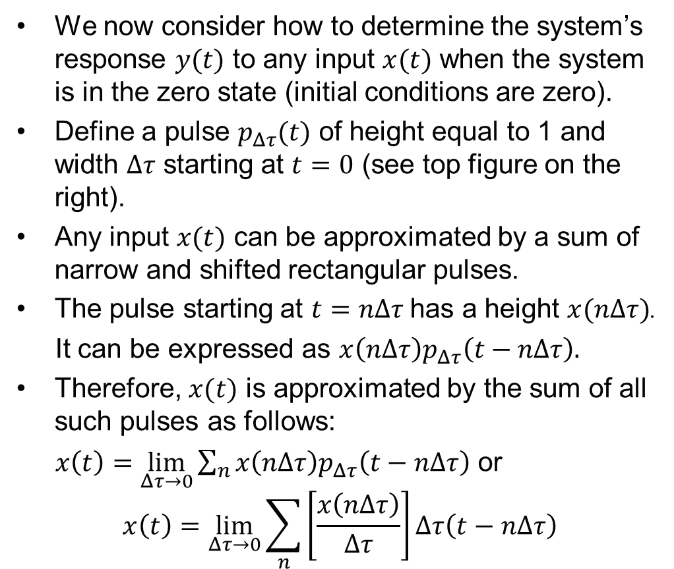

Zero-state response cont.
We now consider how to determine the system’s response $y(t)$ to any input $x(t)$ when the system is in the zero state (initial conditions are zero).
Define a pulse $p_{Δτ}(t)$ of height equal to 1 and width $Δτ$ starting at $t=0$ (see top figure on the right).
Any input $x(t)$ can be approximated by a sum of narrow and shifted rectangular pulses.
The pulse starting at $t=nΔτ$ has a height $x(nΔτ)$.
It can be expressed as $x\left(nΔτ\right)p_{Δτ}\left(t−nΔτ\right).$
Therefore, $x(t)$ is approximated by the sum of all such pulses as follows:
$x\left(t\right)=\lim_{Δτ→0}{\sum_{n}{x\left(nΔτ\right)p_{Δτ}\left(t−nΔτ\right)}}$ or
$$x\left(t\right)=\lim_{Δτ→0}{\sum_{n}{\left[\frac{x\left(nΔτ\right)}{Δτ}\right]Δτ\left(t−nΔτ\right)}}$$
$$p_{Δτ}\left(t\right)$$

Slide 9
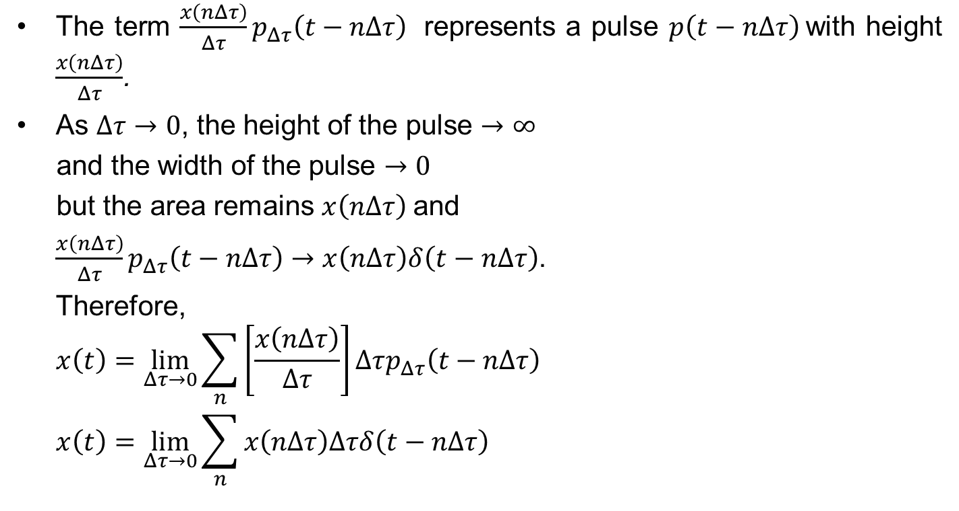
Zero-state response cont.
The term $\frac{x\left(nΔτ\right)}{Δτ}p_{Δτ}\left(t−nΔτ\right)$ represents a pulse $p\left(t−nΔτ\right)$with height $\frac{x\left(nΔτ\right)}{Δτ}$.
As $Δτ→0$, the height of the pulse $→∞$
and the width of the pulse $→0$
but the area remains $x\left(nΔτ\right)$and
$\frac{x\left(nΔτ\right)}{Δτ}p_{Δτ}\left(t−nΔτ\right)→$ $x\left(nΔτ\right)δ\left(t−nΔτ\right)$.
Therefore,
$$x\left(t\right)=\lim_{Δτ→0}{\sum_{n}{\left[\frac{x\left(nΔτ\right)}{Δτ}\right]Δτp_{Δτ}\left(t−nΔτ\right)}}$$
$$x\left(t\right)=\lim_{Δτ→0}{\sum_{n}{x\left(nΔτ\right)Δτδ\left(t−nΔτ\right)}}$$

Slide 10
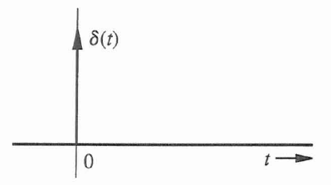
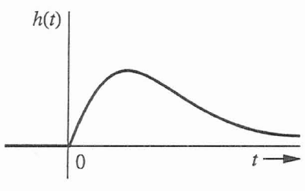
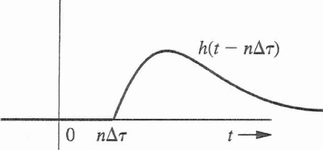
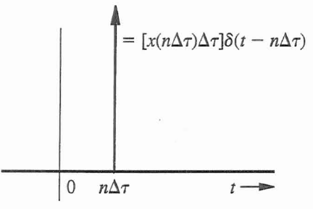
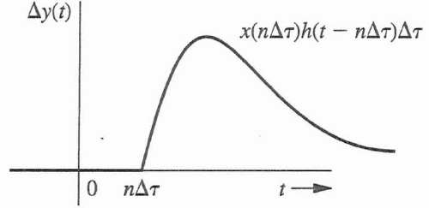
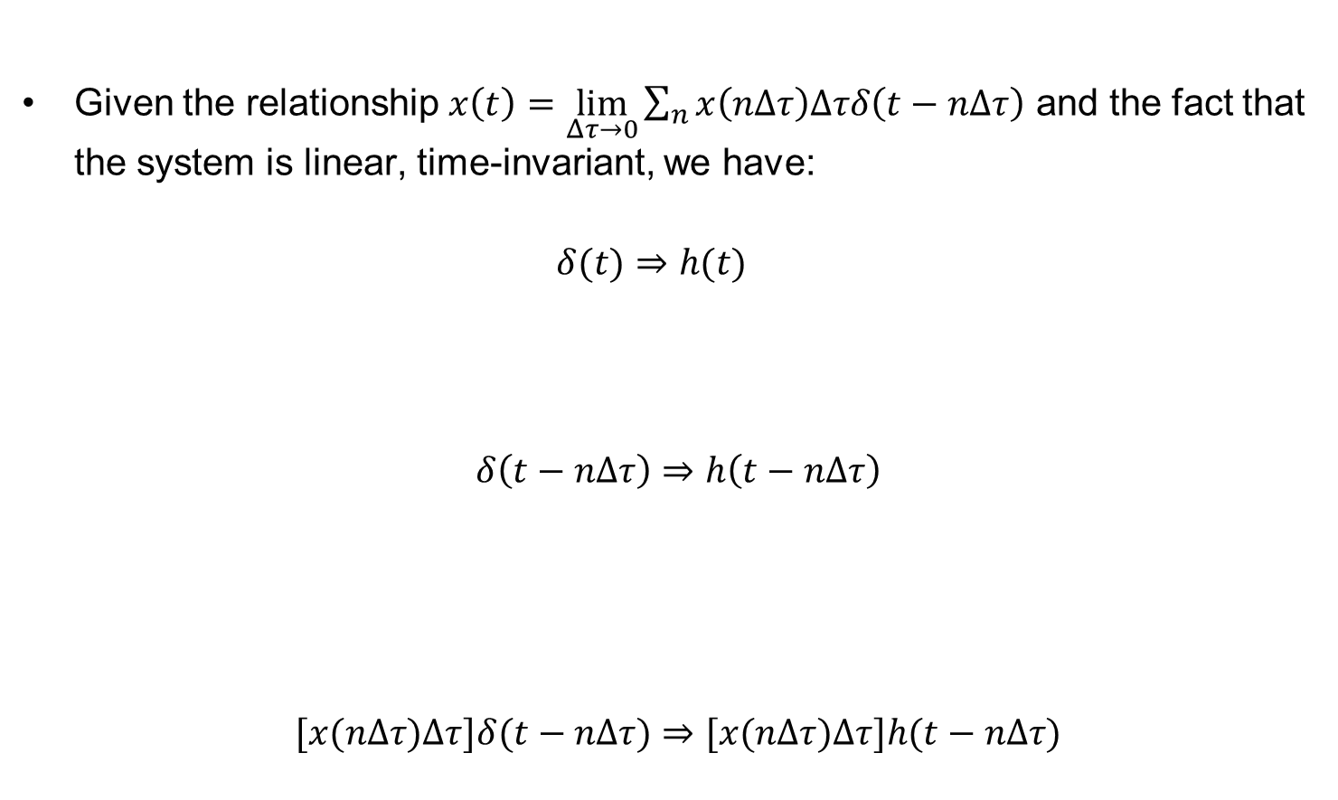
Zero-state response cont.
Given the relationship $x\left(t\right)=\lim_{Δτ→0}{\sum_{n}{x\left(nΔτ\right)Δτδ\left(t−nΔτ\right)}}$ and the fact that the system is linear, time-invariant, we have:
$$δ(t)⇒h(t)$$
$$δ\left(t−nΔτ\right)⇒h\left(t−nΔτ\right)$$
$$[x(nΔτ)Δτ]δ(t−nΔτ)⇒[x(nΔτ)Δτ]h(t−nΔτ)$$

Slide 11



Zero-state response cont.
Based on the previous analysis, the input-output relationship of an LTI system as a function of the impulse response is shown below.
$\lim_{Δτ→0}{\sum_{n}{x\left(nΔτ\right)Δτδ\left(t−nΔτ\right)⇒}}$ $\lim_{Δτ→0}{\sum_{n}{x\left(nΔτ\right)Δτh\left(t−nΔτ\right)}}$
$\lim_{Δτ→0}{\sum_{n}{x\left(nΔτ\right)δ\left(t−nΔτ\right)Δτ⇒}}$ $\lim_{Δτ→0}{\sum_{n}{x\left(nΔτ\right)h\left(t−nΔτ\right)Δτ}}$

Slide 12
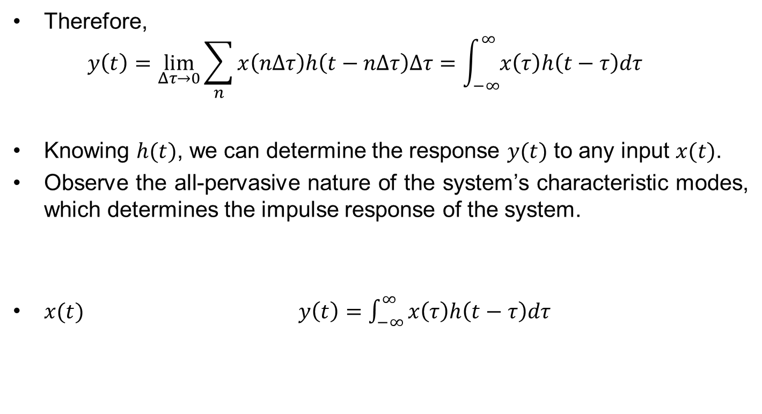

Zero-state response cont.
Therefore,
$$y\left(t\right)=\lim_{Δτ→0}{\sum_{n}{x\left(nΔτ\right)h\left(t−nΔτ\right)Δτ=\int_{−∞}^{∞}{x\left(τ\right)h\left(t−τ\right)dτ}}}$$
Knowing $h(t)$, we can determine the response $y(t)$ to any input $x(t)$.
Observe the all-pervasive nature of the system’s characteristic modes, which determines the impulse response of the system.
$x(t)y\left(t\right)=\int_{−∞}^{∞}{x\left(τ\right)h\left(t−τ\right)dτ}{}$
LTI System
$$h(t)$$

Slide 13
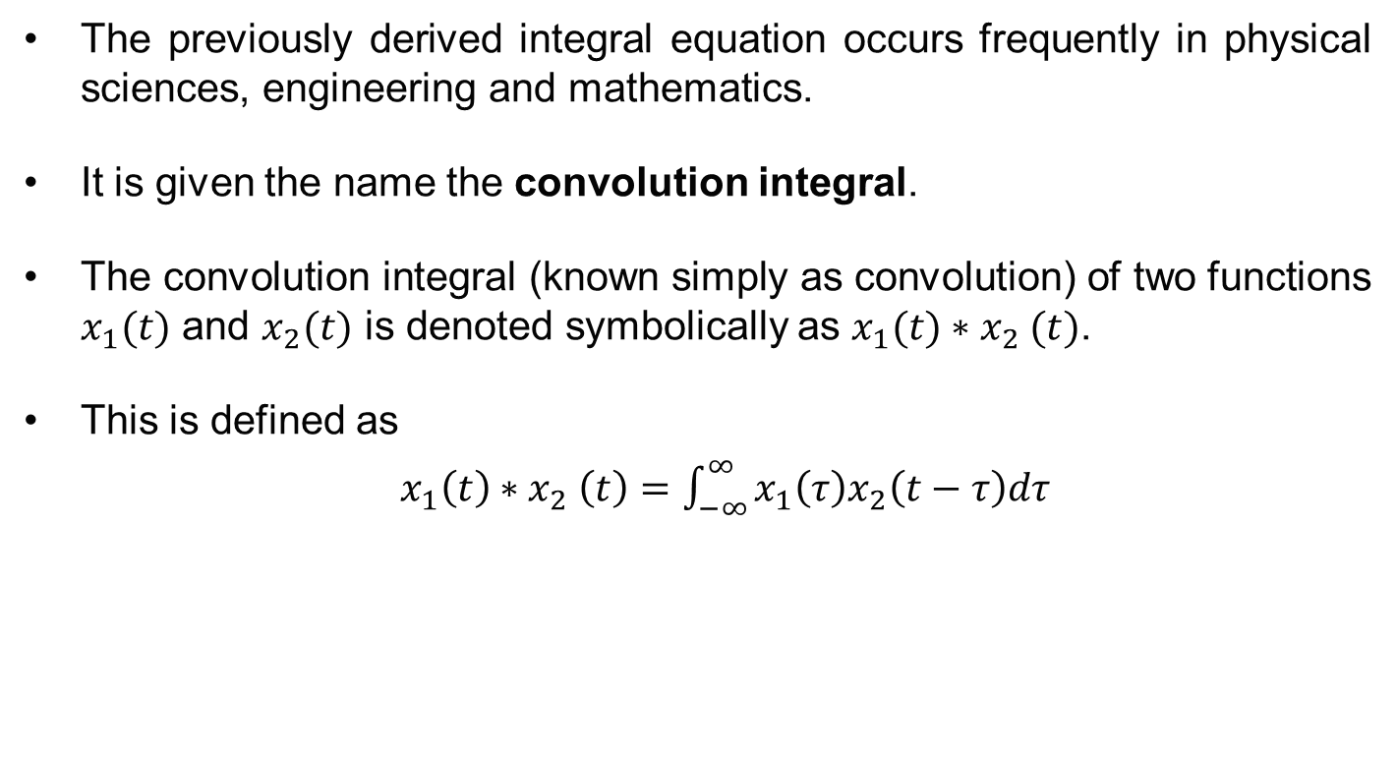
The convolution integral
The previously derived integral equation occurs frequently in physical sciences, engineering and mathematics.
It is given the name the convolution integral.
The convolution integral (known simply as convolution) of two functions $x_{1}(t)$ and $x_{2}(t)$ is denoted symbolically as $x_{1}(t){∗x}_{2}(t)$.
This is defined as
$x_{1}\left(t\right){∗x}_{2}\left(t\right)=$ $\int_{−∞}^{∞}{x_{1}\left(τ\right)x_{2}\left(t−τ\right)dτ}$

Slide 14
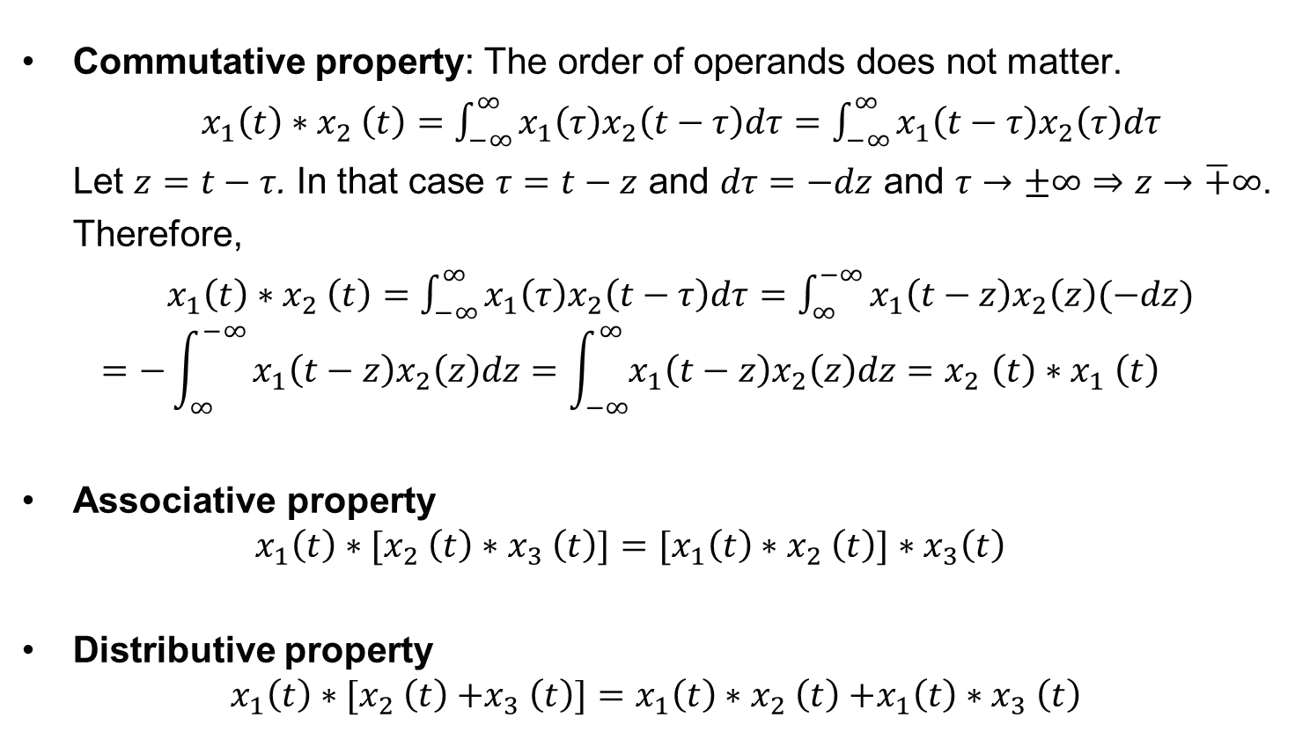
Convolution properties
Commutative property: The order of operands does not matter.
$x_{1}\left(t\right){∗x}_{2}\left(t\right)=$ $\int_{−∞}^{∞}{x_{1}\left(τ\right)x_{2}\left(t−τ\right)dτ}=\int_{−∞}^{∞}{x_{1}\left(t−τ\right)x_{2}\left(τ\right)dτ}$
Let $z=t−τ$. In that case $τ=t−z$ and $dτ=−dz$ and $τ→±∞⇒z→\overline{+}∞$.
Therefore,
$x_{1}\left(t\right){∗x}_{2}\left(t\right)=$ $\int_{−∞}^{∞}{x_{1}\left(τ\right)x_{2}\left(t−τ\right)dτ}=\int_{∞}^{−∞}{x_{1}\left(t−z\right)x_{2}\left(z\right)(−dz})$
$$=−\int_{∞}^{−∞}{x_{1}\left(t−z\right)x_{2}\left(z\right)dz=\int_{−∞}^{∞}{x_{1}\left(t−z\right)x_{2}\left(z\right)dz{=x}_{2}\left(t\right){∗x}_{1}\left(t\right)}}$$
Associative property
$$x_{1}\left(t\right){∗[x}_{2}\left(t\right){∗x}_{3}\left(t\right)]={[x}_{1}\left(t\right){∗x}_{2}\left(t\right){]∗x}_{3}\left(t\right)$$
Distributive property
$$x_{1}\left(t\right){∗[x}_{2}\left(t\right){+x}_{3}\left(t\right)]=x_{1}\left(t\right){∗x}_{2}\left(t\right){+x_{1}\left(t\right)∗x}_{3}\left(t\right)$$

Slide 15
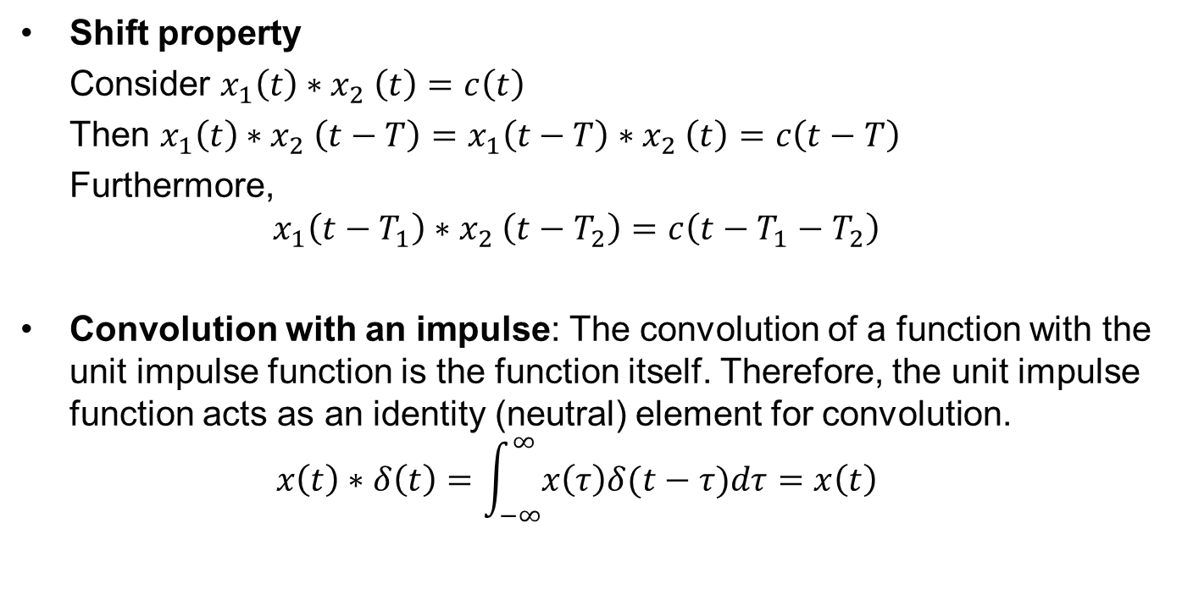
Convolution properties cont.
Shift property
Consider $x_{1}\left(t\right){∗x}_{2}\left(t\right)=c\left(t\right)$
Then $x_{1}\left(t\right){∗x}_{2}\left(t−T\right)=x_{1}\left(t−T\right){∗x}_{2}\left(t\right)=c\left(t−T\right)$
Furthermore,
$$x_{1}\left(t−T_{1}\right){∗x}_{2}\left(t−T_{2}\right)=c\left(t−T_{1}−T_{2}\right)$$
Convolution with an impulse: The convolution of a function with the unit impulse function is the function itself. Therefore, the unit impulse function acts as an identity (neutral) element for convolution.
$$x\left(t\right)∗δ\left(t\right)=\int_{−∞}^{∞}{x\left(τ\right)δ(t−τ)dτ}=x\left(t\right)$$

Slide 16
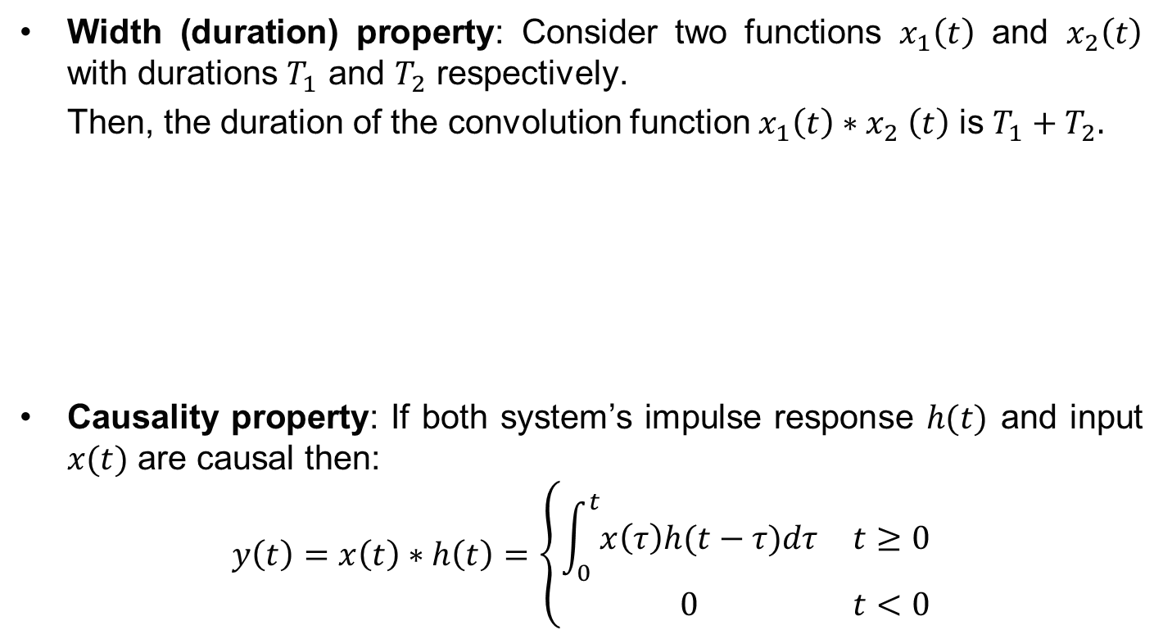
Convolution properties cont.
Width (duration) property: Consider two functions $x_{1}\left(t\right)$ and $x_{2}\left(t\right)$ with durations $T_{1}$ and $T_{2}$ respectively.
Then, the duration of the convolution function $x_{1}\left(t\right){∗x}_{2}\left(t\right)$ is $T_{1}+T_{2}.$
Causality property: If both system’s impulse response $h(t)$ and input $x(t)$ are causal then:
$$y\left(t\right)=x\left(t\right)∗h\left(t\right)=\left\{\begin{matrix}\int_{0}^{t}{x\left(τ\right)h(t−τ)dτ} & t≥0 \\ 0 & t<0\end{matrix}\right.$$

Slide 17
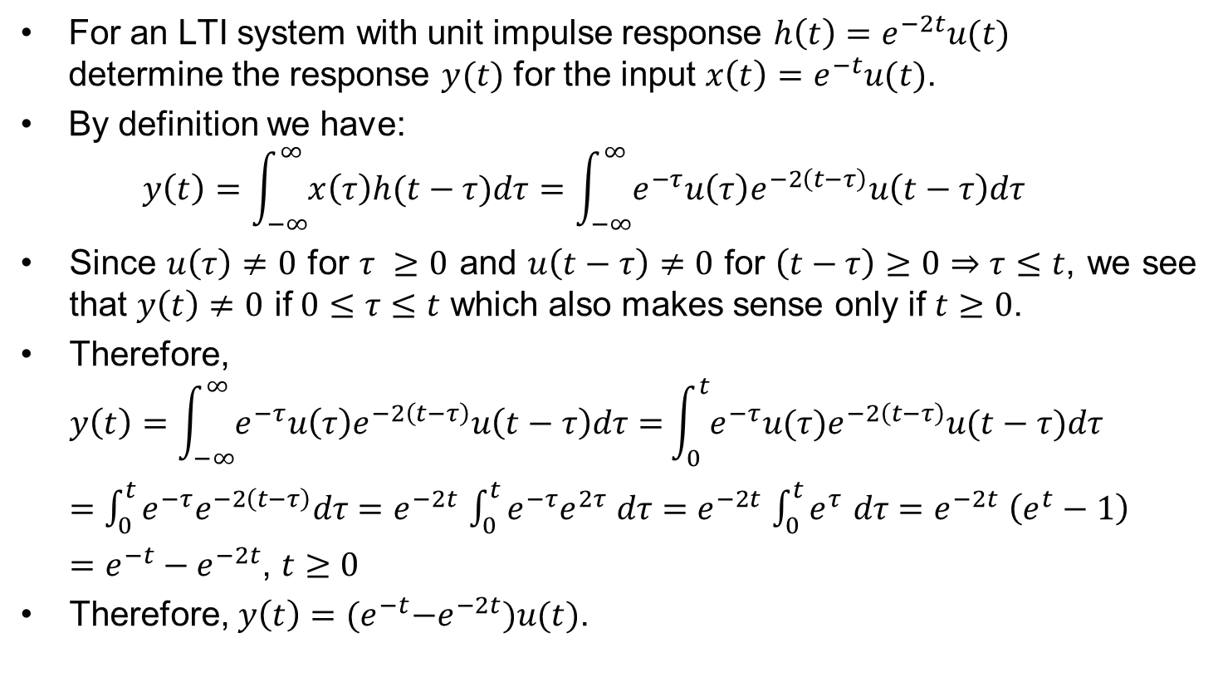
Example
For an LTI system with unit impulse response $h\left(t\right)=e^{−2t}u(t)$ determine the response $y(t)$ for the input $x\left(t\right)=e^{−t}u(t)$.
By definition we have:
$$y\left(t\right)=\int_{−∞}^{∞}{x\left(τ\right)h(t−τ)dτ}=\int_{−∞}^{∞}{e^{−τ}u\left(τ\right)e^{−2\left(t−τ\right)}u\left(t−τ\right)dτ}$$
Since $u\left(τ\right)≠0$ for $τ ≥0$ and $u\left(t−τ\right)≠0$ for $\left(t−τ\right)≥0⇒τ≤t$, we see that $y\left(t\right)≠0$ if $0≤τ≤t$ which also makes sense only if $t≥0$.
Therefore,
$$y\left(t\right)=\int_{−∞}^{∞}{e^{−τ}u\left(τ\right)e^{−2\left(t−τ\right)}u\left(t−τ\right)dτ=}\int_{0}^{t}{e^{−τ}u(τ)e^{−2\left(t−τ\right)}u(t−τ)dτ}$$
$=$ $\int_{0}^{t}{e^{−τ}e^{−2\left(t−τ\right)}dτ}=e^{−2t}$ $\int_{0}^{t}{{e^{−τ}e}^{2τ }dτ}=$ $e^{−2t}$ $\int_{0}^{t}{e^{τ }dτ}{=e}^{−2t}\left(e^{t}−1\right)$
$=e^{−t}−e^{−2t}$, $t≥0$
Therefore, $y\left(t\right)={(e}^{−t}−e^{−2t})u(t)\text{.}$

Slide 18

Example cont.
$h\left(t\right)=e^{−2t}u(t)$
$x\left(t\right)=e^{−t}u\left(t\right)$
$y\left(t\right)={(e}^{−t}−e^{−2t})u(t)$

Slide 19
Relation to other courses
Convolution has been introduced last year in the Signals and Communications course. We will emphasize into convolution and its physical implication in the next lecture.
Zero-state response (as determined through the convolution operation) is very important, and is intimately related to the zero-input response and the characteristic modes of the system.
All these are relevant to the 2nd year Control course.
You will also come across convolution again in your 2nd year Communications course and third year DSP course.

