Slide 1
Signals and Systems Lecture 3
DR TANIA STATHAKI
READER (ASSOCIATE PROFFESOR) IN SIGNAL PROCESSING IMPERIAL COLLEGE LONDON

Slide 2
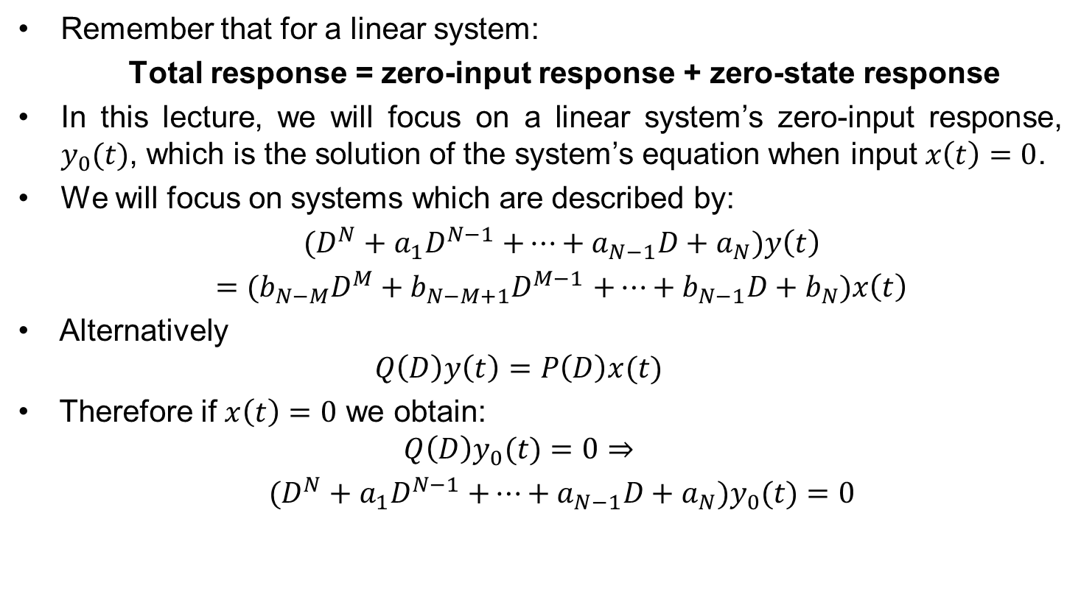
Zero-input response basics
Remember that for a linear system:
Total response = zero-input response + zero-state response
In this lecture, we will focus on a linear system’s zero-input response, $y_{0}(t)$, which is the solution of the system’s equation when input $x\left(t\right)=0$.
We will focus on systems which are described by:
$(D^{N}+a_{1}D^{N−1}$ $+…+a_{N−1}D+a_{N})y\left(t\right)$
$=$ ${(b}_{N−M}D^{M}+b_{N−M+1}D^{M−1}$ $+…+b_{N−1}D+b_{N})x\left(t\right)$
Alternatively
$$Q\left(D\right)y\left(t\right)=P\left(D\right)x(t)$$
Therefore if $x\left(t\right)=0$ we obtain:
$$Q\left(D\right)y_{0}(t)=0⇒$$
$(D^{N}+a_{1}D^{N−1}$ $+…+a_{N−1}D+a_{N})y_{0}(t)=0$

Slide 3
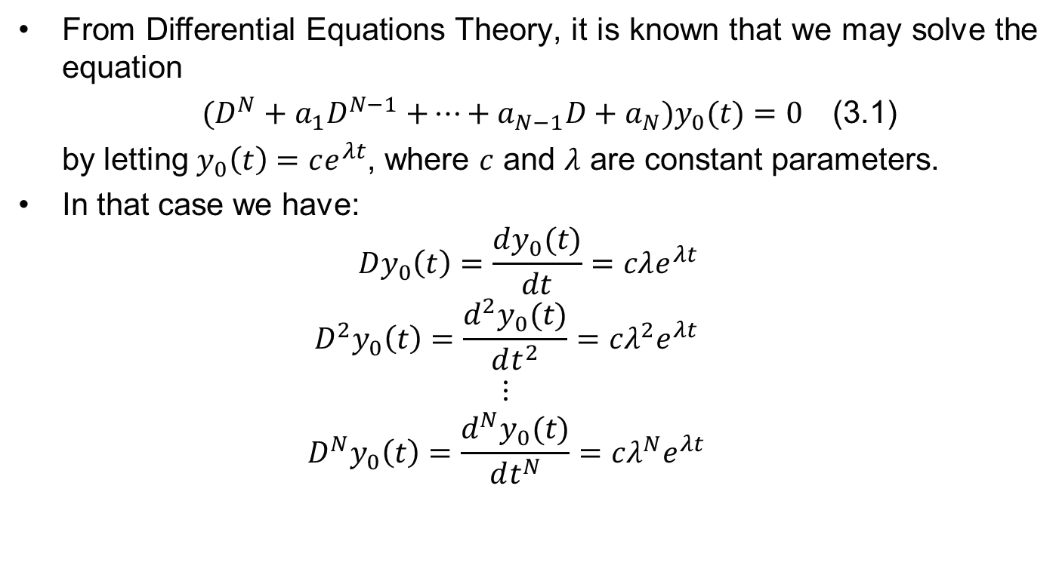
General solution to the zero-input response equation
From Differential Equations Theory, it is known that we may solve the equation
$(D^{N}+a_{1}D^{N−1}$ $+…+a_{N−1}D+a_{N})y_{0}(t)=0$ (3.1)
by letting $y_{0}\left(t\right)=ce^{λt}$, where $c$ and $λ$ are constant parameters.
In that case we have:
$$Dy_{0}\left(t\right)=\frac{dy_{0}(t)}{dt}=cλe^{λt}$$
$$D^{2}y_{0}\left(t\right)=\frac{d^{2}y_{0}(t)}{dt^{2}}=cλ^{2}e^{λt}$$
$$⋮$$
$$D^{N}y_{0}\left(t\right)=\frac{d^{N}y_{0}(t)}{dt^{N}}=cλ^{N}e^{λt}$$
Substitute into (3.1)

Slide 4
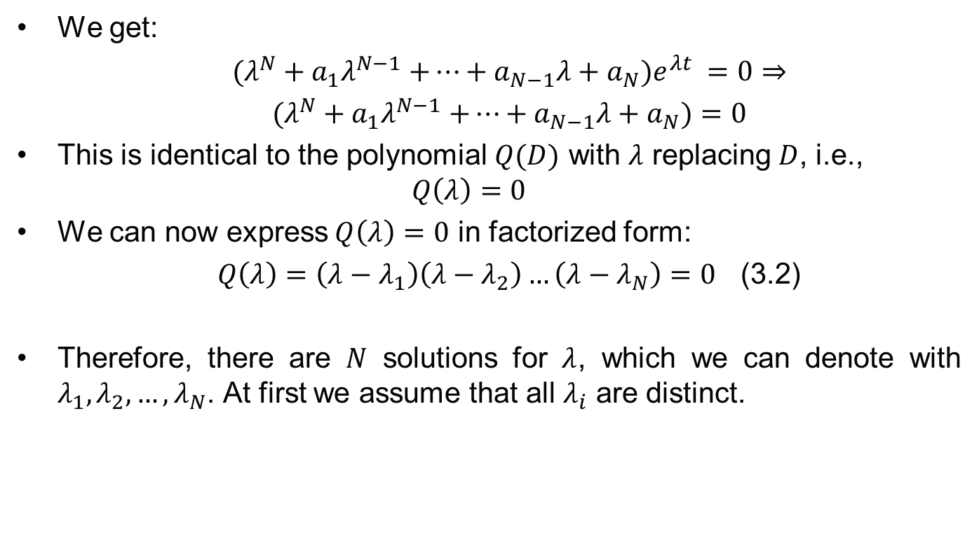
General solution to the zero-input response equation cont.
We get:
$(λ^{N}+a_{1}λ^{N−1}$ $+…+a_{N−1}λ+a_{N})e^{λt} =0⇒$
$(λ^{N}+a_{1}λ^{N−1}$ $+…+a_{N−1}λ+a_{N})=0$
This is identical to the polynomial $Q(D)$ with $λ$ replacing $D$, i.e.,
$$Q\left(λ\right)=0$$
We can now express$Q\left(λ\right)=0$ in factorized form:
$Q\left(λ\right)=\left(λ−λ_{1}\right)\left(λ−λ_{2}\right)…\left(λ−λ_{N}\right)=0$ (3.2)
Therefore, there are $N$ solutions for $λ$, which we can denote with $λ_{1}, λ_{2}, …,λ_{N}$. At first we assume that all $λ_{i}$ are distinct.

Slide 5
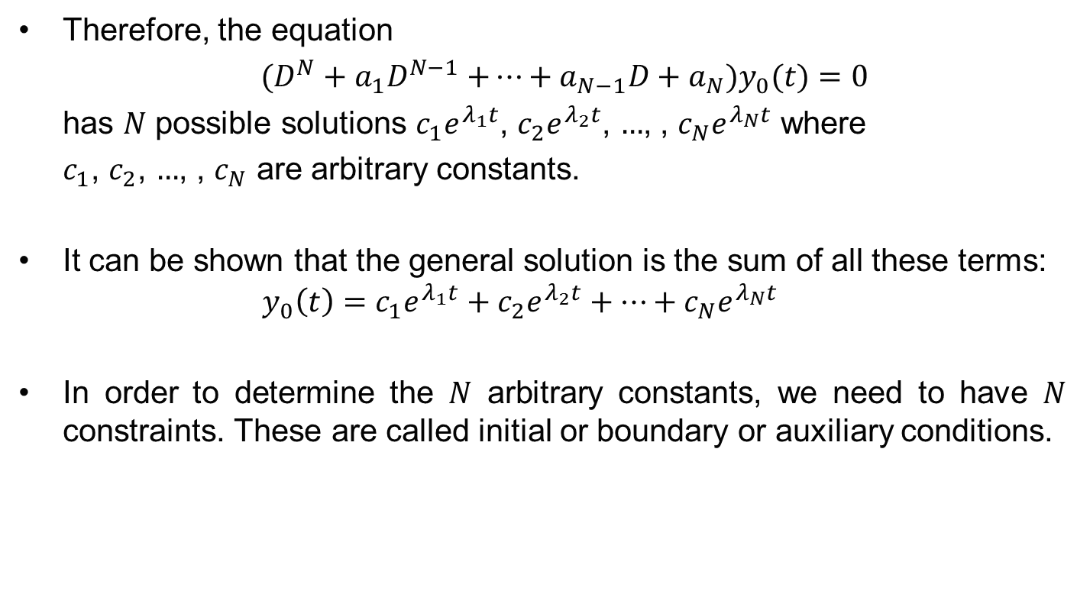
General solution to the zero-input response equation cont.
Therefore, the equation
$(D^{N}+a_{1}D^{N−1}$ $+…+a_{N−1}D+a_{N})y_{0}(t)=0$
has $N$ possible solutions $c_{1}e^{λ_{1}t}$, $c_{2}e^{λ_{2}t}$, $…$, , $c_{N}e^{λ_{N}t}$ where
$c_{1}$, $c_{2}$, $…$, , $c_{N}$ are arbitrary constants.
It can be shown that the general solution is the sum of all these terms:
$$y_{0}\left(t\right)=c_{1}e^{λ_{1}t}+c_{2}e^{λ_{2}t}+…+c_{N}e^{λ_{N}t}$$
In order to determine the $N$ arbitrary constants, we need to have $N$ constraints. These are called initial or boundary or auxiliary conditions.

Slide 6
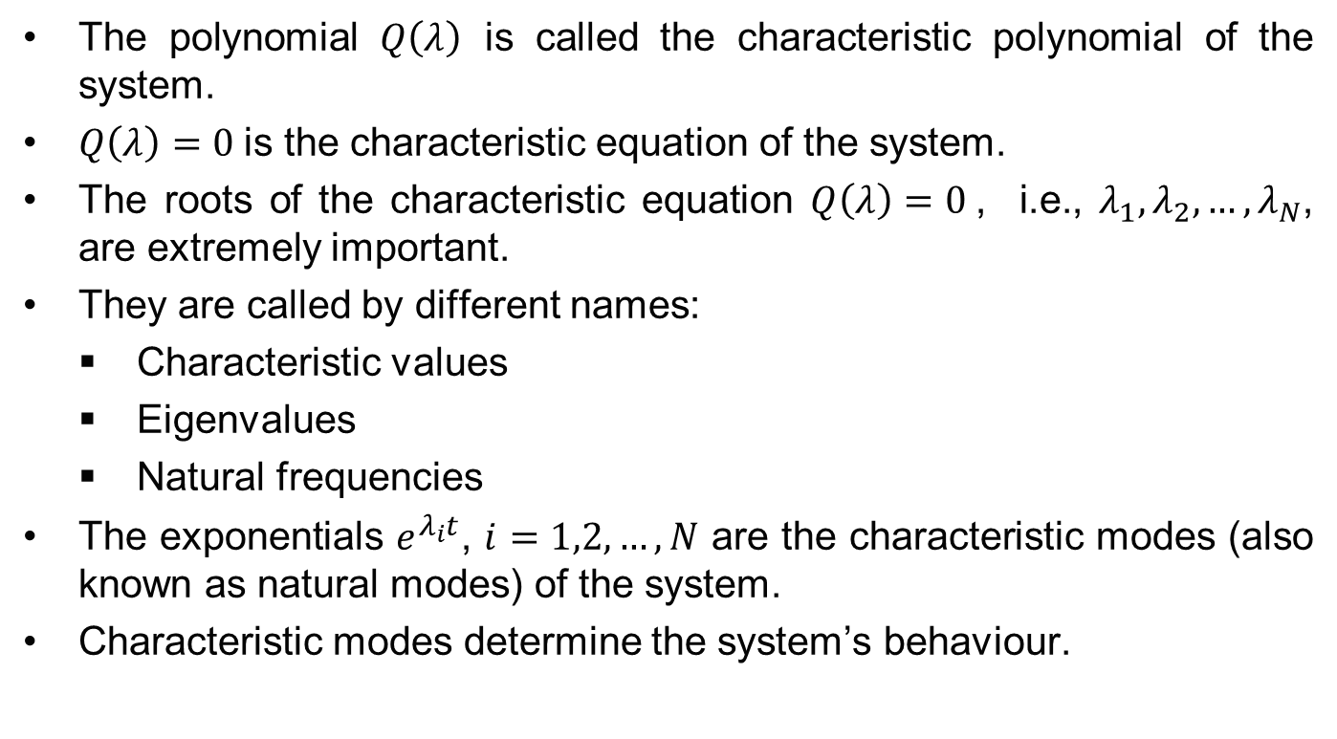
Characteristic polynomial
The polynomial $Q\left(λ\right)$ is called the characteristic polynomial of the system.
$Q\left(λ\right)=0$is the characteristic equation of the system.
The roots of the characteristic equation $Q\left(λ\right)=0$, i.e., $λ_{1}, λ_{2}, …,λ_{N}$, are extremely important.
They are called by different names:
Characteristic values
Eigenvalues
Natural frequencies
The exponentials $e^{λ_{i}t}$, $i=1,2,…,N$ are the characteristic modes (also known as natural modes) of the system.
Characteristic modes determine the system’s behaviour.

Slide 7
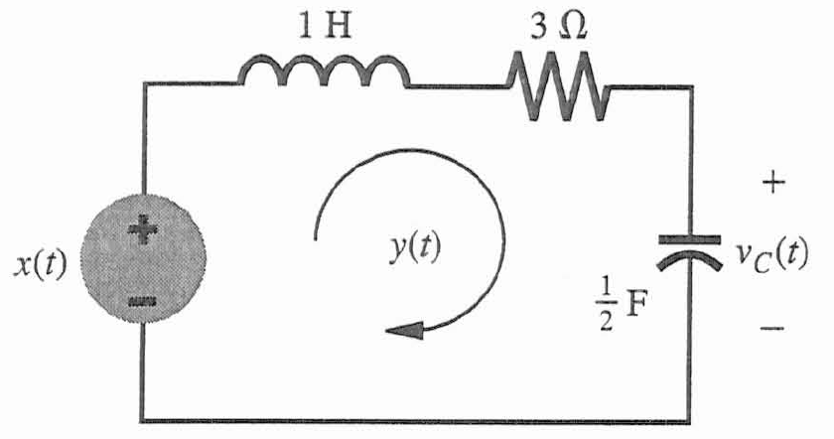
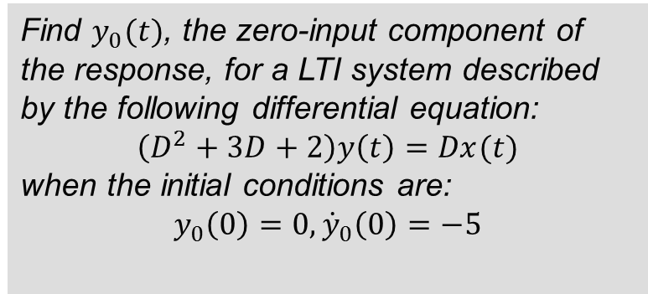
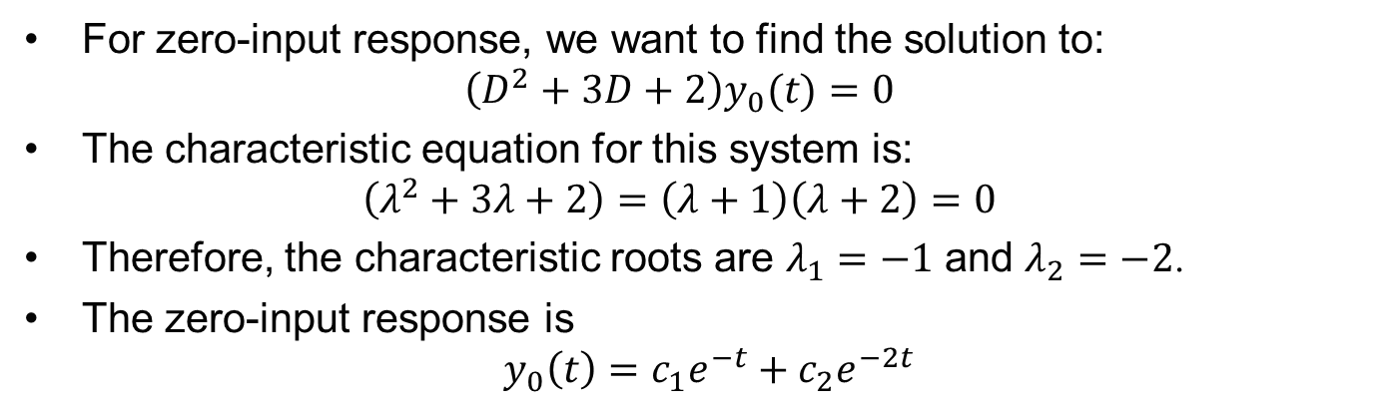
Example 1
Find $y_{0}(t)$, the zero-input component of the response, for a LTI system described by the following differential equation:
$$\left(D^{2}+3D+2\right)y\left(t\right)=Dx(t)$$
when the initial conditions are:
$$y_{0}\left(0\right)=0, {\dot{y}}_{0}\left(0\right)=−5$$
For zero-input response, we want to find the solution to:
$$\left(D^{2}+3D+2\right)y_{0}(t)=0$$
The characteristic equation for this system is:
$$\left(λ^{2}+3λ+2\right)=\left(λ+1\right)\left(λ+2\right)=0$$
Therefore, the characteristic roots are $λ_{1}=−1$ and $λ_{2}=−2$.
The zero-input response is
$$y_{0}\left(t\right)=c_{1}e^{−t}+c_{2}e^{−2t}$$

Slide 8
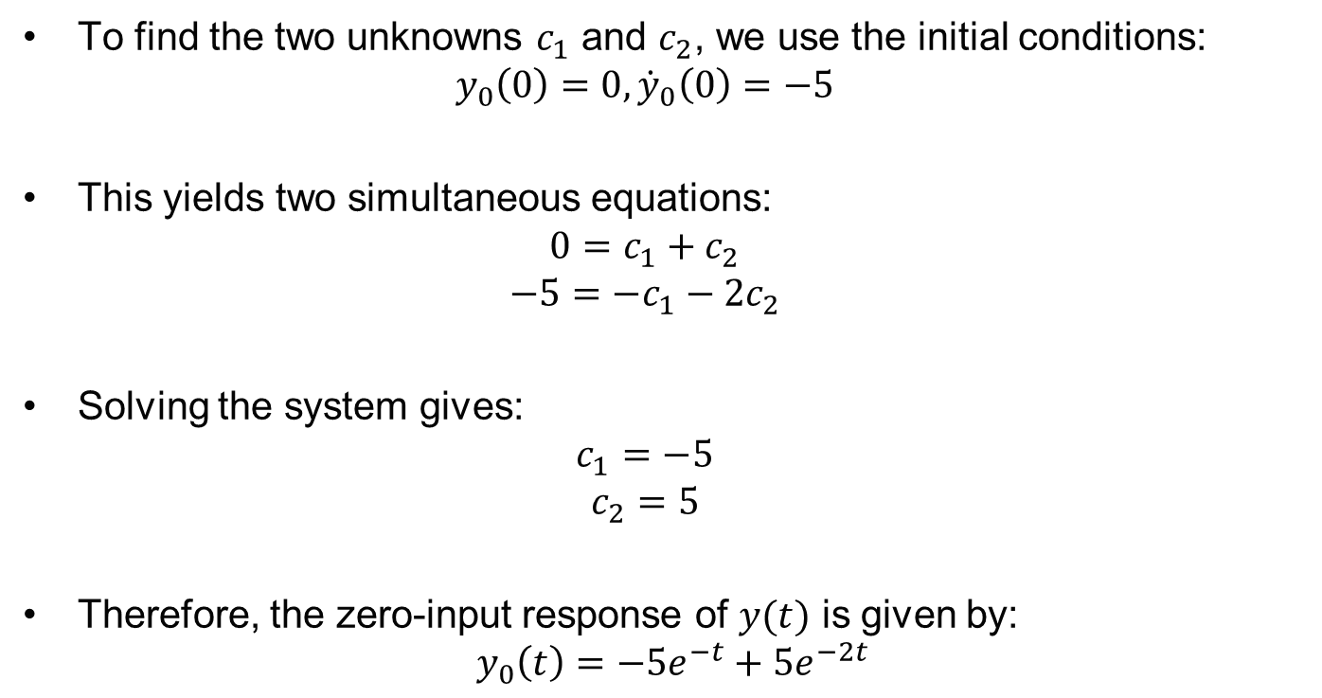
Example 1
To find the two unknowns $c_{1}$ and $c_{2}$, we use the initial conditions:
$$y_{0}\left(0\right)=0, {\dot{y}}_{0}\left(0\right)=−5$$
This yields two simultaneous equations:
$$0=c_{1}+c_{2}$$
$$−5={−c}_{1}−2c_{2}$$
Solving the system gives:
$$c_{1}=−5$$
$$c_{2}=5$$
Therefore, the zero-input response of $y(t)$ is given by:
$$y_{0}\left(t\right)=−5e^{−t}+5e^{−2t}$$

Slide 9
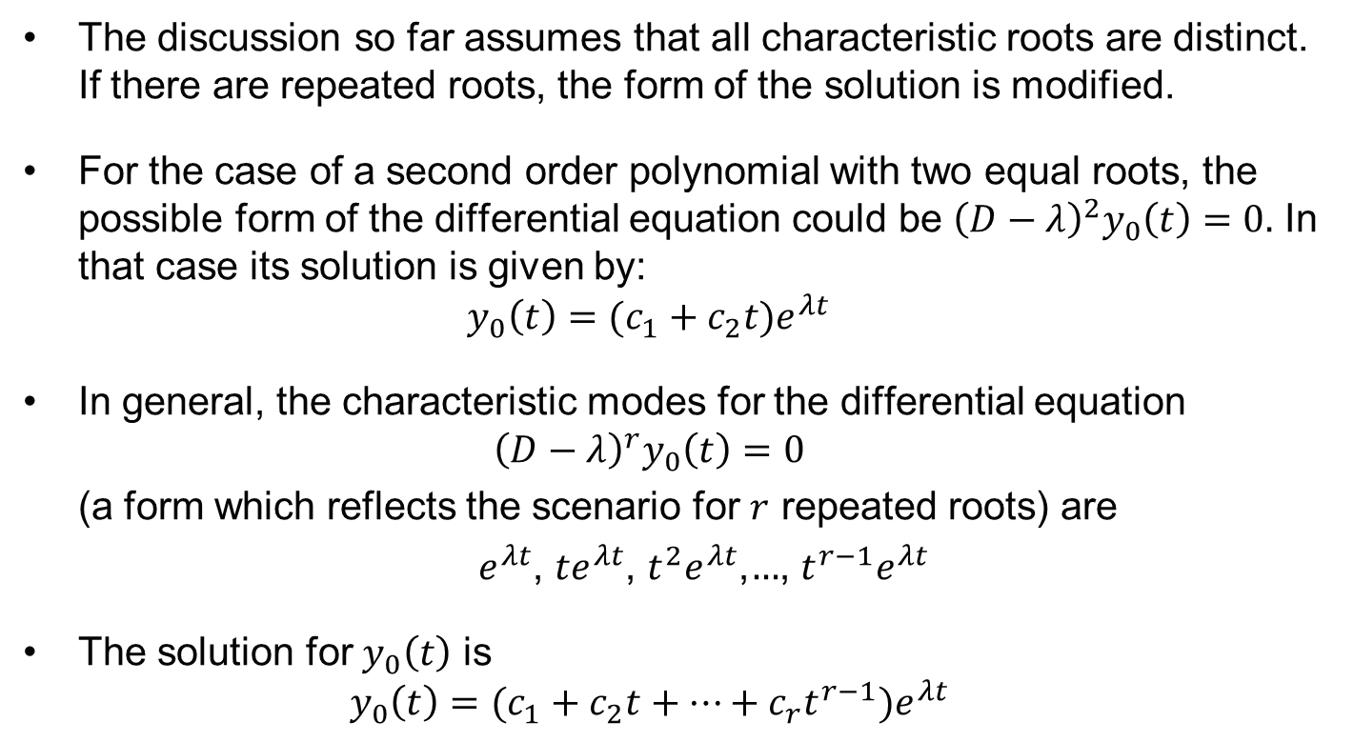
Repeated characteristic roots
The discussion so far assumes that all characteristic roots are distinct. If there are repeated roots, the form of the solution is modified.
For the case of a second order polynomial with two equal roots, the possible form of the differential equation could be ${\left(D−λ\right)}^{2}y_{0}\left(t\right)=0.$ In that case its solution is given by:
$$y_{0}\left(t\right)=(c_{1}+c_{2}t)e^{λt}$$
In general, the characteristic modes for the differential equation
$${\left(D−λ\right)}^{r}y_{0}\left(t\right)=0$$
(a form which reflects the scenario for $r$ repeated roots) are
$e^{λt}$, ${te}^{λt}$, $t^{2}e^{λt}$,$…$, $t^{r−1}e^{λt}$
The solution for $y_{0}\left(t\right)$ is
$$y_{0}\left(t\right)=(c_{1}+c_{2}t+…+c_{r}{t^{r−1})e}^{λt}$$

Slide 10
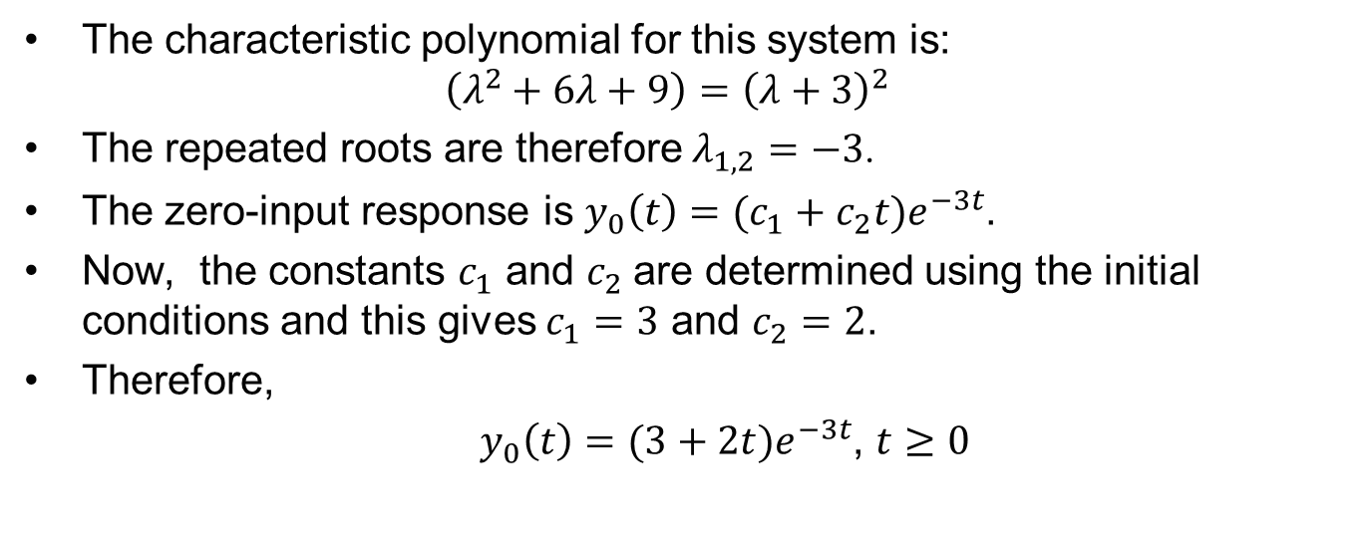
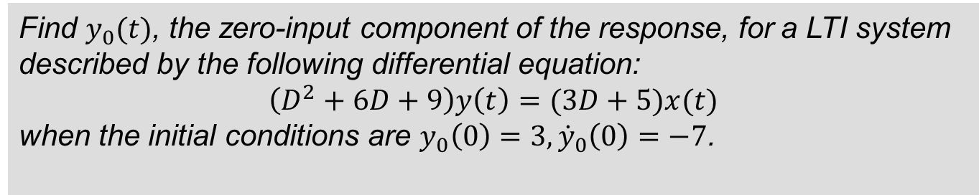
Example 2
Find $y_{0}(t)$, the zero-input component of the response, for a LTI system described by the following differential equation:
$$\left(D^{2}+6D+9\right)y\left(t\right)=(3D+5)x(t)$$
when the initial conditions are $y_{0}\left(0\right)=3, {\dot{y}}_{0}\left(0\right)=−7$.
The characteristic polynomial for this system is:
$$\left(λ^{2}+6λ+9\right)={\left(λ+3\right)}^{2}$$
The repeated roots are therefore $λ_{1,2}=−3$.
The zero-input response is $y_{0}\left(t\right)=(c_{1}+c_{2}t)e^{−3t}$.
Now, the constants $c_{1}$ and $c_{2}$are determined using the initial conditions and this gives $c_{1}=3$ and $c_{2}=2$.
Therefore,
$y_{0}\left(t\right)=(3+2t{)e}^{−3t}$, $t≥0$

Slide 11
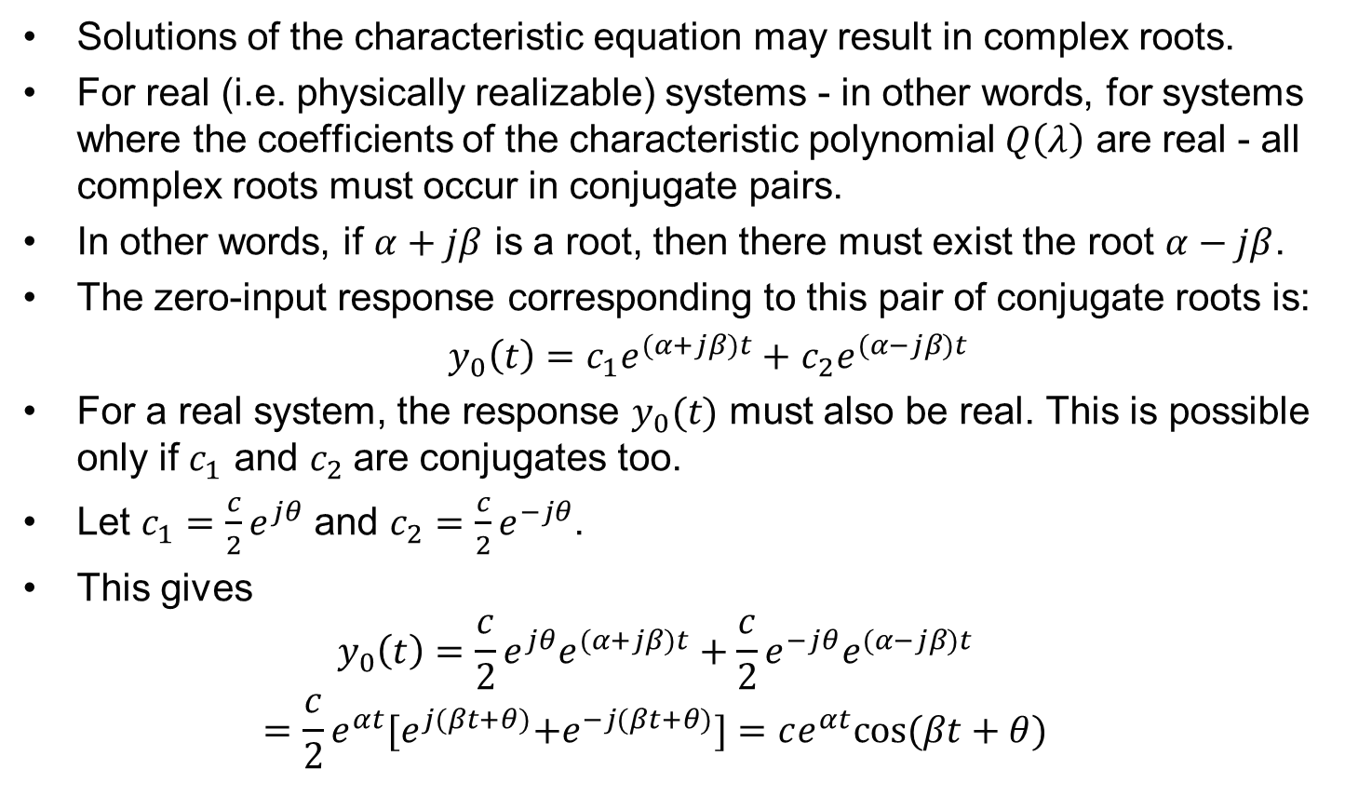
Complex characteristic roots
Solutions of the characteristic equation may result in complex roots.
For real (i.e. physically realizable) systems - in other words, for systems where the coefficients of the characteristic polynomial $Q\left(λ\right)$ are real - all complex roots must occur in conjugate pairs.
In other words, if $α+jβ$ is a root, then there must exist the root $α−jβ$.
The zero-input response corresponding to this pair of conjugate roots is:
$y_{0}\left(t\right)=c_{1}e^{(α+jβ)t}+$ $c_{2}e^{(α−jβ)t}$
For a real system, the response $y_{0}(t)$ must also be real. This is possible only if $c_{1}$ and $c_{2}$are conjugates too.
Let $c_{1}=\frac{c}{2}e^{jθ}$ and $c_{2}=\frac{c}{2}e^{−jθ}$.
This gives
$$y_{0}\left(t\right)=\frac{c}{2}e^{jθ}e^{(α+jβ)t}+\frac{c}{2}e^{−jθ}e^{(α−jβ)t}$$
$$=\frac{c}{2}e^{αt}{[e}^{j(βt+θ)}+e^{−j(βt+θ)}]=ce^{αt}cos⁡(βt+θ)$$

Slide 12
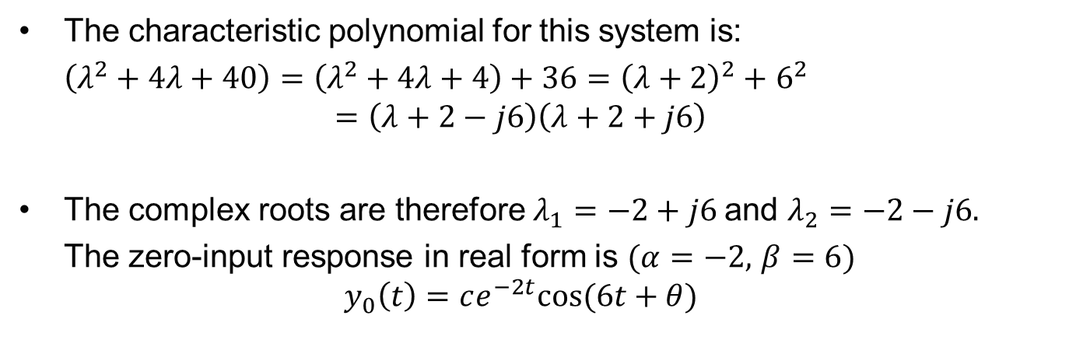
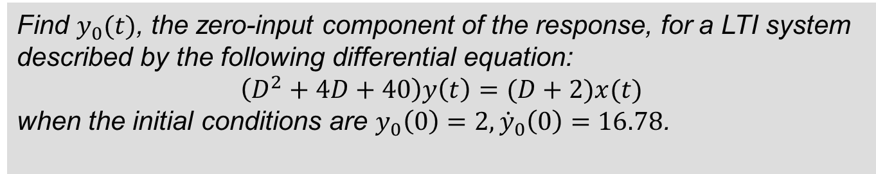
Example 3
Find $y_{0}(t)$, the zero-input component of the response, for a LTI system described by the following differential equation:
$$\left(D^{2}+4D+40\right)y\left(t\right)=(D+2)x(t)$$
when the initial conditions are $y_{0}\left(0\right)=2, {\dot{y}}_{0}\left(0\right)=16.78$.
The characteristic polynomial for this system is:
$\left(λ^{2}+4λ+40\right)=\left(λ^{2}+4λ+4\right)+36={\left(λ+2\right)}^{2}+$ $6^{2}$
$$=\left(λ+2−j6\right)\left(λ+2+j6\right)$$
The complex roots are therefore $λ_{1}=−2+j6$and $λ_{2}=−2−j6.$
The zero-input response in real form is $(α=−2,$ $β=6)$
$$y_{0}\left(t\right)=ce^{−2t}cos⁡(6t+θ)$$

Slide 13
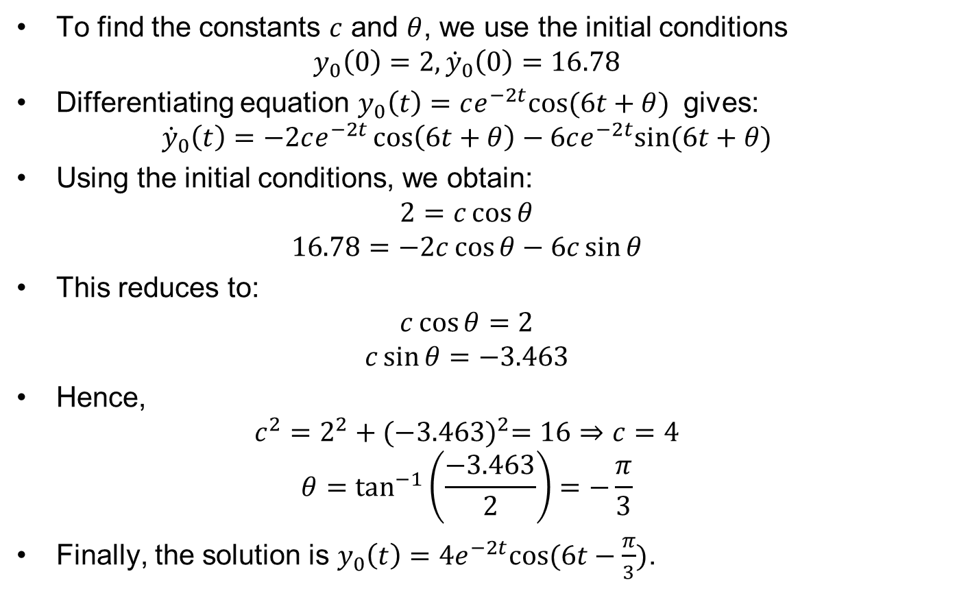
Example 3 cont.
To find the constants $c$ and $θ$, we use the initial conditions
$$y_{0}\left(0\right)=2, {\dot{y}}_{0}\left(0\right)=16.78$$
Differentiating equation $y_{0}\left(t\right)=ce^{−2t}cos⁡(6t+θ)$ gives:
$${\dot{y}}_{0}\left(t\right)=−2ce^{−2t}\cos\left(6t+θ\right)−6ce^{−2t}sin⁡(6t+θ)$$
Using the initial conditions, we obtain:
$$2=c\cos{θ}$$
$$16.78=−2c\cos{θ}−6c\sin{θ}$$
This reduces to:
$$c\cos{θ=2}$$
$$c\sin{θ=−3.463}$$
Hence,
$$c^{2}=2^{2}+{(−3.463)}^{2}=16⇒c=4$$
$$θ=\tan^{−1}\left(\frac{−3.463}{2}\right)=−\frac{π}{3}$$
Finally, the solution is $y_{0}\left(t\right)=4e^{−2t}cos⁡(6t−\frac{π}{3})$.

Slide 14
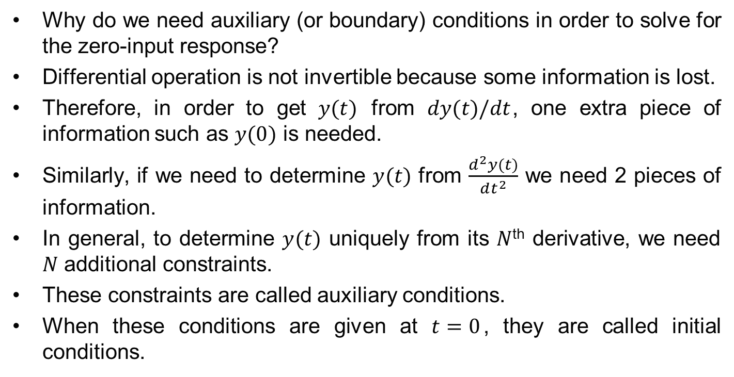
Comments on auxiliary conditions
Why do we need auxiliary (or boundary) conditions in order to solve for the zero-input response?
Differential operation is not invertible because some information is lost.
Therefore, in order to get $y(t)$ from $dy(t)/dt$, one extra piece of information such as $y(0)$ is needed.
Similarly, if we need to determine $y(t)$ from $\frac{d^{2}y(t)}{dt^{2}}$ we need 2 pieces of information.
In general, to determine $y(t)$ uniquely from its $N$^{th} derivative, we need $N$ additional constraints.
These constraints are called auxiliary conditions.
When these conditions are given at $t=0$, they are called initial conditions.

Slide 15
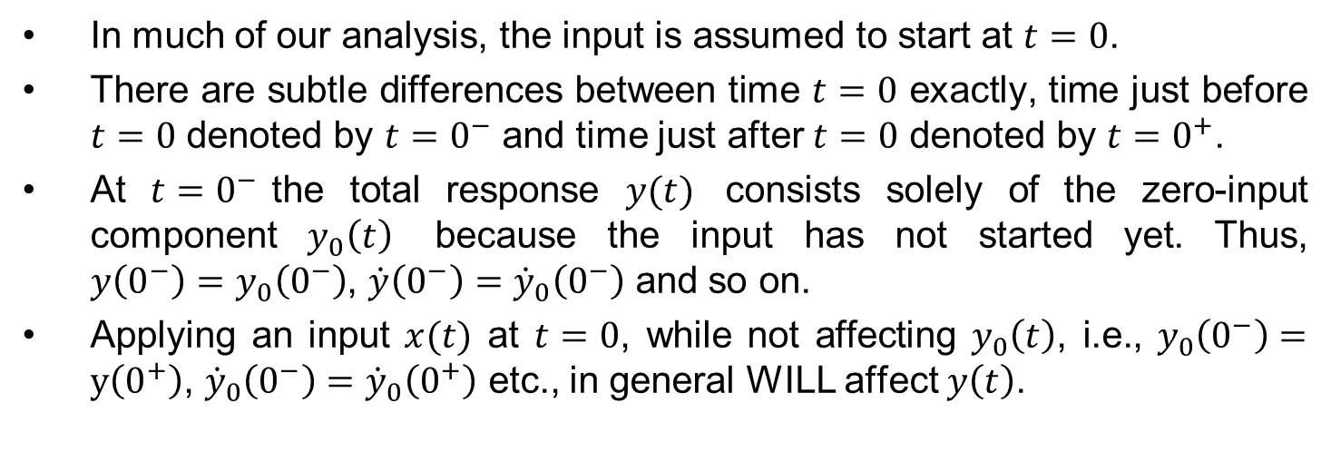



The meaning of $0^{+}$ and $0^{−}$
In much of our analysis, the input is assumed to start at $t=0$.
There are subtle differences between time $t=0$ exactly, time just before $t=0$ denoted by ${t=0}^{−}$ and time just after $t=0$ denoted by ${t=0}^{+}$.
At ${t=0}^{−}$the total response $y(t)$ consists solely of the zero-input component $y_{0}\left(t\right)$ because the input has not started yet. Thus, ${y\left(0^{−}\right)=y}_{0}\left(0^{−}\right)$, ${\dot{y}\left(0^{−}\right)=\dot{y}}_{0}\left(0^{−}\right)$ and so on.
Applying an input $x(t)$ at $t=0$, while not affecting $y_{0}\left(t\right)$, i.e., $y_{0}\left(0^{−}\right)=y\left(0^{+}\right)$, ${\dot{y}}_{0}\left(0^{−}\right)={\dot{y}}_{0}\left(0^{+}\right)$ etc., in general WILL affect $y\left(t\right)$.
$${t=0}^{−}$$
$${t=0}^{+}$$
time
$$t=0$$

Slide 16
Insights into zero-input behaviour
Assume (a mechanical) system is initially at rest.
If we disturb a system momentarily and then remove the disturbance so that the system goes back to zero-input, the system will not come back to rest instantaneously.
In general, it will go back to rest over a period of time, and only through some special type of motion that is characteristic of the system.
Such response must be sustained without any external source (because the disturbance has been removed).
In fact the system uses a linear combination of the characteristic modes to come back to the rest position while satisfying some boundary (or initial) conditions.

Slide 17
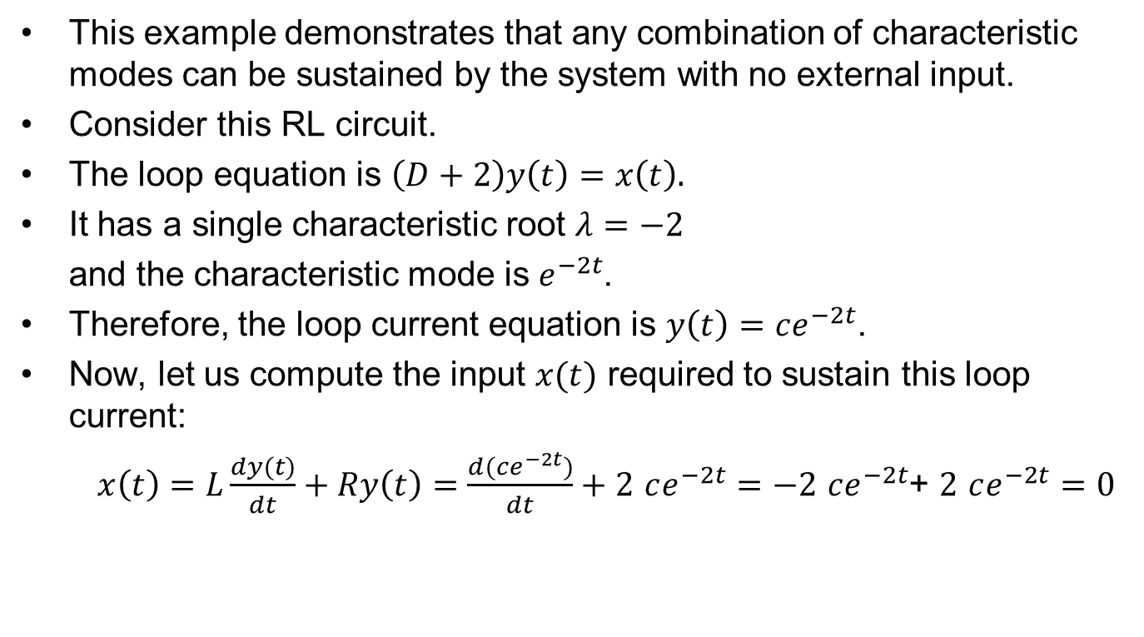
Example 4
This example demonstrates that any combination of characteristic modes can be sustained by the system with no external input.
Consider this RL circuit.
The loop equation is $\left(D+2\right)y\left(t\right)=x\left(t\right).$
It has a single characteristic root $λ=−2$
and the characteristic mode is $e^{−2t}$.
Therefore, the loop current equation is $y\left(t\right)=ce^{−2t}$.
Now, let us compute the input $x(t)$ required to sustain this loop current:
$x\left(t\right)=L\frac{dy(t)}{dt}+Ry\left(t\right)=$ $\frac{d(ce^{−2t})}{dt}+2$ $ce^{−2t}=−2 ce^{−2t}$+ $2$ $ce^{−2t}=0$
The loop current is sustained by the RL circuit on its own without any external input voltage.

Slide 18
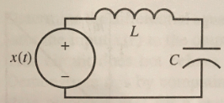
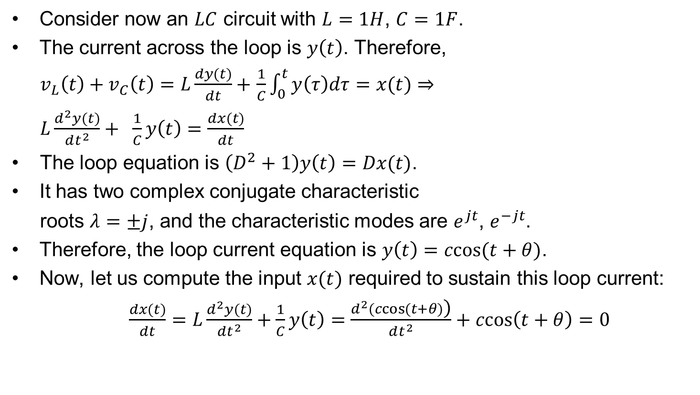
Example 5
Consider now an $LC$ circuit with $L=1H$, $C=1F$.
The current across the loop is $y\left(t\right)$. Therefore,
$v_{L}\left(t\right)+v_{C}\left(t\right)=L\frac{dy(t)}{dt}+$ $\frac{1}{C}\int_{0}^{t}{y\left(τ\right)dτ}=x(t)⇒$
$L\frac{d^{2}y(t)}{dt^{2}}+ \frac{1}{C}y\left(t\right)=\frac{dx(t)}{dt}$
The loop equation is $\left(D^{2}+1\right)y\left(t\right)=Dx(t)$.
It has two complex conjugate characteristic
roots $λ=±j$, and the characteristic modes are $e^{jt}$, $e^{−jt}$.
Therefore, the loop current equation is $y\left(t\right)=ccos(t+θ)$.
Now, let us compute the input $x(t)$ required to sustain this loop current:
$\frac{dx(t)}{dt}=L\frac{d^{2}y(t)}{dt^{2}}+\frac{1}{C}y\left(t\right)=$ $\frac{d^{2}(ccos(t+θ)\text{)}}{dt^{2}}+ccos\left(t+θ\right)=0$
As previously, the loop current is indefinitely sustained by the LC circuit on its own without any external input voltage.

Slide 19

The resonance behaviour
Any signal consisting of a system’s characteristic mode is sustained by the system on its own.
In other words, the system offers NO obstacle to such signals.
It is like asking an alcoholic to be a whisky taster.
Driving a system with an input of the form of the characteristic mode will cause resonance behaviour.

Slide 20
Relating to other courses
Zero-input response is very important to understanding control systems. However, the 2nd year Control course will approach the subject from a different point of view.
You should also have come across some of these concepts last year in Circuit Analysis course, but not from a “black box” system point of view.
Ideas in this lecture is essential for deep understanding of the next two lectures on impulse response and on convolution, both you have touched on in your first year course on Signals and Communications.

