Slide 1
Signals and Systems Lecture 2
DR TANIA STATHAKI
READER (ASSOCIATE PROFFESOR) IN SIGNAL PROCESSING IMPERIAL COLLEGE LONDON

Slide 2
Definition of systems
Systems are used to process signals and to modify or extract information regarding those signals.
Physical systems are characterized by their input-output relationships.
E.g. electrical systems are characterized by voltage-current relationships for their components and the laws of interconnections (i.e. Kirchhoff’s laws).
We can derive a mathematical model for a system represented by (a so called) “black box”.
SYSTEM
MODEL

Slide 3
Classification of systems
Systems may be classified into:
Linear and non-linear systems
Constant parameter and time-varying-parameter systems
Instantaneous (memoryless) and dynamic (with memory) systems
Causal and non-causal systems
Continuous-time and discrete-time systems
Analogue and digital systems
Invertible and non-invertible systems
Stable and unstable systems

Slide 4
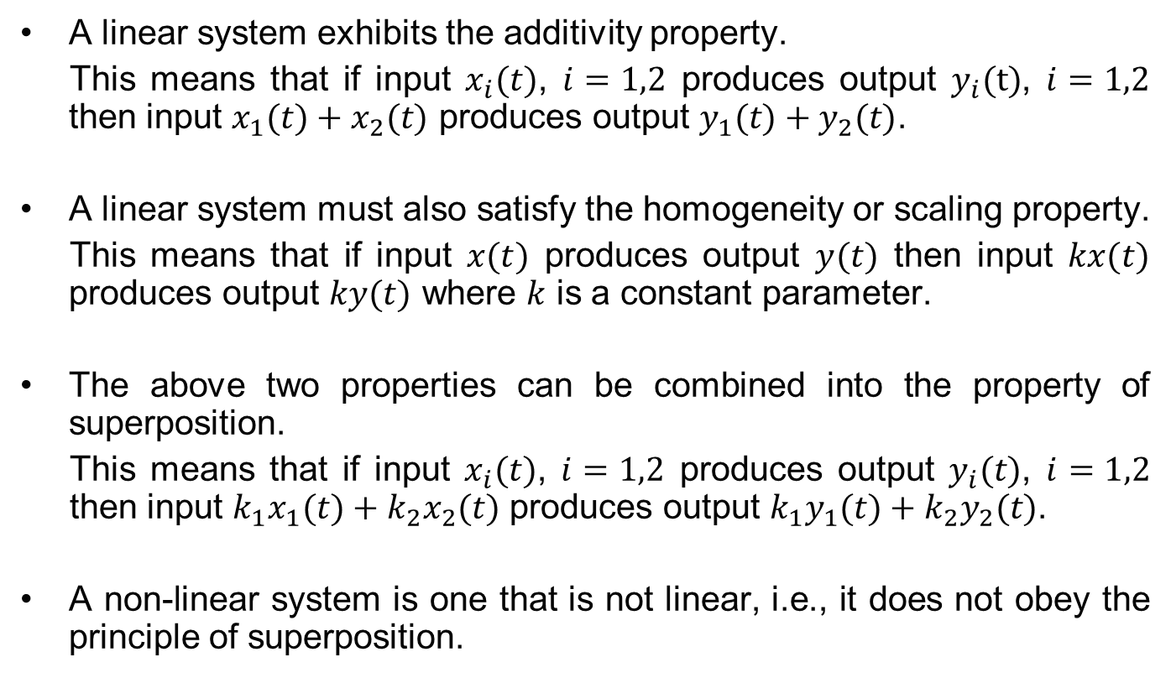
Linear systems
A linear system exhibits the additivity property.
This means that if input $x_{i}(t)$, $i=1,2$ produces output $y_{i}(t)$, $i=1,2$ then input $x_{1}(t)+x_{2}(t)$ produces output $y_{1}(t)+y_{2}(t)$.
A linear system must also satisfy the homogeneity or scaling property.
This means that if input $x(t)$ produces output $y(t)$ then input $kx(t)$ produces output $ky(t)$ where $k$ is a constant parameter.
The above two properties can be combined into the property of superposition.
This means that if input $x_{i}(t)$, $i=1,2$ produces output $y_{i}(t)$, $i=1,2$ then input $k_{1}x_{1}(t)+{k_{2}x}_{2}(t)$ produces output ${k_{1}y}_{1}(t)+k_{2}y_{2}(t)$.
A non-linear system is one that is not linear, i.e., it does not obey the principle of superposition.

Slide 5
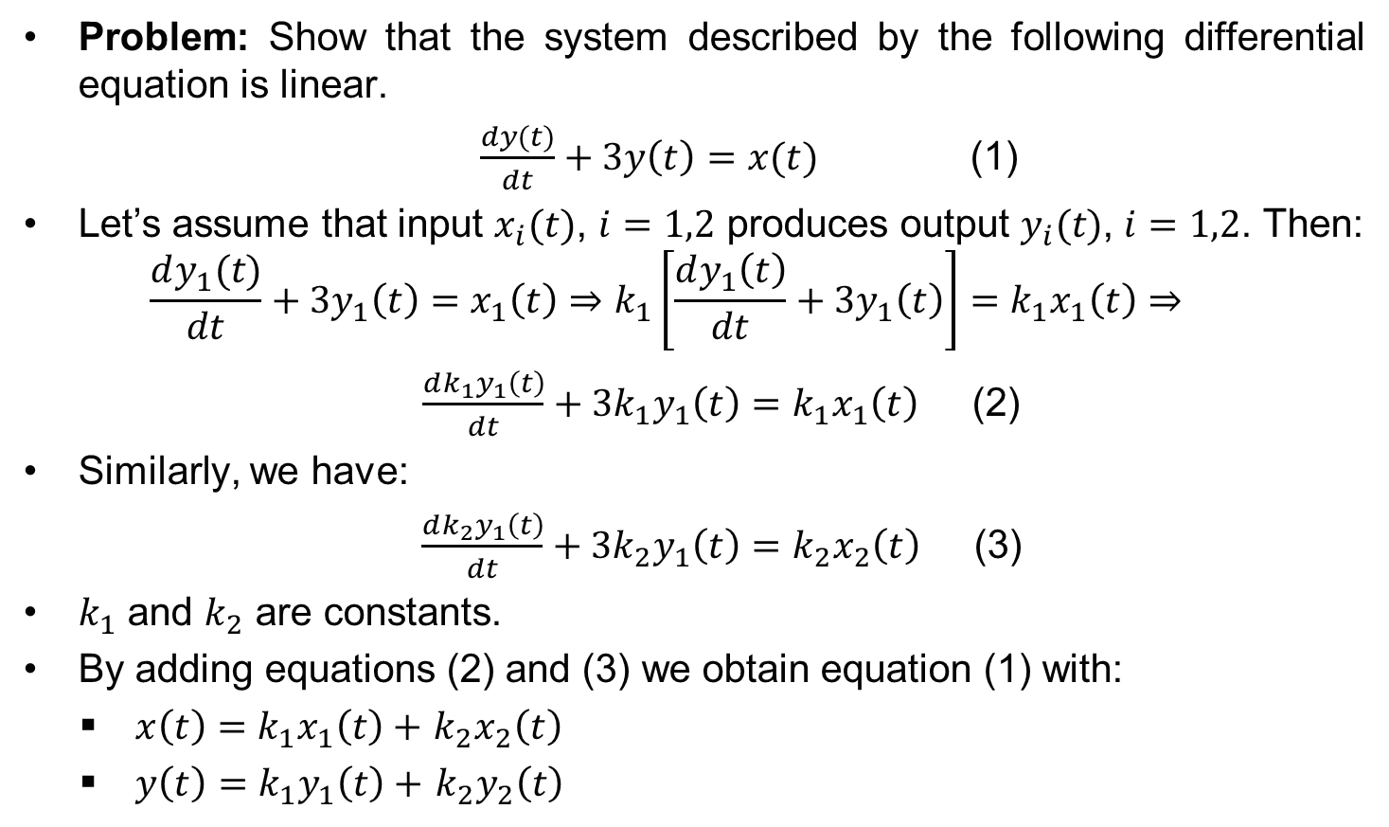
Linear systems
Problem: Show that the system described by the following differential equation is linear.
$\frac{dy(t)}{dt}+3y\left(t\right)=x(t)$ (1)
Let’s assume that input $x_{i}(t)$, $i=1,2$ produces output $y_{i}(t)$, $i=1,2$. Then:
$$\frac{dy_{1}(t)}{dt}+3y_{1}\left(t\right)=x_{1}\left(t\right)⇒k_{1}\left[\frac{dy_{1}\left(t\right)}{dt}+3y_{1}\left(t\right)\right]=k_{1}x_{1}\left(t\right)⇒$$
$\frac{dk_{1}y_{1}\left(t\right)}{dt}+3{k_{1}y}_{1}\left(t\right)=k_{1}x_{1}\left(t\right)$ (2)
Similarly, we have:
$\frac{dk_{2}y_{1}\left(t\right)}{dt}+3{k_{2}y}_{1}\left(t\right)=k_{2}x_{2}\left(t\right)$ (3)
$k_{1}$ and $k_{2}$ are constants.
By adding equations (2) and (3) we obtain equation (1) with:
$x\left(t\right)=$ $k_{1}x_{1}\left(t\right)+$ $k_{2}x_{2}\left(t\right)$
$y\left(t\right)=$ $k_{1}y_{1}\left(t\right)+$ $k_{2}y_{2}\left(t\right)$

Slide 6
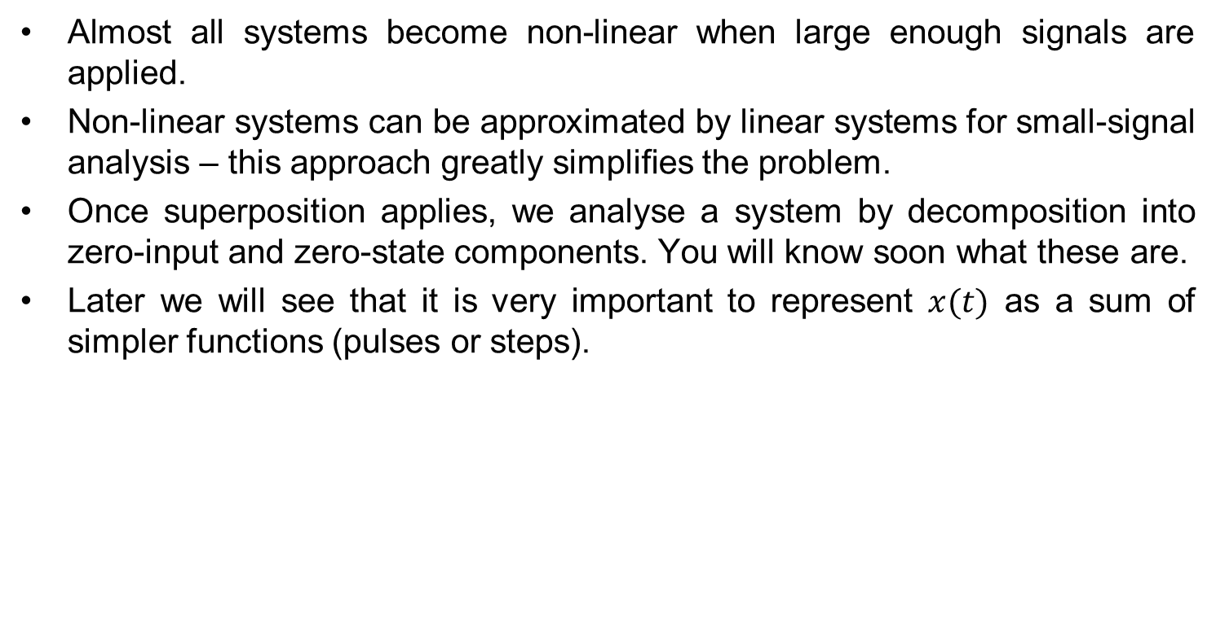
Linear systems
Almost all systems become non-linear when large enough signals are applied.
Non-linear systems can be approximated by linear systems for small-signal analysis – this approach greatly simplifies the problem.
Once superposition applies, we analyse a system by decomposition into zero-input and zero-state components. You will know soon what these are.
Later we will see that it is very important to represent $x(t)$ as a sum of simpler functions (pulses or steps).

Slide 7
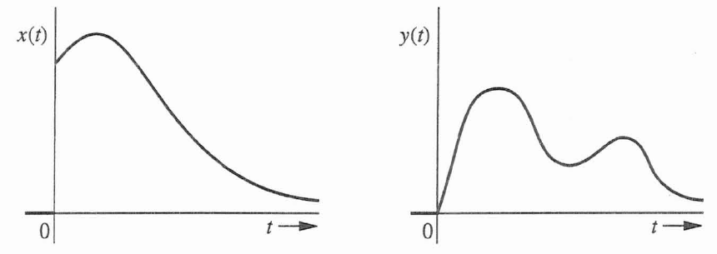

Time-invariant systems
Time-invariant system is one whose parameters do not change with time:
Linear time-invariant (LTI) systems are one of the main topics for both this course and the Control course in 2nd year.
Terminology by Lathi: LTIC = LTI continuous, LTID = LTI discrete.
TI System
delay by
T seconds
delay by
T seconds
TI System

Slide 8
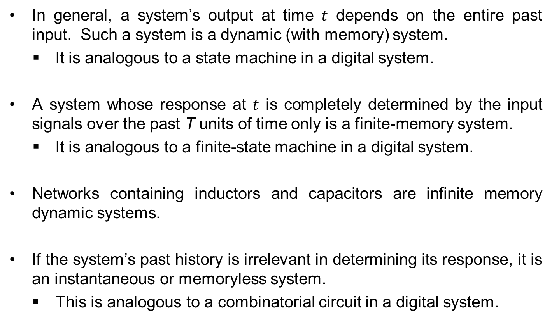
Instantaneous and dynamic systems
In general, a system’s output at time $t$ depends on the entire past input. Such a system is a dynamic (with memory) system.
It is analogous to a state machine in a digital system.
A system whose response at $t$ is completely determined by the input signals over the past T units of time only is a finite-memory system.
It is analogous to a finite-state machine in a digital system.
Networks containing inductors and capacitors are infinite memory dynamic systems.
If the system’s past history is irrelevant in determining its response, it is an instantaneous or memoryless system.
This is analogous to a combinatorial circuit in a digital system.

Slide 9
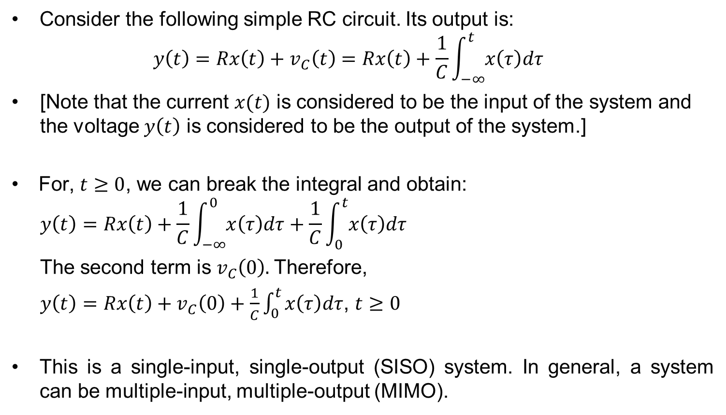
Analog circuits are linear systems
Consider the following simple RC circuit. Its output is:
$$y\left(t\right)=Rx\left(t\right)+v_{C}\left(t\right)=Rx\left(t\right)+\frac{1}{C}\int_{−∞}^{t}{x\left(τ\right)dτ}$$
[Note that the current $x(t)$ is considered to be the input of the system and the voltage $y\left(t\right)$ is considered to be the output of the system.]
For, $t≥0$, we can break the integral and obtain:
$$y\left(t\right)=Rx\left(t\right)+\frac{1}{C}\int_{−∞}^{0}{x\left(τ\right)dτ}+\frac{1}{C}\int_{0}^{t}{x\left(τ\right)dτ}$$
The second term is $v_{C}\left(0\right).$Therefore,
$y\left(t\right)=Rx\left(t\right)+v_{C}\left(0\right)+\frac{1}{C}\int_{0}^{t}{x\left(τ\right)dτ}$, $t≥0$
This is a single-input, single-output (SISO) system. In general, a system can be multiple-input, multiple-output (MIMO).

Slide 10
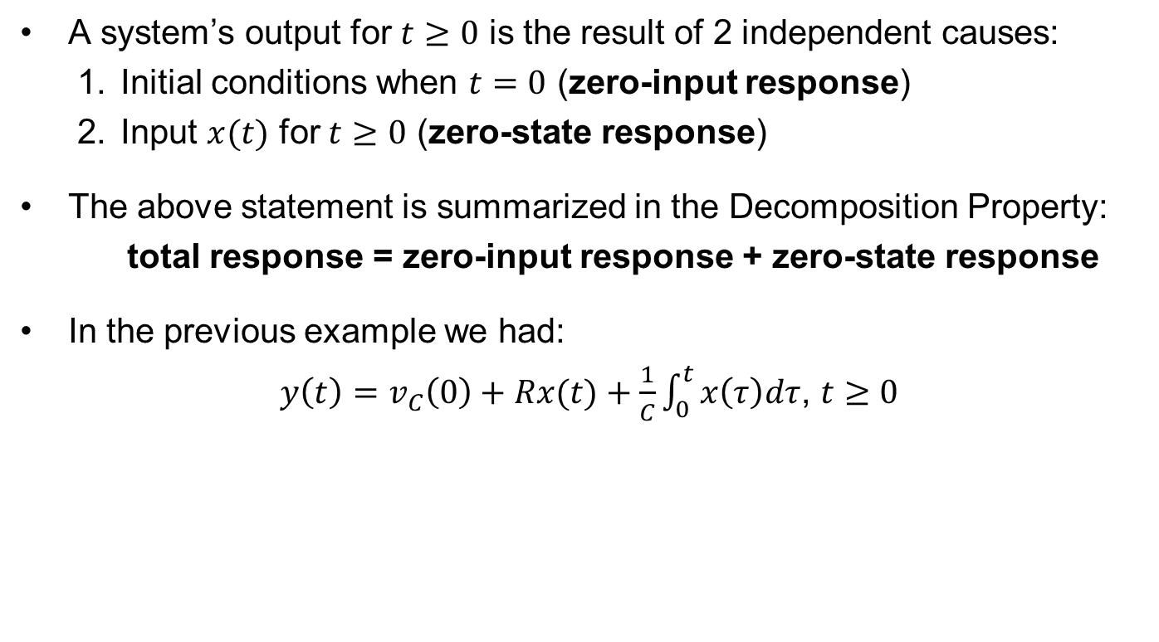
Analog circuits are linear systems cont.
A system’s output for $t≥0$ is the result of 2 independent causes:
Initial conditions when $t=0$ (zero-input response)
Input $x(t)$ for $t≥0$ (zero-state response)
The above statement is summarized in the Decomposition Property:
total response = zero-input response + zero-state response
In the previous example we had:
$y\left(t\right)=v_{C}\left(0\right)+Rx(t)+\frac{1}{C}\int_{0}^{t}{x\left(τ\right)dτ}$, $t≥0$
zero-input response
zero-state response
=
+

Slide 11
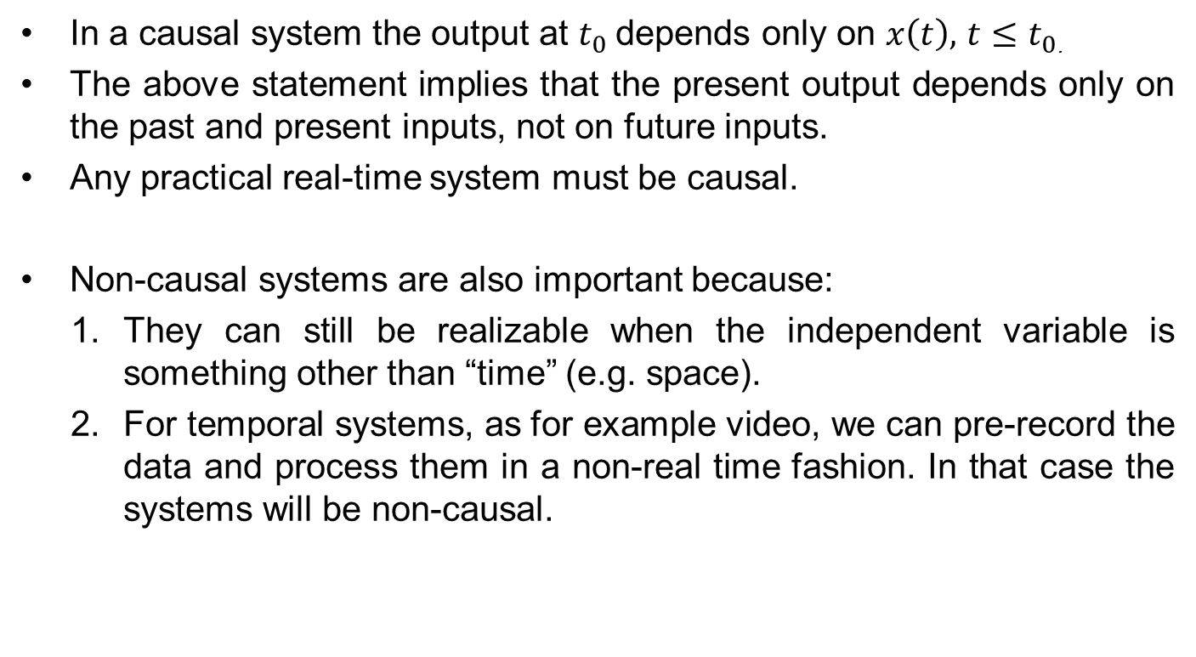
Causal and non-causal systems
In a causal system the output at $t_{0}$depends only on $x\left(t\right),$ $t≤t_{0}$.
The above statement implies that the present output depends only on the past and present inputs, not on future inputs.
Any practical real-time system must be causal.
Non-causal systems are also important because:
They can still be realizable when the independent variable is something other than “time” (e.g. space).
For temporal systems, as for example video, we can pre-record the data and process them in a non-real time fashion. In that case the systems will be non-causal.

Slide 12

Continuous-time and discrete-time systems
In contrast to continuous-time systems, discrete-time systems process data samples (sampled signals) instead of continuous-time signals.
Data samples normally arise from continuous-time signals when these are regularly sampled every $T$ units of time.
Continuous-time input and output are $x(t)$ and $y(t)$. Discrete-time input and output samples are $x[nT]$ and $y[nT]$ where $n$ is an integer and $−∞≤n≤∞$.

Slide 13




Analogue and digital Systems
In discrete-time signals the samples are discrete in time, but are continuous in amplitude.
Most modern systems are both discrete in amplitude and discrete in time. We often use the term “digital”. Consider for example the internal circuits of most current electronic devices, as for example, the MP3 player.
$$x(t)$$
A-D
Converter
$$x[n]$$
Digital System
$$y[n]$$
D-A
Converter
$$y(t)$$

Slide 14

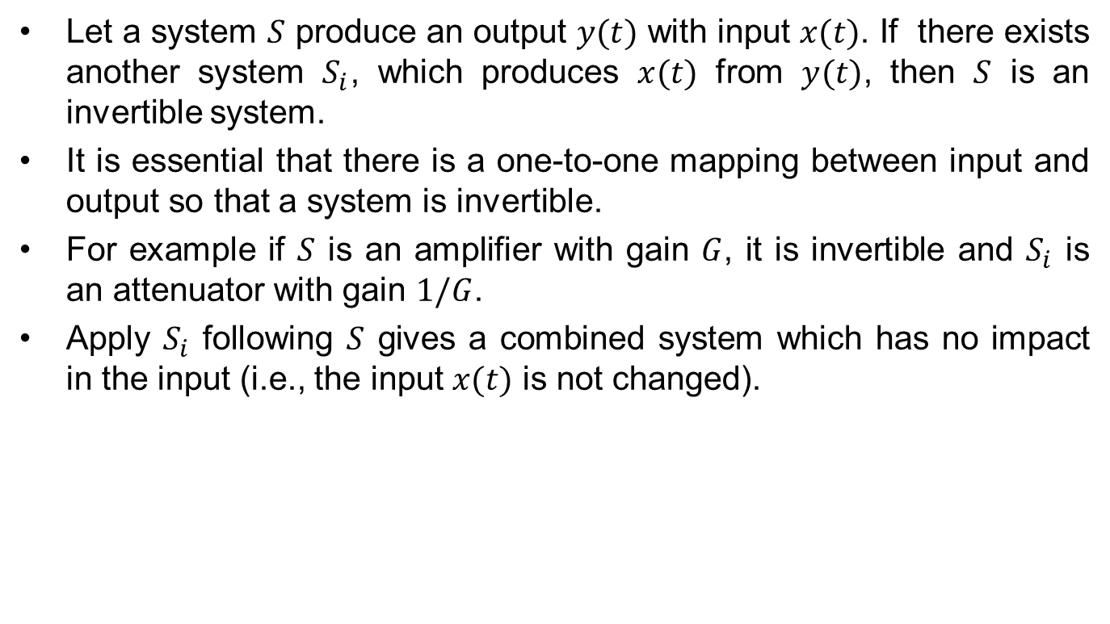




Invertible and non-invertible systems
Let a system $S$ produce an output $y(t)$ with input $x(t)$. If there exists another system $S_{i}$, which produces $x(t)$ from $y(t)$, then $S$ is an invertible system.
It is essential that there is a one-to-one mapping between input and output so that a system is invertible.
For example if $S$ is an amplifier with gain $G$, it is invertible and $S_{i}$ is an attenuator with gain $1/G$.
Apply $S_{i}$ following $S$ gives a combined system which has no impact in the input (i.e., the input $x(t)$ is not changed).
$$x(t)$$
$$y(t)$$
System $S_{i}$
$$x(t)$$
System $S$

Slide 15
Stable and unstable systems
Externally stable systems are the ones in which a bounded input results in a bounded output (the system is said to be stable in the BIBO sense).
Stability of a system will be discussed after introducing Fourier and Laplace transforms.
More detailed analysis of stability is covered in the second year Control course.

Slide 16
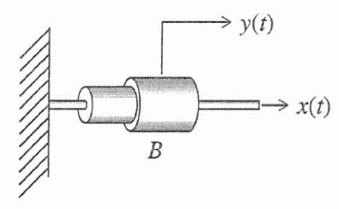
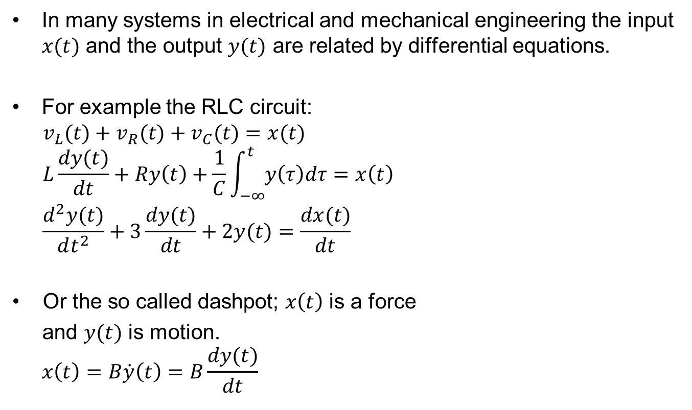
Linear differential systems
In many systems in electrical and mechanical engineering the input $x(t)$ and the output $y(t)$ are related by differential equations.
For example the RLC circuit:
$$v_{L}(t)+v_{R}(t)+v_{C}(t)=x(t)$$
$$L\frac{dy(t)}{dt}+Ry\left(t\right)+\frac{1}{C}\int_{−∞}^{t}{y\left(τ\right)dτ}=x\left(t\right)$$
$$\frac{d^{2}y(t)}{dt^{2}}+3\frac{dy(t)}{dt}+2y(t)=\frac{dx(t)}{dt}$$
Or the so called dashpot; $x\left(t\right)$ is a force
and $y(t)$ is motion.
$$x\left(t\right)=B\dot{y}\left(t\right)=B\frac{dy(t)}{dt}$$

Slide 17
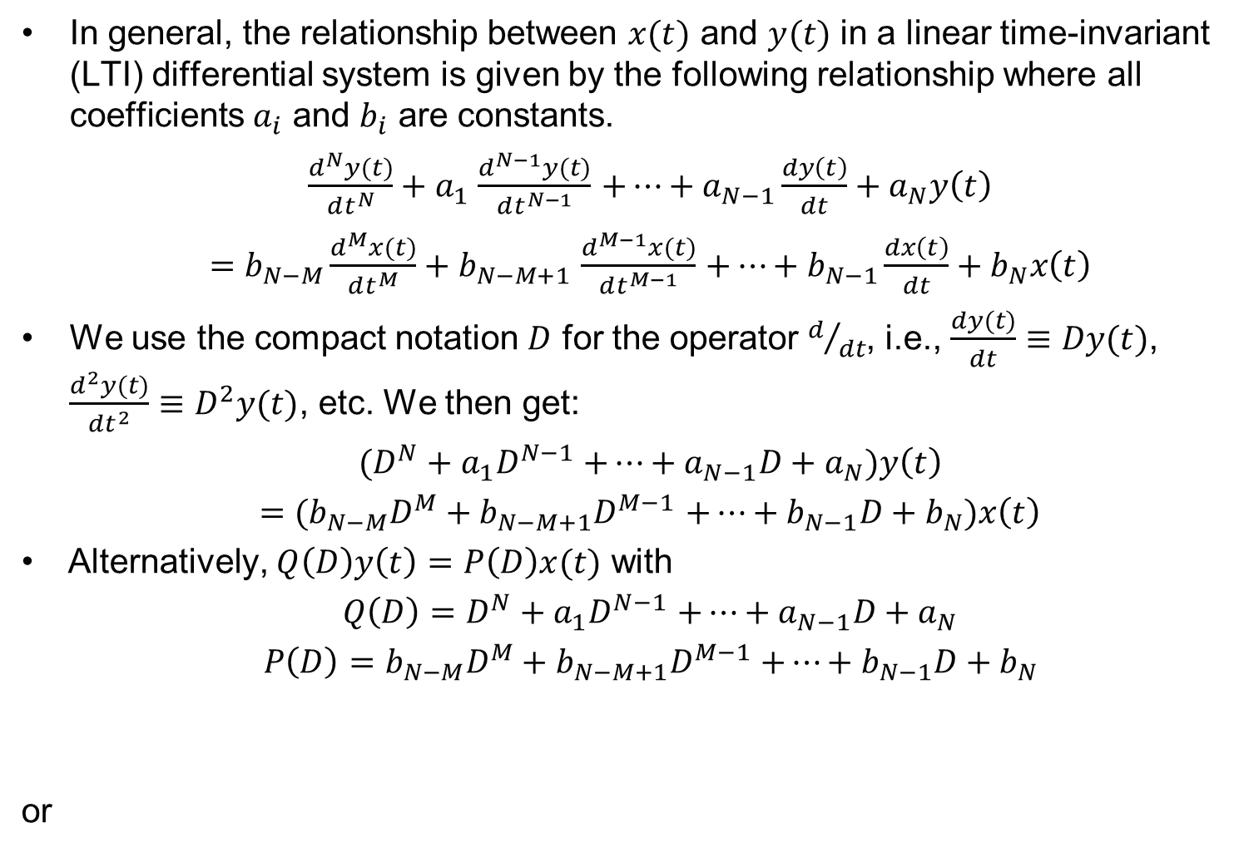
Linear differential systems cont.
In general, the relationship between $x(t)$ and $y(t)$ in a linear time-invariant (LTI) differential system is given by the following relationship where all coefficients $a_{i}$ and $b_{i}$ are constants.
$\frac{d^{N}y(t)}{dt^{N}}+a_{1}$ $\frac{d^{N−1}y(t)}{dt^{N−1}}$ $+…+a_{N−1}\frac{dy\left(t\right)}{dt}+a_{N}y\left(t\right)$
$=$ $b_{N−M}\frac{d^{M}x(t)}{dt^{M}}+b_{N−M+1}$ $\frac{d^{M−1}x(t)}{dt^{M−1}}$ $+…+b_{N−1}\frac{dx\left(t\right)}{dt}+b_{N}x\left(t\right)$
We use the compact notation $D$ for the operator $d/{dt}$, i.e., $\frac{dy(t)}{dt}≡Dy(t)$, $\frac{d^{2}y(t)}{dt^{2}}≡D^{2}y(t)$, etc. We then get:
$(D^{N}+a_{1}D^{N−1}$ $+…+a_{N−1}D+a_{N})y\left(t\right)$
$=$ ${(b}_{N−M}D^{M}+b_{N−M+1}D^{M−1}$ $+…+b_{N−1}D+b_{N})x\left(t\right)$
Alternatively, $Q\left(D\right)y\left(t\right)=P\left(D\right)x(t)$ with
$Q\left(D\right)=D^{N}+a_{1}D^{N−1}$ $+…+a_{N−1}D+a_{N}$
${P\left(D\right)=b}_{N−M}D^{M}+b_{N−M+1}D^{M−1}$ $+…+b_{N−1}D+b_{N}$
or

Slide 18


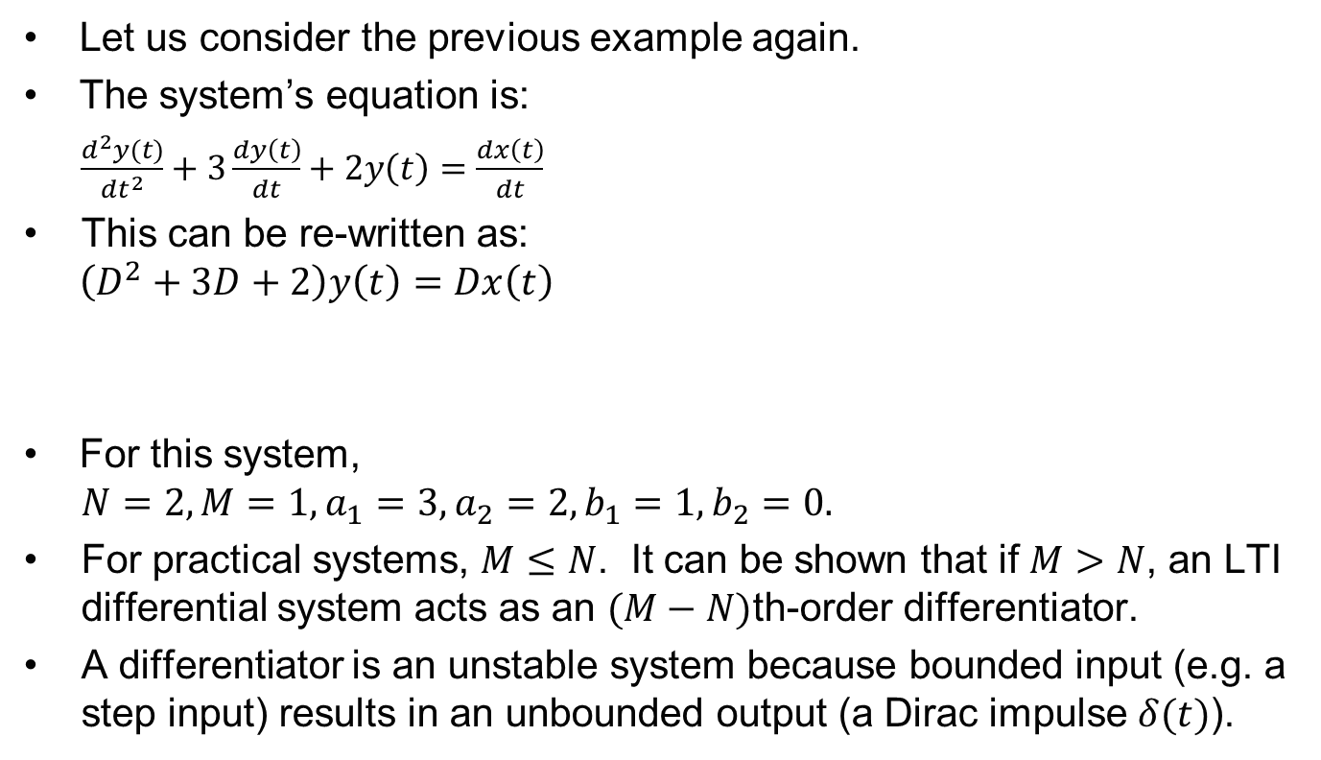

Linear differential systems cont.
Let us consider the previous example again.
The system’s equation is:
$\frac{d^{2}y(t)}{dt^{2}}+3\frac{dy\left(t\right)}{dt}+2y\left(t\right)=$ $\frac{dx\left(t\right)}{dt}$
This can be re-written as:
$$\left(D^{2}+3D+2\right)y\left(t\right)=Dx\left(t\right)$$
For this system,
$$N=2, M=1, a_{1}=3, a_{2}=2, b_{1}=1, b_{2}=0.$$
For practical systems, $M≤N$. It can be shown that if $M>N$, an LTI differential system acts as an $(M−N)$th-order differentiator.
A differentiator is an unstable system because bounded input (e.g. a step input) results in an unbounded output (a Dirac impulse $δ(t)$).
$$P(D)$$
Also
$$Q(D)$$

Slide 19

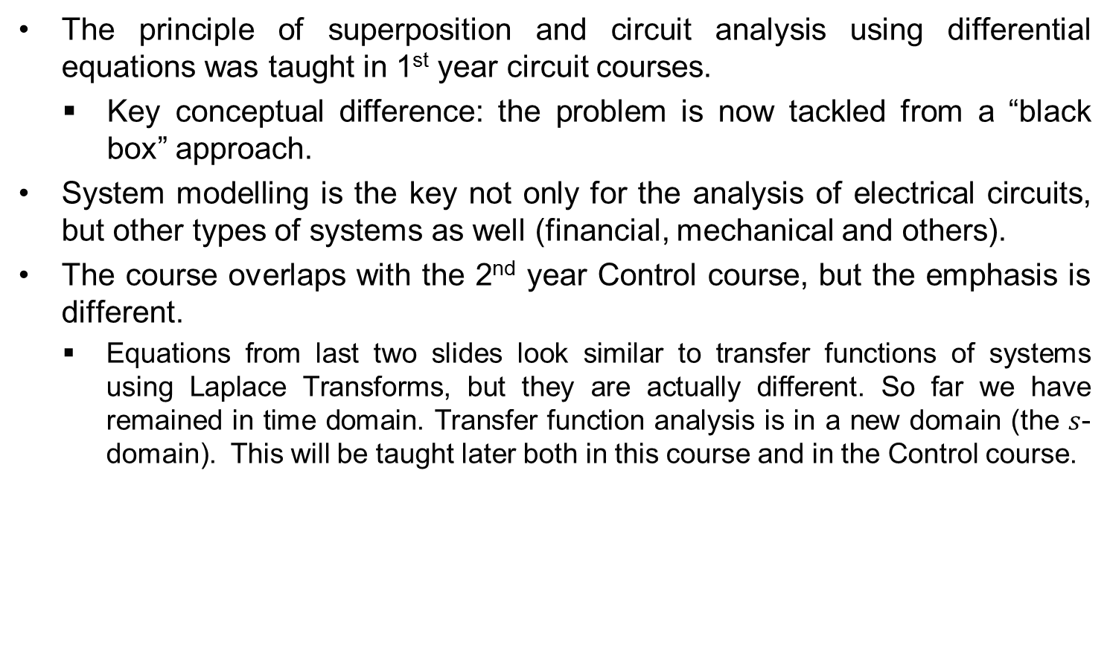
Relating this course to other courses
The principle of superposition and circuit analysis using differential equations was taught in 1st year circuit courses.
Key conceptual difference: the problem is now tackled from a “black box” approach.
System modelling is the key not only for the analysis of electrical circuits, but other types of systems as well (financial, mechanical and others).
The course overlaps with the 2nd year Control course, but the emphasis is different.
Equations from last two slides look similar to transfer functions of systems using Laplace Transforms, but they are actually different. So far we have remained in time domain. Transfer function analysis is in a new domain (the $s$-domain). This will be taught later both in this course and in the Control course.
Time-domain
$s$-domain

