Slide 1
Signals and Systems Lecture 1
DR TANIA STATHAKI
READER (ASSOCIATE PROFFESOR) IN SIGNAL PROCESSING IMPERIAL COLLEGE LONDON

Slide 2
Miscellanea
Teacher:
Dr. Tania Stathaki, Reader (Associate Professor) in Signal Processing, Imperial College London
E-mail: t.stathaki@imperial.ac.uk
Office: 812

Slide 3
Logistics of the course
Lectures - 15 hours over 8-9 weeks
Problem Classes – 7-8 hours over 8-9 weeks
Assessment – 100% by examination in June
Handouts in the form of pdf slides are available at http://www.commsp.ee.ic.ac.uk/~tania/
Text Books:
B.P. Lathi, “Linear Systems and Signals”, 2nd Ed., Oxford University Press
A.V. Oppenheim & A.S. Willsky “Signals and Systems”, Prentice Hall

Slide 4
Aims and Objectives of Signals and Systems
The concepts of signals and systems arise in a variety of fields such as, communications, aeronautics, bio-engineering, energy, circuit design and others.
Although the physical attributes of the signals and systems involved in the above disciplines are different, all signal and systems have basic features in common.
The aim of this course is to provide the fundamental and universal tools for the analysis of signals.
Furthermore, the course aims at teaching the analysis and design of basic systems independently of the domain of application.

Slide 5
Aims and Objectives cont.
By the end of the course, you will have understood:
Basic signal analysis
Basic system analysis
Time-domain system analysis including convolution
Laplace and Fourier Transform
System analysis in Laplace and Fourier domains
Filter design
Sampling Theorem and signal reconstructions
Basics on z-transform

Slide 6
Today’s Lecture
In this lecture we will talk about:
Examples of signals
Some useful signal operations
Classification of signals
Some specific widely used signals:
Unit step function
Unit impulse function
The exponential function

Slide 7
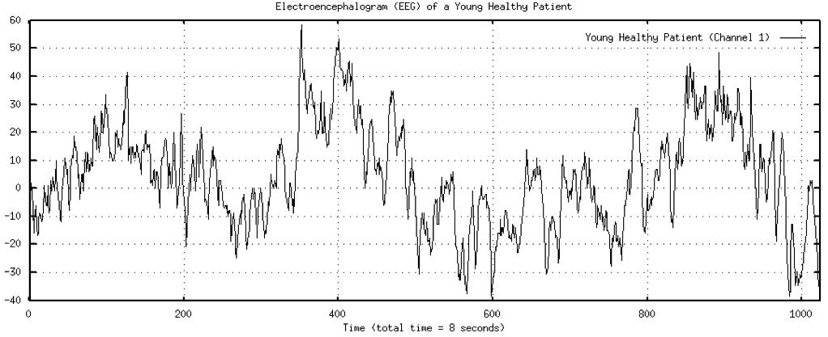
Example of an electroenchephalogram (EEG) signal

Slide 8
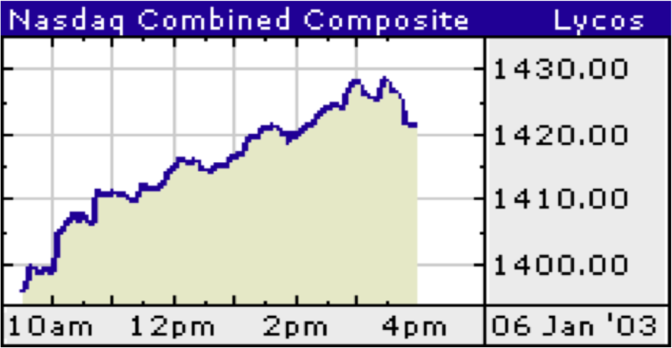
Example of a stock market signal

Slide 9
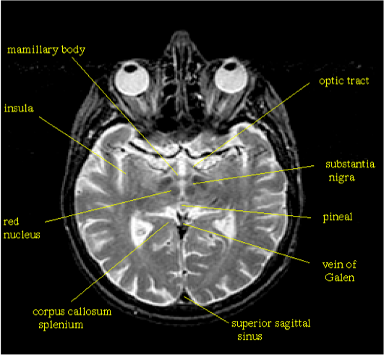
Magnetic resonance tomography image. This is a signal in 2 dimensions.

Slide 10
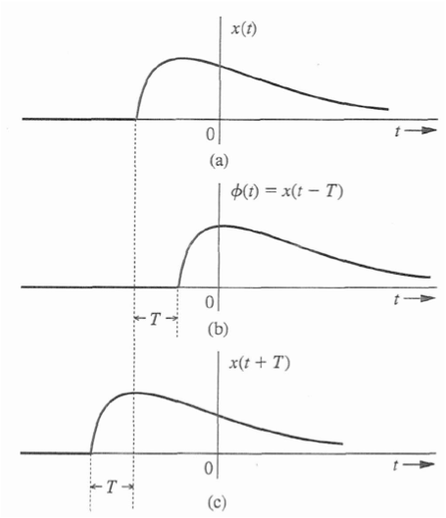

Useful signal operations: time shifting
Consider a signal $x(t)$ in continuous
time shown in the figure right.
The signal $x\left(t\right)$ may be delayed
by $T$ units of time; in that case
the signal $φ\left(t\right)=x(t−T)$ is obtained.
The signal $x\left(t\right)$ may be advanced
by $T$ units of time; in that case
the signal $φ\left(t\right)=x(t+T)$ is obtained.

Slide 11
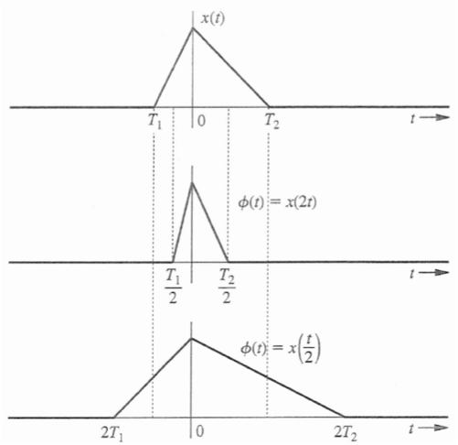

Useful signal operations cont.: time scaling
Consider a signal $x(t)$ in continuous
time shown in the figure right.
The signal $x\left(t\right)$ may be compressed
by a factor of $2$; in that case
the signal $φ\left(t\right)=x(2t)$ is obtained.
The signal $x\left(t\right)$ may be stretched
by a factor of $2$; in that case
the signal $φ\left(t\right)=x\left(\frac{t}{2}\right)$ is obtained.

Slide 12
Classification of signals
Signals may be classified into:
Energy and power signals
Discrete-time and continuous-time signals
Analogue and digital signals
Deterministic and probabilistic signals
Periodic and aperiodic signals
Even and odd signals

Slide 13

Energy of a signal
How do we measure the “size” of a signal $x(t)$?
By the signal energy $E_{x}$
$$E_{x}=\int_{−∞}^{∞}{x^{2}\left(t\right)dt}$$
For a complex-valued signal the above relationship becomes:
$$E_{x}=\int_{−∞}^{∞}{\left|x^{2}\left(t\right)\right|dt}$$
The energy of a signal must be finite. This implies that:
$$\lim_{t→±∞}\left|x(t)\right|=0$$

Slide 14

Power of a signal
If $\lim_{t→±∞}\left|x(t)\right|≠0$we must use the signal power instead
$$P_{x}=\lim_{T→∞}{\frac{1}{T}}\int_{−\frac{T}{2}}^{\frac{T}{2}}{x^{2}\left(t\right)dt}$$
For a complex-valued signal the above relationship becomes:
$$P_{x}=\lim_{T→∞}{\frac{1}{T}}\int_{−\frac{T}{2}}^{\frac{T}{2}}{\left|x^{2}\left(t\right)\right|dt}$$

Slide 15
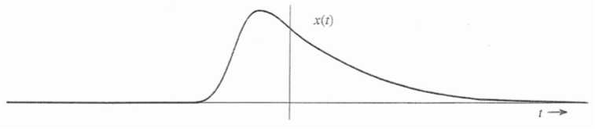
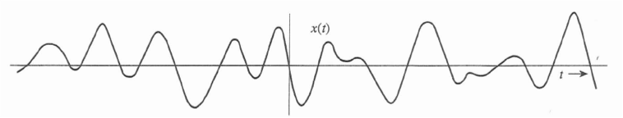
Energy and power cont.
Example of a signal with finite energy, which implies that the power of the signal is zero.
Example of a signal with finite power, which implies that the energy of the signal is infinite.

Slide 16
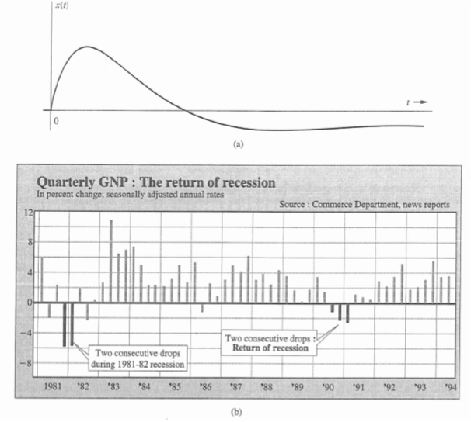

Continuous - and Discrete - Time Signals This classification refers to time $t$
Example of a continuous-time
signal. This is defined for any
value of time.
Example of a discrete-time
signal.
This is defined for certain
instants of time only.
It arises from a continuous-time
signal if only its values at these
certain time instants are kept.
This process is called sampling.

Slide 17
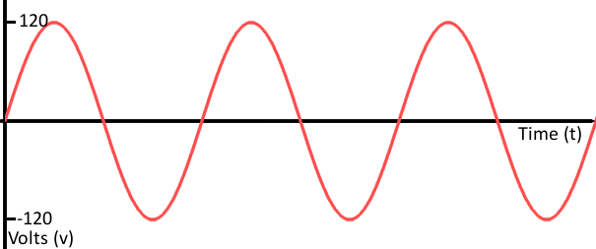
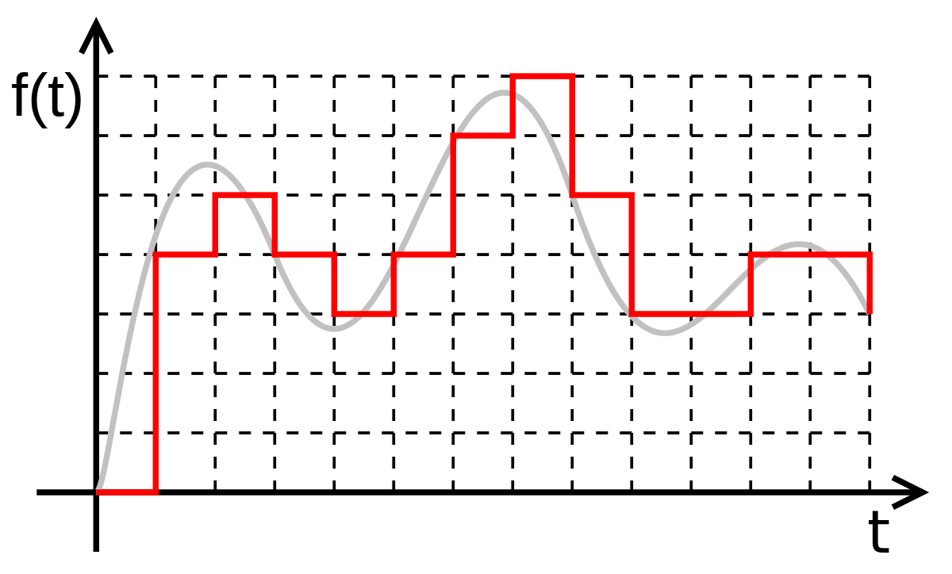

Analog and Digital Signals This classification refers to the value of the signal $x(t)$
An analog signal can take infinite
number of values.
A digital signal can take only a
finite number of values.
It arises from an analog
signal if all values are replaced
with a finite number of values.
The total error arising from this
process must be as small as
possible.
This process is called
quantization.

Slide 18
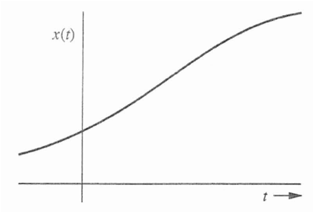
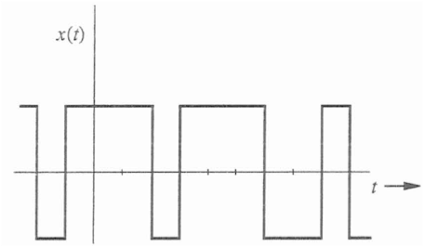


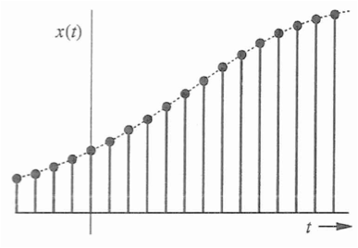
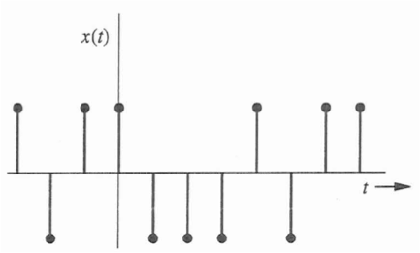


We now have 4 types of signals

Slide 19
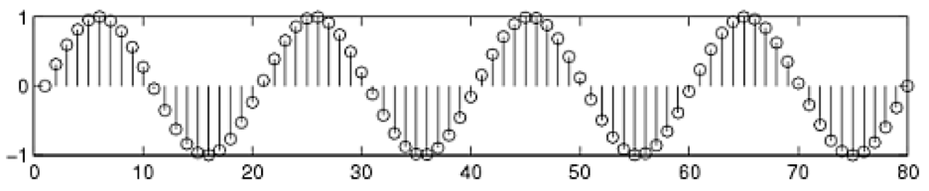
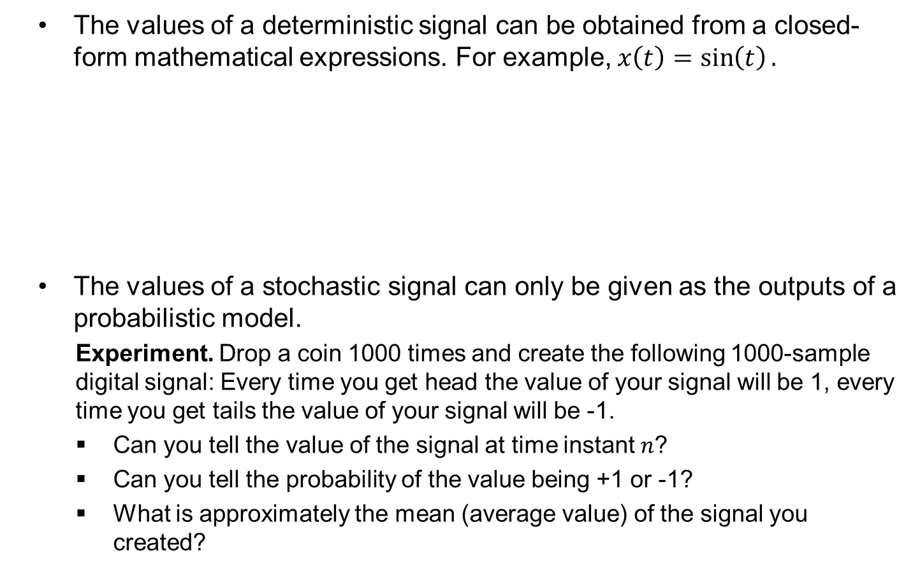
Deterministic and Stochastic Signals
The values of a deterministic signal can be obtained from a closed-form mathematical expressions. For example, $x\left(t\right)=\sin\left(t\right).$
The values of a stochastic signal can only be given as the outputs of a probabilistic model.
Experiment. Drop a coin 1000 times and create the following 1000-sample digital signal: Every time you get head the value of your signal will be 1, every time you get tails the value of your signal will be -1.
Can you tell the value of the signal at time instant $n$?
Can you tell the probability of the value being +1 or -1?
What is approximately the mean (average value) of the signal you created?

Slide 20
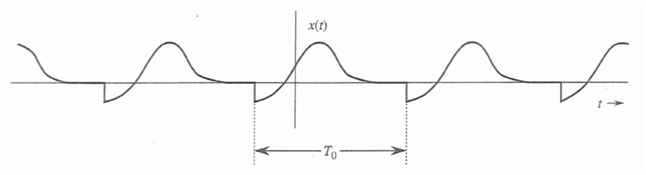

Periodic and Aperiodic Signals
A signal is said to be periodic if for some constant $T_{0}$ the following holds:
$x\left(t+T_{0}\right)=x\left(t\right),$ $∀t$
The smallest $T_{0}$ that satisfies the above relationship is called the fundamental period of the signal.

Slide 21
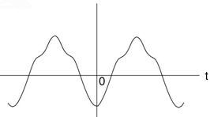
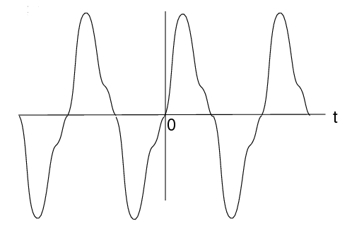

Even and Odd Signals
An even signal remains the same if you rotate it along the vertical axis. In mathematical terms this property is defined as $x\left(−t\right)=x(t).$
An odd signal gets reflected along the horizontal axis if you rotate it along the vertical axis. In mathematical terms this property is defined as $x\left(−t\right)=−x(t).$

Slide 22

Even and Odd Signals
Easy problems
Verify that the signal $x\left(t\right)+x(−t)$ is always even.
Verify that the signal $x\left(t\right)−x(−t)$ is always odd.
Based on the above, any signal can be written as a the sum of an even and an odd signal as follows:
$x\left(t\right)=\frac{1}{2}\left[x\left(t\right)+x(−t)\right]+$ $\frac{1}{2}\left[x\left(t\right)−x(−t)\right]$

Slide 23
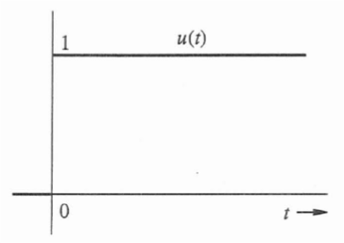
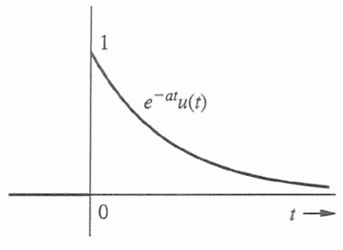

Unit step function
The unit step function is defined as follows:
$$u\left(t\right)=\left\{\begin{matrix}1 & t≥0 \\ 0 & t<0\end{matrix}\right.$$
The unit step function is often used to describe a signal that starts at $t=0.$
For example, consider the everlasting exponential signal $x\left(t\right)=e^{−t}$.
The causal form of the above signal is $e^{−t}u(t)$.

Slide 24
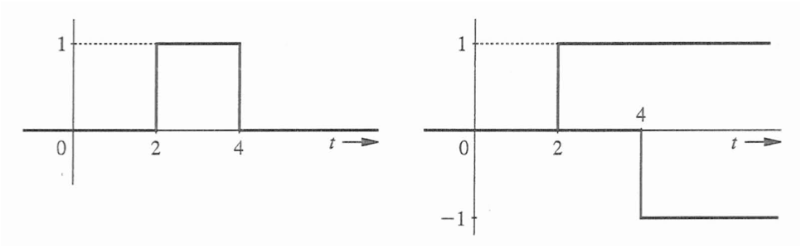

Pulse signals
A pulse signal can be generated using two step functions, as for example:
$$x\left(t\right)=u\left(t−2\right)−u(t−4)$$

Slide 25
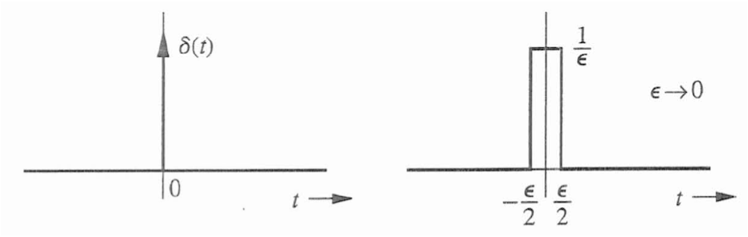

Unit impulse (Dirac) function
The Dirac function is defined as follows:
$$δ\left(t\right)=0, t≠0$$
$$\int_{−∞}^{∞}{δ\left(t\right)dt=1}$$
The Dirac function is the limit of a family of functions $δ_{ε}(t)$ when $ε→0.$ The simplest of these functions is the rectangular pulse shown in the figure below right. The width and height depend on $ε$ but the entire area under the function is equal to 1.

Slide 26

Sampling property of the unit impulse function
Since the unit impulse function is non-zero only at $t=0$, for any function $φ(t)$ we have
$$φ\left(t\right)δ\left(t\right)=φ\left(0\right)δ\left(t\right)$$
From the above we get:
$\int_{−∞}^{∞}{φ\left(t\right)δ\left(t\right)dt}=$ $\int_{−∞}^{∞}{φ\left(0\right)δ\left(t\right)dt=φ\left(0\right)\int_{−∞}^{∞}{δ\left(t\right)dt=φ\left(0\right)}}$
Furthermore, we have:
$\int_{−∞}^{∞}{φ\left(t\right)δ\left(t−T\right)dt}=$ $\int_{−∞}^{∞}{φ\left(τ+T\right)δ\left(τ\right)dτ=φ\left(T\right)}$

Slide 27

Unit Step and Unit Impulse function
It is proven that $\frac{du(t)}{dt}=δ\left(t\right)$
$u_{ε}(t)$ $u \left(t\right)$
$ε→0$
$−ε$ $ε$
$ε→0$
$−ε$ $ε$

Slide 28


The Exponential Function $e^{st}$
The exponential function is very important in Signals and Systems.
The parameter $s$ is a complex variable given by $s=σ+jω$.
Therefore, $e^{st}=e^{\left(σ+jω\right)t}=e^{σt}$ $e^{jωt}=$ $e^{σt}(cosωt+jsinωt)$
If $s^{∗}$ is the complex conjugate of $s$ then $s=σ−jω$
$e^{s^{∗}t}=e^{\left(σ−jω\right)t}=e^{σt}$ $e^{−jωt}=$ $e^{σt}(cosωt−jsinωt)$
$$e^{σt}cosωt=\frac{1}{2}\left(e^{st}+e^{s^{∗}t}\right)$$
The exponential function can be used to model a large class of signals.
A constant ${k=ke}^{0t}, s=0$
A monotonic exponential $e^{σt}, s=σ, ω=0$
A sinusoid $cosωt$, $σ=0, s=±jω$
An exponentially varying sinusoid $e^{σt}cosωt$, $s=σ±jω$

Slide 29
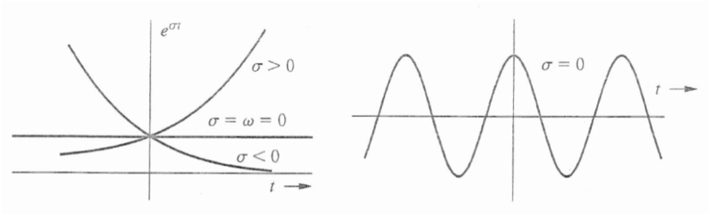
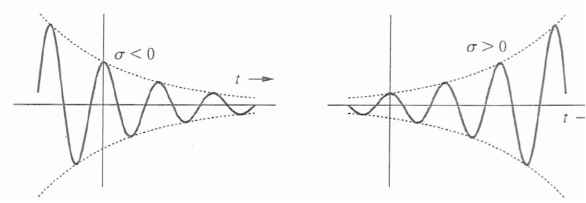


The Exponential Function $e^{st}$ cont.
$ω=0$

Slide 30


Discrete-Time Exponential $γ^{n}$
A continuous-time exponential $e^{st}$ can be expressed in alternate form as $e^{st}=γ^{t}$ with $γ=e^{s}$.
Similarly for discrete time exponentials we have $e^{λn}=γ^{n}$.
When $Re\left\{λ\right\}<0$ then $\left|γ\right|<1$ and the exponential decays.
When $Re\left\{λ\right\}>0$ then $\left|γ\right|>1$ and the exponential grows.
When $Re\left\{λ\right\}=0$ then $\left|γ\right|=1$. The exponential is of constant-amplitude and oscillates.

Slide 31


Discrete-Time Exponential $γ^{n}$ cont.
Mapping from $λ$ to $γ$

