Slide 1
Signals and Systems Revision Lecture 2
DR TANIA STATHAKI
READER (ASSOCIATE PROFESSOR) IN SIGNAL PROCESSING IMPERIAL COLLEGE LONDON

Slide 2

Sampling
In this revision lecture we will focus on:
Sampling.
The $z−$ transform.

Slide 3
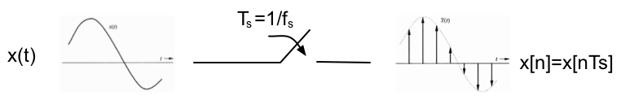
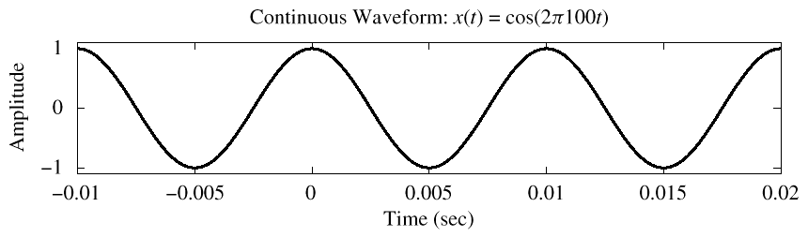
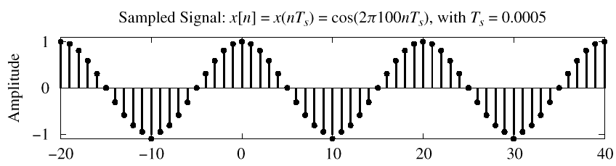
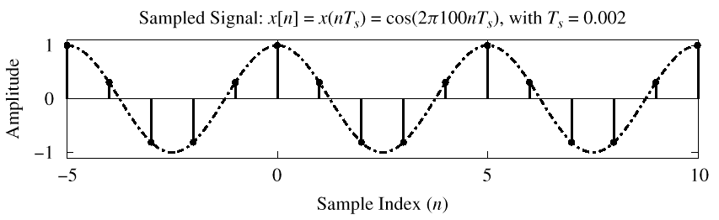

Sampling
The sampling process converts continuous signals $x(t)$ into numbers $x[n]$.
A sample is kept every $T_{s}$ units of time. This process is called uniform sampling and $x\left[n\right]=x(nT_{s})$.
$x(t)$ $T_{s}=1/f_{s}$ $x[n]$

Slide 4

Sampling theorem
Sampling theorem is the bridge between continuous-time and discrete-time signals.
It states how often we must sample in order not to loose any information.
$x(t)$ $T_{s}=1/f_{s}$ $x[n]$
Sampling theorem
A continuous-time lowpass signal $x(t)$ with frequencies no higher than $f_{max} Hz$ can be perfectly reconstructed from samples taken every $T_{s}$ units of time, $x\left[n\right]=x(nT_{s})$, if the samples are taken at a rate $f_{s}=1/T_{s}$that is greater than ${2f}_{max}$.

Slide 5
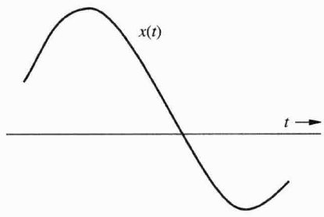
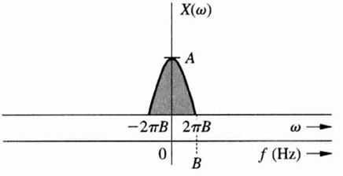
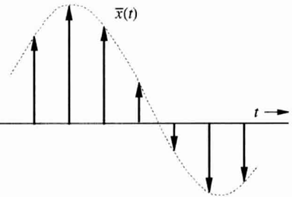
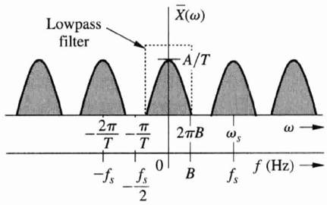

Recall: spectrum of sampled signal
Consider a signal, bandlimited to $BHz$, with Fourier transform $X(ω)$ (depicted real for convenience).
The sampled signal has the following spectrum.

Slide 6
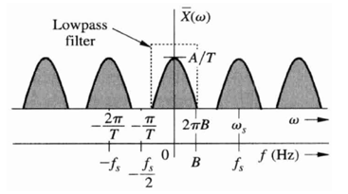

Reconstruction of the original signal
The gap between two adjacent spectral repetitions is ${(f}_{s}−2B)Hz$.
In theory, in order to reconstruct the original signal $x(t)$, we can use an ideal lowpass filter on the sampled spectrum which has a bandwidth of any value between $B$ and $(f_{s}−BHz)$.
Reconstruction process is possible only if the shaded parts do not overlap. This means that $f_{s}$ must be greater that twice $B$.
We can also visually verify the sampling theorem in the above figure.

Slide 7
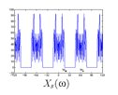
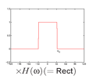
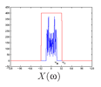

Reconstruction generic example
Frequency domain
The signal $x\left(nT_{s}\right)=<x\left(t\right),δ(t−nT_{s})>$ has a spectrum $X_{s}(ω)$ which is multiplied with a rectangular pulse in frequency domain.

Slide 8




Reconstruction generic example cont.
Time domain
The signal $x\left(nT_{s}\right)=<x\left(t\right),δ(t−nT_{s})>$ is convolved with a $sinc$ function, which is the time domain version of a rectangular pulse in frequency domain centred at the origin.
$<x\left(t\right),δ(t−nT_{s})>∗$ $sinc\left(at\right)=\sum_{n}{x[n]}sinc[a(t−nT_{s})]$
[Recall that convolution with a shifted Delta function, shifts the original function at the location of the Delta function].

Slide 9
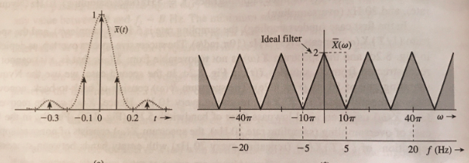

Recall Nyquist sampling: Just about the correct sampling rate
In that case we use the Nyquist sampling rate of $10Hz=2BHz.$
The spectrum $\overline{X}\left(ω\right)$ consists of back-to-back, non-overlapping repetitions of $\frac{1}{T_{s}}X\left(ω\right)$ repeating every $10Hz.$
In order to recover $X(ω)$ from $\overline{X}\left(ω\right)$ we must use an ideal lowpass filter of bandwidth $5Hz.$ This is shown in the right figure below with the dotted line.

Slide 10
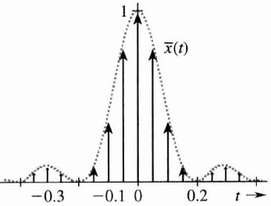
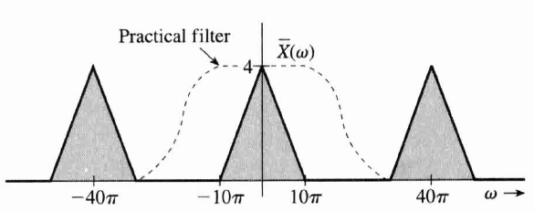
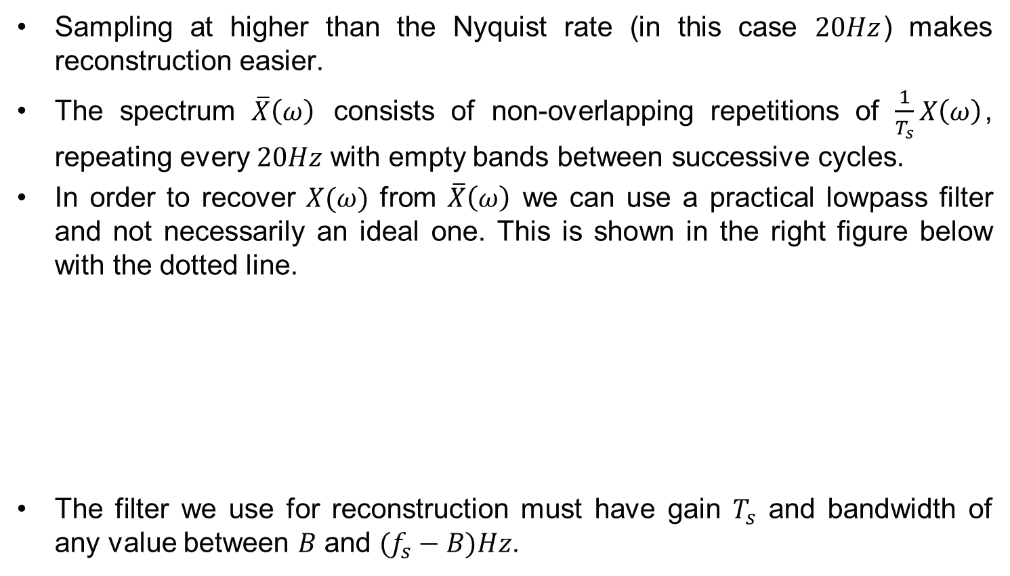
Recall oversampling: What happens if we sample too quickly?
Sampling at higher than the Nyquist rate (in this case $20Hz$) makes reconstruction easier.
The spectrum $\overline{X}\left(ω\right)$ consists of non-overlapping repetitions of $\frac{1}{T_{s}}X\left(ω\right)$, repeating every $20Hz$ with empty bands between successive cycles.
In order to recover $X(ω)$ from $\overline{X}\left(ω\right)$ we can use a practical lowpass filter and not necessarily an ideal one. This is shown in the right figure below with the dotted line.
The filter we use for reconstruction must have gain $T_{s}$ and bandwidth of any value between $B$ and $(f_{s}−B)Hz$.

Slide 11
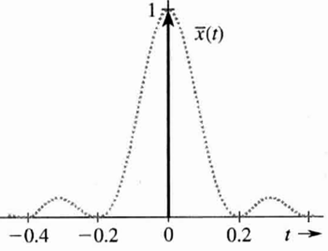
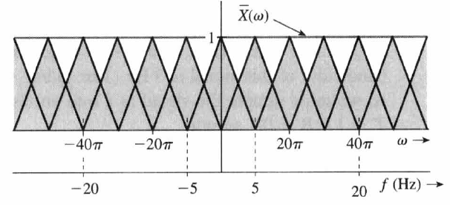
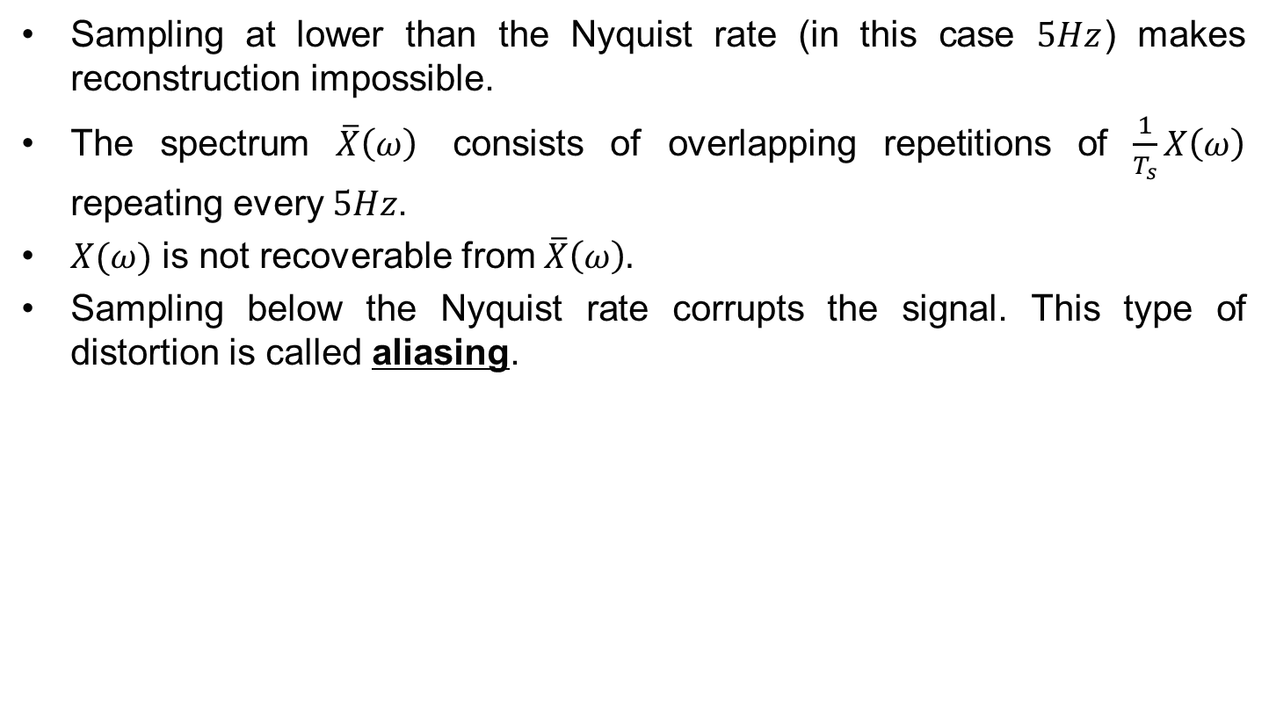
Recall undersampling: What happens if we sample too slowly?
Sampling at lower than the Nyquist rate (in this case $5Hz$) makes reconstruction impossible.
The spectrum $\overline{X}\left(ω\right)$ consists of overlapping repetitions of $\frac{1}{T_{s}}X\left(ω\right)$ repeating every $5Hz$.
$X(ω)$ is not recoverable from $\overline{X}\left(ω\right).$
Sampling below the Nyquist rate corrupts the signal. This type of distortion is called aliasing.

Slide 12
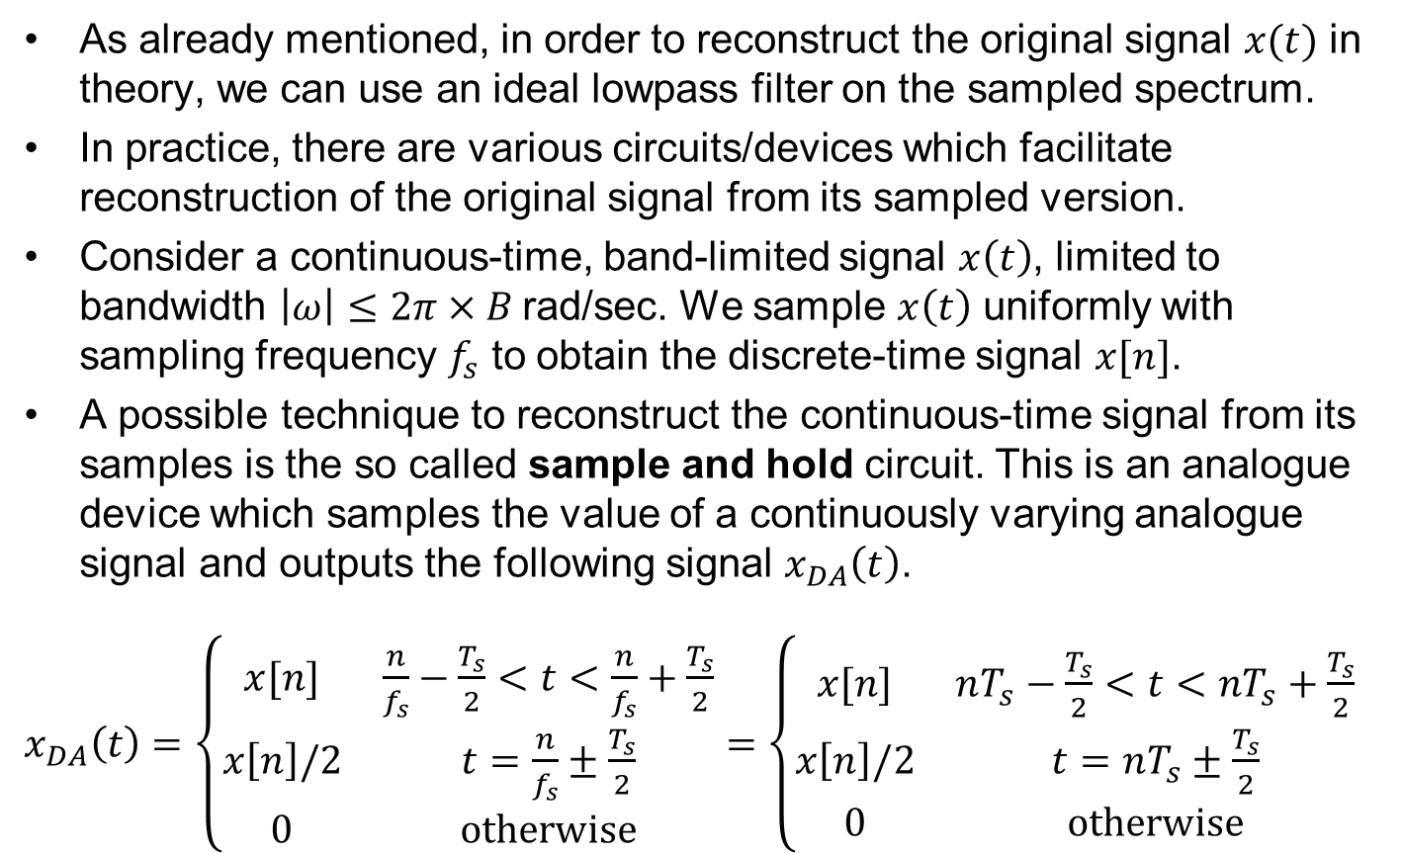
Problem: Reconstruction of the continuous time using the sample and hold operation
As already mentioned, in order to reconstruct the original signal $x(t)$ in theory, we can use an ideal lowpass filter on the sampled spectrum.
In practice, there are various circuits/devices which facilitate reconstruction of the original signal from its sampled version.
Consider a continuous-time, band-limited signal $x\left(t\right)$, limited to bandwidth $\left|ω\right|≤2π×B$rad/sec. We sample $x\left(t\right)$ uniformly with sampling frequency $f_{s}$ to obtain the discrete-time signal $x[n]$.
A possible technique to reconstruct the continuous-time signal from its samples is the so called sample and hold circuit. This is an analogue device which samples the value of a continuously varying analogue signal and outputs the following signal $x_{DA}\left(t\right)$.
$x_{DA}\left(t\right)=\left\{\begin{matrix}x[n] & \frac{n}{f_{s}}−\frac{T_{s}}{2}<t<\frac{n}{f_{s}}+\frac{T_{s}}{2} \\ x\left[n\right]/2 & t=\frac{n}{f_{s}}±\frac{T_{s}}{2} \\ 0 & otherwise\end{matrix}\right.=$ $\left\{\begin{matrix}x[n] & nT_{s}−\frac{T_{s}}{2}<t<nT_{s}+\frac{T_{s}}{2} \\ x\left[n\right]/2 & t=nT_{s}±\frac{T_{s}}{2} \\ 0 & otherwise\end{matrix}\right.$

Slide 13
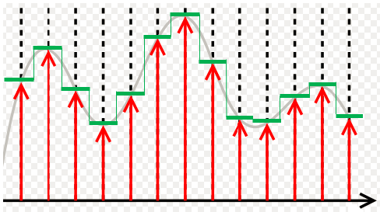

Reconstruction of the continuous time using the sample and hold operation cont.
The figure below facilitates the understanding of sample and hold operation.
The grey continuous curve depicts the continuous signal $x\left(t\right).$
The red arrows depict the locations of the discrete (sampled) signal $x\left[n\right].$
The green continuous curve depicts the signal $x_{DA}\left(t\right)$.

Slide 14
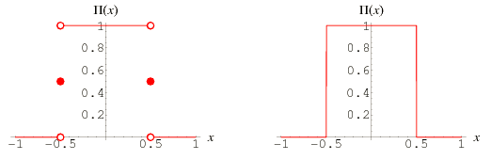
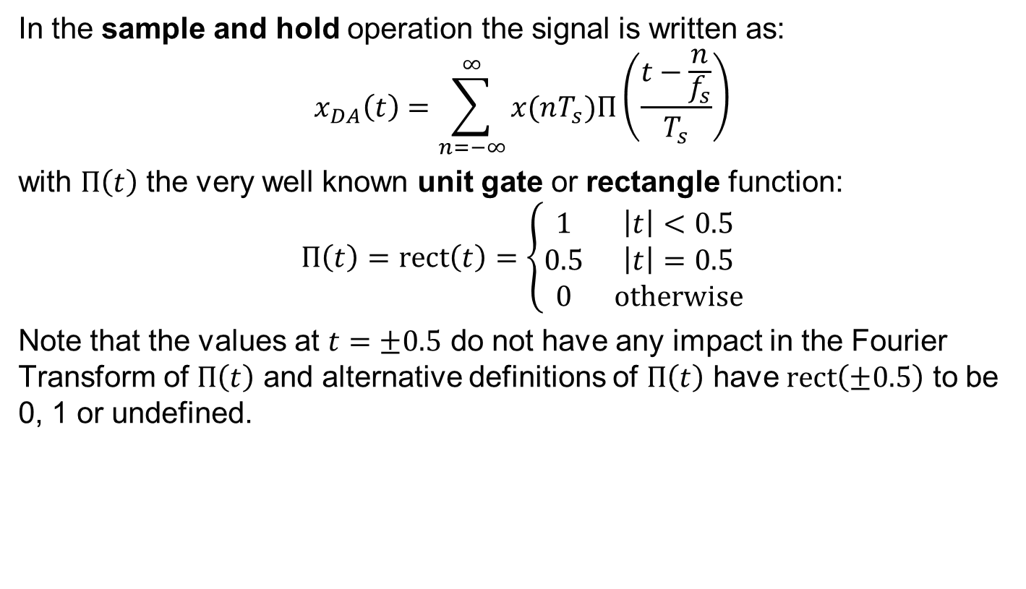
Problem: Reconstruction of the continuous time using the sample and hold operation cont.
In the sample and hold operation the signal is written as:
$$x_{DA}\left(t\right)=\sum_{n=−∞}^{∞}{x(nT_{s})Π\left(\frac{t−\frac{n}{f_{s}}}{T_{s}}\right)}$$
with $Π\left(t\right)$ the very well known unit gate or rectangle function:
$$Π\left(t\right)=rect\left(t\right)=\left\{\begin{matrix}1 & \left|t\right|<0.5 \\ 0.5 & \left|t\right|=0.5 \\ 0 & otherwise\end{matrix}\right.$$
Note that the values at $t=±0.5$ do not have any impact in the Fourier Transform of $Π\left(t\right)$ and alternative definitions of $Π\left(t\right)$ have $rect\left(±0.5\right)$ to be 0, 1 or undefined.

Slide 15
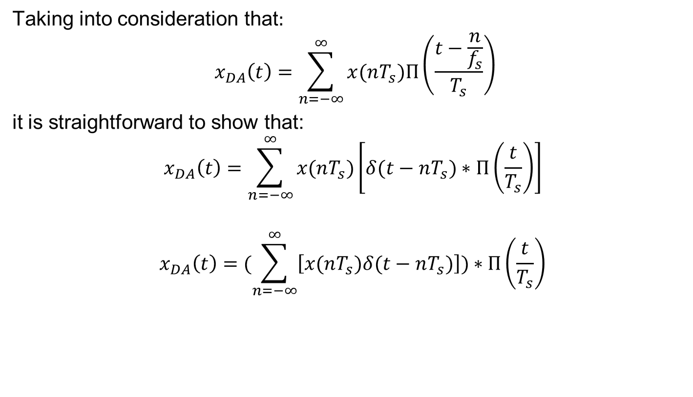
Problem: Reconstruction of the continuous time using the sample and hold operation cont.
Taking into consideration that$:$
$$x_{DA}\left(t\right)=\sum_{n=−∞}^{∞}{x(nT_{s})Π\left(\frac{t−\frac{n}{f_{s}}}{T_{s}}\right)}$$
it is straightforward to show that:
$$x_{DA}\left(t\right)=\sum_{n=−∞}^{∞}{x(nT_{s})\left[δ(t−nT_{s})∗Π\left(\frac{t}{T_{s}}\right)\right]}$$
$$x_{DA}\left(t\right)=(\sum_{n=−∞}^{∞}{\left[x(nT_{s})δ(t−nT_{s})\right])∗Π\left(\frac{t}{T_{s}}\right)}$$

Slide 16
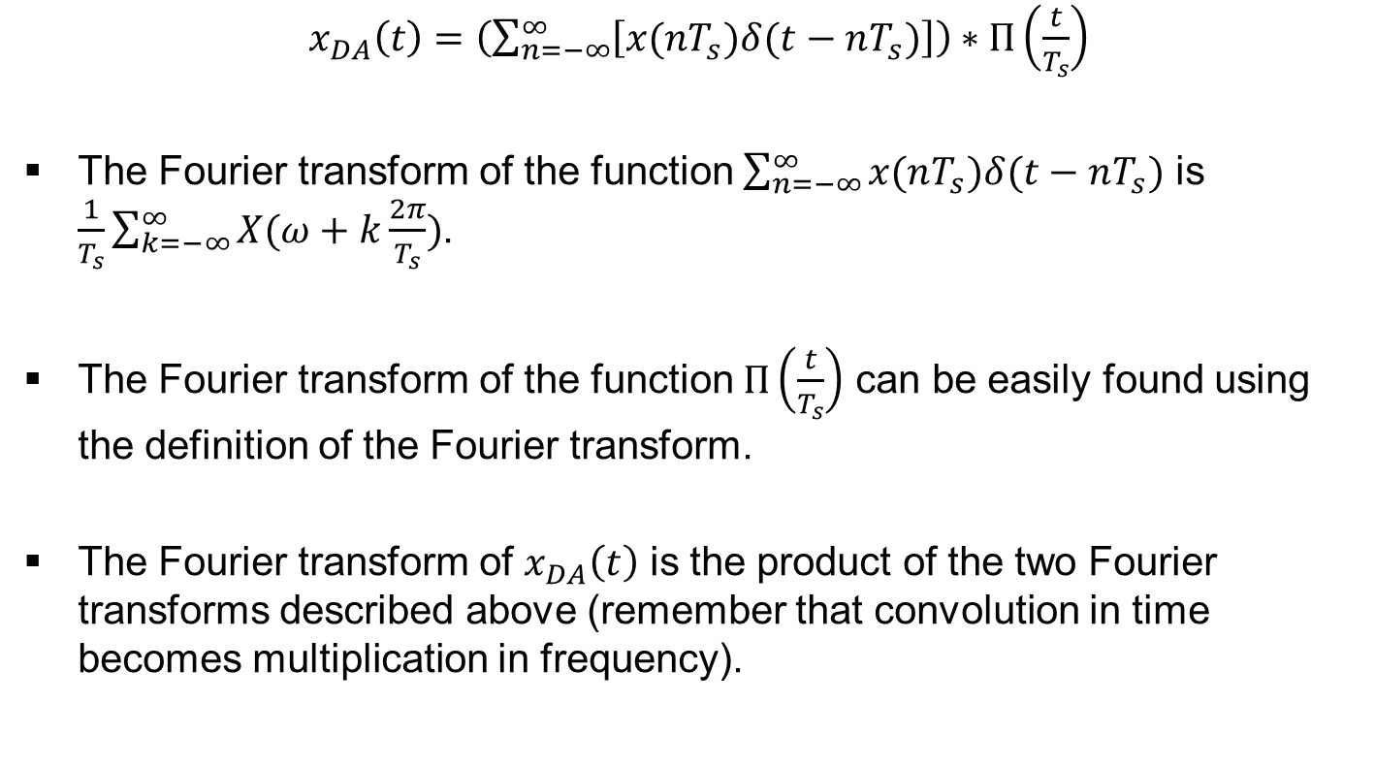
Problem: Reconstruction of the continuous time using the sample and hold operation cont.
$x_{DA}\left(t\right)=\left(\sum_{n=−∞}^{∞}{\left[x(nT_{s})δ(t−nT_{s})\right]}\right)$ $∗Π\left(\frac{t}{T_{s}}\right)$
The Fourier transform of the function $\sum_{n=−∞}^{∞}{x(nT_{s})δ(t−nT_{s})}$ is $\frac{1}{T_{s}}\sum_{k=−∞}^{∞}{X(ω+k\frac{2π}{T_{s}})}$.
The Fourier transform of the function $Π\left(\frac{t}{T_{s}}\right)$ can be easily found using the definition of the Fourier transform.
The Fourier transform of $x_{DA}\left(t\right)$ is the product of the two Fourier transforms described above (remember that convolution in time becomes multiplication in frequency).

Slide 17
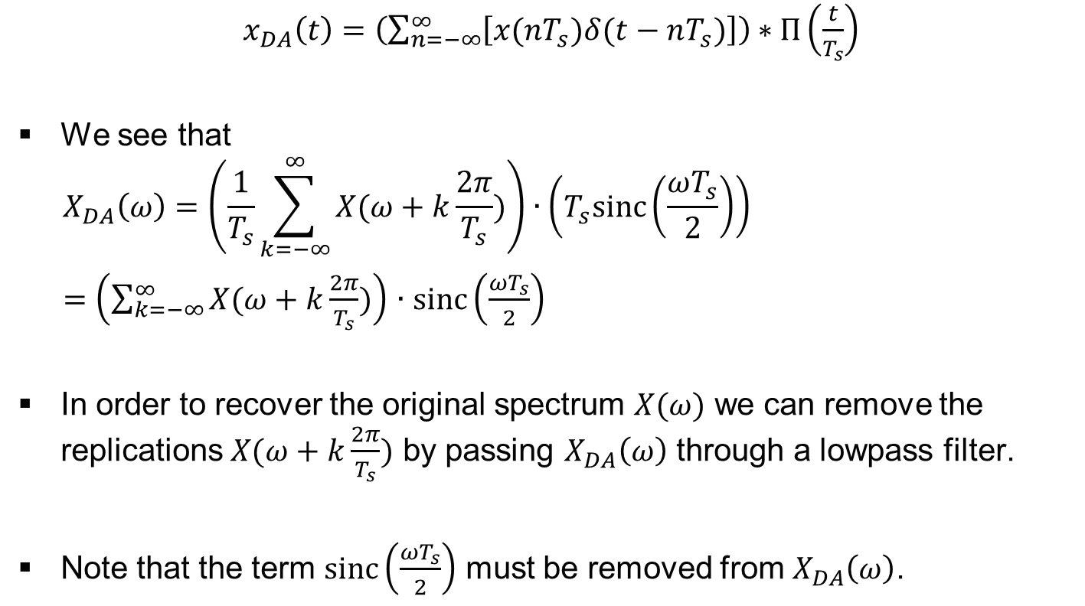
Problem: Reconstruction of the continuous time using the sample and hold operation cont.
$x_{DA}\left(t\right)=\left(\sum_{n=−∞}^{∞}{\left[x(nT_{s})δ(t−nT_{s})\right]}\right)$ $∗Π\left(\frac{t}{T_{s}}\right)$
We see that
$$X_{DA}\left(ω\right)=\left(\frac{1}{T_{s}}\sum_{k=−∞}^{∞}{X(ω+k\frac{2π}{T_{s}})}\right)∙\left(T_{s}sinc\left(\frac{ωT_{s}}{2}\right)\right)$$
$=$ $\left(\sum_{k=−∞}^{∞}{X(ω+k\frac{2π}{T_{s}})}\right)$ $∙$ $sinc\left(\frac{ωT_{s}}{2}\right)$
In order to recover the original spectrum $X(ω)$ we can remove the replications $X(ω+k\frac{2π}{T_{s}})$ by passing $X_{DA}\left(ω\right)$ through a lowpass filter.
Note that the term $sinc\left(\frac{ωT_{s}}{2}\right)$ must be removed from $X_{DA}\left(ω\right)$.

Slide 18
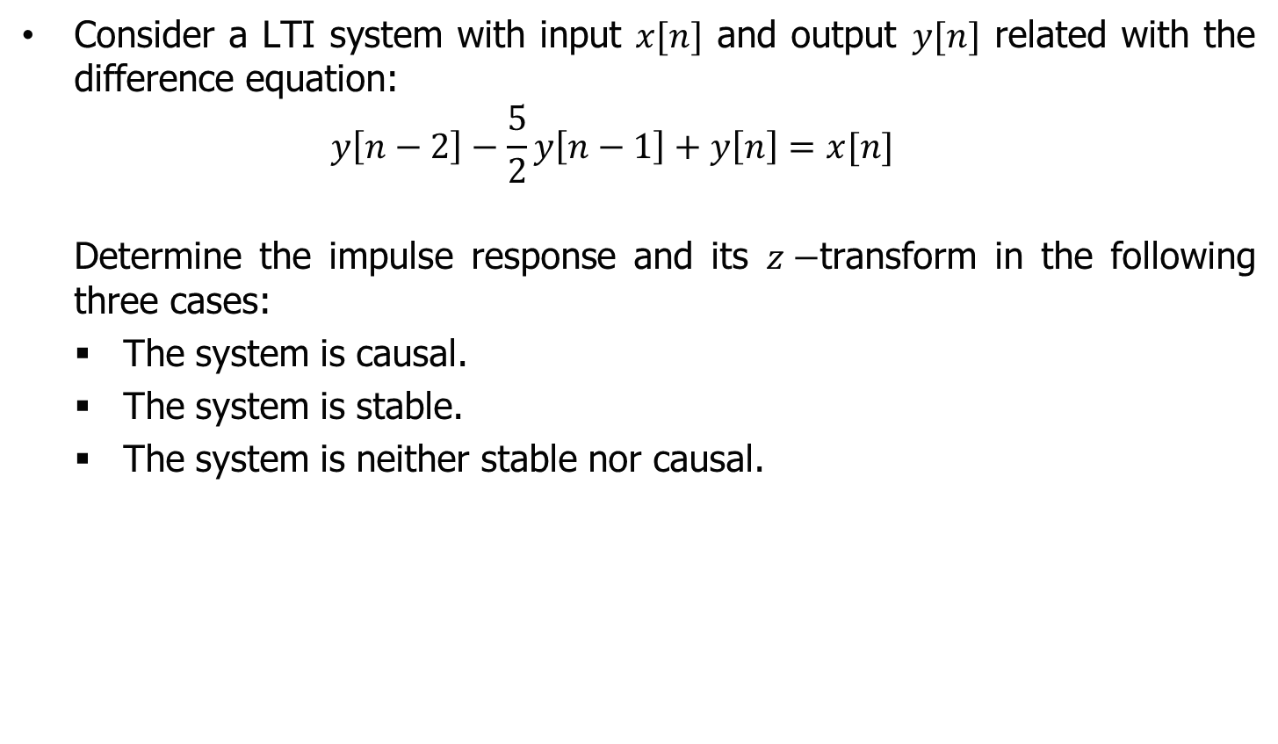
Example on a discrete system’s transfer function
Consider a LTI system with input $x[n]$ and output $y[n]$ related with the difference equation:
$$y\left[n−2\right]−\frac{5}{2}y\left[n−1\right]+y\left[n\right]=x[n]$$
Determine the impulse response and its $z−$transform in the following three cases:
The system is causal.
The system is stable.
The system is neither stable nor causal.

Slide 19
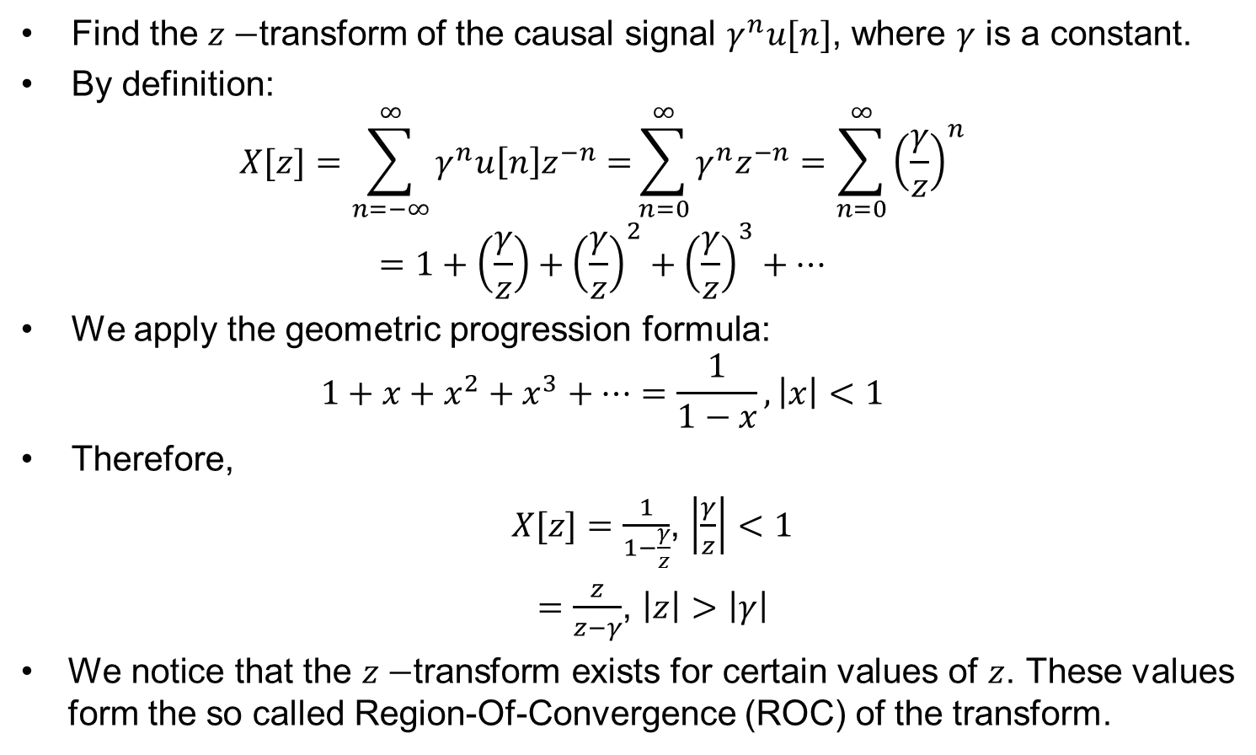
Recall: Find the $z−$transform of ${x\left[n\right]=γ}^{n}u[n]$
Find the $z−$transform of the causal signal $γ^{n}u[n]$, where $γ$ is a constant.
By definition:
$$X[z]=\sum_{n=−∞}^{∞}{γ^{n}u\left[n\right]z^{−n}=}\sum_{n=0}^{∞}{γ^{n}z^{−n}}=\sum_{n=0}^{∞}{{\left(\frac{γ}{z}\right)}^{n}}=1+\left(\frac{γ}{z}\right)+{\left(\frac{γ}{z}\right)}^{2}+{\left(\frac{γ}{z}\right)}^{3}+…$$
We apply the geometric progression formula:
$$1+x+x^{2}+x^{3}+…=\frac{1}{1−x}, \left|x\right|<1$$
Therefore,
$X[z]=\frac{1}{1−\frac{γ}{z}}$, $\left|\frac{γ}{z}\right|<1$
$=\frac{z}{z−γ}$, $\left|z\right|>\left|γ\right|$
We notice that the $z−$transform exists for certain values of $z$. These values form the so called Region-Of-Convergence (ROC) of the transform.

Slide 20
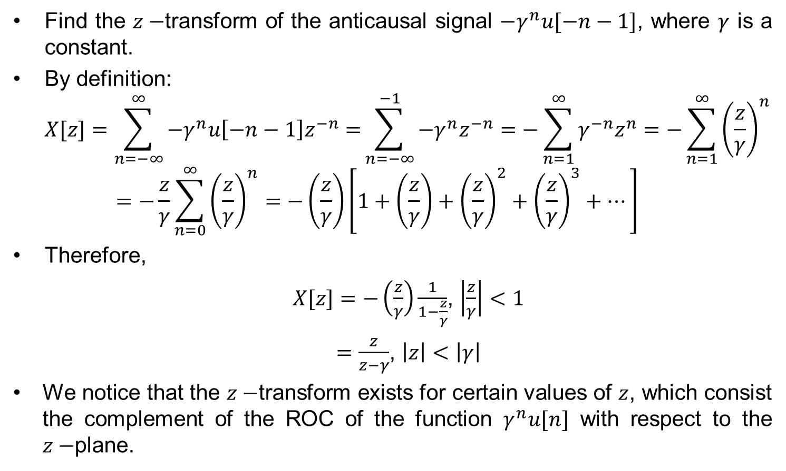
Recall: Find the $z−$transform of ${x\left[n\right]=−γ}^{n}u[−n−1]$
Find the $z−$transform of the anticausal signal $−γ^{n}u[−n−1]$, where $γ$ is a constant.
By definition:
$$X[z]=\sum_{n=−∞}^{∞}{−γ^{n}u\left[−n−1\right]z^{−n}=}\sum_{n=−∞}^{−1}{−γ^{n}z^{−n}}=−\sum_{n=1}^{∞}{γ^{−n}z^{n}}=−\sum_{n=1}^{∞}{{\left(\frac{z}{γ}\right)}^{n}}=−\frac{z}{γ}\sum_{n=0}^{∞}{{\left(\frac{z}{γ}\right)}^{n}}=−\left(\frac{z}{γ}\right)\left[1+\left(\frac{z}{γ}\right)+{\left(\frac{z}{γ}\right)}^{2}+{\left(\frac{z}{γ}\right)}^{3}+…\right]$$
Therefore,
$X[z]=−\left(\frac{z}{γ}\right)\frac{1}{1−\frac{z}{γ}}$, $\left|\frac{z}{γ}\right|<1$
$=\frac{z}{z−γ}$, $\left|z\right|<\left|γ\right|$
We notice that the $z−$transform exists for certain values of $z$, which consist the complement of the ROC of the function $γ^{n}u[n]$ with respect to the $z−$plane.

Slide 21
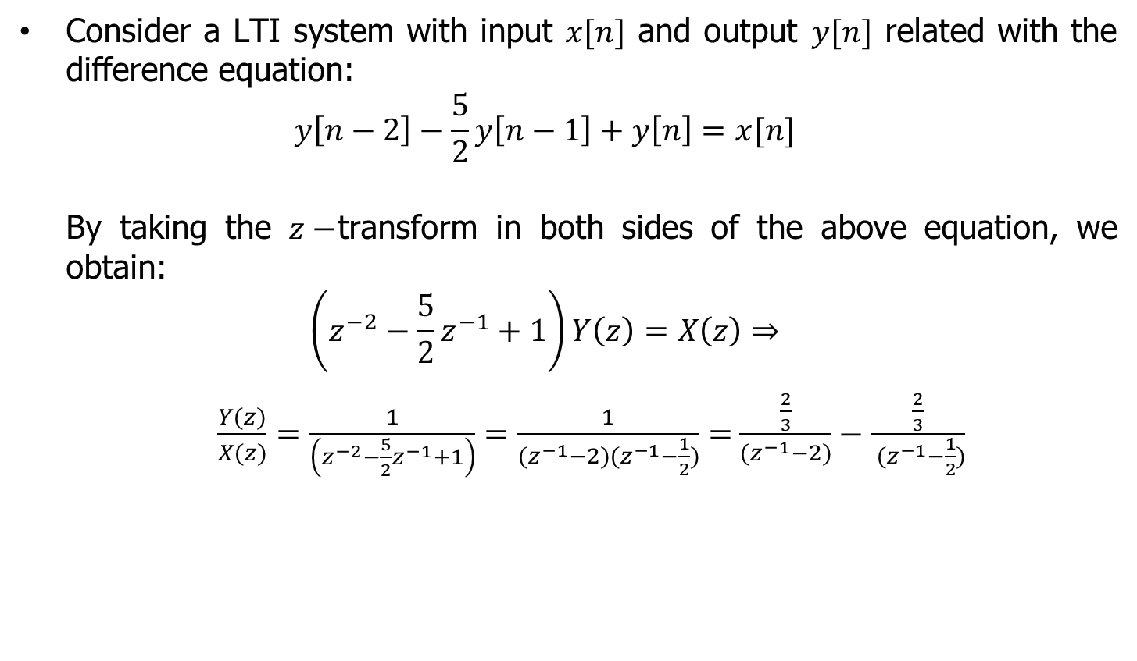
Example cont.
Consider a LTI system with input $x[n]$ and output $y[n]$ related with the difference equation:
$$y\left[n−2\right]−\frac{5}{2}y\left[n−1\right]+y\left[n\right]=x[n]$$
By taking the $z−$transform in both sides of the above equation, we obtain:
$$\left(z^{−2}−\frac{5}{2}z^{−1}+1\right)Y\left(z\right)=X\left(z\right)⇒$$
$\frac{Y(z)}{X(z)}=\frac{1}{\left(z^{−2}−\frac{5}{2}z^{−1}+1\right)}=\frac{1}{(z^{−1}−2)(z^{−1}−\frac{1}{2})}=$ $\frac{\frac{2}{3}}{(z^{−1}−2)}−$ $\frac{\frac{2}{3}}{ (z^{−1}−\frac{1}{2})}$

Slide 22
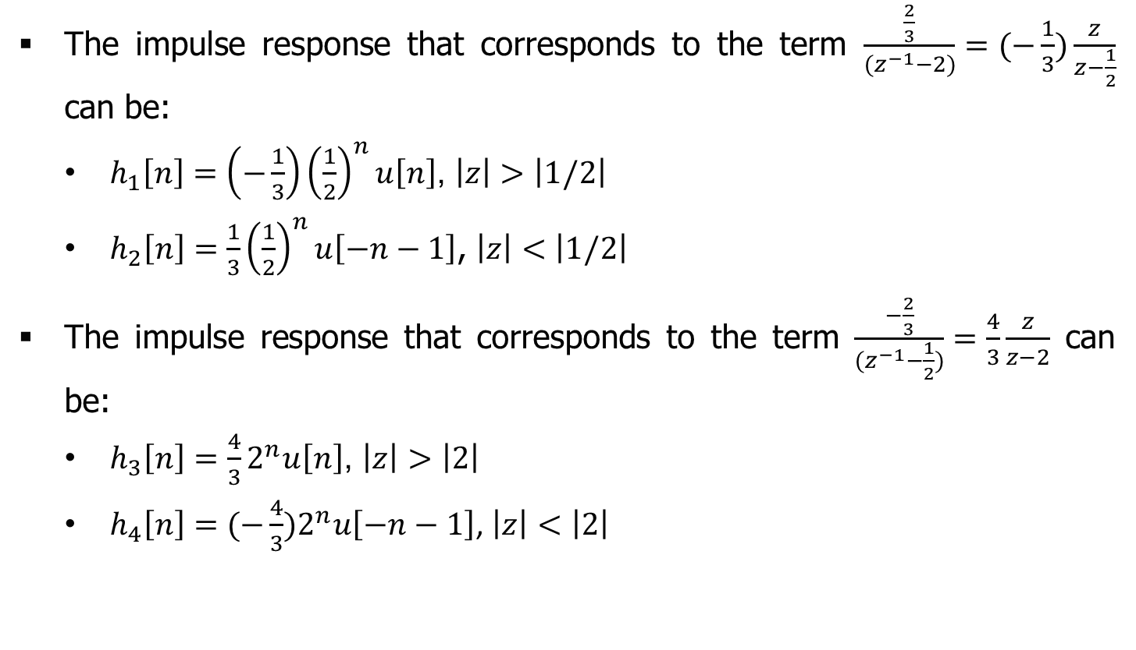
Example cont.
The impulse response that corresponds to the term $\frac{\frac{2}{3}}{(z^{−1}−2)}=(−\frac{1}{3})\frac{z}{z−\frac{1}{2}}$ can be:
$h_{1}\left[n\right]=$ $\left(−\frac{1}{3}\right){\left(\frac{1}{2}\right)}^{n}u\left[n\right]$, $\left|z\right|>\left|1/2\right|$
$h_{2}\left[n\right]=$ $\frac{1}{3}{\left(\frac{1}{2}\right)}^{n}u\left[−n−1\right]$, $\left|z\right|<\left|1/2\right|$
The impulse response that corresponds to the term $\frac{−\frac{2}{3}}{(z^{−1}−\frac{1}{2})}=\frac{4}{3}\frac{z}{z−2}$ can be:
$h_{3}\left[n\right]=\frac{4}{3}2^{n}u\left[n\right]$, $\left|z\right|>\left|2\right|$
$h_{4}\left[n\right]=$ $(−\frac{4}{3})2^{n}u\left[−n−1\right]$, $\left|z\right|<\left|2\right|$

Slide 23

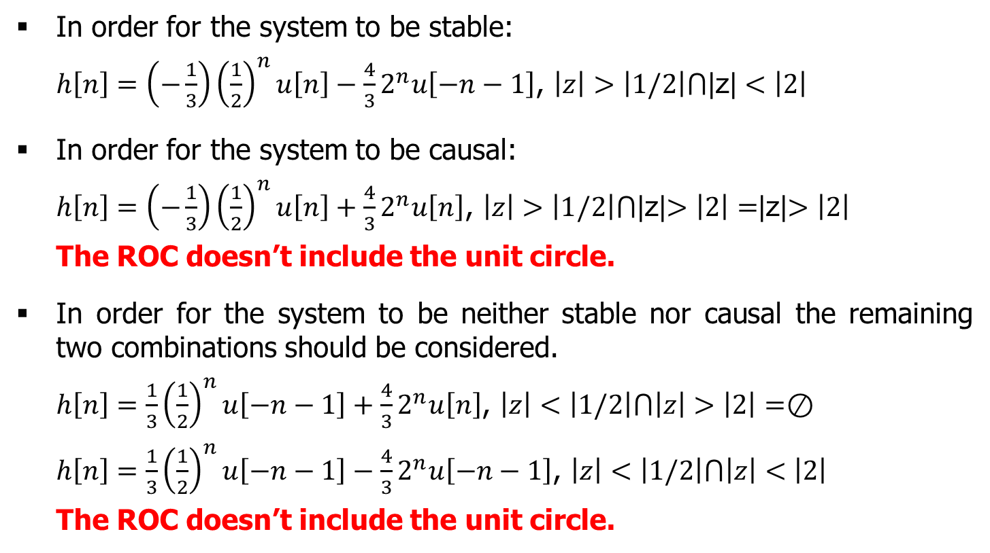
Example cont.
In order for the system to be stable:
$h\left[n\right]=$ $\left(−\frac{1}{3}\right){\left(\frac{1}{2}\right)}^{n}u\left[n\right]−\frac{4}{3}2^{n}u\left[−n−1\right]$, $\left|z\right|>\left|1/2\right|⋂\text{|}\text{z}\text{|}<\left|2\right|$
In order for the system to be causal:
$h\left[n\right]=$ $\left(−\frac{1}{3}\right){\left(\frac{1}{2}\right)}^{n}u\left[n\right]+\frac{4}{3}2^{n}u\left[n\right]$, $\left|z\right|>\left|1/2\right|⋂$|z|$>\left|2\right|=$|z|$>\left|2\right|$
The ROC doesn’t include the unit circle.
In order for the system to be neither stable nor causal the remaining two combinations should be considered.
$h\left[n\right]=\frac{1}{3}{\left(\frac{1}{2}\right)}^{n}u\left[−n−1\right]+\frac{4}{3}2^{n}u\left[n\right]$, $\left|z\right|<\left|1/2\right|⋂\left|z\right|>\left|2\right|=⊘$
$h\left[n\right]=\frac{1}{3}{\left(\frac{1}{2}\right)}^{n}u\left[−n−1\right]−\frac{4}{3}2^{n}u\left[−n−1\right]$, $\left|z\right|<\left|1/2\right|⋂\left|z\right|<\left|2\right|$
The ROC doesn’t include the unit circle.

