Slide 1
Signals and Systems Revision Lecture 1
DR TANIA STATHAKI
READER (ASSOCIATE PROFESSOR) IN SIGNAL PROCESSING IMPERIAL COLLEGE LONDON

Slide 2
Exam structure
The Signal and Systems exam comprises of 3 questions.
Question 1 consists of around 8 relatively general sub-questions which cover the entire syllabus. It values 40% of the exam.
Questions 2 and 3 consist of more specific questions. Each values 30% of the exam.
Students must attempt all questions.
Calculators are allowed.

Slide 3
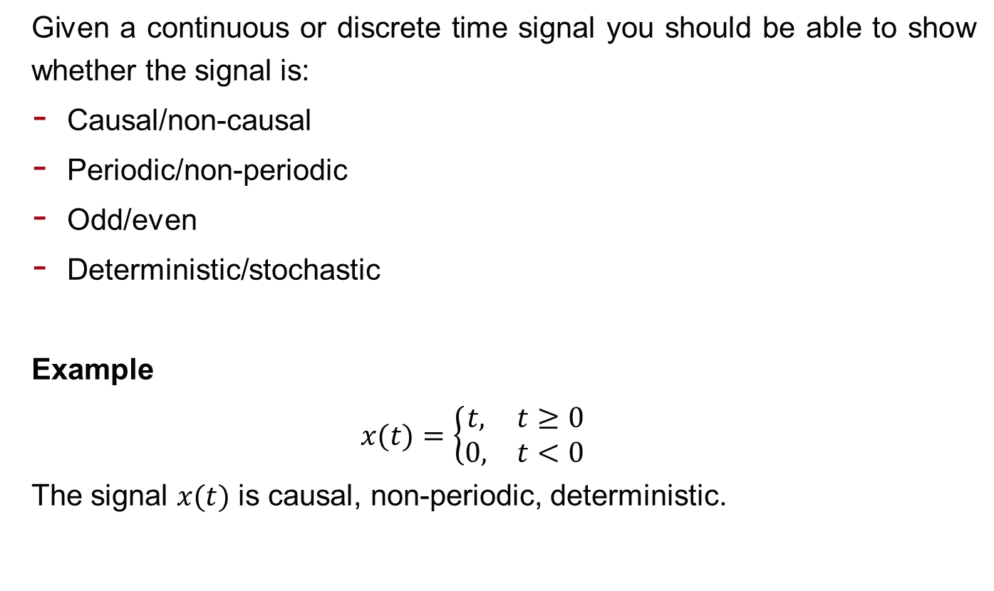
Revision Lecture 1 Introduction to signals-Signal classification
Given a continuous or discrete time signal you should be able to show whether the signal is:
Causal/non-causal
Periodic/non-periodic
Odd/even
Deterministic/stochastic
Example
$$x(t)=\left\{\begin{matrix}t, & t≥0 \\ 0, & t<0\end{matrix}\right.$$
The signal $x(t)$ is causal, non-periodic, deterministic.

Slide 4
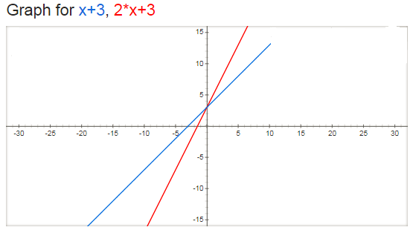
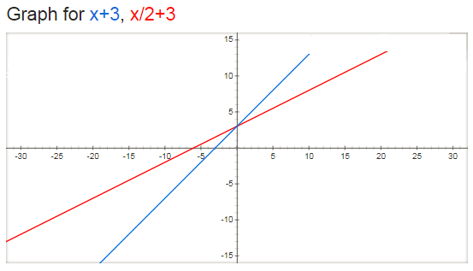

Revision Lecture 1 cont. Signal form: Linear transformation of the independent variable.
Given a simple continuous time signal $x(t)$ you should be able to:
Sketch the signal $x(t)$.
Sketch the signal $x(g\left(t\right))$ where $g(t)$ is a linear function of $t$, i.e. $g\left(t\right)=at+b$. By this you will demonstrate the properties of signal stretching, signal compression and signal shifting.
Example

Slide 5
Revision Lecture 2 Introduction to systems
Given a simple continuous or discrete system you should be able to show (by carrying specific analysis) whether the system is:
Linear or non-linear
Constant parameter or time-varying parameter
Instantaneous (memoryless) or dynamic (with memory)
Causal or non-causal
Continuous time or discrete time
Analogue or digital
Invertible or non-invertible
Stable or unstable

Slide 6
Revision Lecture 3 Time-domain analysis – Zero-input response
You must read this lecture to understand better the transition to zero-state response.
I will not ask you about zero-input response analysis in the exam.

Slide 7
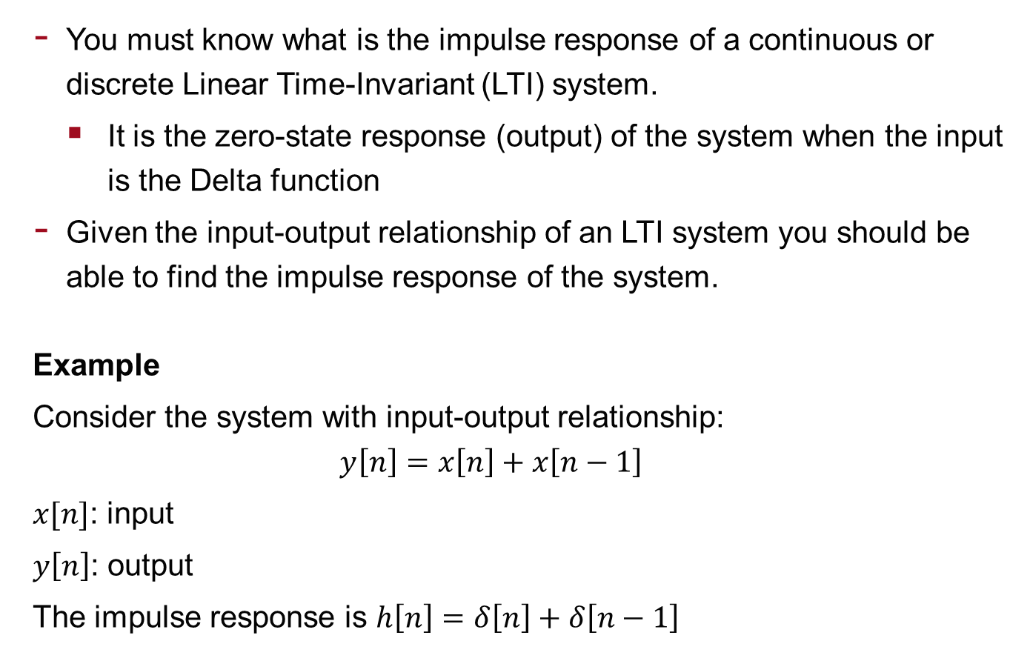
Revision Lectures 4-5 Zero-state response – Convolution
You must know what is the impulse response of a continuous or discrete Linear Time-Invariant (LTI) system.
It is the zero-state response (output) of the system when the input is the Delta function
Given the input-output relationship of an LTI system you should be able to find the impulse response of the system.
Example
Consider the system with input-output relationship:
$$y\left[n\right]=x\left[n\right]+x\left[n−1\right]$$
$x[n]$: input
$y\left[n\right]$: output
The impulse response is $h\left[n\right]=δ\left[n\right]+δ\left[n−1\right]$

Slide 8
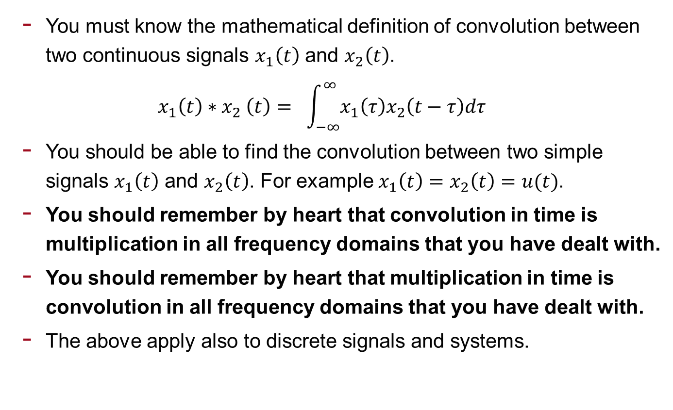
Revision Lectures 4-5 cont. Zero-state response – Convolution
You must know the mathematical definition of convolution between two continuous signals $x_{1}\left(t\right)$ and $x_{2}\left(t\right)$.
$$x_{1}\left(t\right){∗x}_{2}\left(t\right)= \int_{−∞}^{∞}{x_{1}\left(τ\right)x_{2}\left(t−τ\right)dτ}$$
You should be able to find the convolution between two simple signals $x_{1}\left(t\right)$ and $x_{2}\left(t\right)$. For example $x_{1}\left(t\right)=$ $x_{2}\left(t\right)=u(t)$.
You should remember by heart that convolution in time is multiplication in all frequency domains that you have dealt with.
You should remember by heart that multiplication in time is convolution in all frequency domains that you have dealt with.
The above apply also to discrete signals and systems.

Slide 9
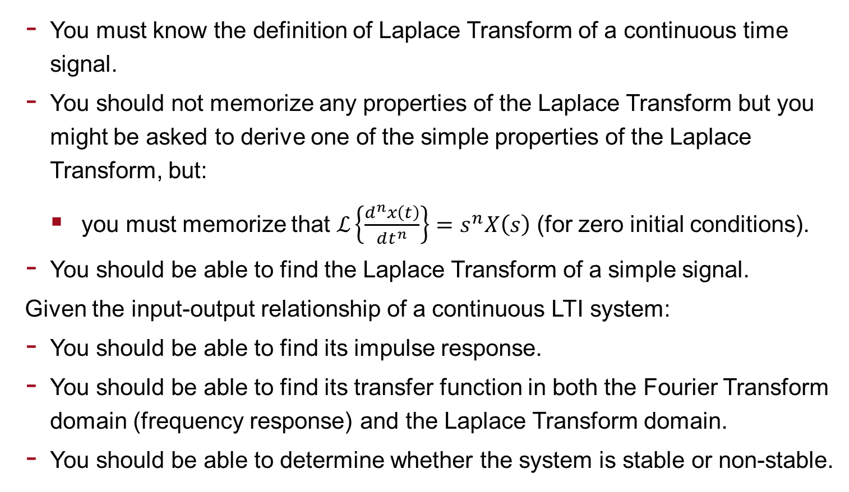
Revision Lectures 6-7 and 9 Laplace Transform and Continuous LTI Systems
You must know the definition of Laplace Transform of a continuous time signal.
You should not memorize any properties of the Laplace Transform but you might be asked to derive one of the simple properties of the Laplace Transform, but:
you must memorize that $ℒ\left\{\frac{d^{n}x\left(t\right)}{dt^{n}}\right\}=$ $s^{n}X\left(s\right)$ (for zero initial conditions).
You should be able to find the Laplace Transform of a simple signal.
Given the input-output relationship of a continuous LTI system:
You should be able to find its impulse response.
You should be able to find its transfer function in both the Fourier Transform domain (frequency response) and the Laplace Transform domain.
You should be able to determine whether the system is stable or non-stable.

Slide 10
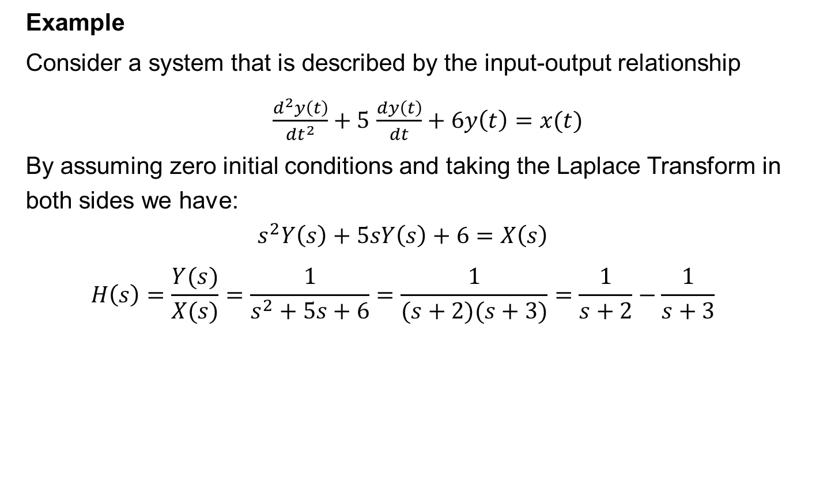
Revision Lectures 6-7 and 9 cont. Laplace Transform and Continuous LTI Systems
Example
Consider a system that is described by the input-output relationship
$\frac{d^{2}y\left(t\right)}{dt^{2}}+5$ $\frac{dy\left(t\right)}{dt}+6y\left(t\right)=x(t)$
By assuming zero initial conditions and taking the Laplace Transform in both sides we have:
$$s^{2}Y\left(s\right)+5sY\left(s\right)+6=X\left(s\right)$$
$$H\left(s\right)=\frac{Y(s)}{X(s)}=\frac{1}{s^{2}+5s+6}=\frac{1}{(s+2)(s+3)}=\frac{1}{s+2}−\frac{1}{s+3}$$

Slide 11
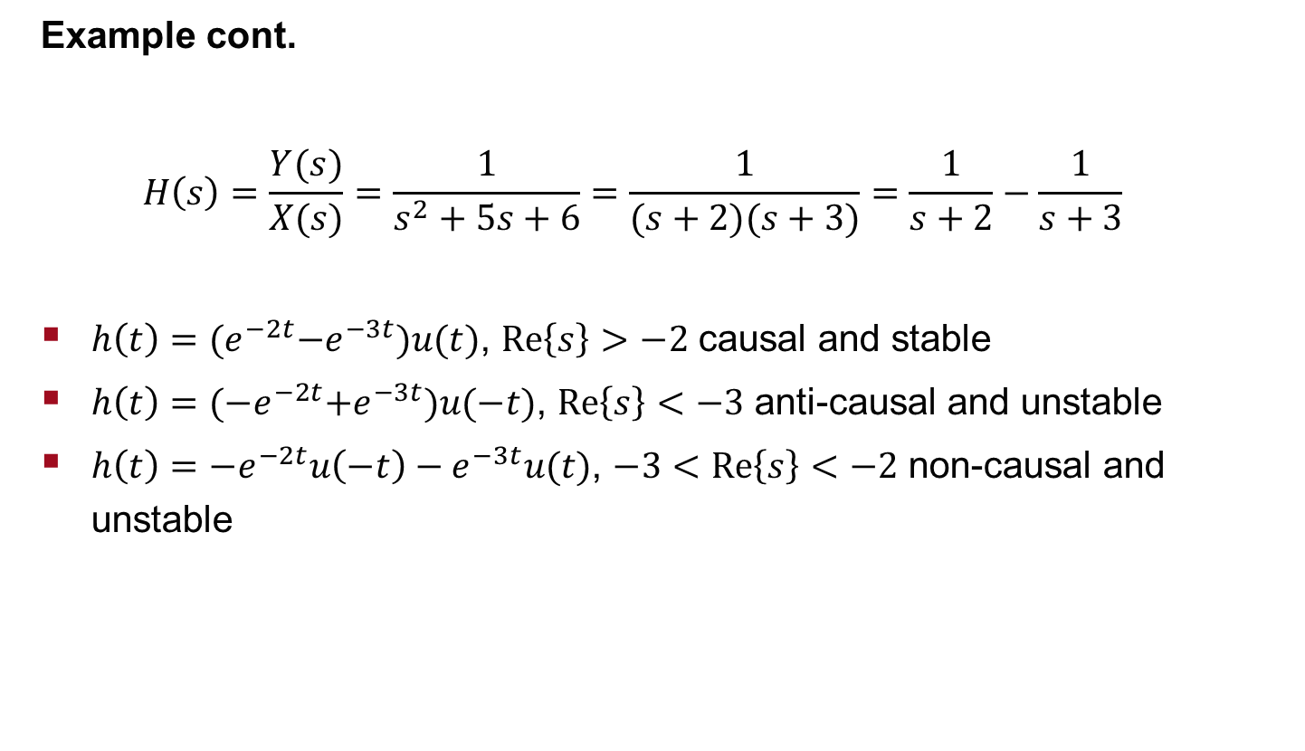
Revision Lecture 6-7 and 9 cont. Laplace Transform and Continuous LTI Systems
Example cont.
$$H\left(s\right)=\frac{Y(s)}{X(s)}=\frac{1}{s^{2}+5s+6}=\frac{1}{(s+2)(s+3)}=\frac{1}{s+2}−\frac{1}{s+3}$$
$h\left(t\right)={(e}^{−2t}−e^{−3t})u(t)$, $Re\left\{s\right\}>$ $−2$ causal and stable
$h\left(t\right)={(−e}^{−2t}+e^{−3t})u(−t)$, $Re\left\{s\right\}<$ $−3$ anti-causal and unstable
$h\left(t\right)=−e^{−2t}u\left(−t\right)−e^{−3t}u(t)$, $−3<Re\left\{s\right\}<$ $−2$ non-causal and unstable

Slide 12
Revision Lecture 8 Fourier Transform
You must know the definition of Fourier Transform of a continuous time signal.
You should not memorize any properties of the Fourier Transform but you might be asked to derive one of the simple properties of the Fourier Transform. The knowledge of the definition of the Fourier Transform together with basic mathematics is enough for this task. However, if you want to practice deriving simple properties of transform you will benefit from it.
You should be able to find the Fourier transform of a simple signal.

Slide 13
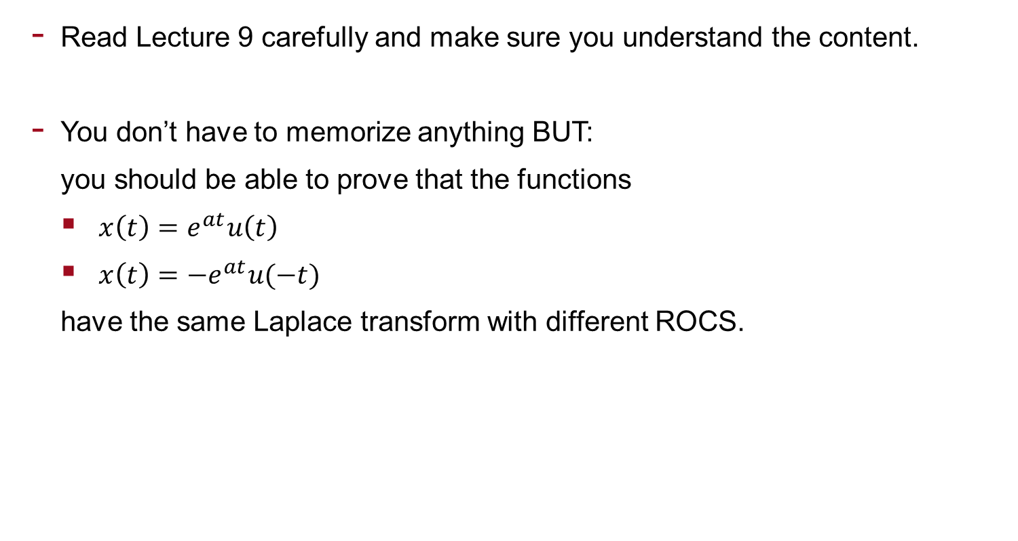
Revision Lecture 9 Stability
Read Lecture 9 carefully and make sure you understand the content.
You don’t have to memorize anything BUT:
you should be able to prove that the functions
$x\left(t\right)=e^{at}u\left(t\right)$
$x\left(t\right)={−e}^{at}u(−t)$
have the same Laplace transform with different ROCS.

Slide 14
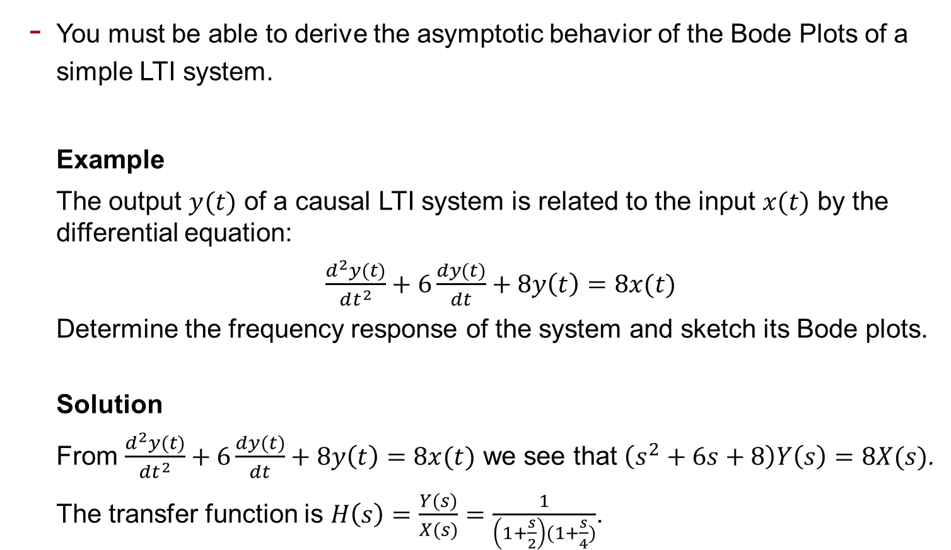
Revision Lecture 10 Bode Plots
You must be able to derive the asymptotic behavior of the Bode Plots of a simple LTI system.
Example
The output $y(t)$ of a causal LTI system is related to the input $x(t)$ by the differential equation:
$\frac{d^{2}y(t)}{dt^{2}}+6\frac{dy(t)}{dt}+8y\left(t\right)=8x(t)$
Determine the frequency response of the system and sketch its Bode plots.
Solution
From $\frac{d^{2}y(t)}{dt^{2}}+6\frac{dy(t)}{dt}+8y\left(t\right)=8x(t)$ we see that $\left(s^{2}+6s+8\right)Y\left(s\right)=8X(s)$.
The transfer function is $H\left(s\right)=\frac{Y(s)}{X(s)}=\frac{1}{\left(1+\frac{s}{2}\right)(1+\frac{s}{4})}$.

Slide 15
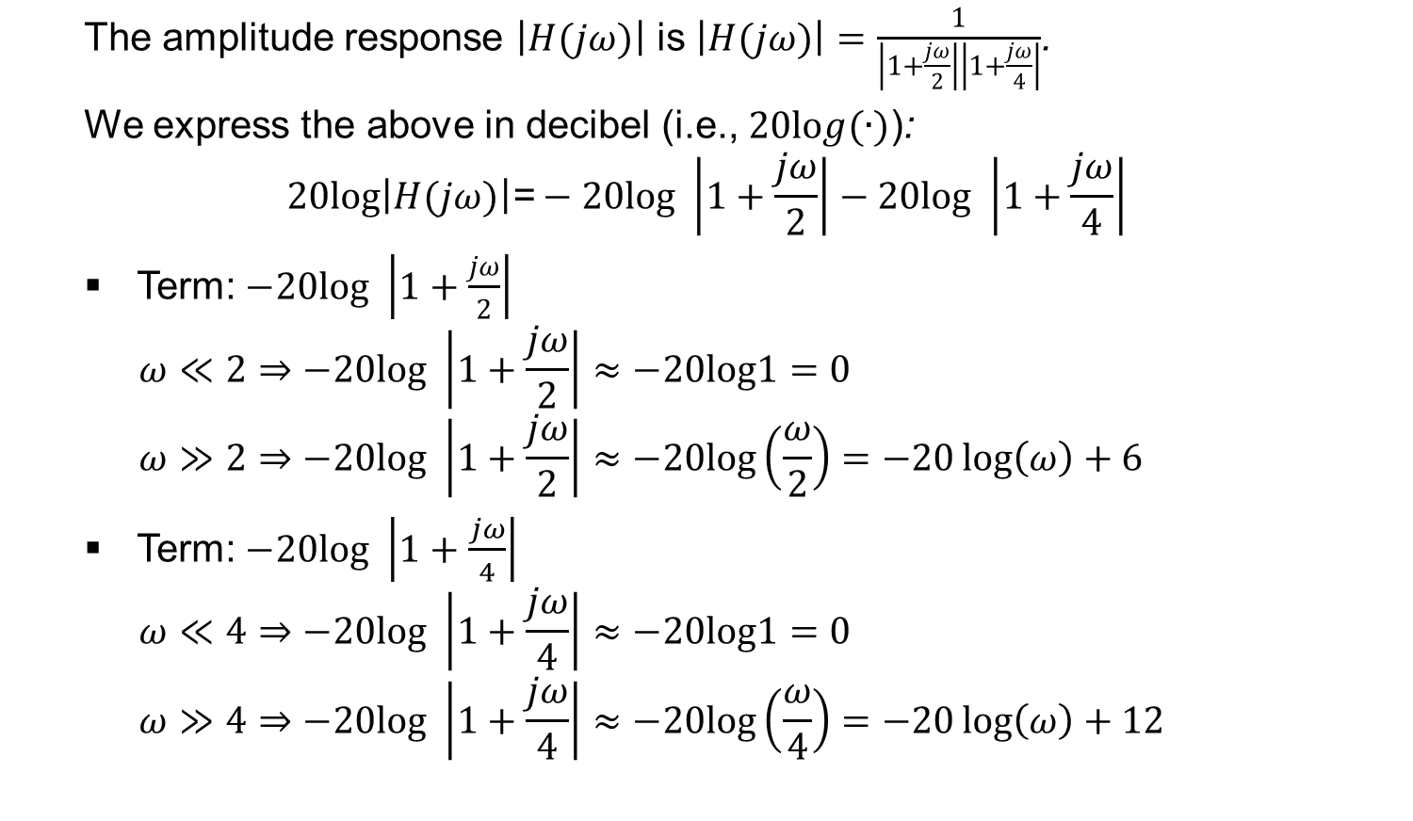
Revision: Bode Plots example cont.
The amplitude response $\left|H(jω)\right|$ is $\left|H(jω)\right|=$ $\frac{1}{\left|1+\frac{jω}{2}\right|\left|1+\frac{jω}{4}\right|}$.
We express the above in decibel (i.e., $20log(∙)$):
$$20log\left|H(jω)\right|\text{=}−20log \left|1+\frac{jω}{2}\right|−20log \left|1+\frac{jω}{4}\right|$$
Term:$−20log \left|1+\frac{jω}{2}\right|$
$$ω≪2⇒−20log \left|1+\frac{jω}{2}\right|≈−20log1=0$$
$$ω≫2⇒−20log \left|1+\frac{jω}{2}\right|≈−20log\left(\frac{ω}{2}\right)=−20\log\left(ω\right)+6$$
Term:$−20log \left|1+\frac{jω}{4}\right|$
$$ω≪4⇒−20log \left|1+\frac{jω}{4}\right|≈−20log1=0$$
$$ω≫4⇒−20log \left|1+\frac{jω}{4}\right|≈−20log\left(\frac{ω}{4}\right)=−20\log\left(ω\right)+12$$

Slide 16
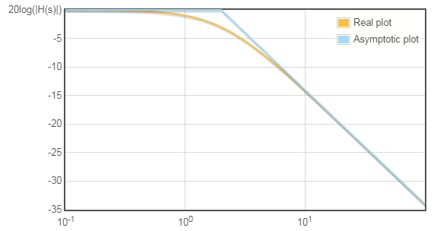
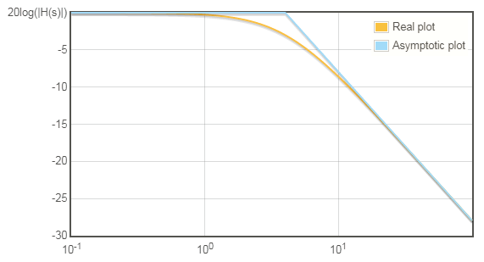

Revision: Bode Plots example cont.
Term:$−20log \left|1+\frac{jω}{2}\right|$
$$ω≪2⇒0$$
$$ω≫2⇒−20\log\left(ω\right)+6$$
Term:$−20log \left|1+\frac{jω}{4}\right|$
$$ω≪4⇒0$$
$$ω≫4⇒−20\log\left(ω\right)+12$$

Slide 17
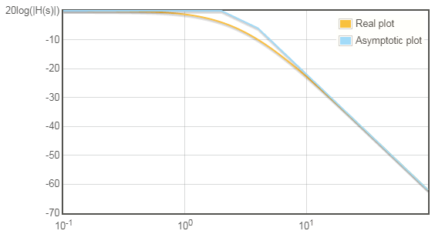
Revision: Bode Plots example cont.
Final response is the sum of the above.

Slide 18
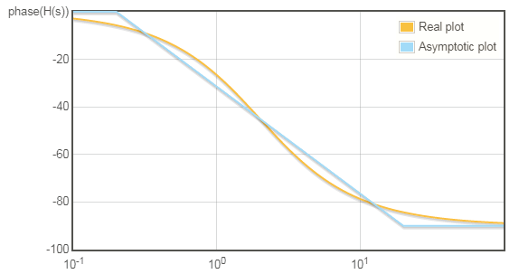
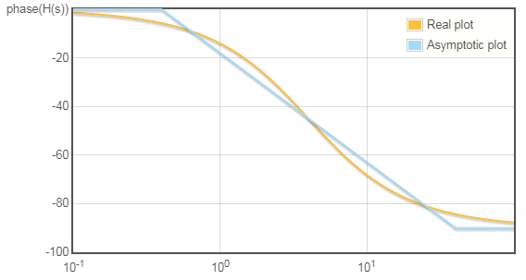

Revision: Bode Plots example cont.
The phase response $∠H\left(jω\right)$is $∠H\left(jω\right)=−$ $∠\left(1+\frac{jω}{2}\right)$ $−$ $∠\left(1+\frac{jω}{4}\right)$.
Term:$−$ $∠\left(1+\frac{jω}{2}\right)$ ${=−tan}^{−1}$ $\left(\frac{ω}{2}\right)$
$$ω<0.1∗2≪2⇒−\tan^{−1} \left(\frac{ω}{2}\right)≈0$$
$ω>10∗2≫2⇒−\tan^{−1} \left(\frac{ω}{2}\right)≈$ $−{90}^{o}$
Term:$−$ $∠\left(1+\frac{jω}{4}\right)$ ${=−tan}^{−1}$ $\left(\frac{ω}{4}\right)$
$$ω<0.1∗4≪4⇒−\tan^{−1} \left(\frac{ω}{4}\right)≈0$$
$ω>10∗4≫4⇒−\tan^{−1} \left(\frac{ω}{4}\right)≈$ $−{90}^{o}$

Slide 19
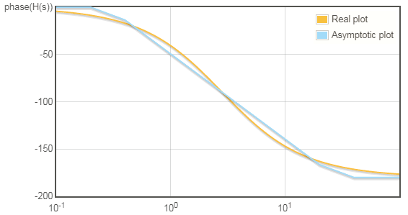
Revision: Bode Plots example cont.
Final response is the sum of the above.

Slide 20
Revision Lectures 11-12 Zeros-Poles-Filters Signal Transmission-Group Delay-Windowing Effects
Read Lectures 11-12 carefully and make sure you understand the content.

Slide 21
Revision Lecture 13 Sampling-Quantisation
Lecture 13 is important.
You should know what is sampling.
You should know when is sampling possible (sampling theorem).
You should know how the spectrum of a continuous signal and its sampled version are related.
You should not memorize anything because I will give you formulas within the related exam question.

Slide 22
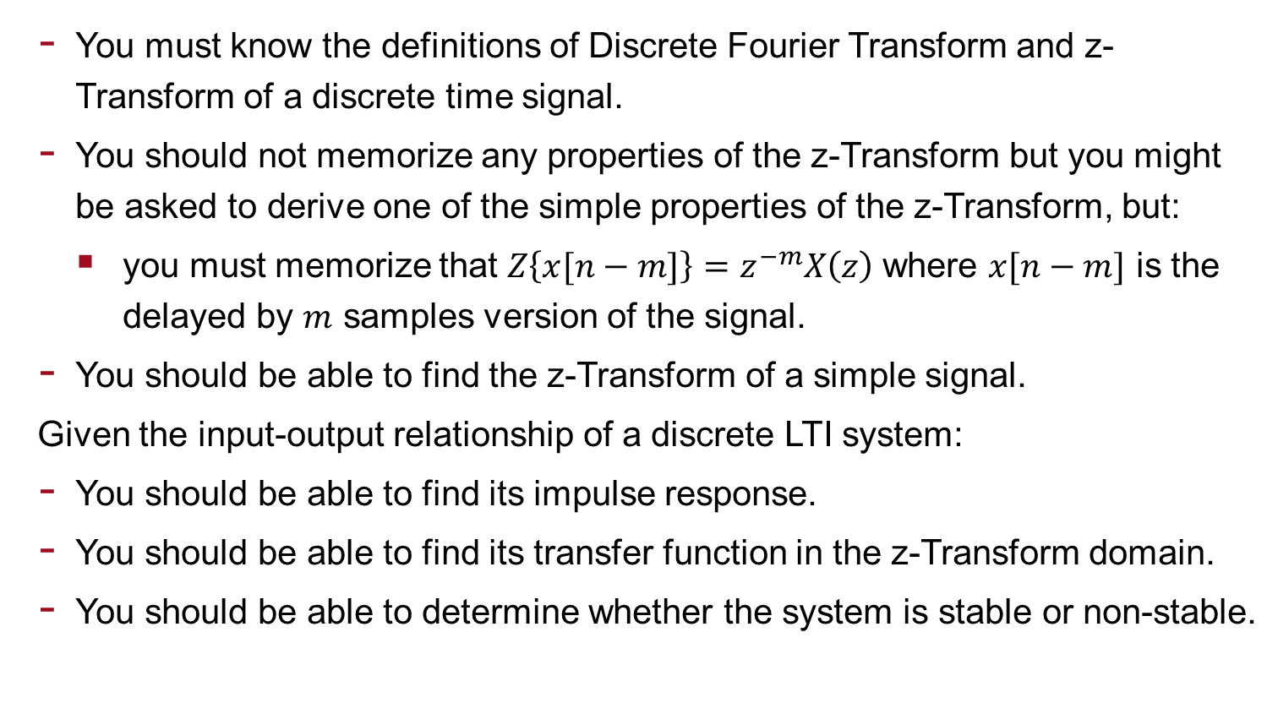
Revision Lectures 14-15 DFT and Discrete LTI Systems
You must know the definitions of Discrete Fourier Transform and z-Transform of a discrete time signal.
You should not memorize any properties of the z-Transform but you might be asked to derive one of the simple properties of the z-Transform, but:
you must memorize that $Z\left\{x[n−m]\right\}=$ $z^{−m}X\left(z\right)$ where $x[n−m]$ is the delayed by $m$ samples version of the signal.
You should be able to find the z-Transform of a simple signal.
Given the input-output relationship of a discrete LTI system:
You should be able to find its impulse response.
You should be able to find its transfer function in the z-Transform domain.
You should be able to determine whether the system is stable or non-stable.

