Slide 1
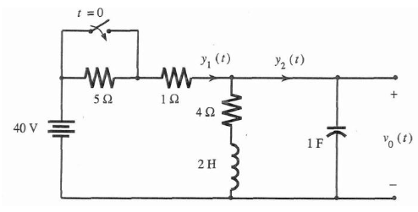

Problem Sheet 5 Question 4
Problem: For the circuit shown in the figure below, the switch is in open position for a long time before $t=0$, when it is closed instantaneously.

Slide 2
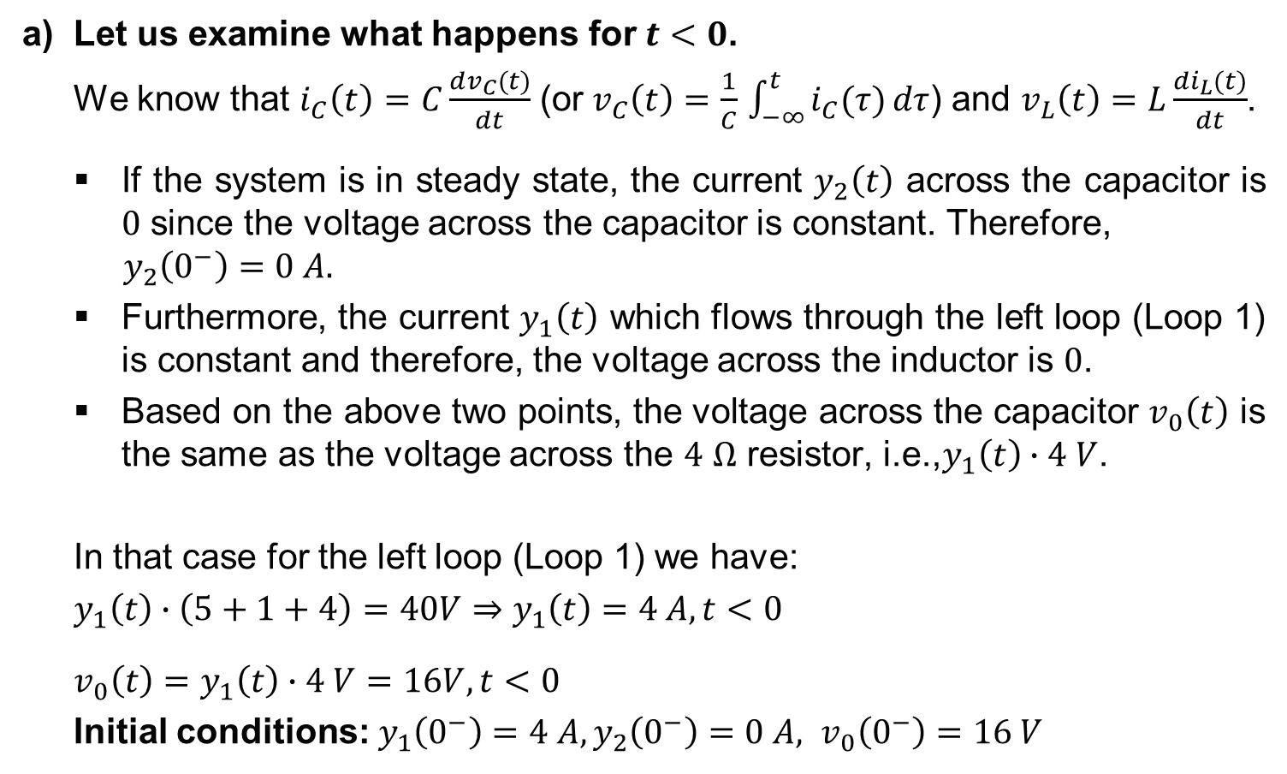
Problem Sheet 5 Question 4
a) Let us examine what happens for $t<0$.
We know that $i_{C}\left(t\right)=C\frac{dv_{C}(t)}{dt}$ (or $v_{C}\left(t\right)=\frac{1}{C}$ $\int_{−∞}^{t}{i_{C}(τ)}dτ$) and $v_{L}\left(t\right)=L\frac{di_{L}(t)}{dt}$.
If the system is in steady state, the current $y_{2}\left(t\right)$ across the capacitor is $0$ since the voltage across the capacitor is constant. Therefore,
$$y_{2}\left(0^{−}\right)=0 A.$$
Furthermore, the current $y_{1}\left(t\right)$ which flows through the left loop (Loop 1) is constant and therefore, the voltage across the inductor is $0$.
Based on the above two points, the voltage across the capacitor $v_{0}\left(t\right)$ is the same as the voltage across the $4$ $Ω$ resistor, i.e.,$y_{1}\left(t\right)∙4 V$.
In that case for the left loop (Loop 1) we have:
$y_{1}\left(t\right)∙\left(5+1+4\right)=40V⇒$ $y_{1}\left(t\right)=4 A, t<0$
$v_{0}\left(t\right)=$ $y_{1}\left(t\right)∙4 V=16V, t<0$
Initial conditions: $y_{1}\left(0^{−}\right)=4 A, {y_{2}\left(0^{−}\right)=0 A, v}_{0}\left(0^{−}\right)=16 V$

Slide 3
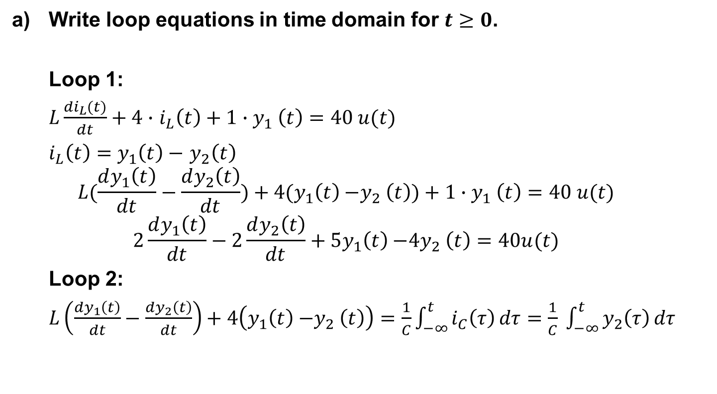
Problem Sheet 5 Question 4 cont.
Write loop equations in time domain for $t≥0$.
Loop 1:
$L\frac{di_{L}(t)}{dt}+4∙$ $i_{L}\left(t\right)+1{∙y}_{1}\left(t\right)=40 u(t)$
$i_{L}\left(t\right)=$ $y_{1}\left(t\right)−$ $y_{2}\left(t\right)$
$$L(\frac{dy_{1}\left(t\right)}{dt}−\frac{dy_{2}\left(t\right)}{dt})+4(y_{1}\left(t\right){−y}_{2}\left(t\right))+1{∙y}_{1}\left(t\right)=40 u(t)$$
$$2\frac{dy_{1}\left(t\right)}{dt}−2\frac{dy_{2}\left(t\right)}{dt}+5y_{1}\left(t\right){−4y}_{2}\left(t\right)=40u(t)$$
Loop 2:
$L\left(\frac{dy_{1}\left(t\right)}{dt}−\frac{dy_{2}\left(t\right)}{dt}\right)+4\left(y_{1}\left(t\right){−y}_{2}\left(t\right)\right)=\frac{1}{C}\int_{−∞}^{t}{i_{C}\left(τ\right)}dτ=$ $\frac{1}{C} \int_{−∞}^{t}{y_{2}\left(τ\right)}dτ$

Slide 4
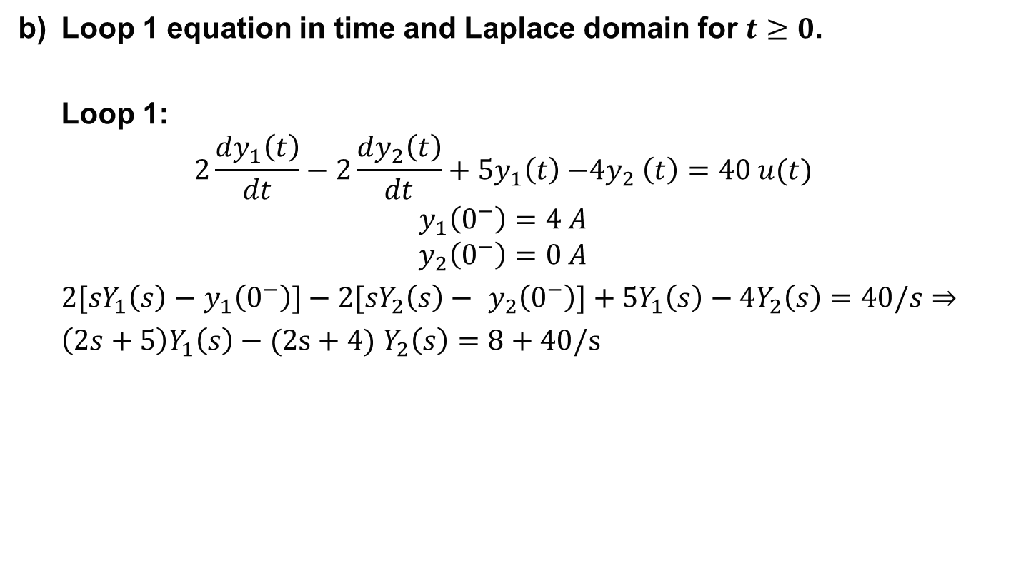
Problem Sheet 5 Question 4 cont.
b) Loop 1 equation in time and Laplace domain for $t≥0$.
Loop 1:
$$2\frac{dy_{1}\left(t\right)}{dt}−2\frac{dy_{2}\left(t\right)}{dt}+5y_{1}\left(t\right){−4y}_{2}\left(t\right)=40 u(t)$$
$$y_{1}\left(0^{−}\right)=4 A$$
$$y_{2}\left(0^{−}\right)=0 A$$
$2{[sY}_{1}\left(s\right)−$ $y_{1}\left(0^{−}\right)]−2{[sY}_{2}\left(s\right)− y_{2}\left(0^{−}\right)]+5Y_{1}\left(s\right)−4Y_{2}\left(s\right)=40/s⇒$
$\left(2s+5\right)Y_{1}\left(s\right)−(2s+4)$ $Y_{2}\left(s\right)=8+40/s$

Slide 5
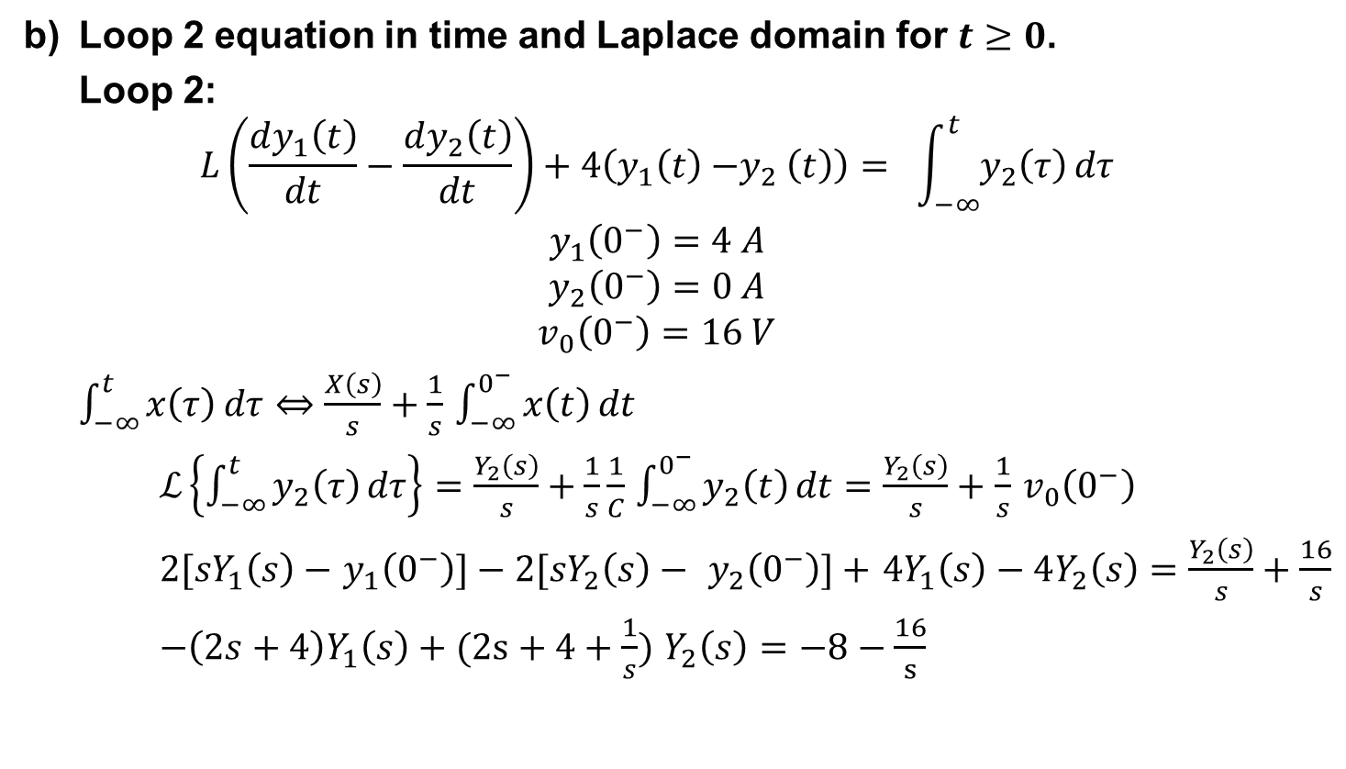
Problem Sheet 5 Question 4 cont.
b) Loop 2 equation in time and Laplace domain for $t≥0$.
Loop 2:
$$L\left(\frac{dy_{1}\left(t\right)}{dt}−\frac{dy_{2}\left(t\right)}{dt}\right)+4\left(y_{1}\left(t\right){−y}_{2}\left(t\right)\right)= \int_{−∞}^{t}{y_{2}\left(τ\right)}dτ$$
$$y_{1}\left(0^{−}\right)=4 A$$
$$y_{2}\left(0^{−}\right)=0 A$$
$$v_{0}\left(0^{−}\right)=16 V$$
$\int_{−∞}^{t}{x\left(τ\right)}dτ⇔$ $\frac{X\left(s\right)}{s}+\frac{1}{s}$ $\int_{−∞}^{0^{−}}{x\left(t\right)}dt$
$ℒ\left\{\int_{−∞}^{t}{y_{2}\left(τ\right)}dτ\right\}=\frac{Y_{2}\left(s\right)}{s}+\frac{1}{s}\frac{1}{C}$ $\int_{−∞}^{0^{−}}{y_{2}\left(t\right)}dt=$ $\frac{Y_{2}\left(s\right)}{s}+$ $\frac{1}{s}$ $v_{0}\left(0^{−}\right)$
$2{[sY}_{1}\left(s\right)−$ $y_{1}\left(0^{−}\right)]−2{[sY}_{2}\left(s\right)− y_{2}\left(0^{−}\right)]+$ $4Y_{1}\left(s\right)−4Y_{2}\left(s\right)=$ $\frac{Y_{2}\left(s\right)}{s}+\frac{16}{s}$
$−\left(2s+4\right)Y_{1}\left(s\right)+(2s+4+\frac{1}{s})$ $Y_{2}\left(s\right)=−8−\frac{16}{s}$

Slide 6
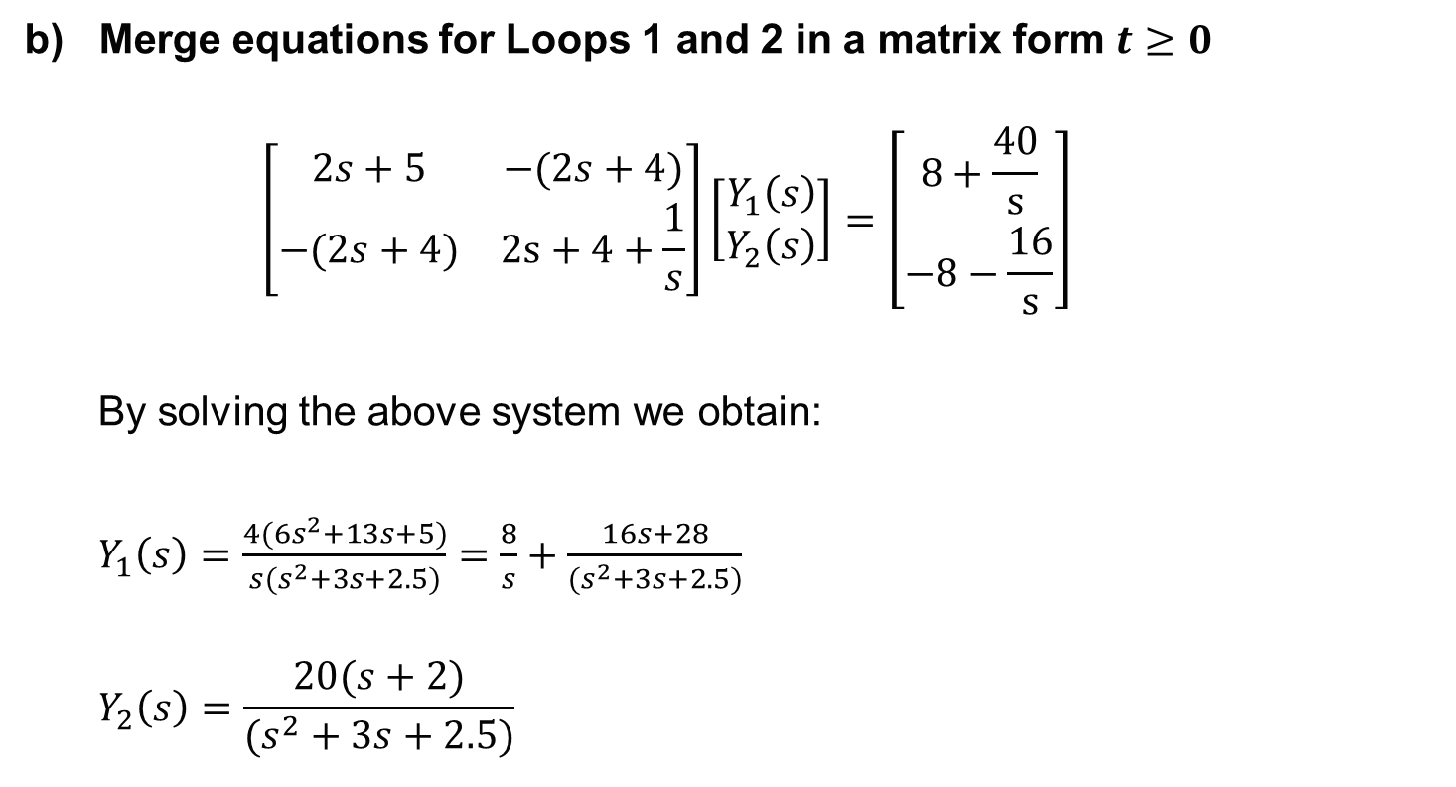
Problem Sheet 5 Question 4 cont.
Merge equations for Loops 1 and 2 in a matrix form $t≥0$
$$\left[\begin{matrix}2s+5 & −(2s+4) \\ −(2s+4) & 2s+4+\frac{1}{s}\end{matrix}\right]\left[\begin{matrix}Y_{1}\left(s\right) \\ Y_{2}\left(s\right)\end{matrix}\right]=\left[\begin{matrix}8+\frac{40}{s} \\ −8−\frac{16}{s}\end{matrix}\right]$$
By solving the above system we obtain:
$Y_{1}\left(s\right)=\frac{4(6s^{2}+13s+5)}{s(s^{2}+3s+2.5)}=\frac{8}{s}+$ $\frac{16s+28}{{(s}^{2}+3s+2.5)}$
$$Y_{2}\left(s\right)=\frac{20(s+2)}{(s^{2}+3s+2.5)}$$

Slide 7
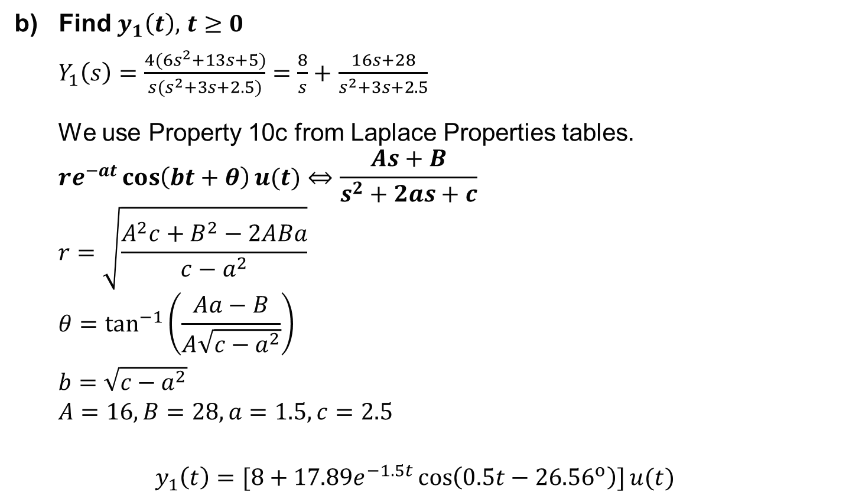
Problem Sheet 5 Question 4 cont.
Find $y_{1}\left(t\right),$ $t≥0$
$Y_{1}\left(s\right)=\frac{4(6s^{2}+13s+5)}{s(s^{2}+3s+2.5)}=\frac{8}{s}+$ $\frac{16s+28}{s^{2}+3s+2.5}$
We use Property 10c from Laplace Properties tables.
$$re^{−at}\cos\left(bt+θ\right)u(t)⇔\frac{As+B}{s^{2}+2as+c}$$
$$r=\sqrt{\frac{A^{2}c+B^{2}−2ABa}{c−a^{2}}}$$
$$θ=\tan^{−1}\left(\frac{Aa−B}{A\sqrt{c−a^{2}}}\right)$$
$b=$ $\sqrt{c−a^{2}}$
$$A=16, B=28, a=1.5, c=2.5$$
$$y_{1}\left(t\right)=[8+17.89e^{−1.5t}\cos\left(0.5t−{26.56}^{ο}\right)]u(t)$$

Slide 8

Problem Sheet 5 Question 4 cont.
b) Find $y_{1}\left(t\right),$ $t≥0$
$Y_{2}\left(s\right)=\frac{20(s+2)}{(s^{2}+3s+2.5)}=$ $\frac{20s+40}{(s^{2}+3s+2.5)}$
Property 10c
$$re^{−at}\cos\left(bt+θ\right)u(t)⇔\frac{As+B}{s^{2}+2as+c}$$
$$r=\sqrt{\frac{A^{2}c+B^{2}−2ABa}{c−a^{2}}}$$
$$θ=\tan^{−1}\left(\frac{Aa−B}{A\sqrt{c−a^{2}}}\right)$$
$b=$ $\sqrt{c−a^{2}}$
$$A=20, B=40, a=1.5, c=2.5$$
$$y_{2}\left(t\right)=20\sqrt{2}e^{−1.5t}\cos\left(0.5t−{45}^{ο}\right)u(t)$$

