Slide 1
Maths for Signals and Systems
Linear Algebra in Engineering
Lectures 13 – 15, Tuesday 8th and Friday 11th November 2016
DR TANIA STATHAKI
READER (ASSOCIATE PROFFESOR) IN SIGNAL PROCESSING
IMPERIAL COLLEGE LONDON

Slide 2
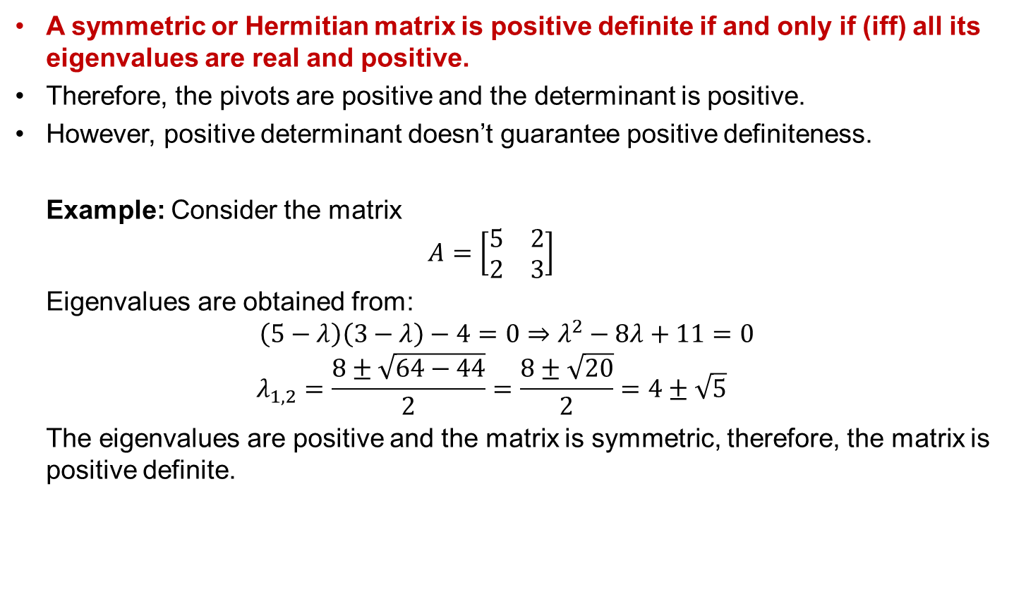
Positive definite matrices
A symmetric or Hermitian matrix is positive definite if and only if (iff) all its eigenvalues are real and positive.
Therefore, the pivots are positive and the determinant is positive.
However, positive determinant doesn’t guarantee positive definiteness.
Example: Consider the matrix
$$A=\left[\begin{matrix}5 & 2 \\ 2 & 3\end{matrix}\right]$$
Eigenvalues are obtained from:
$$\left(5−λ\right)\left(3−λ\right)−4=0⇒λ^{2}−8λ+11=0$$
$$λ_{1,2}=\frac{8±\sqrt{64−44}}{2}=\frac{8±\sqrt{20}}{2}=4±\sqrt{5}$$
The eigenvalues are positive and the matrix is symmetric, therefore, the matrix is positive definite.

Slide 3
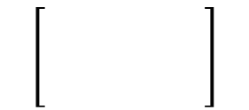
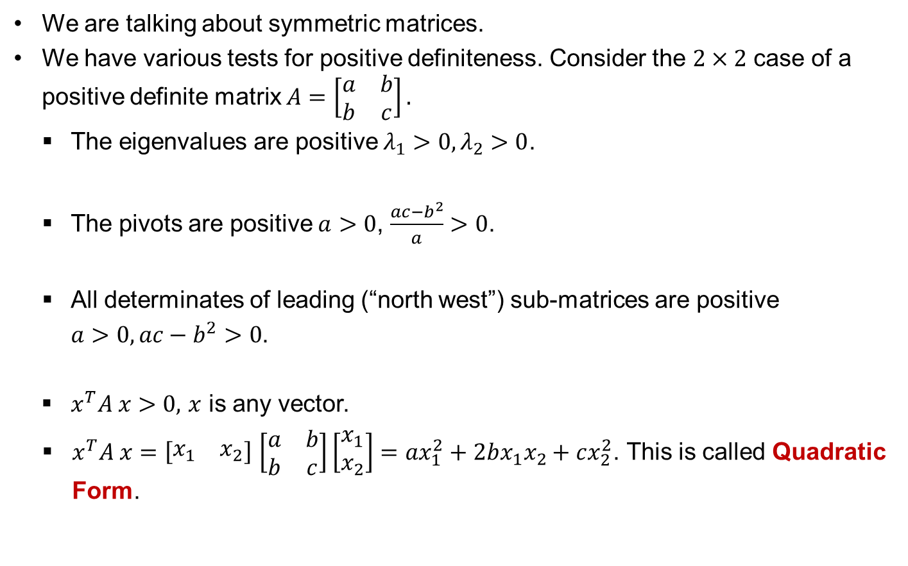
Positive definite matrices cont.
We are talking about symmetric matrices.
  We have various tests for positive definiteness. Consider the $2×2$ case of a positive definite matrix $A=\left[\begin{matrix}a & b \\ b & c\end{matrix}\right].$
  The eigenvalues are positive $λ_{1}>0, λ_{2}>0$.
  The pivots are positive $a>0$, $\frac{ac−b^{2}}{a}>0$.
  All determinates of leading (“north west”) sub-matrices are positive
  $a>0, ac−b^{2}>0$.
  $x^{T}A x>0,$ $x$ is any vector.
  $x^{T}A x=\left[\begin{matrix}x_{1} & x_{2}\end{matrix}\right]$ $\left[\begin{matrix}a & b \\ b & c\end{matrix}\right]\left[\begin{matrix}x_{1} \\ x_{2}\end{matrix}\right]=ax_{1}^{2}+2bx_{1}x_{2}+cx_{2}^{2}$. This is called Quadratic Form.

Slide 4
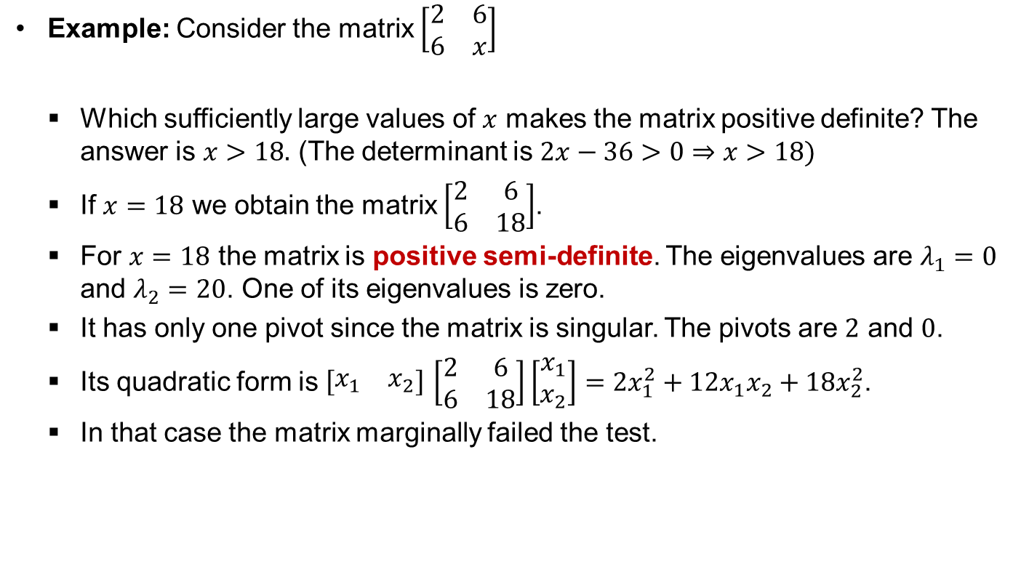
Positive semi-definite matrices
Example: Consider the matrix $\left[\begin{matrix}2 & 6 \\ 6 & x\end{matrix}\right]$
    Which sufficiently large values of $x$ makes the matrix positive definite? The answer is $x>18.$ (The determinant is $2x−36>0⇒x>18)$
    If $x=18$ we obtain the matrix $\left[\begin{matrix}2 & 6 \\ 6 & 18\end{matrix}\right]$.
    For $x=18$ the matrix is positive semi-definite. The eigenvalues are $λ_{1}=0$ and $λ_{2}=20$. One of its eigenvalues is zero.
    It has only one pivot since the matrix is singular. The pivots are $2$ and $0$.
    Its quadratic form is $\left[\begin{matrix}x_{1} & x_{2}\end{matrix}\right]$ $\left[\begin{matrix}2 & 6 \\ 6 & 18\end{matrix}\right]\left[\begin{matrix}x_{1} \\ x_{2}\end{matrix}\right]=2x_{1}^{2}+12x_{1}x_{2}+18x_{2}^{2}$.
    In that case the matrix marginally failed the test.

Slide 5


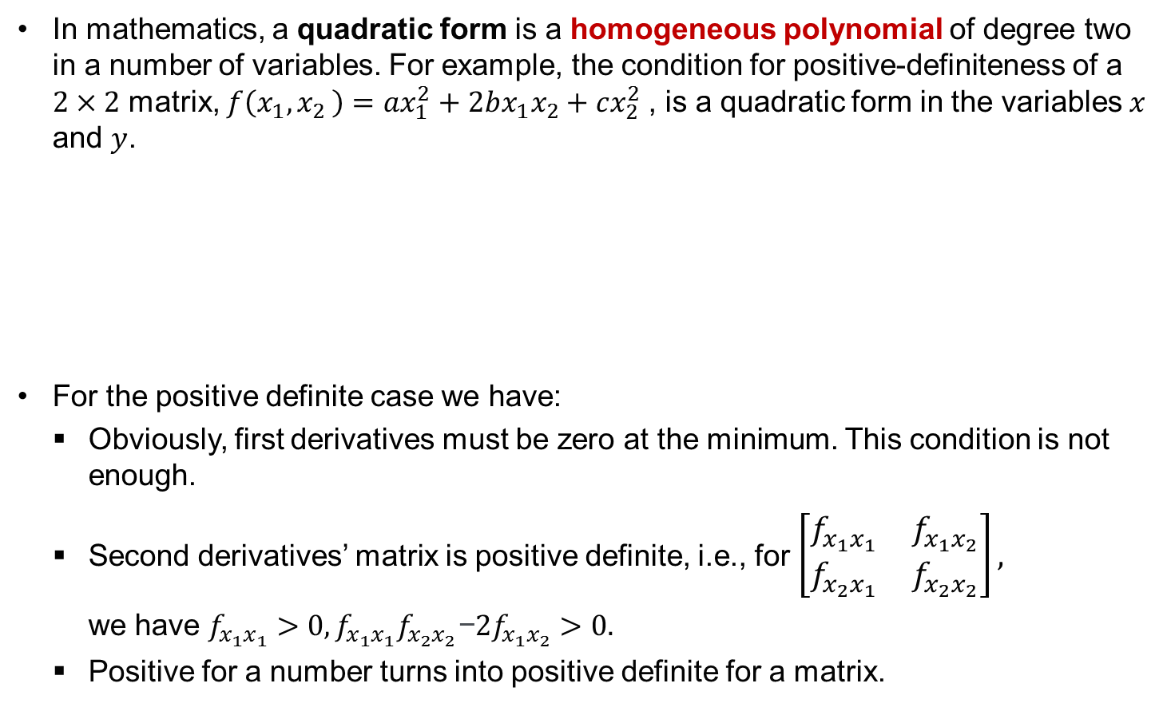


Graph of quadratic form
In mathematics, a quadratic form is a homogeneous polynomial of degree two in a number of variables. For example, the condition for positive-definiteness of a $2×2$ matrix, $f\left(x_{1}{,x}_{2}\right)=ax_{1}^{2}+2bx_{1}x_{2}+cx_{2}^{2}$, is a quadratic form in the variables $x$ and $y$.
  For the positive definite case we have:
    Obviously, first derivatives must be zero at the minimum. This condition is not enough.
    Second derivatives’ matrix is positive definite, i.e., for $\left[\begin{matrix}f_{x_{1}x_{1}} & f_{x_{1}x_{2}} \\ f_{x_{2}x_{1}} & f_{x_{2}x_{2}}\end{matrix}\right],$
    we have $f_{x_{1}x_{1}}>0, f_{x_{1}x_{1}}f_{x_{2}x_{2}}\text{−}{2f}_{x_{1}x_{2}}>0.$
    Positive for a number turns into positive definite for a matrix.
Positive definite
Not positive definite
$$x_{1}$$
$$x_{1}$$
minimum
$$x_{2}$$
$$x_{2}$$

Slide 6

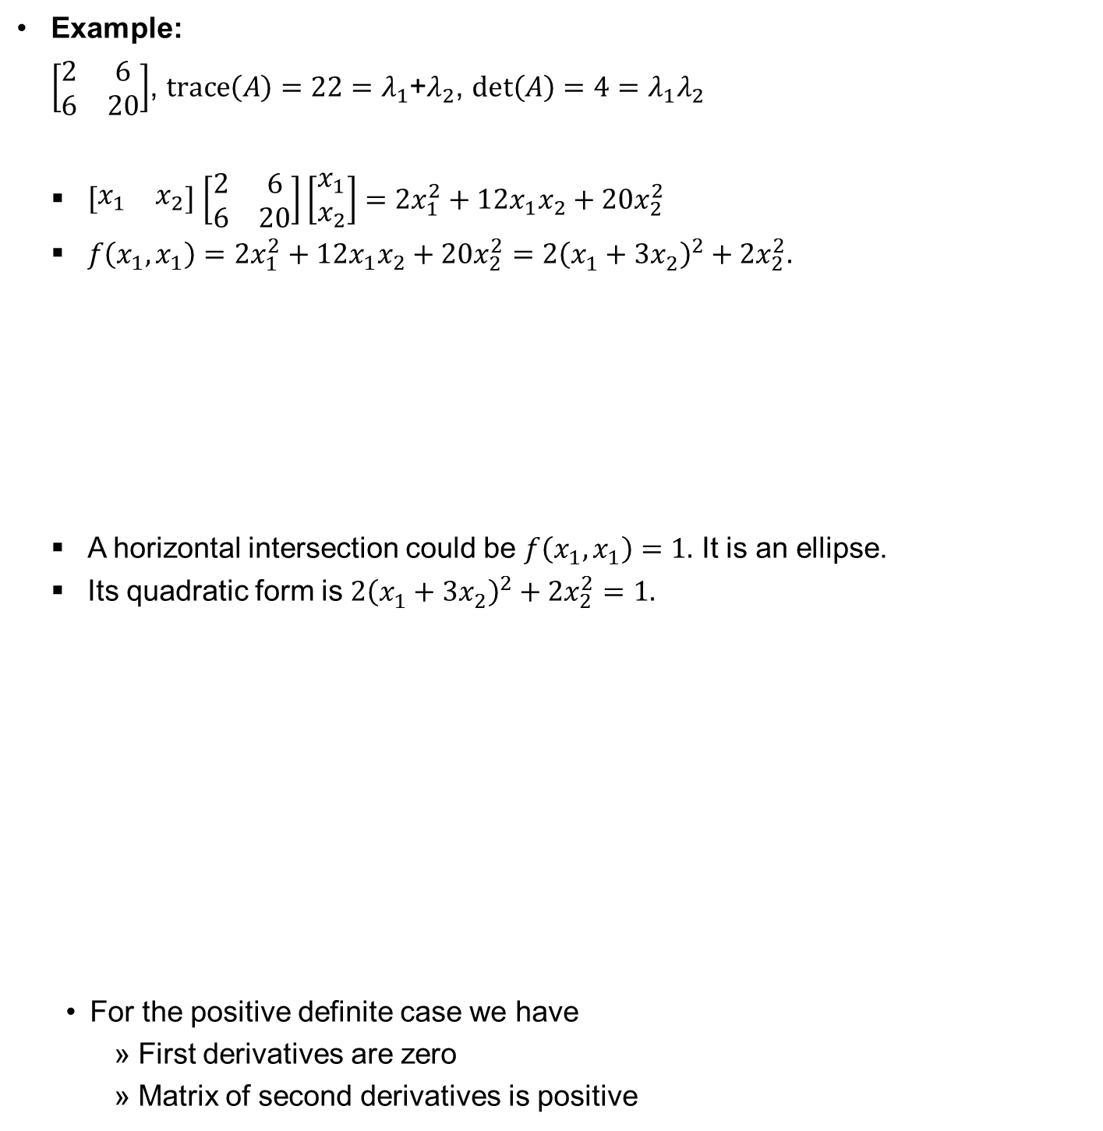

Example 1
  Example:
  $\left[\begin{matrix}2 & 6 \\ 6 & 20\end{matrix}\right]$, $trace\left(A\right)=22=λ_{1}$+$λ_{2}$, $det\left(A\right)=4=λ_{1}λ_{2}$
  $\left[\begin{matrix}x_{1} & x_{2}\end{matrix}\right]$ $\left[\begin{matrix}2 & 6 \\ 6 & 20\end{matrix}\right]\left[\begin{matrix}x_{1} \\ x_{2}\end{matrix}\right]=2x_{1}^{2}+12x_{1}x_{2}+20x_{2}^{2}$
  $f\left(x_{1},x_{1}\right)=2x_{1}^{2}+12x_{1}x_{2}+20x_{2}^{2}={2\left(x_{1}^{}+{3x}_{2}^{}\right)}^{2}+{2x}_{2}^{2}.$
  A horizontal intersection could be $f\left(x_{1},x_{1}\right)=1.$ It is an ellipse.
  Its quadratic form is ${2\left(x_{1}^{}+{3x}_{2}^{}\right)}^{2}+{2x}_{2}^{2}=1.$
  For the positive definite case we have
    First derivatives are zero
    Matrix of second derivatives is positive
$$x_{1}$$
minimum
$$x_{2}$$

Slide 7
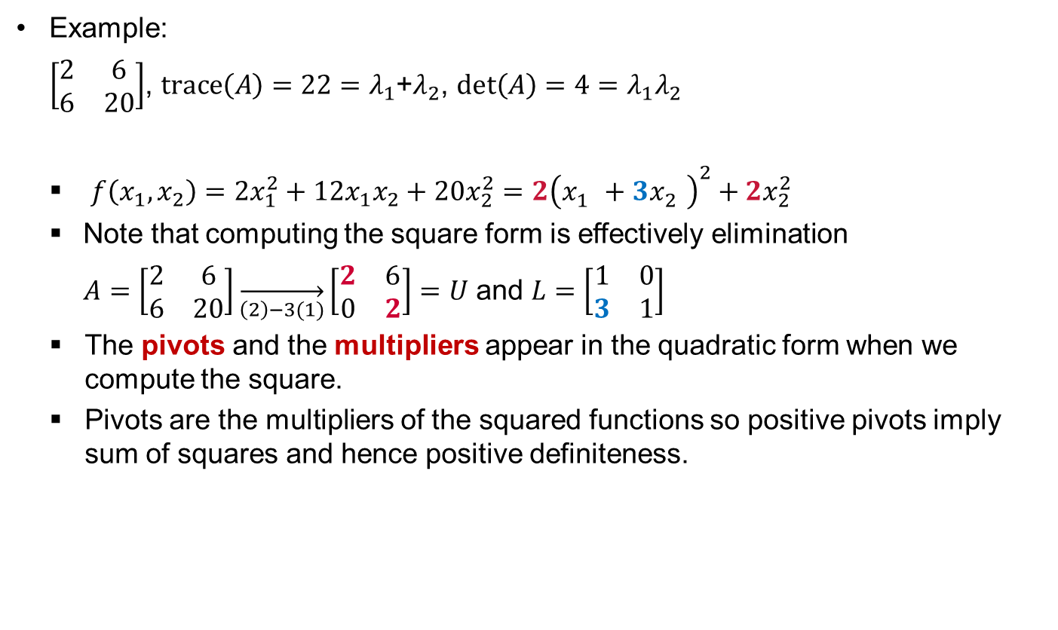
Example 1 cont.
Example:
$\left[\begin{matrix}2 & 6 \\ 6 & 20\end{matrix}\right]$, $trace\left(A\right)=22=λ_{1}$+$λ_{2}$, $det\left(A\right)=4=λ_{1}λ_{2}$
  $f\left(x_{1},x_{2}\right)=2x_{1}^{2}+12x_{1}x_{2}+20x_{2}^{2}={2\left(x_{1}^{}+{3x}_{2}^{}\right)}^{2}+{2x}_{2}^{2}$
  Note that computing the square form is effectively elimination
  $A=\left[\begin{matrix}2 & 6 \\ 6 & 20\end{matrix}\right]\overset{→}{\left(2\right)−3(1)}\left[\begin{matrix}2 & 6 \\ 0 & 2\end{matrix}\right]=U$ and $L=\left[\begin{matrix}1 & 0 \\ 3 & 1\end{matrix}\right]$
  The pivots and the multipliers appear in the quadratic form when we compute the square.
  Pivots are the multipliers of the squared functions so positive pivots imply sum of squares and hence positive definiteness.

Slide 8
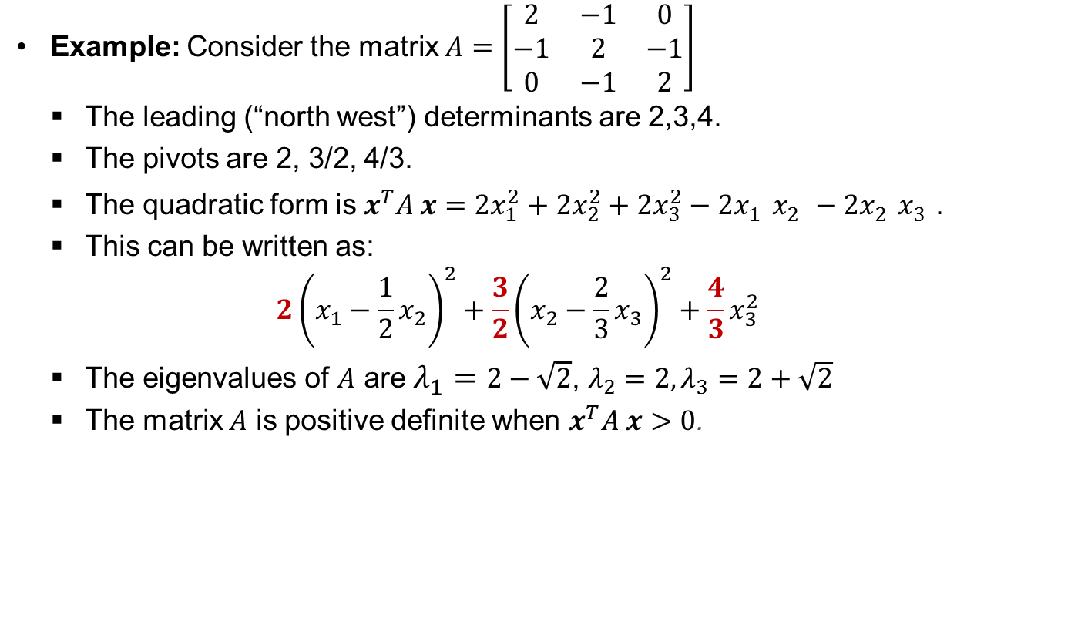
Example 2
Example: Consider the matrix $A=\left[\begin{matrix}2 & −1 & 0 \\ −1 & 2 & −1 \\ 0 & −1 & 2\end{matrix}\right]$
  The leading (“north west”) determinants are 2,3,4.
  The pivots are 2, 3/2, 4/3.
  The quadratic form is $x^{T}A x={2x}_{1}^{2}+{2x}_{2}^{2}+{2x}_{3}^{2}−2x_{1}^{}x_{2}^{}−2x_{2}^{}x_{3}^{}$.
  This can be written as:
  $$2{\left(x_{1}−\frac{1}{2}x_{2}\right)}^{2}+\frac{3}{2}{\left(x_{2}−\frac{2}{3}x_{3}\right)}^{2}+\frac{4}{3}x_{3}^{2}$$
  The eigenvalues of $A$ are $λ_{1}=2−\sqrt{2}$, $λ_{2}=2, λ_{3}=2+\sqrt{2}$
  The matrix $A$ is positive definite when $x^{T}A x>0$.

Slide 9
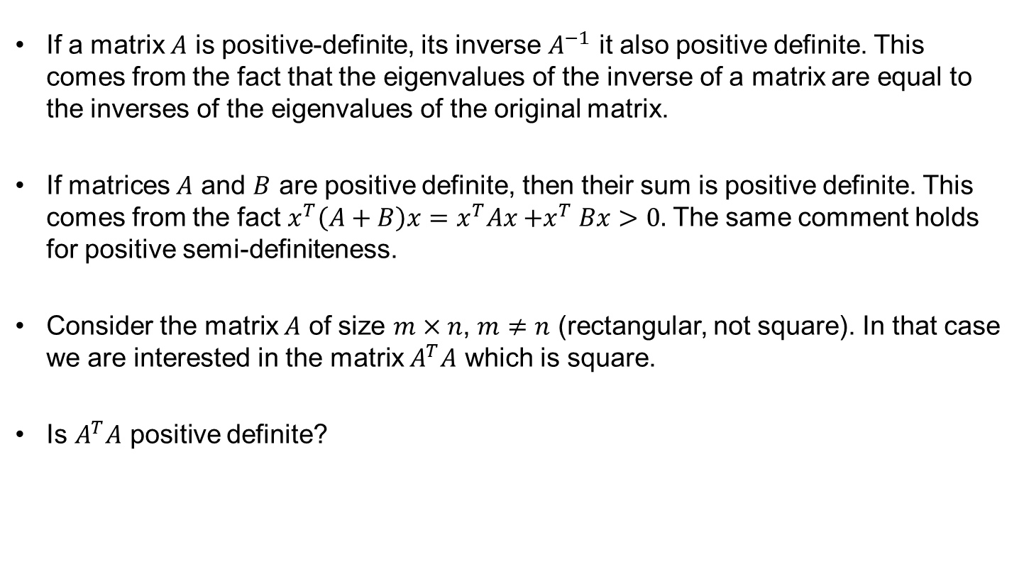
Positive definite matrices cont.
If a matrix $A$ is positive-definite, its inverse $A^{−1}$ it also positive definite. This comes from the fact that the eigenvalues of the inverse of a matrix are equal to the inverses of the eigenvalues of the original matrix.
If matrices $A$ and $B$ are positive definite, then their sum is positive definite. This comes from the fact $x^{T}\left(A+B\right)x=x^{T}Ax{+x}^{T}Bx>0.$ The same comment holds for positive semi-definiteness.
Consider the matrix $A$ of size $m×n$, $m≠n$ (rectangular, not square). In that case we are interested in the matrix $A^{T}A$ which is square.
Is $A^{T}A$ positive definite?

Slide 10

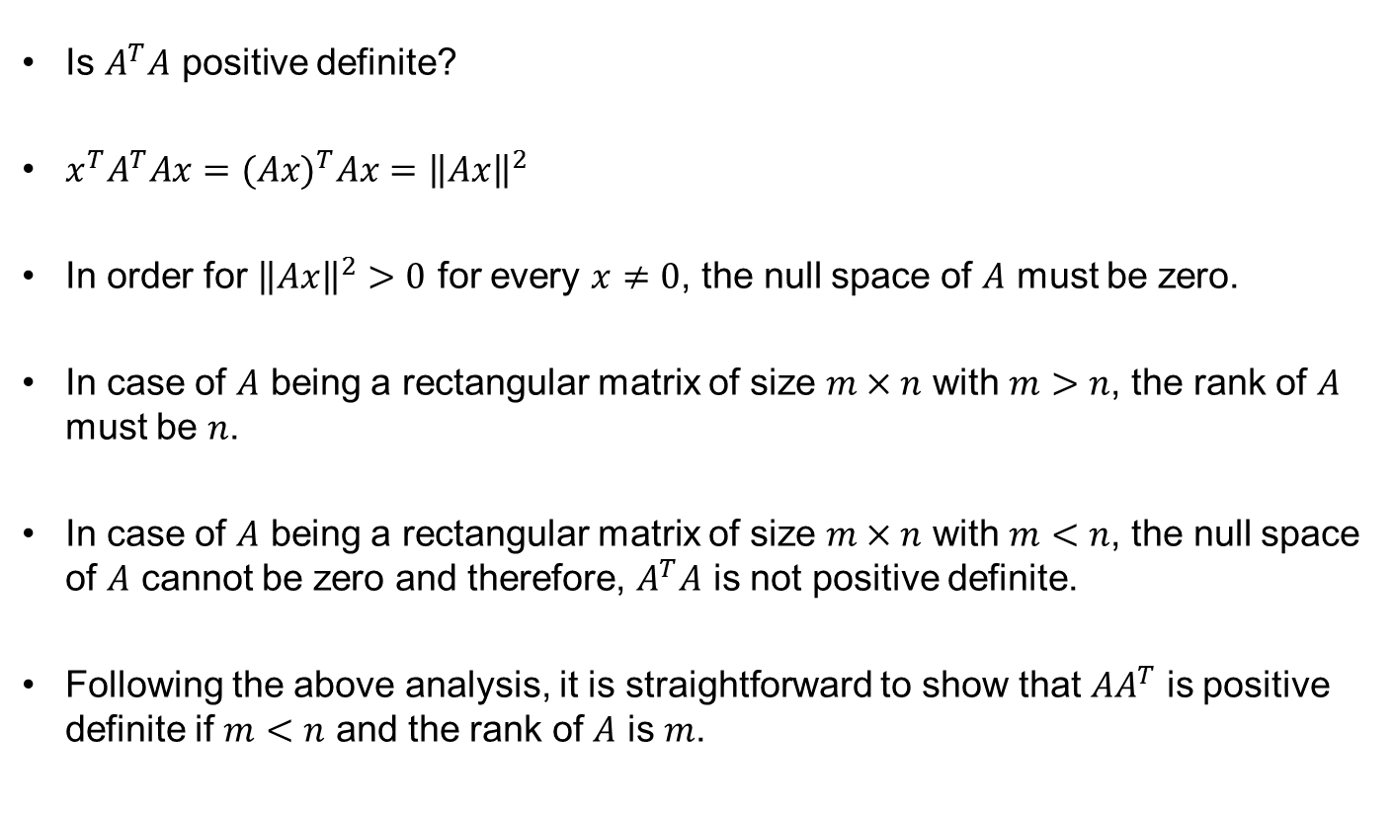
The case of $A^{T}A$and $AA^{T}$
Is $A^{T}A$ positive definite?
$x^{T}A^{T}Ax={(Ax)}^{T}Ax={\left\|Ax\right\|}^{2}$
In order for ${\left\|Ax\right\|}^{2}>0$ for every $x≠0$, the null space of $A$ must be zero.
In case of $A$ being a rectangular matrix of size $m×n$ with $m>n$, the rank of $A$ must be $n$.
In case of $A$ being a rectangular matrix of size $m×n$ with $m<n$, the null space of $A$ cannot be zero and therefore, $A^{T}A$ is not positive definite.
Following the above analysis, it is straightforward to show that ${AA}^{T}$ is positive definite if $m<n$ and the rank of $A$ is $m$.

Slide 11
Similar matrices
Consider two square matrices $A$ and $B$.
Suppose that for some invertible matrix $M$ the relationship $B=M^{−1}AM$ holds. In that case we say that $A$ and $B$ are similar matrices.
Example: Consider a matrix $A$ which has a full set of eigenvectors. In that case $S^{−1}AS=Λ$. Based on the above $A$ is similar to $Λ$.
Similar matrices have the same eigenvalues.
Matrices with identical eigenvalues are not necessarily similar.
There are different families of matrices with the same eigenvalues.
Consider the matrix $A$ with eigenvalues $λ$ and corresponding eigenvectors $x$and the matrix $B=M^{−1}AM$ .
We have$Ax=λx⇒AMM^{−1}x=λx⇒M^{−1}AMM^{−1}x={λM}^{−1}x$
$$BM^{−1}x={λM}^{−1}x$$
Therefore, $λ$ is also an eigenvalue of $B$ with corresponding eigenvector $M^{−1}x$.

Slide 12
Matrices with identical eigenvalues with some repeated
Consider the families of matrices with repeated eigenvalues.
Example: Lets take the $2×2$ size matrices with eigenvalues $λ_{1}=λ_{2}=4$.
The following two matrices
$\left[\begin{matrix}4 & 0 \\ 0 & 4\end{matrix}\right]=4I$ and $\left[\begin{matrix}4 & 1 \\ 0 & 4\end{matrix}\right]$
have eigenvalues $4,4$ but they belong to different families.
There are two families of matrices with eigenvalues $4,4$.
The matrix $\left[\begin{matrix}4 & 0 \\ 0 & 4\end{matrix}\right]$ has no “relatives”. The only matrix similar to it, is itself.
The big family includes $\left[\begin{matrix}4 & 1 \\ 0 & 4\end{matrix}\right]$ and any matrix of the form $\left[\begin{matrix}4 & a \\ 0 & 4\end{matrix}\right]$, $a≠0$. These matrices are not diagonalizable since they only have one non-zero eigenvector.

Slide 13
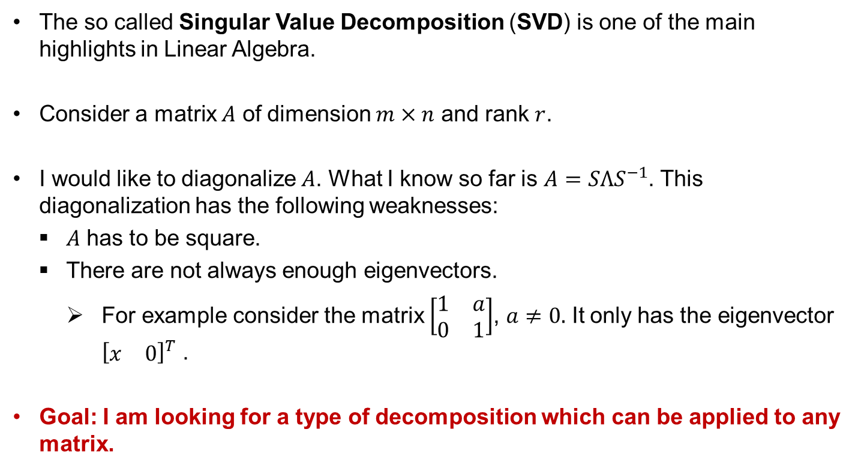
Singular Value Decomposition (SVD)
The so called Singular Value Decomposition (SVD) is one of the main highlights in Linear Algebra.
Consider a matrix $A$ of dimension $m×n$ and rank $r$.
I would like to diagonalize $A$. What I know so far is $A=SΛS^{−1}$. This diagonalization has the following weaknesses:
$A$ has to be square.
There are not always enough eigenvectors.
For example consider the matrix $\left[\begin{matrix}1 & a \\ 0 & 1\end{matrix}\right]$, $a≠0.$ It only has the eigenvector ${\left[\begin{matrix}x & 0\end{matrix}\right]}^{T}$ .
Goal: I am looking for a type of decomposition which can be applied to any matrix.

Slide 14
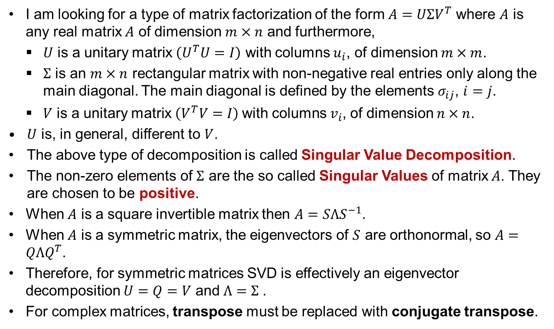
Singular Value Decomposition (SVD) cont.
I am looking for a type of matrix factorization of the form $A=UΣV^{T}$ where $A$ is any real matrix $A$ of dimension $m×n$ and furthermore,
    $U$ is a unitary matrix $\left(U^{T}U=I\right)$ with columns $u_{i}$, of dimension $m×m$.
    $Σ$ is an $m×n$ rectangular matrix with non-negative real entries only along the main diagonal. The main diagonal is defined by the elements $σ_{ij}$, $i=j$.
    $V$ is a unitary matrix $\left(V^{T}V=I\right)$with columns $v_{i}$, of dimension $n×n$.
  $U$ is, in general, different to $V$.
  The above type of decomposition is called Singular Value Decomposition.
  The non-zero elements of $Σ$ are the so called Singular Values of matrix $A$. They are chosen to be positive.
  When $A$ is a square invertible matrix then $A=SΛS^{−1}$.
  When $A$ is a symmetric matrix, the eigenvectors of $S$ are orthonormal, so $A=QΛQ^{T}$.
  Therefore, for symmetric matrices SVD is effectively an eigenvector decomposition $U=Q=V$ and $Λ=Σ$.
  For complex matrices, transpose must be replaced with conjugate transpose.

Slide 15
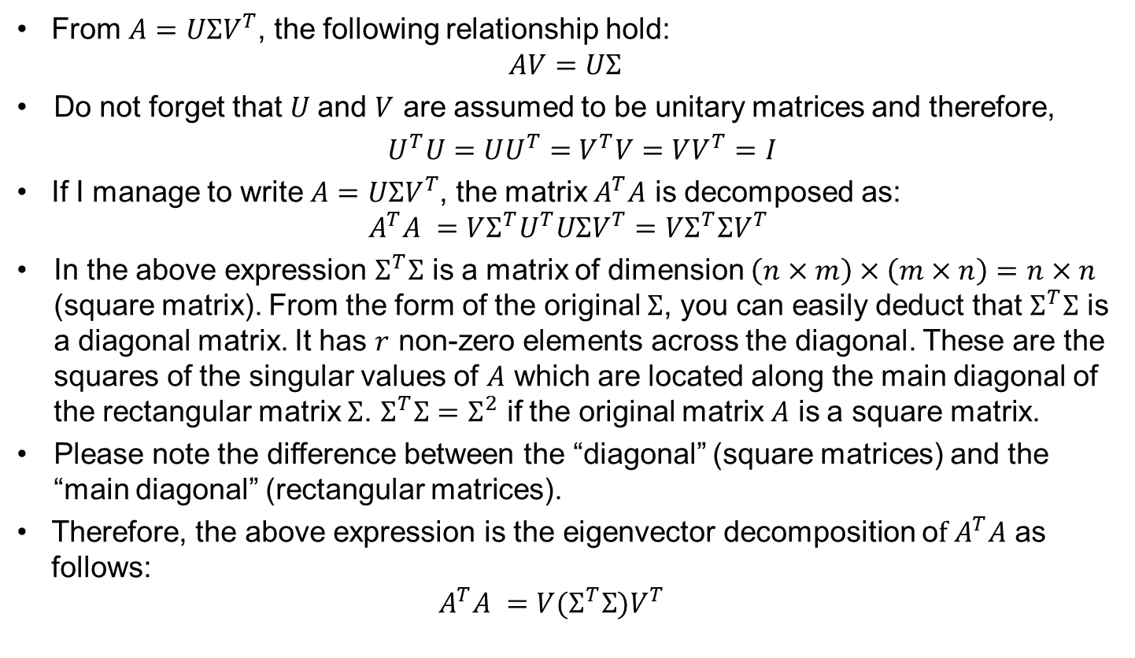
Singular Value Decomposition (SVD) cont.
From $A=UΣV^{T}$, the following relationship hold:
  $$AV=UΣ$$
  Do not forget that $U$and $V$ are assumed to be unitary matrices and therefore,
  $U^{T}U=UU^{T}=$ $V^{T}V=VV^{T}=I$
  If I manage to write $A=UΣV^{T}$, the matrix $A^{T}A$ is decomposed as:
  $${ A}^{T}A =V{Σ^{T}U}^{T}UΣV^{T}=VΣ^{T}ΣV^{T}$$
  In the above expression $Σ^{T}Σ$ is a matrix of dimension $\left(n×m\right)×\left(m×n\right)=n×n$ (square matrix). From the form of the original $Σ$, you can easily deduct that $Σ^{T}Σ$ is a diagonal matrix. It has $r$ non-zero elements across the diagonal. These are the squares of the singular values of $A$ which are located along the main diagonal of the rectangular matrix $Σ$. $Σ^{T}Σ{=Σ}^{2}$ if the original matrix $A$ is a square matrix.
  Please note the difference between the “diagonal” (square matrices) and the “main diagonal” (rectangular matrices).
  Therefore, the above expression is the eigenvector decomposition o$f A^{T}A$ as follows:
  $${ A}^{T}A =V{(Σ}^{T}Σ)V^{T}$$

Slide 16
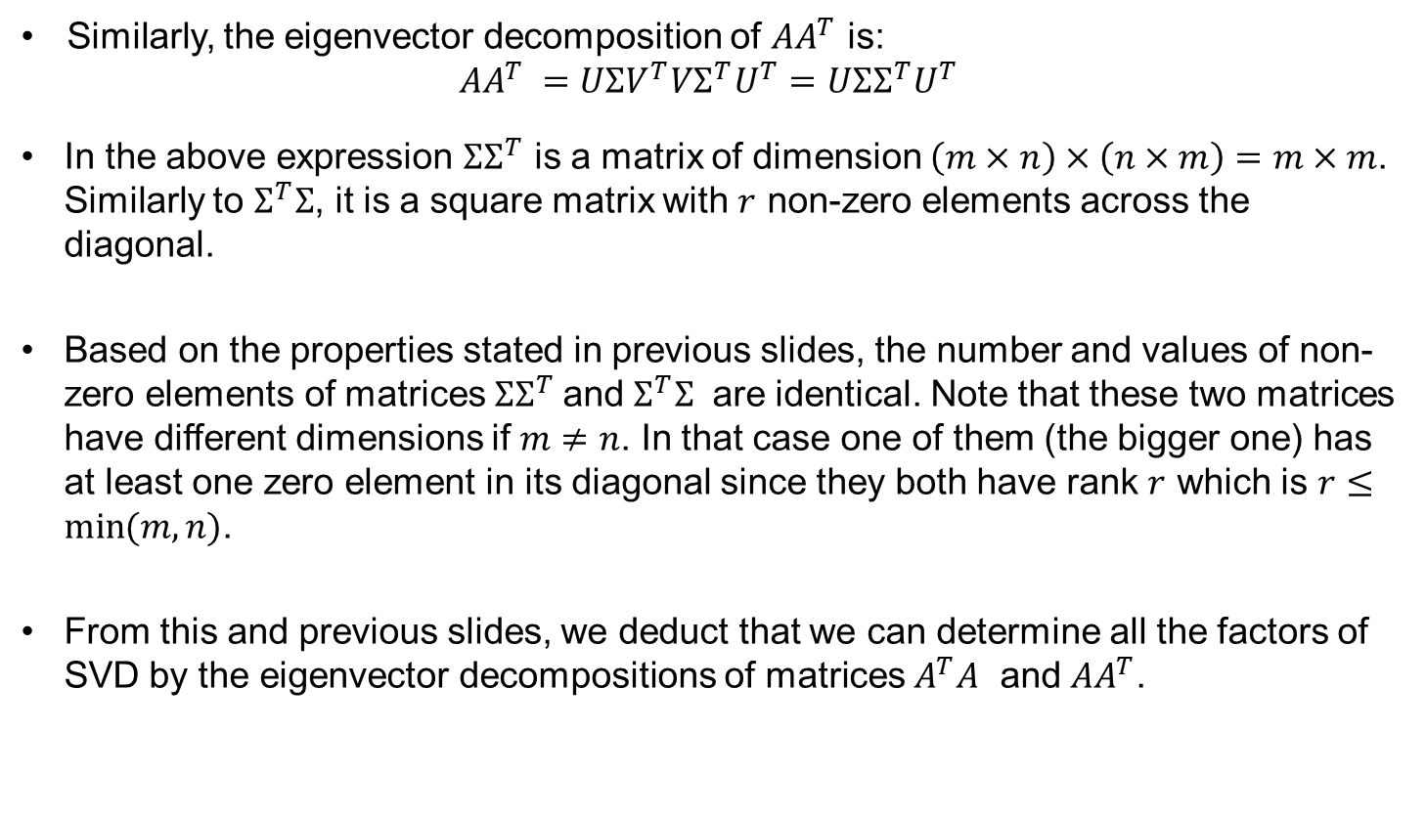
Singular Value Decomposition (SVD) cont.
  Similarly, the eigenvector decomposition of $AA^{T}$ is:
  $${AA}^{T} =UΣV^{T}V{Σ^{T}U}^{T}=UΣ{Σ^{T}U}^{T}$$
  In the above expression ${ΣΣ}^{T}$ is a matrix of dimension $\left(m×n\right)×\left(n×m\right)=m×m$. Similarly to $Σ^{T}Σ$, it is a square matrix with $r$ non-zero elements across the diagonal.
  Based on the properties stated in previous slides, the number and values of non-zero elements of matrices ${ΣΣ}^{T}$and $Σ^{T}Σ$ are identical. Note that these two matrices have different dimensions if $m≠n$. In that case one of them (the bigger one) has at least one zero element in its diagonal since they both have rank $r$ which is $r≤\min{(m,n)}$.
  From this and previous slides, we deduct that we can determine all the factors of SVD by the eigenvector decompositions of matrices $A^{T}A$ and $AA^{T}$.

Slide 17
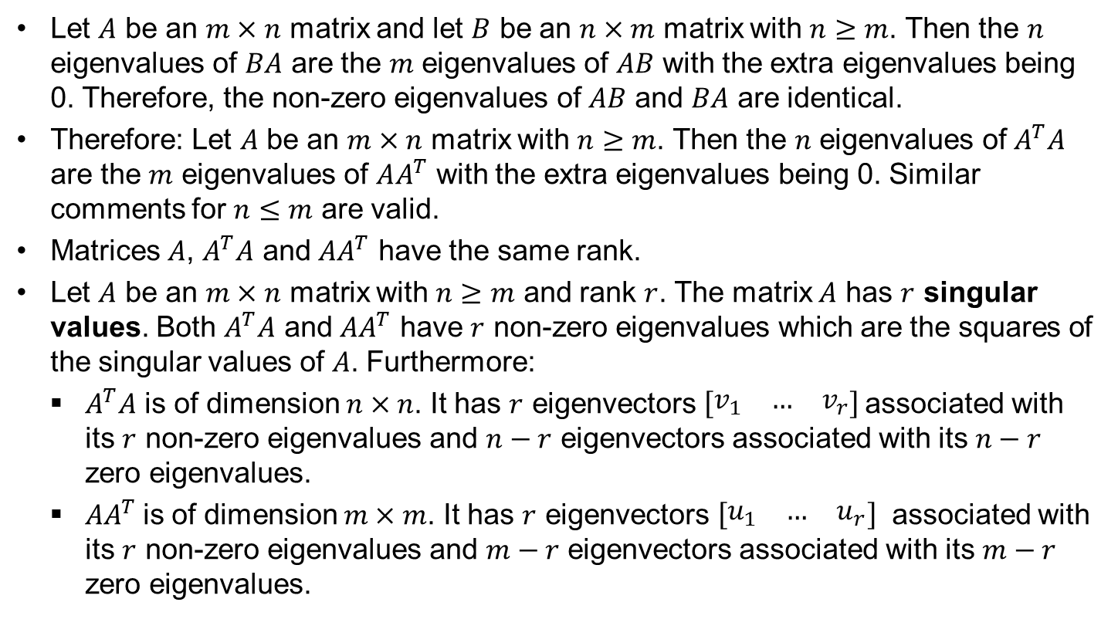
Useful properties
Let $A$ be an $m×n$ matrix and let $B$ be an $n×m$ matrix with $n≥m$. Then the $n$ eigenvalues of $BA$ are the $m$ eigenvalues of $AB$ with the extra eigenvalues being 0. Therefore, the non-zero eigenvalues of $AB$ and $BA$ are identical.
Therefore: Let $A$ be an $m×n$ matrix with $n≥m$. Then the $n$ eigenvalues of $A^{T}A$ are the $m$ eigenvalues of $AA^{T}$ with the extra eigenvalues being 0. Similar comments for $n≤m$ are valid.
Matrices $A$, $A^{T}A$ and $AA^{T}$ have the same rank.
Let $A$ be an $m×n$ matrix with $n≥m$ and rank $r$. The matrix $A$ has $r$ singular values. Both $A^{T}A$ and $AA^{T}$ have $r$ non-zero eigenvalues which are the squares of the singular values of $A$. Furthermore:
$A^{T}A$ is of dimension $n×n$. It has $r$ eigenvectors $\left[\begin{matrix}v_{1} & … & v_{r}\end{matrix}\right]$associated with its $r$ non-zero eigenvalues and $n−r$ eigenvectors associated with its $n−r$ zero eigenvalues.
$AA^{T}$is of dimension $m×m$. It has $r$ eigenvectors $\left[\begin{matrix}u_{1} & … & u_{r}\end{matrix}\right]$ associated with its $r$ non-zero eigenvalues and $m−r$ eigenvectors associated with its $m−r$ zero eigenvalues.

Slide 18
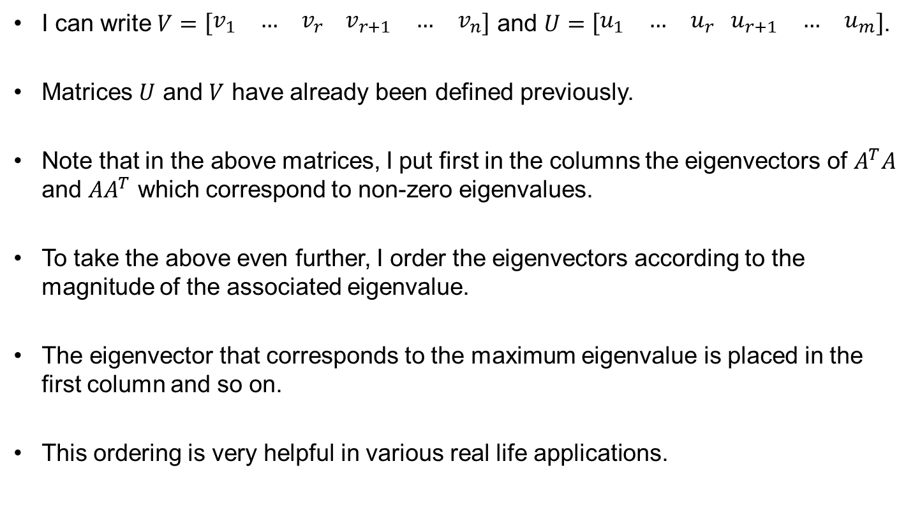
Singular Value Decomposition (SVD) cont.
I can write $V=\left[\begin{matrix}v_{1} & … & v_{r}\end{matrix}\begin{matrix}{ v}_{r+1} & … & v_{n}\end{matrix}\right]$ and $U=\left[\begin{matrix}u_{1} & … & u_{r} \end{matrix}\begin{matrix}u_{r+1} & … & u_{m}\end{matrix}\right]$.
Matrices $U$ and $V$ have already been defined previously.
Note that in the above matrices, I put first in the columns the eigenvectors of $A^{T}A$ and $AA^{T}$ which correspond to non-zero eigenvalues.
To take the above even further, I order the eigenvectors according to the magnitude of the associated eigenvalue.
The eigenvector that corresponds to the maximum eigenvalue is placed in the first column and so on.
This ordering is very helpful in various real life applications.

Slide 19
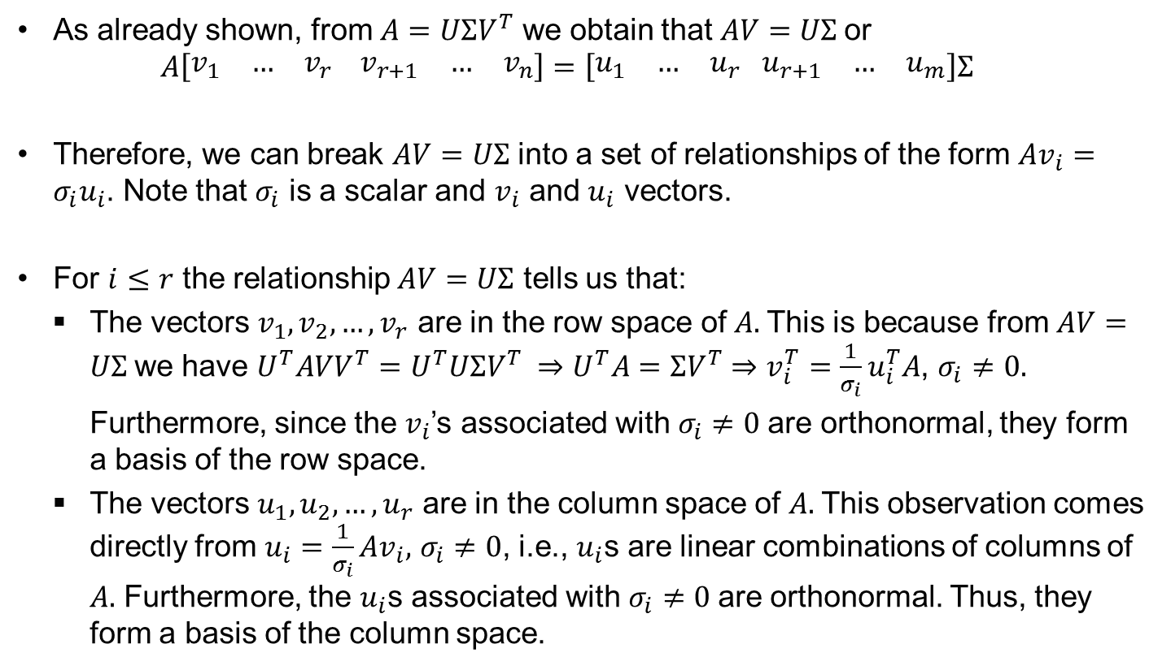
Singular Value Decomposition (SVD) cont.
As already shown, from $A=UΣV^{T}$ we obtain that $AV=UΣ$or
$$A\left[\begin{matrix}v_{1} & … & v_{r}\end{matrix}\begin{matrix}{ v}_{r+1} & … & v_{n}\end{matrix}\right]=\left[\begin{matrix}u_{1} & … & u_{r} \end{matrix}\begin{matrix}u_{r+1} & … & u_{m}\end{matrix}\right]Σ$$
Therefore, we can break $AV=UΣ$ into a set of relationships of the form $Av_{i}=σ_{i}u_{i}$. Note that $σ_{i}$ is a scalar and $v_{i}$ and $u_{i}$ vectors.
For $i≤r$ the relationship $AV=UΣ$ tells us that:
The vectors $v_{1},v_{2},…,v_{r}$ are in the row space of $A.$This is because from $AV=UΣ$we have $U^{T}AVV^{T}=U^{T}UΣV^{T} ⇒U^{T}A=ΣV^{T}⇒v_{i}^{T}=\frac{1}{σ_{i}}u_{i}^{T}A$, $σ_{i}≠0.$
Furthermore, since the $v_{i}$’s associated with $σ_{i}≠0$are orthonormal, they form a basis of the row space.
The vectors $u_{1},u_{2},…,u_{r}$ are in the column space of $A.$This observation comes directly from $u_{i}=\frac{1}{σ_{i}}Av_{i},$ $σ_{i}≠0$, i.e., $u_{i}$s are linear combinations of columns of $A.$ Furthermore, the $u_{i}$s associated with $σ_{i}≠0$are orthonormal. Thus, they form a basis of the column space.

Slide 20
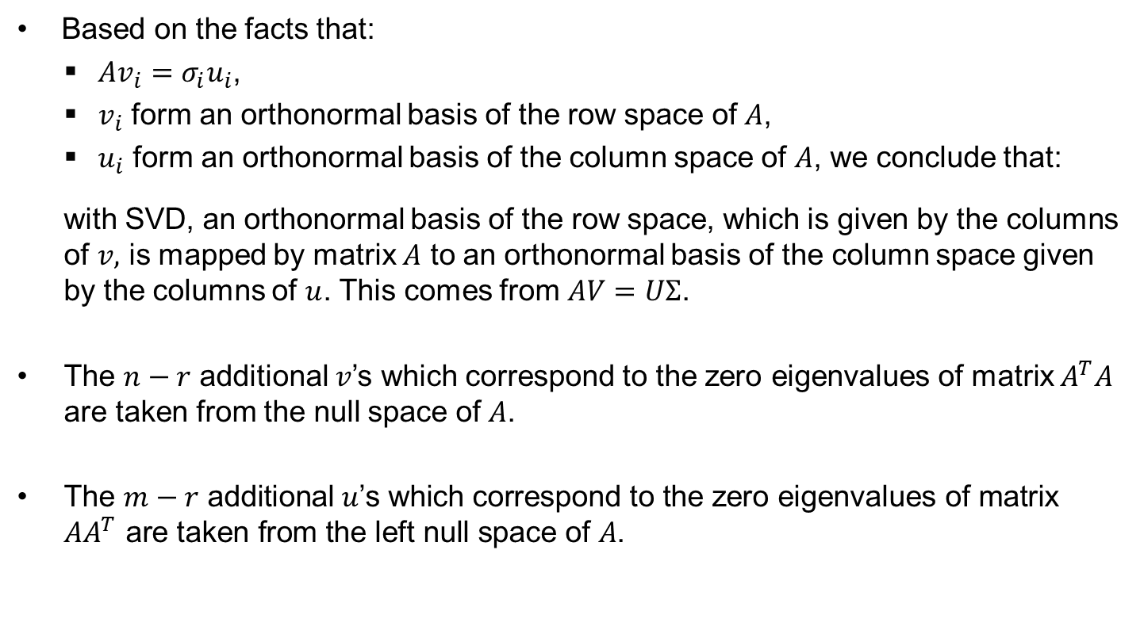
Singular Value Decomposition (SVD) cont.
Based on the facts that:
$Av_{i}=σ_{i}u_{i}$,
$v_{i}$ form an orthonormal basis of the row space of $A$,
$u_{i}$ form an orthonormal basis of the column space of $A$, we conclude that:
with SVD, an orthonormal basis of the row space, which is given by the columns of $v,$ is mapped by matrix $A$ to an orthonormal basis of the column space given by the columns of $u$. This comes from $AV=UΣ$.
The $n−r$ additional $v$’s which correspond to the zero eigenvalues of matrix $A^{T}A$ are taken from the null space of $A$.
$\text{The} m−r \text{additional} u\text{’}\text{s} \text{which} \text{correspond} \text{to} \text{the} \text{zero} \text{eigenvalues} \text{of} \text{matrix} {AA}^{T} \text{are} \text{taken} \text{from} \text{the} \text{left} \text{null} \text{space} \text{of} A\text{.}$

Slide 21

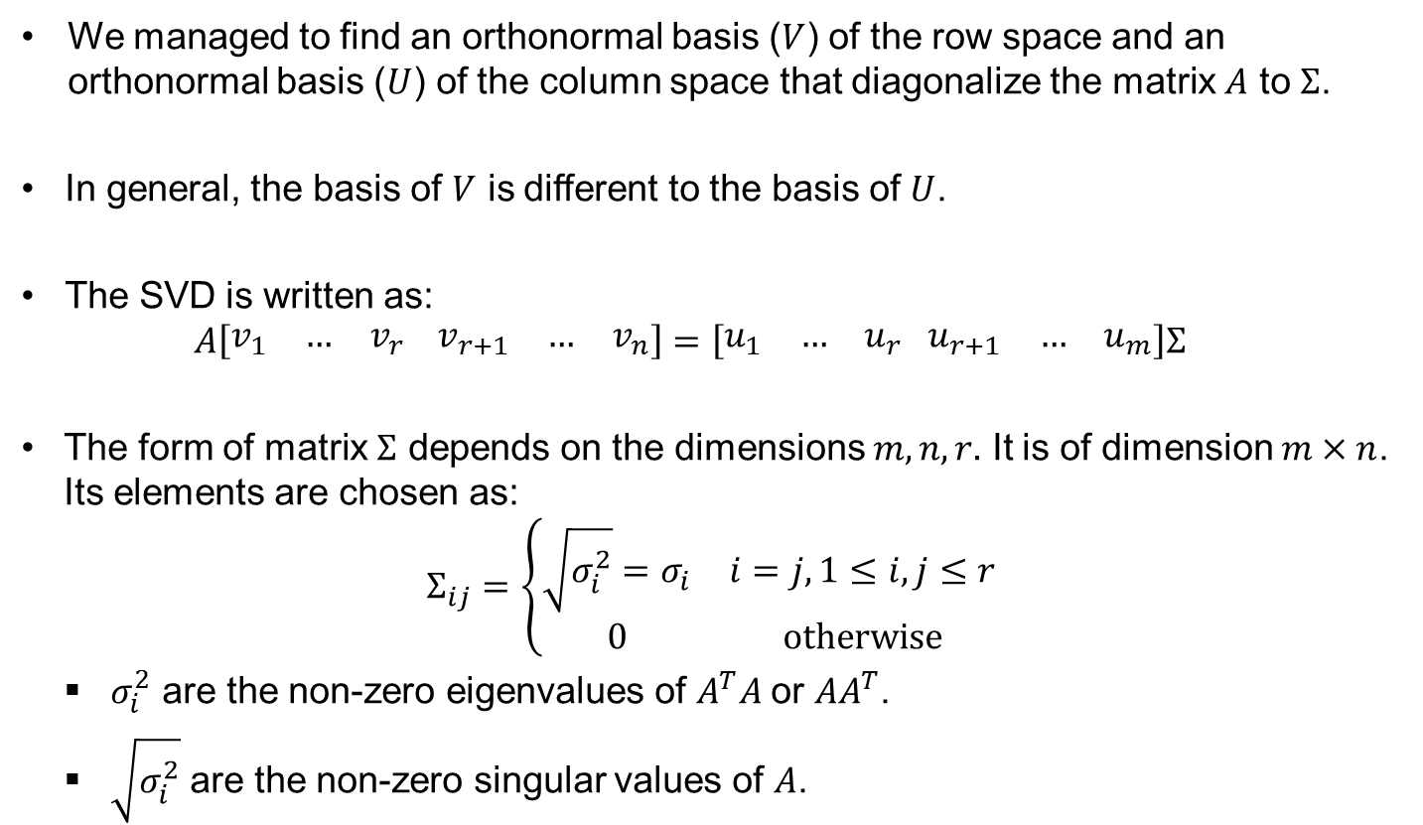
Examples of different $Σ$matrices
  We managed to find an orthonormal basis ($V$) of the row space and an orthonormal basis ($U$) of the column space that diagonalize the matrix $A$ to $Σ$.
  In general, the basis of $V$ is different to the basis of $U$.
  The SVD is written as:
  $$A\left[\begin{matrix}v_{1} & … & v_{r}\end{matrix}\begin{matrix}{ v}_{r+1} & … & v_{n}\end{matrix}\right]=\left[\begin{matrix}u_{1} & … & u_{r} \end{matrix}\begin{matrix}u_{r+1} & … & u_{m}\end{matrix}\right]Σ$$
  The form of matrix $Σ$ depends on the dimensions $m, n, r.$ It is of dimension $m×n$. Its elements are chosen as:
  $$Σ_{ij}=\left\{\begin{matrix}\sqrt{σ_{i}^{2}}=σ_{i} & i=j, 1≤i,j≤r \\ 0 & otherwise\end{matrix}\right.$$
  $σ_{i}^{2}$ are the non-zero eigenvalues of $A^{T}A$or ${AA}^{T}$.
  $\sqrt{σ_{i}^{2}}$ are the non-zero singular values of $A$.

Slide 22


Examples of different $Σ$matrices cont.
  Example: $m=n=r=3.$
  $$Σ=\left[\begin{matrix}\sqrt{σ_{1}^{2}} & 0 & 0 \\ 0 & \sqrt{σ_{2}^{2}} & 0 \\ 0 & 0 & \sqrt{σ_{3}^{2}}\end{matrix}\right]$$
  Example: $m=4, n=3,r=2.$
  $$Σ=\left[\begin{matrix}\begin{matrix}\sqrt{σ_{1}^{2}} \\ 0\end{matrix} & \begin{matrix}0 \\ \sqrt{σ_{2}^{2}}\end{matrix} & \begin{matrix}0 \\ 0\end{matrix} \\ 0 & 0 & 0 \\ 0 & 0 & 0\end{matrix}\right]$$

Slide 23
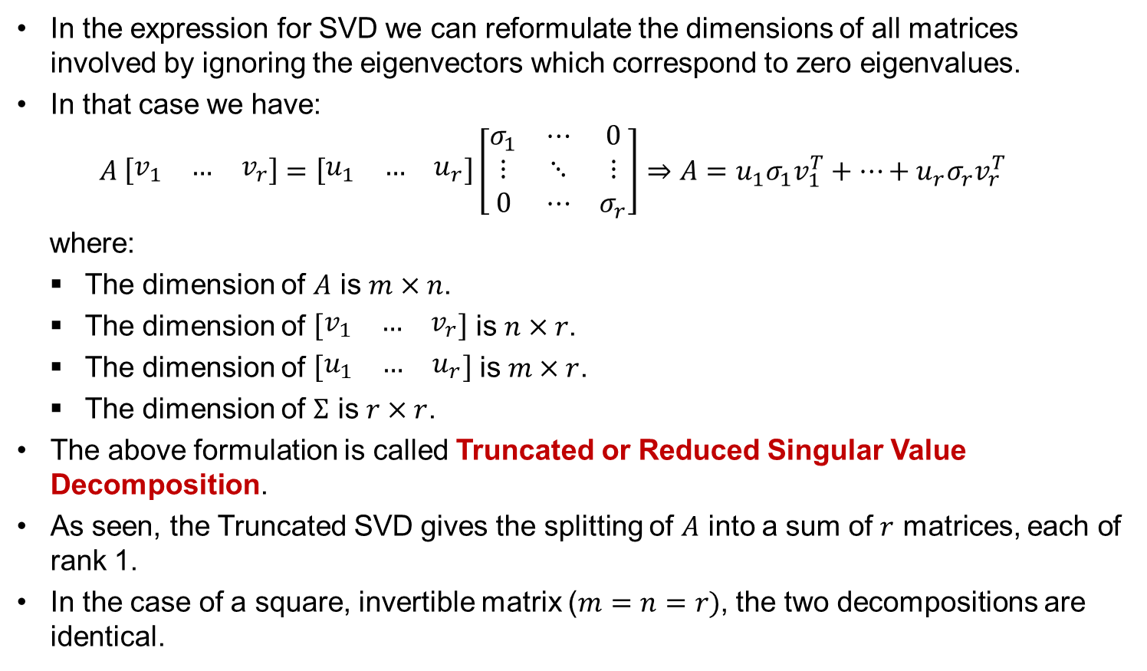
Truncated or Reduced Singular Value Decomposition
In the expression for SVD we can reformulate the dimensions of all matrices involved by ignoring the eigenvectors which correspond to zero eigenvalues.
In that case we have:
$$A \left[\begin{matrix}v_{1} & … & v_{r}\end{matrix}\right]=\left[\begin{matrix}u_{1} & … & u_{r}\end{matrix}\right]\left[\begin{matrix}σ_{1} & ⋯ & 0 \\ ⋮ & ⋱ & ⋮ \\ 0 & ⋯ & σ_{r}\end{matrix}\right]⇒{A=u}_{1}σ_{1}v_{1}^{T}+…+u_{r}σ_{r}v_{r}^{T}$$
where:
The dimension of $A$ is $m×n$.
The dimension of $\left[\begin{matrix}v_{1} & … & v_{r}\end{matrix}\right]$ is $n×r$.
The dimension of $\left[\begin{matrix}u_{1} & … & u_{r}\end{matrix}\right]$ is $m×r$.
The dimension of $Σ$ is $r×r$.
  The above formulation is called Truncated or Reduced Singular Value Decomposition.
  As seen, the Truncated SVD gives the splitting of $A$ into a sum of $r$ matrices, each of rank 1.
  In the case of a square, invertible matrix ($m=n=r)$, the two decompositions are identical.

Slide 24
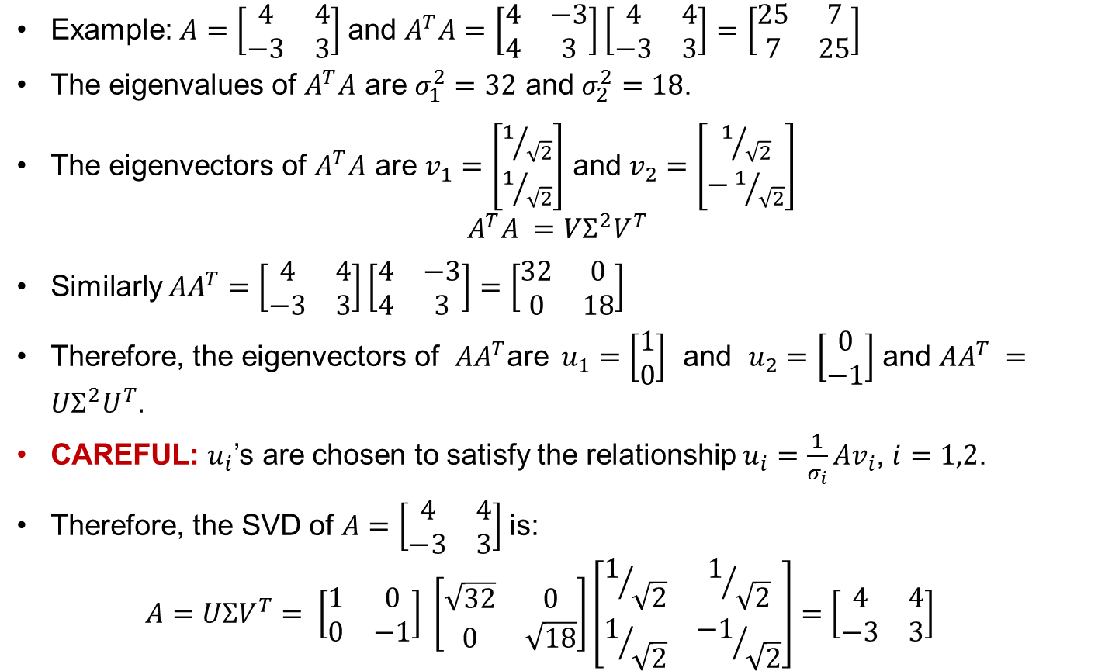
Singular Value Decomposition. Example 1.
Example:$A=\left[\begin{matrix}4 & 4 \\ −3 & 3\end{matrix}\right]$ and $A^{T}A=\left[\begin{matrix}4 & −3 \\ 4 & 3\end{matrix}\right]\left[\begin{matrix}4 & 4 \\ −3 & 3\end{matrix}\right]=\left[\begin{matrix}25 & 7 \\ 7 & 25\end{matrix}\right]$
  The eigenvalues of $A^{T}A$ are $σ_{1}^{2}=32$ and $σ_{2}^{2}=18$.
  The eigenvectors of $A^{T}A$ are $v_{1}=\left[\begin{matrix}1/{\sqrt{2}} \\ 1/{\sqrt{2}}\end{matrix}\right]$ and $v_{2}=\left[\begin{matrix}1/{\sqrt{2}} \\ −1/{\sqrt{2}}\end{matrix}\right]$
  $$A^{T}A =VΣ^{2}V^{T}$$
  Similarly ${AA}^{T}=\left[\begin{matrix}4 & 4 \\ −3 & 3\end{matrix}\right]\left[\begin{matrix}4 & −3 \\ 4 & 3\end{matrix}\right]=\left[\begin{matrix}32 & 0 \\ 0 & 18\end{matrix}\right]$
  Therefore, the eigenvectors of $AA^{T}\text{a}\text{re} u_{1}=\left[\begin{matrix}1 \\ 0\end{matrix}\right]$ and $u_{2}=\left[\begin{matrix}0 \\ −1\end{matrix}\right]$ and ${AA}^{T} =UΣ^{2}U^{T}.$
  CAREFUL: $u_{i}$’s are chosen to satisfy the relationship $u_{i}=\frac{1}{σ_{i}}Av_{i}$, $i=1,2$.
  Therefore, the SVD of $A=\left[\begin{matrix}4 & 4 \\ −3 & 3\end{matrix}\right]$is:
  $$A=UΣV^{T}= \left[\begin{matrix}1 & 0 \\ 0 & −1\end{matrix}\right] \left[\begin{matrix}\sqrt{32} & 0 \\ 0 & \sqrt{18}\end{matrix}\right]\left[\begin{matrix}1/{\sqrt{2}} & 1/{\sqrt{2}} \\ 1/{\sqrt{2}} & {−1}/{\sqrt{2}}\end{matrix}\right]=\left[\begin{matrix}4 & 4 \\ −3 & 3\end{matrix}\right]$$

Slide 25
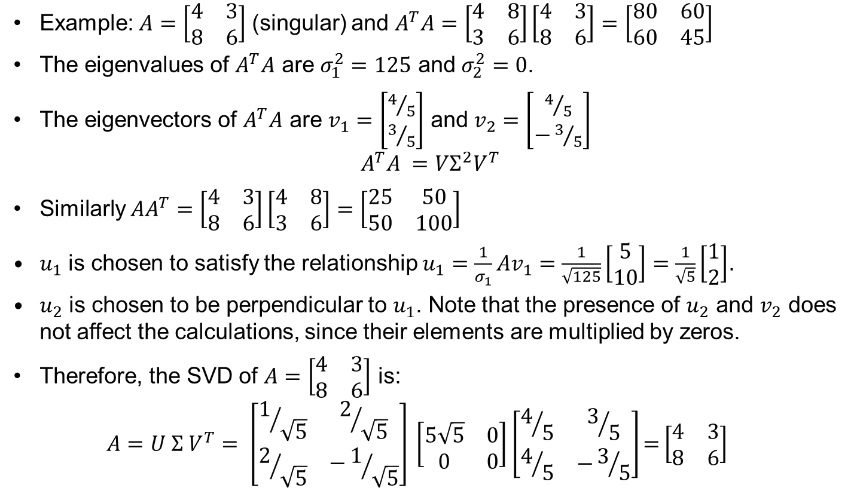
Singular Value Decomposition. Example 2.
Example:$A=\left[\begin{matrix}4 & 3 \\ 8 & 6\end{matrix}\right]$ (singular) and $A^{T}A=\left[\begin{matrix}4 & 8 \\ 3 & 6\end{matrix}\right]\left[\begin{matrix}4 & 3 \\ 8 & 6\end{matrix}\right]=\left[\begin{matrix}80 & 60 \\ 60 & 45\end{matrix}\right]$
  The eigenvalues of $A^{T}A$ are $σ_{1}^{2}=125$ and $σ_{2}^{2}=0$.
  The eigenvectors of $A^{T}A$ are $v_{1}=\left[\begin{matrix}4/5 \\ 3/5\end{matrix}\right]$ and $v_{2}=\left[\begin{matrix}4/5 \\ −3/5\end{matrix}\right]$
  $$A^{T}A =VΣ^{2}V^{T}$$
  Similarly ${AA}^{T}=\left[\begin{matrix}4 & 3 \\ 8 & 6\end{matrix}\right]\left[\begin{matrix}4 & 8 \\ 3 & 6\end{matrix}\right]=\left[\begin{matrix}25 & 50 \\ 50 & 100\end{matrix}\right]$
  $u_{1}$ is chosen to satisfy the relationship $u_{1}=\frac{1}{σ_{1}}Av_{1}=\frac{1}{\sqrt{125}}\left[\begin{matrix}5 \\ 10\end{matrix}\right]=\frac{1}{\sqrt{5}}\left[\begin{matrix}1 \\ 2\end{matrix}\right]$.
  $u_{2}$ is chosen to be perpendicular to $u_{1}$. Note that the presence of $u_{2}$ and $v_{2}$ does not affect the calculations, since their elements are multiplied by zeros.
  Therefore, the SVD of $A=\left[\begin{matrix}4 & 3 \\ 8 & 6\end{matrix}\right]$ is:
  $$A=U Σ V^{T}= \left[\begin{matrix}1/{\sqrt{5}} & 2/{\sqrt{5}} \\ 2/{\sqrt{5}} & −1/{\sqrt{5}}\end{matrix}\right] \left[\begin{matrix}5\sqrt{5} & 0 \\ 0 & 0\end{matrix}\right]\left[\begin{matrix}4/5 & 3/5 \\ 4/5 & −3/5\end{matrix}\right]\text{=}\left[\begin{matrix}4 & 3 \\ 8 & 6\end{matrix}\right]$$

Slide 26

Singular Value Decomposition. Example 2 cont.
  The SVD of $A=\left[\begin{matrix}4 & 3 \\ 8 & 6\end{matrix}\right]$ is:
  $$A=U Σ V^{T}= \left[\begin{matrix}1/{\sqrt{5}} & 2/{\sqrt{5}} \\ 2/{\sqrt{5}} & −1/{\sqrt{5}}\end{matrix}\right] \left[\begin{matrix}5\sqrt{5} & 0 \\ 0 & 0\end{matrix}\right]\left[\begin{matrix}4/5 & 3/5 \\ 4/5 & −3/5\end{matrix}\right]\text{=}\left[\begin{matrix}4 & 3 \\ 8 & 6\end{matrix}\right]$$
  The truncated SVD is:
  $$A=U Σ V^{T}=\left[\begin{matrix}1/{\sqrt{5}} \\ 2/{\sqrt{5}}\end{matrix}\right]5\sqrt{5}\left[\begin{matrix}4/5 & 3/5\end{matrix}\right]\text{=}\left[\begin{matrix}4 & 3 \\ 8 & 6\end{matrix}\right]$$

Slide 27
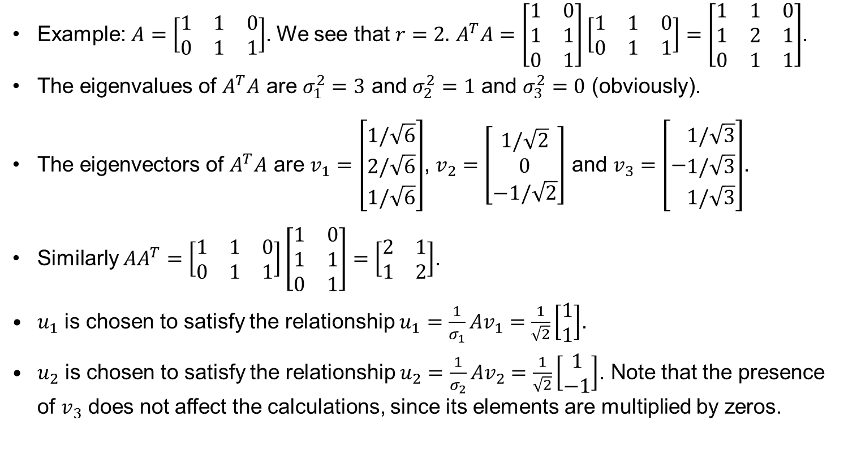
Singular Value Decomposition. Example 3.
Example:$A=\left[\begin{matrix}1 & 1 & 0 \\ 0 & 1 & 1\end{matrix}\right]$. We see that $r=2.$ $A^{T}A=\left[\begin{matrix}1 & 0 \\ 1 & 1 \\ 0 & 1\end{matrix}\right]\left[\begin{matrix}1 & 1 & 0 \\ 0 & 1 & 1\end{matrix}\right]=\left[\begin{matrix}1 & 1 & 0 \\ 1 & 2 & 1 \\ 0 & 1 & 1\end{matrix}\right]$.
  The eigenvalues of $A^{T}A$ are $σ_{1}^{2}=3$ and $σ_{2}^{2}=1$ and $σ_{3}^{2}=0$ (obviously).
  The eigenvectors of $A^{T}A$ are $v_{1}=\left[\begin{matrix}1/\sqrt{6} \\ 2/\sqrt{6} \\ 1/\sqrt{6}\end{matrix}\right]$, $v_{2}=\left[\begin{matrix}1/\sqrt{2} \\ 0 \\ −1/\sqrt{2}\end{matrix}\right]$ and $v_{3}=\left[−\begin{matrix}1/\sqrt{3} \\ 1/\sqrt{3} \\ 1/\sqrt{3}\end{matrix}\right]$.
  Similarly ${AA}^{T}=\left[\begin{matrix}1 & 1 & 0 \\ 0 & 1 & 1\end{matrix}\right]\left[\begin{matrix}1 & 0 \\ 1 & 1 \\ 0 & 1\end{matrix}\right]=\left[\begin{matrix}2 & 1 \\ 1 & 2\end{matrix}\right]$.
  $u_{1}$ is chosen to satisfy the relationship $u_{1}=\frac{1}{σ_{1}}Av_{1}=\frac{1}{\sqrt{2}}\left[\begin{matrix}1 \\ 1\end{matrix}\right]$.
  $u_{2}$ is chosen to satisfy the relationship $u_{2}=\frac{1}{σ_{2}}Av_{2}=\frac{1}{\sqrt{2}}\left[\begin{matrix}1 \\ −1\end{matrix}\right]$. Note that the presence of $v_{3}$ does not affect the calculations, since its elements are multiplied by zeros.

Slide 28
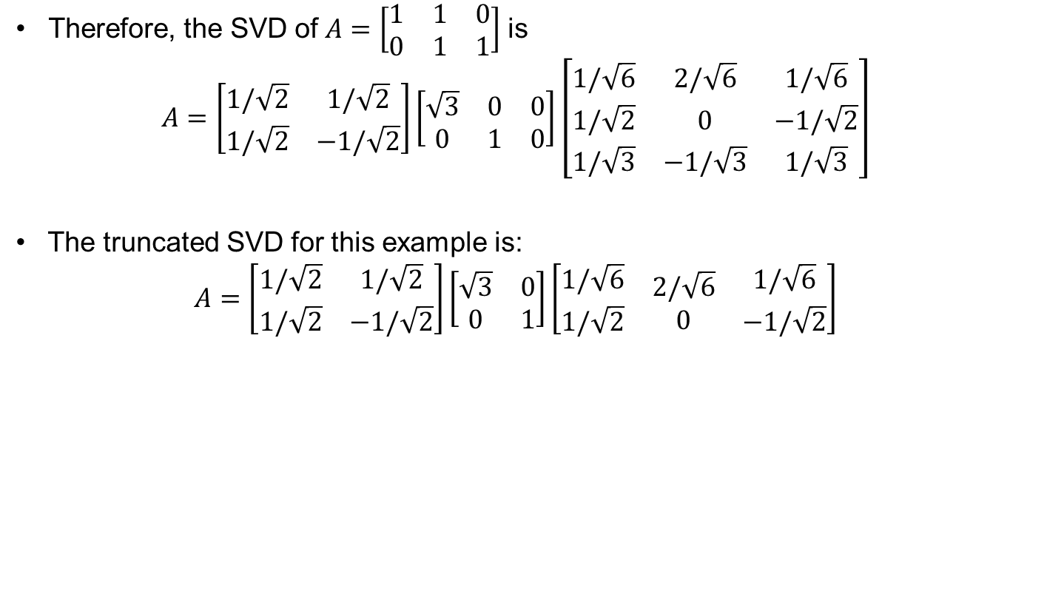
Singular Value Decomposition. Example.
Therefore, the SVD of$A=\left[\begin{matrix}1 & 1 & 0 \\ 0 & 1 & 1\end{matrix}\right]$ is
$$A=\left[\begin{matrix}1/\sqrt{2} & 1/\sqrt{2} \\ 1/\sqrt{2} & −1/\sqrt{2}\end{matrix}\right]\left[\begin{matrix}\sqrt{3} & 0 & 0 \\ 0 & 1 & 0\end{matrix}\right]\left[\begin{matrix}1/\sqrt{6} & 2/\sqrt{6} & 1/\sqrt{6} \\ 1/\sqrt{2} & 0 & −1/\sqrt{2} \\ 1/\sqrt{3} & −1/\sqrt{3} & 1/\sqrt{3}\end{matrix}\right]$$
The truncated SVD for this example is:
$$A=\left[\begin{matrix}1/\sqrt{2} & 1/\sqrt{2} \\ 1/\sqrt{2} & −1/\sqrt{2}\end{matrix}\right]\left[\begin{matrix}\sqrt{3} & 0 \\ 0 & 1\end{matrix}\right]\left[\begin{matrix}\begin{aligned}1/\sqrt{6} \\ 1/\sqrt{2}\end{aligned} & \begin{aligned}2/\sqrt{6} \\ 0\end{aligned} & \begin{aligned}1/\sqrt{6} \\ −1/\sqrt{2}\end{aligned}\end{matrix}\right]$$

Slide 29
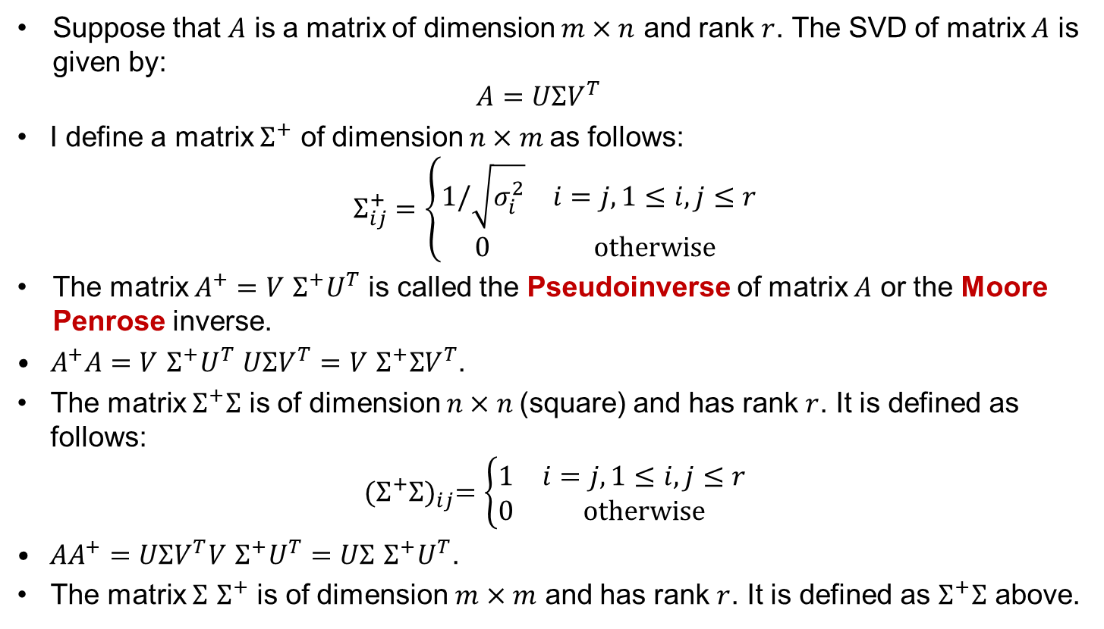
Pseudoinverse
Suppose that $A$ is a matrix of dimension $m×n$ and rank $r$. The SVD of matrix $A$ is given by:
$$A=UΣV^{T}$$
  I define a matrix $Σ^{+}$ of dimension $n×m$as follows:
  $$Σ_{ij}^{+}=\left\{\begin{matrix}1/\sqrt{σ_{i}^{2}} & i=j, 1≤i,j≤r \\ 0 & otherwise\end{matrix}\right.$$
  The matrix $A^{+}=V$ $Σ^{+}U^{T}$ is called the Pseudoinverse of matrix $A$ or the Moore Penrose inverse.
  $A^{+}A=$ $V$ $Σ^{+}U^{T}$ $UΣV^{T}=V$ $Σ^{+}ΣV^{T}$.
  The matrix $Σ^{+}Σ$ is of dimension $n×n$(square) and has rank $r$. It is defined as follows:
  $${(Σ^{+}Σ)}_{ij}=\left\{\begin{matrix}1 & i=j, 1≤i,j≤r \\ 0 & otherwise\end{matrix}\right.$$
  ${AA}^{+}=$ $UΣV^{T}V$ $Σ^{+}U^{T}$ $=UΣ$ $Σ^{+}U^{T}$.
  The matrix $Σ$ $Σ^{+}$ is of dimension $m×m$ and has rank $r$. It is defined as $Σ^{+}Σ$ above.

Slide 30
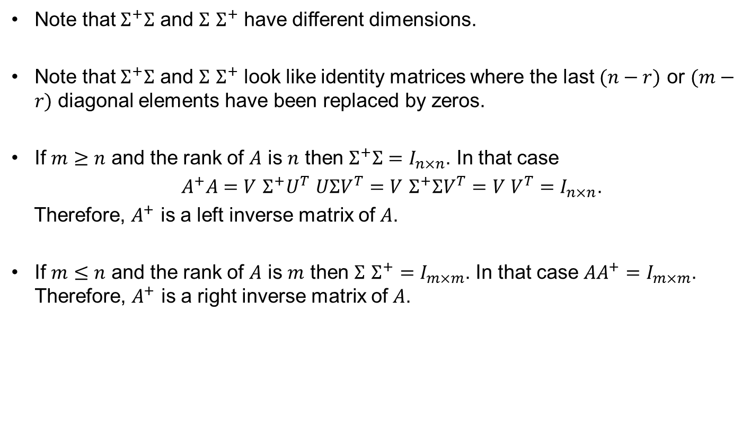
Pseudoinverse
  Note that $Σ^{+}Σ$ and $Σ$ $Σ^{+}$ have different dimensions.
  Note that $Σ^{+}Σ$ and $Σ$ $Σ^{+}$ look like identity matrices where the last $(n−r)$ or $(m−r)$ diagonal elements have been replaced by zeros.
  If $m≥n$ and the rank of $A$ is $n$ then $Σ^{+}Σ=I_{n×n}$. In that case
  $A^{+}A=$ $V$ $Σ^{+}U^{T}$ $UΣV^{T}=V$ $Σ^{+}ΣV^{T}=V V^{T}=I_{n×n}$.
  Therefore, $A^{+}$ is a left inverse matrix of $A$.
  If $m≤n$ and the rank of $A$ is $m$ then $Σ$ $Σ^{+}=I_{m×m}$. In that case ${AA}^{+}=I_{m×m}$. Therefore, $A^{+}$ is a right inverse matrix of $A$.

Slide 31

Pseudoinverse cont.
  As already proved, the relationship $Av_{i}=σ_{i}u_{i}$, which comes directly from $AV=UΣ$, maps a vector from the row space to the column space.
  Similarly, from $A^{+}=V$ $Σ^{+}U^{T}$ we get $A^{+}U=V$ $Σ^{+}$ and therefore, $A^{+}u_{i}$=$\frac{1}{σ_{i}}v_{i}$. Therefore, the multiplication of a vector from the column space with the pseudo inverse $A^{+},$ gives a the vector in the row space.

Slide 32

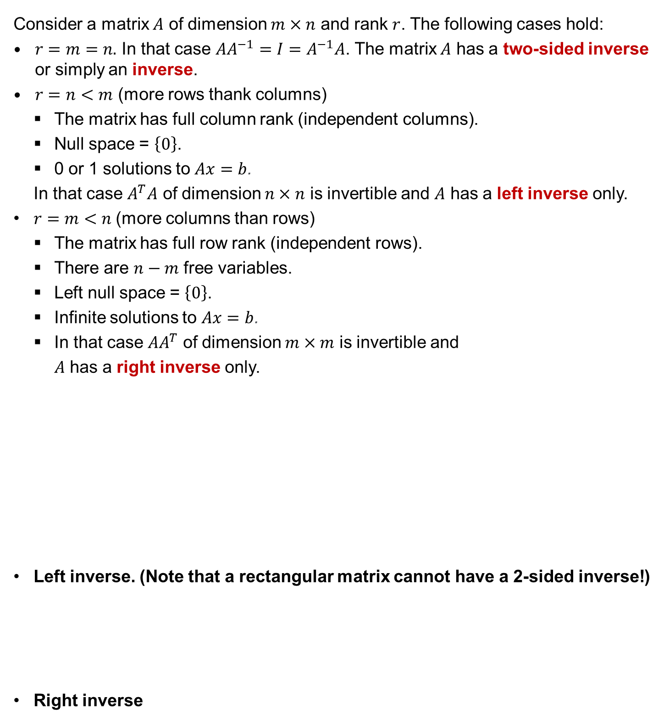







Other types of matrix inverses
  Consider a matrix $A$ of dimension $m×n$ and rank $r$. The following cases hold:
  $r=m=n.$ In that case $AA^{−1}=I=A^{−1}A$. The matrix $A$ has a two-sided inverse or simply an inverse.
  $r=n<m$ (more rows thank columns)
The matrix has full column rank (independent columns).
Null space = $\left\{0\right\}$.
0 or 1 solutions to $Ax=b$.
In that case $A^{T}A$ of dimension $n×n$ is invertible and $A$ has a left inverse only.
  $r=m<n$ (more columns than rows)
The matrix has full row rank (independent rows).
There are $n−m$ free variables.
Left null space = $\left\{0\right\}$.
Infinite solutions to $Ax=b$.
In that case ${AA}^{T}$ of dimension $m×m$ is invertible and
$A$ has a right inverse only.
  Left inverse. (Note that a rectangular matrix cannot have a 2-sided inverse!)
  Right inverse
$${\left(A^{T}A\right)}^{−1}A^{T}A=I_{n×n}$$
$$n×m$$
$$m×n$$
$$A_{left}^{−1} A=I_{n×n}$$
$${{AA}^{T}\left(AA^{T}\right)}^{−1}=I_{m×m}$$
$$m x n$$
$$n x m$$
$${A A}_{right}^{−1}=I_{m×m}$$

