Slide 1
Maths for Signals and Systems
Linear Algebra for Engineering Applications
Lectures 1-2, Tuesday 11th October 2016
DR TANIA STATHAKI
READER (ASSOCIATE PROFFESOR) IN SIGNAL PROCESSING
IMPERIAL COLLEGE LONDON

Slide 2
Miscellanea
Teacher:
  Dr. Tania Stathaki, Reader (Associate Professor) in Signal Processing, Imperial College London
Lectures:
  Tuesdays 10:00 – 12:00, 403a
  Fridays 12:00 – 13:00, 403a
Web Site: http://www.commsp.ee.ic.ac.uk/~tania/
Slides and problem sheets will be available here
E-mail: t.stathaki@imperial.ac.uk
Office: 812

Slide 3
Material
Textbooks
• Introduction to Linear Algebra by Gilbert Strang.
• Linear Algebra: Concepts and Methods by Martin Anthony and Michele Harvey.
• Linear Algebra (Undergraduate Texts in Mathematics) by Serge Lang.
• A Concise Text on Advanced Linear Algebra [Kindle Edition] by Yisong Yang.
Online material
This course follows the material of the lectures of MIT course: http://ocw.mit.edu/courses/mathematics/18-06-linear-algebra-spring-2010
Presentations
By Dr. T. Stathaki.
Problems Sheets
They have been written by Dr. T. Stathaki and are based on the above textbooks.

Slide 4
Mathematics for Signals and Systems
Linear Algebra for Engineering Applications
Linear Algebra is possibly the most important mathematical topic for Electrical Engineering applications. But why is that?
Linear Algebra tackles the problem of solving systems of equations using matrix forms.
Most of the real life engineering problems can be modelled as systems of equations. Their solutions can be obtained from the solutions of these equations.
A competent engineer must have an ample theoretical background on Linear Algebra.

Slide 5
Mathematics for Signals and Systems
In this set of lectures we will tackle the problem of solving small systems of linear equations. More specifically, we will talk about the following topics:
  Row formulation
  Column formulation
  Matrix formulation
  The inverse of a matrix
  Gaussian Elimination (or Row Reduction)
  LU Decomposition
  Row exchanges and Permutation Matrices
  Row Reduction for calculation of the inverse of a matrix

Slide 6
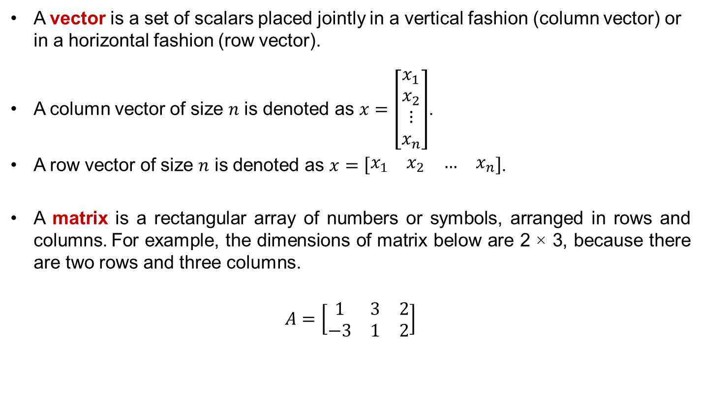
Some background: Vectors and Matrices
A vector is a set of scalars placed jointly in a vertical fashion (column vector) or in a horizontal fashion (row vector).
A column vector of size $n$ is denoted as $x=\left[\begin{matrix}x_{1} \\ x_{2} \\ \begin{matrix}⋮ \\ x_{n}\end{matrix}\end{matrix}\right]$.
A row vector of size $n$ is denoted as $x=\left[\begin{matrix}\begin{matrix}x_{1} & x_{2}\end{matrix} & \begin{matrix}… & x_{n}\end{matrix}\end{matrix}\right]$.
A matrix is a rectangular array of numbers or symbols, arranged in rows and columns. For example, the dimensions of matrix below are 2 × 3, because there are two rows and three columns.
$$A=\left[\begin{matrix}\begin{matrix}1 \\ −3\end{matrix} & \begin{matrix}3 \\ 1\end{matrix} & \begin{matrix}2 \\ 2\end{matrix}\end{matrix}\right]$$

Slide 7
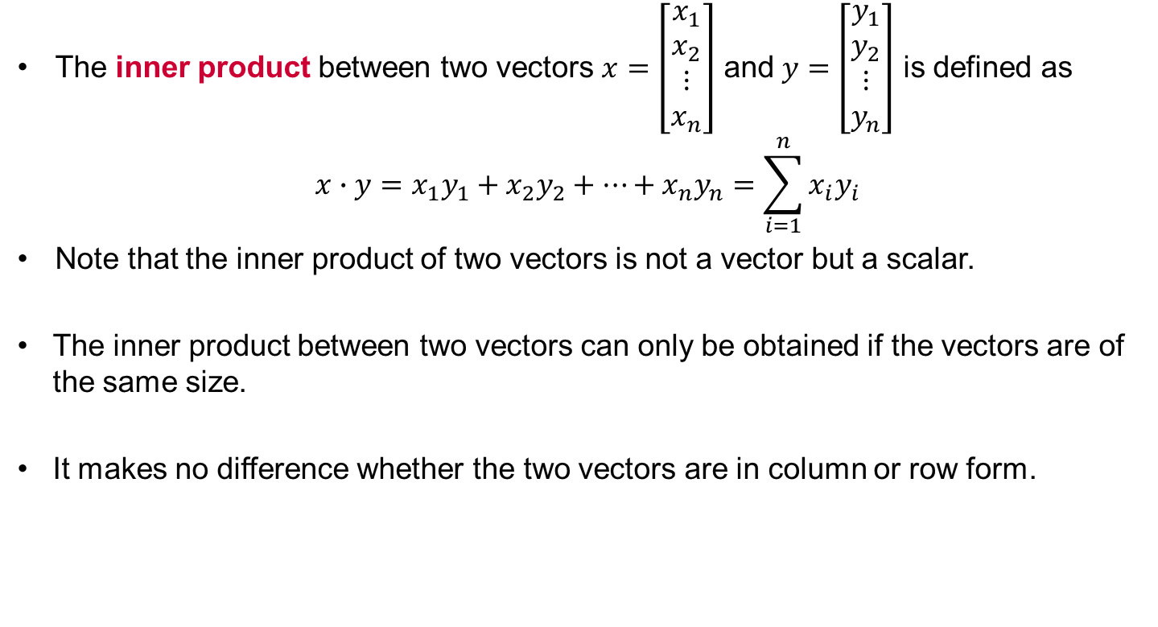
Some background: Vectors and Inner Products
The inner product between two vectors $x=\left[\begin{matrix}x_{1} \\ x_{2} \\ \begin{matrix}⋮ \\ x_{n}\end{matrix}\end{matrix}\right]$ and $y=\left[\begin{matrix}y_{1} \\ y_{2} \\ \begin{matrix}⋮ \\ y_{n}\end{matrix}\end{matrix}\right]$ is defined as
$$x∙y=x_{1}y_{1}+x_{2}y_{2}+…+x_{n}y_{n}=\sum_{i=1}^{n}{x_{i}y_{i}}$$
Note that the inner product of two vectors is not a vector but a scalar.
  The inner product between two vectors can only be obtained if the vectors are of the same size.
  It makes no difference whether the two vectors are in column or row form.

Slide 8
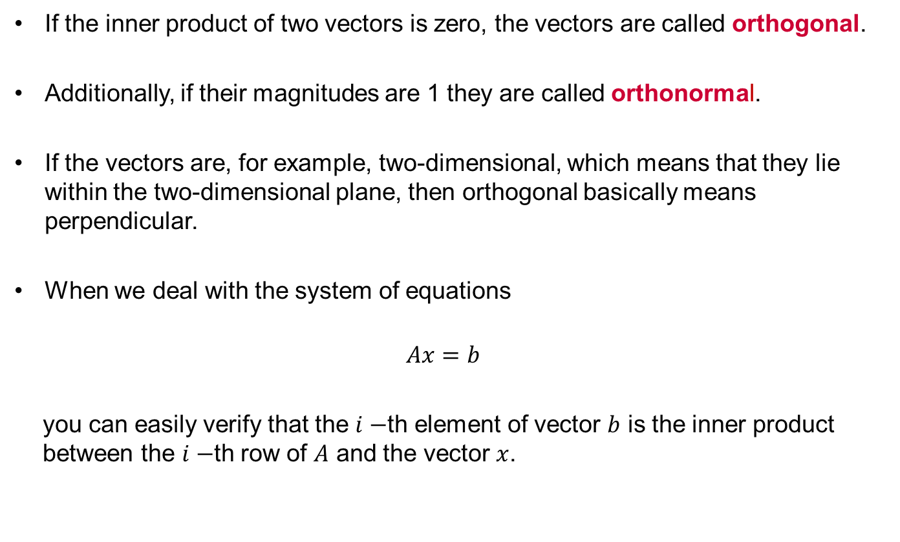
Some background: Inner Products and Orthogonality
If the inner product of two vectors is zero, the vectors are called orthogonal.
Additionally, if their magnitudes are 1 they are called orthonormal.
If the vectors are, for example, two-dimensional, which means that they lie within the two-dimensional plane, then orthogonal basically means perpendicular.
When we deal with the system of equations
$$Ax=b$$
you can easily verify that the $i−$th element of vector $b$ is the inner product between the $i−$th row of $A$ and the vector $x$.

Slide 9






Systems of linear equations
Consider a system of 2 equations with 2 unknowns
If we place the unknowns in a column vector, we can obtain the so called matrix form of the above system as follows.
Coefficient
Matrix
Vector of
unknowns

Slide 10






Systems of linear equations: Row formulation
Consider the previous system of two equations.
  Each equation represents a straight line in the 2D plane.
  The solution of the system is a point of the 2D plane that lies on both straight lines; therefore, it is their intersection.
  In that case, where the system is depicted as a set of equations placed one after another, we have the so called Row Formulation of the system.

Slide 11









Systems of linear equations: Column formulation
Have a look at the representation below:
  The weights of each unknown are placed jointly in a column vector. The above formulation occurs.
  The solution to the system of equations is that linear combination of the two column vectors that yields the vector on the right hand side.
  The above type of depiction is called Column Formulation.

Slide 12








Systems of linear equations: Column Formulation cont.
  The solution to the system of equations is the linear combination of the two vectors above that yields the vector on the right hand side.
  You can see in the figure a geometrical representation of the solution.

Slide 13
Systems of linear equations: Column Formulation cont.
  What does the collection of ALL combinations of columns represents geometrically?
  All possible linear combinations of the columns form (span) the entire 2D plane!

Slide 14
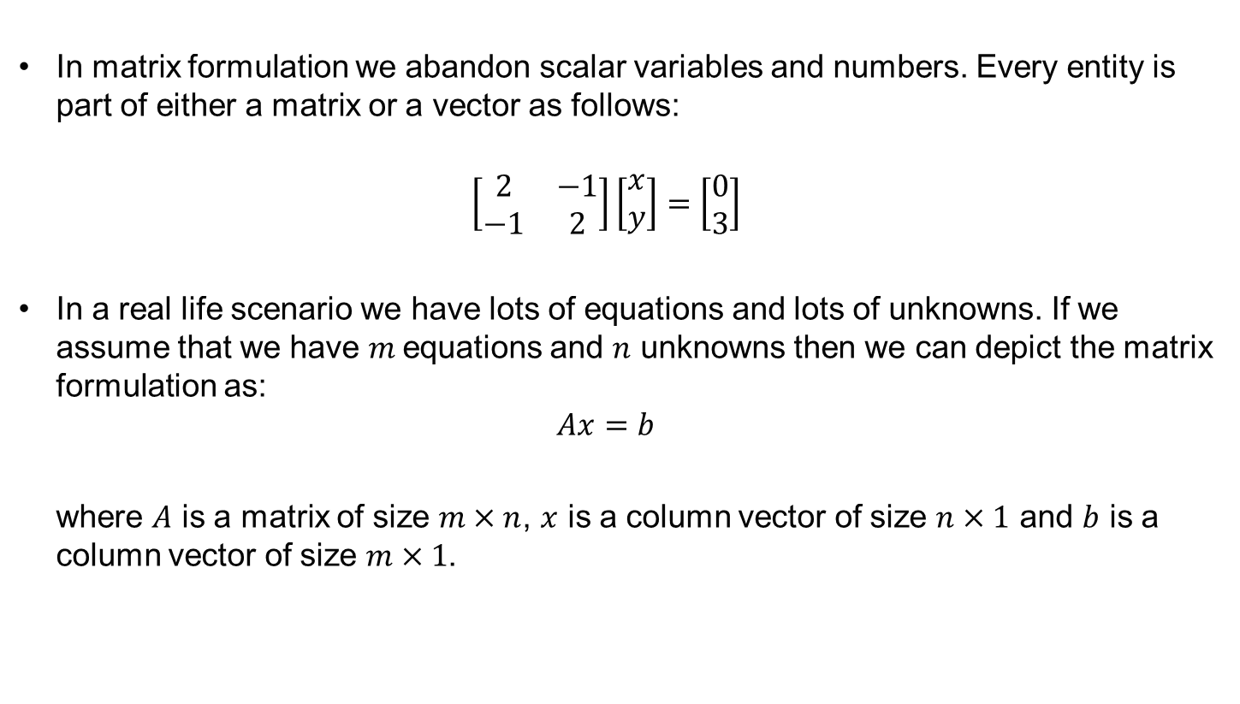
Systems of linear equations: Matrix Formulation
  In matrix formulation we abandon scalar variables and numbers. Every entity is part of either a matrix or a vector as follows:
  $$\left[\begin{matrix}2 & −1 \\ −1 & 2\end{matrix}\right]\left[\begin{matrix}x \\ y\end{matrix}\right]=\left[\begin{matrix}0 \\ 3\end{matrix}\right]$$
  In a real life scenario we have lots of equations and lots of unknowns. If we assume that we have $m$equations and $n$ unknowns then we can depict the matrix formulation as:
  $$Ax=b$$
  where $A$ is a matrix of size $m×n$, $x$ is a column vector of size $n×1$ and $b$ is a column vector of size $m×1$.

Slide 15


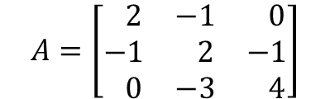
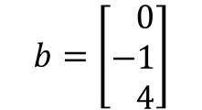





Systems of linear equations: Let’s consider a higher order 3x3
Let us consider the row formulation of a system of 3 equations with 3 unknowns:
In the row formulation:
Each row represents a plane on the 3D space.
The solutions to the system of equations is
the point where the 3 planes meet.
As you can see the row formulation becomes
harder to visualize for multi dimensional
spaces!
Matrix Form: $Ax=b$

Slide 16
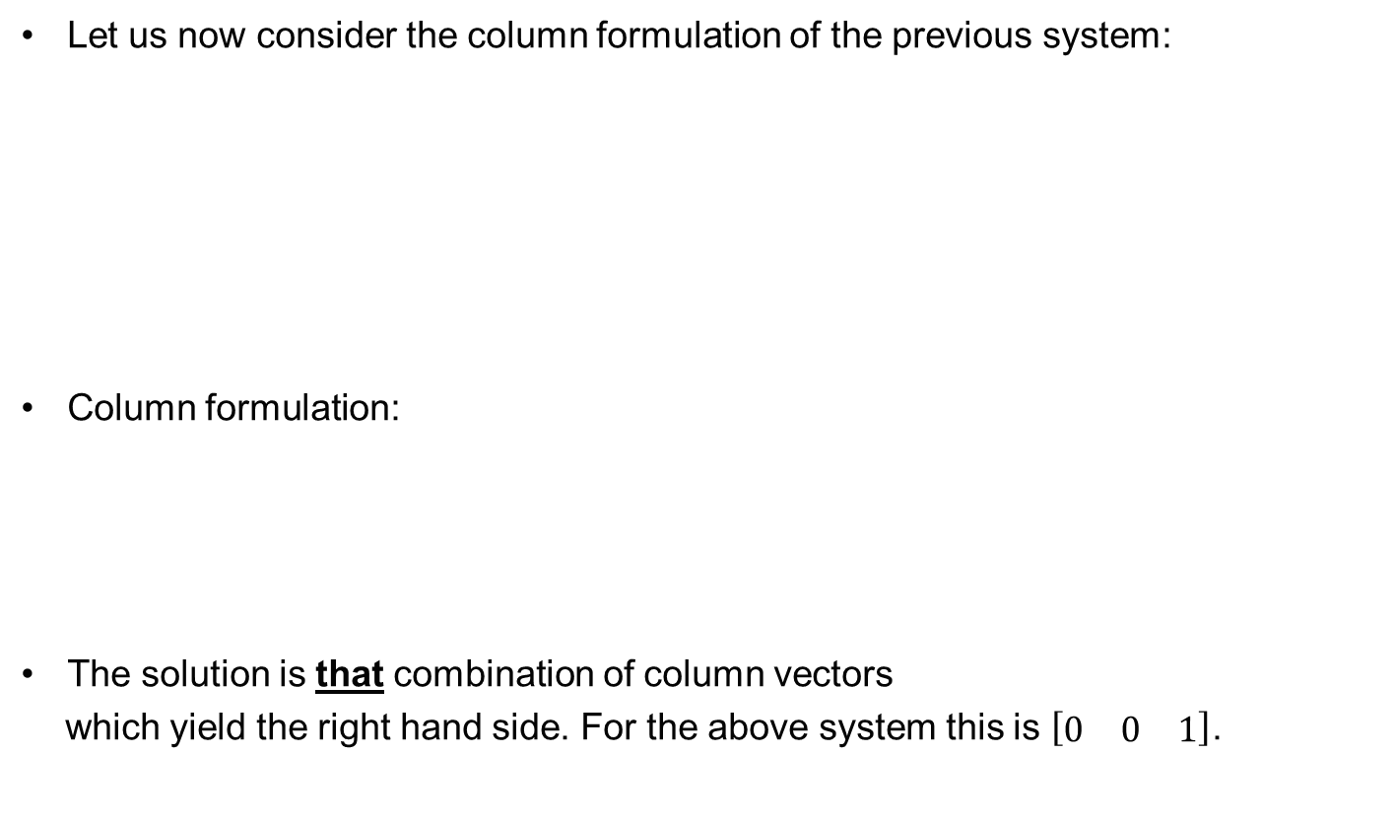

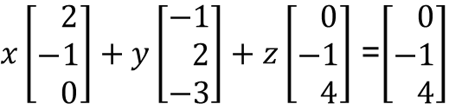



Systems of linear equations 3x3 cont.
Let us now consider the column formulation of the previous system:
Column formulation:
The solution is that combination of column vectors
which yield the right hand side. For the above system this is $\left[\begin{matrix}0 & 0 & 1\end{matrix}\right]$.
Matrix Form: $Ax=b$

Slide 17

Systems of linear equations: Is there always a solution?
The solutions of a system of three
equations with three unknowns lies
inside the 3D plane.
Can you imagine a scenario for which
there is no unique solution to the system?
What if all three vectors lie on the same plane?
Then there would not be a solution for every b.
We will se later that in that case the matrix A
would not be what is called invertible,
since at least one of its column
would be a linear combination of the other two.
Matrix Form:

Slide 18
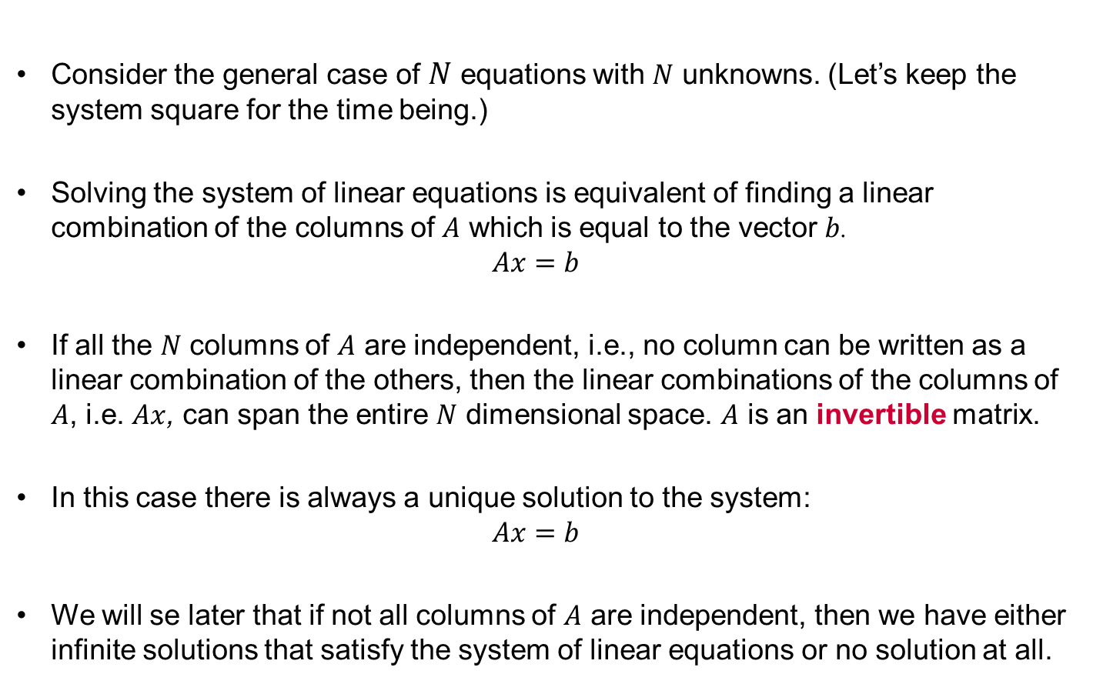
Systems of linear equations
Consider the general case of $N$ equations with $N$ unknowns. (Let’s keep the system square for the time being.)
Solving the system of linear equations is equivalent of finding a linear combination of the columns of $A$ which is equal to the vector $b$.
$$Ax=b$$
If all the $N$ columns of $A$ are independent, i.e., no column can be written as a linear combination of the others, then the linear combinations of the columns of $A$, i.e. $Ax$, can span the entire $N$ dimensional space. $A$ is an invertible matrix.
In this case there is always a unique solution to the system:
$$Ax=b$$
We will se later that if not all columns of $A$ are independent, then we have either infinite solutions that satisfy the system of linear equations or no solution at all.

Slide 19
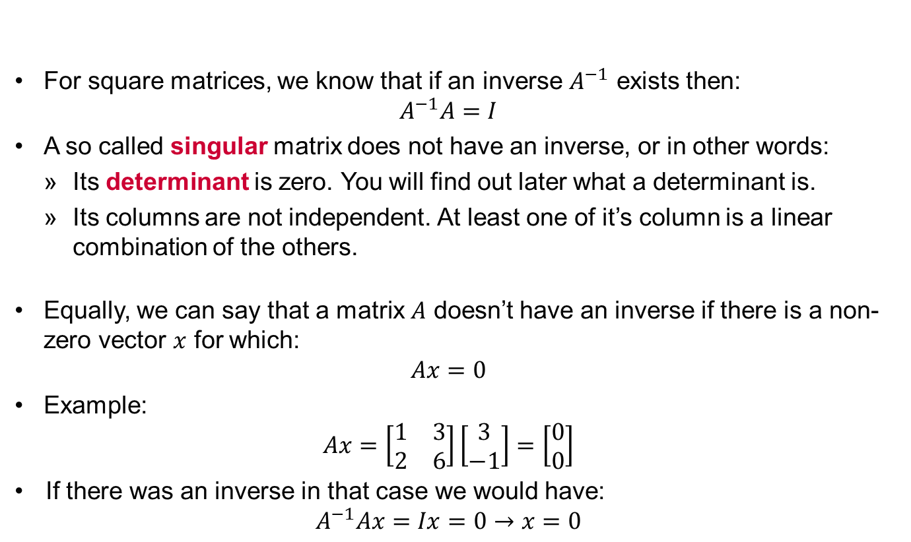
Inverse of a square matrix
  For square matrices, we know that if an inverse $A^{−1}$ exists then:
  $$A^{−1}A=I$$
  A so called singular matrix does not have an inverse, or in other words:
    Its determinant is zero. You will find out later what a determinant is.
    Its columns are not independent. At least one of it’s column is a linear combination of the others.
  Equally, we can say that a matrix $A$ doesn’t have an inverse if there is a non-zero vector $x$ for which:
  $$Ax=0$$
  Example:
$$Ax=\left[\begin{matrix}1 & 3 \\ 2 & 6\end{matrix}\right]\left[\begin{matrix}3 \\ −1\end{matrix}\right]=\left[\begin{matrix}0 \\ 0\end{matrix}\right]$$
If there was an inverse in that case we would have:
$$A^{−1}Ax=Ix=0→x=0$$

Slide 20
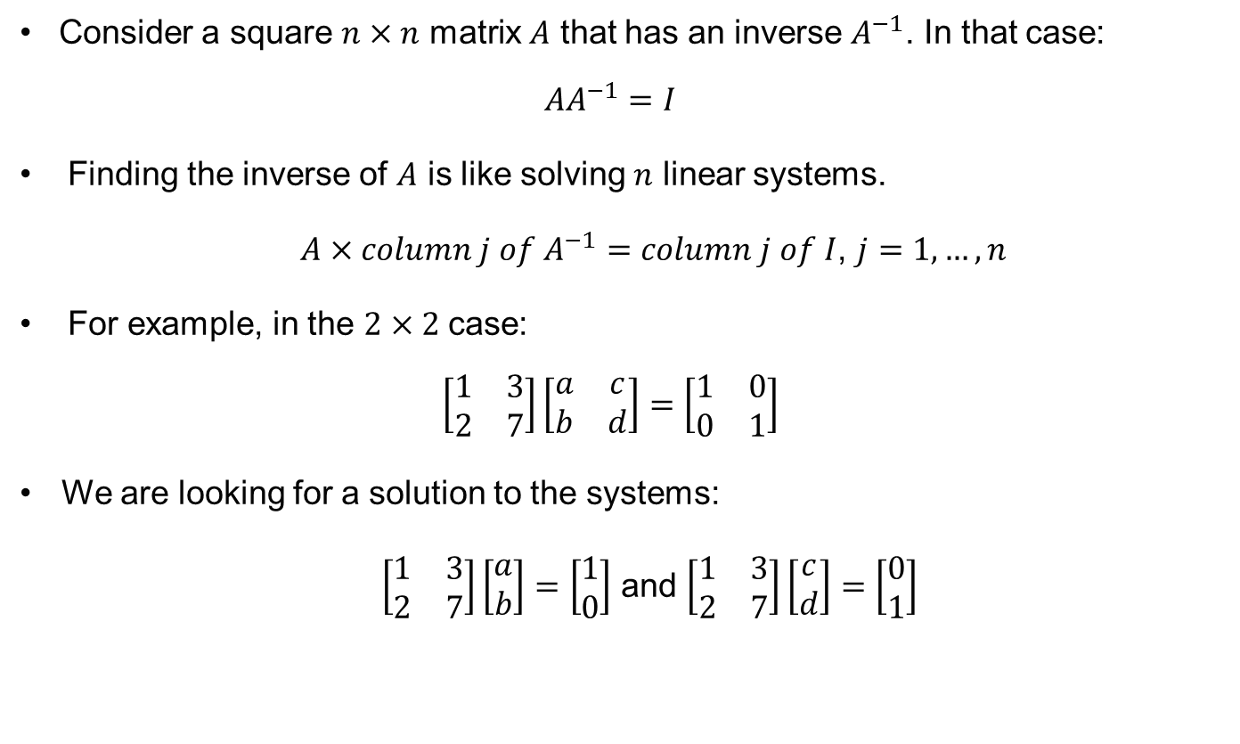
Inverse of a square matrix cont.
Consider a square $n×n$ matrix $A$ that has an inverse $A^{−1}$. In that case:
$${AA}^{−1}=I$$
Finding the inverse of $A$ is like solving $n$ linear systems.
$A×column j of A^{−1}=column j of I$, $j=1,…,n$
For example, in the $2×2$ case:
$$\left[\begin{matrix}1 & 3 \\ 2 & 7\end{matrix}\right]\left[\begin{matrix}a & c \\ b & d\end{matrix}\right]=\left[\begin{matrix}1 & 0 \\ 0 & 1\end{matrix}\right]$$
We are looking for a solution to the systems:
$\left[\begin{matrix}1 & 3 \\ 2 & 7\end{matrix}\right]\left[\begin{matrix}a \\ b\end{matrix}\right]=\left[\begin{matrix}1 \\ 0\end{matrix}\right]$ and $\left[\begin{matrix}1 & 3 \\ 2 & 7\end{matrix}\right]\left[\begin{matrix}c \\ d\end{matrix}\right]=\left[\begin{matrix}0 \\ 1\end{matrix}\right]$

Slide 21






Inverse of a square matrix. Properties.
For square matrices, we know that if an inverse exists then:
The inverse of the product $AB$ is:
Thus,
For square invertible matrices, the inverse of a transpose is the transpose of the inverse.

Slide 22









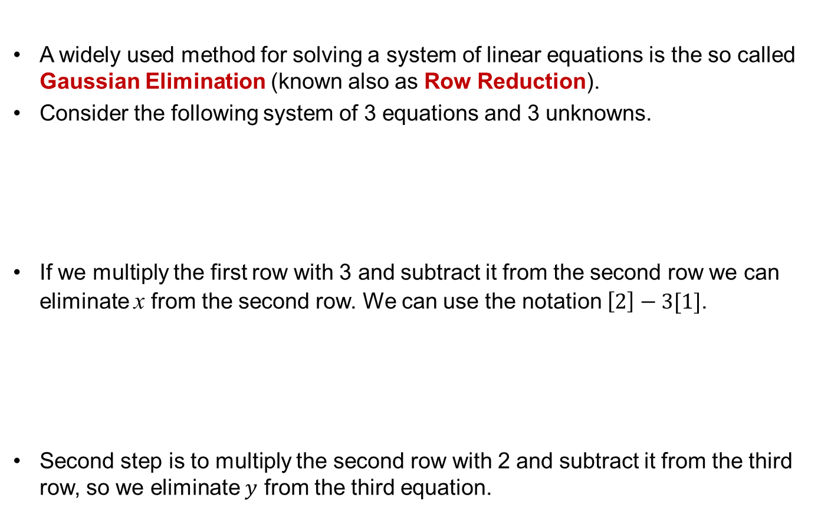
Solving a system of linear equations using
Gaussian Elimination (GE)
A widely used method for solving a system of linear equations is the so called Gaussian Elimination (known also as Row Reduction).
Consider the following system of 3 equations and 3 unknowns.
If we multiply the first row with 3 and subtract it from the second row we can eliminate x from the second row. We can use the notation $\left[2\right]−3[1]$.
Second step is to multiply the second row with 2 and subtract it from the third row, so we eliminate $y$ from the third equation.
[2]-3[1]
[3]-2[2]

Slide 23











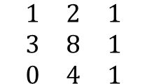
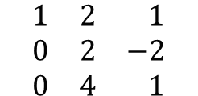
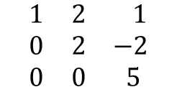



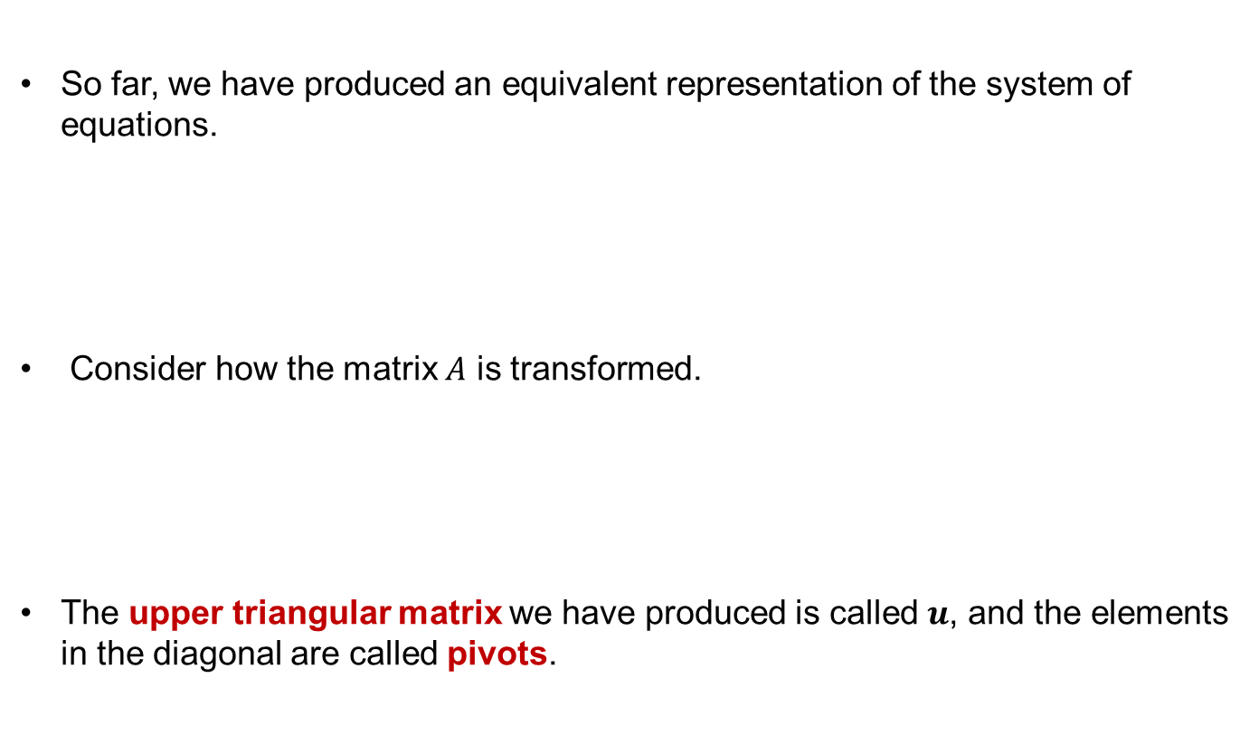

Solving a system of linear equations using GE cont.
So far, we have produced an equivalent representation of the system of equations.
Consider how the matrix $A$ is transformed.
The upper triangular matrix we have produced is called $u$, and the elements in the diagonal are called pivots.
Matrix $A$
Matrix $u$
pivots

Slide 24
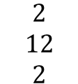

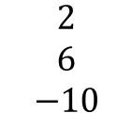


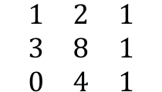
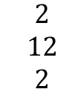
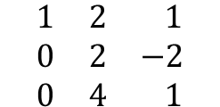

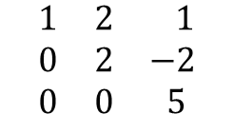
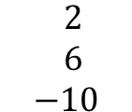




Solving a system of linear equations using GE cont.
So far, we have produced an equivalent representation of the system of equations.
Similarly, the column $b$ becomes:
It is often convenient to operate on the augmented matrix $\left[A\left|b\right.\right]$. .
Matrix $b$
Augmented matrix

Slide 25









Elimination and Back-substitution
The solution to the system of linear equations after Gaussian Elimination, can be found by simply applying back-substitution.
We can solve the equations in reverse order because the system after elimination is triangular.

Slide 26
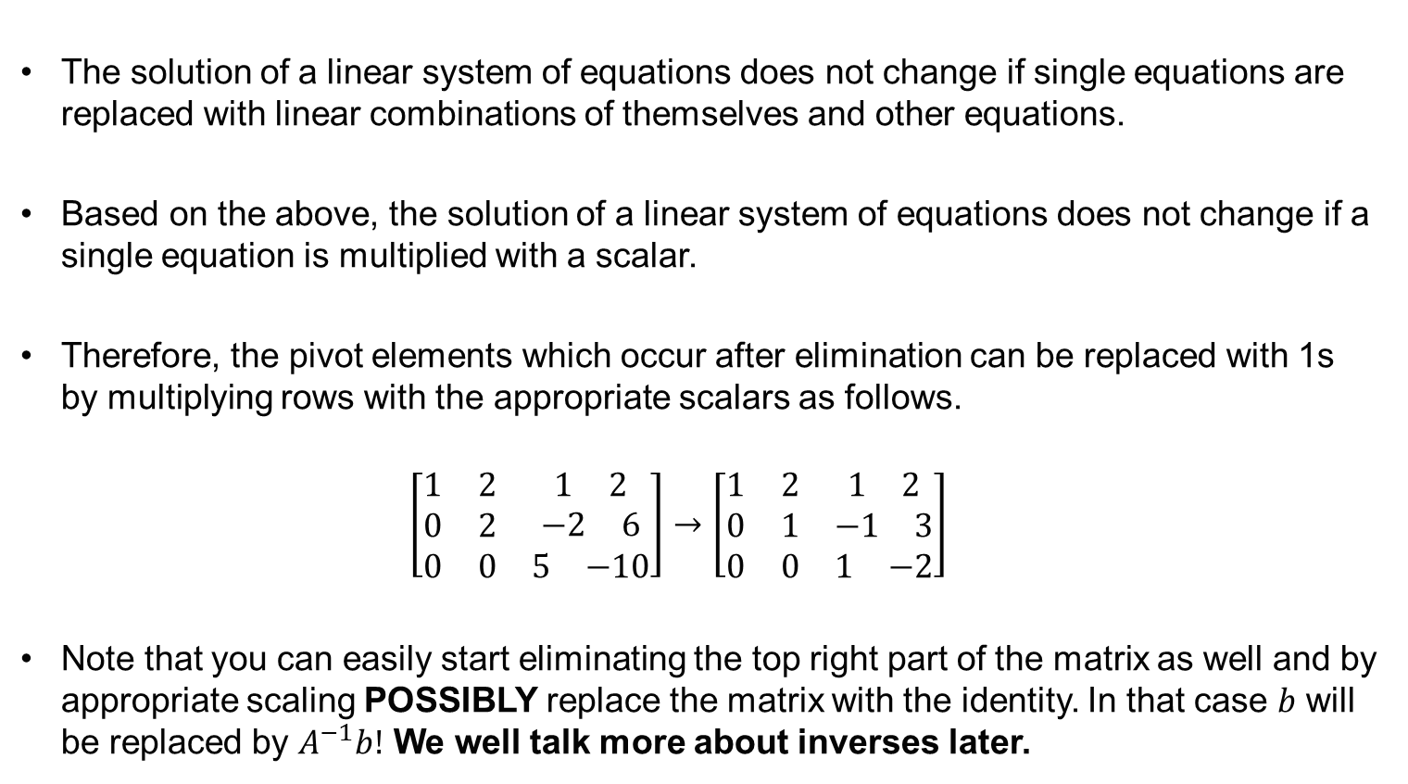
Elimination and Back-substitution
The solution of a linear system of equations does not change if single equations are replaced with linear combinations of themselves and other equations.
Based on the above, the solution of a linear system of equations does not change if a single equation is multiplied with a scalar.
Therefore, the pivot elements which occur after elimination can be replaced with 1s by multiplying rows with the appropriate scalars as follows.
$$\left[\begin{matrix}\begin{matrix}\begin{matrix}1 & 2\end{matrix} \\ \begin{matrix}0 & 2\end{matrix} \\ \begin{matrix}0 & 0\end{matrix}\end{matrix} & \begin{matrix}\begin{matrix}1 & 2\end{matrix} \\ \begin{matrix}−2 & 6\end{matrix} \\ \begin{matrix}5 & −10\end{matrix}\end{matrix}\end{matrix}\right]→\left[\begin{matrix}\begin{matrix}\begin{matrix}1 & 2\end{matrix} \\ \begin{matrix}0 & 1\end{matrix} \\ \begin{matrix}0 & 0\end{matrix}\end{matrix} & \begin{matrix}\begin{matrix}1 & 2\end{matrix} \\ \begin{matrix}−1 & 3\end{matrix} \\ \begin{matrix}1 & −2\end{matrix}\end{matrix}\end{matrix}\right]$$
Note that you can easily start eliminating the top right part of the matrix as well and by appropriate scaling POSSIBLY replace the matrix with the identity. In that case $b$ will be replaced by $A^{−1}b!$ We well talk more about inverses later.

Slide 27











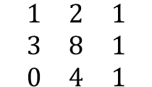
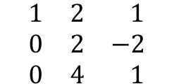
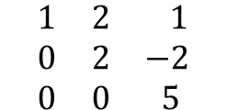


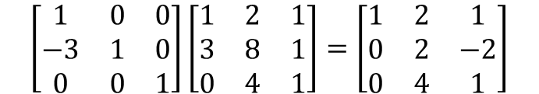


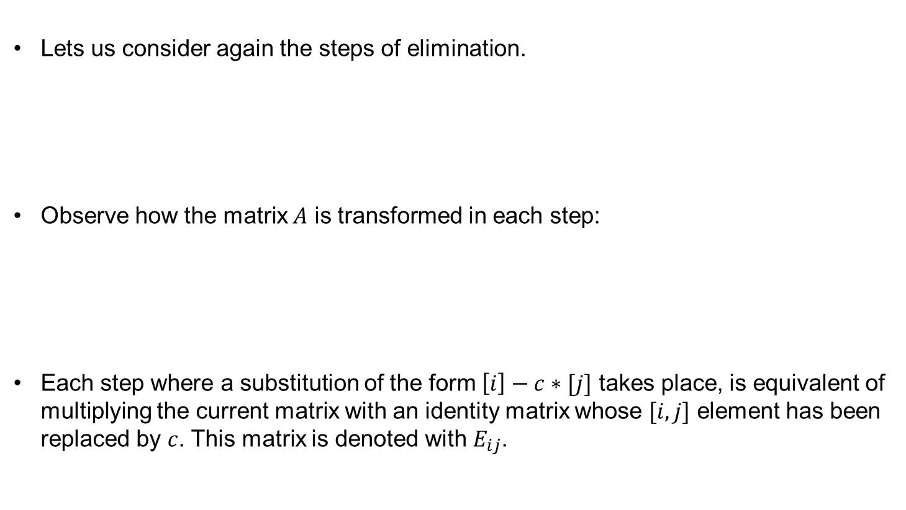

Elimination viewed as matrix multiplication
Lets us consider again the steps of elimination.
Observe how the matrix $A$ is transformed in each step:
Each step where a substitution of the form $\left[i\right]−c∗[j]$ takes place, is equivalent of multiplying the current matrix with an identity matrix whose $[i,j]$ element has been replaced by $c$. This matrix is denoted with $E_{ij}$.
Matrix $A$

Slide 28
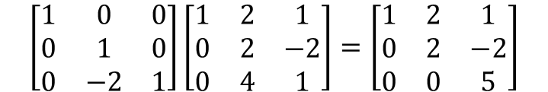


Elimination viewed as matrix multiplication cont.
Lets know consider again the steps of elimination.
Observe how the matrix $A$ is transformed in each step:
The second step of elimination can be viewed as the following matrix multiplication:
Matrix $A$

Slide 29
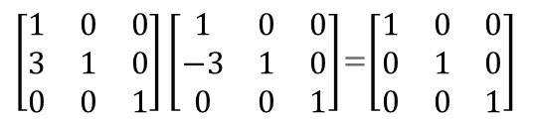


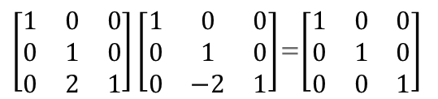


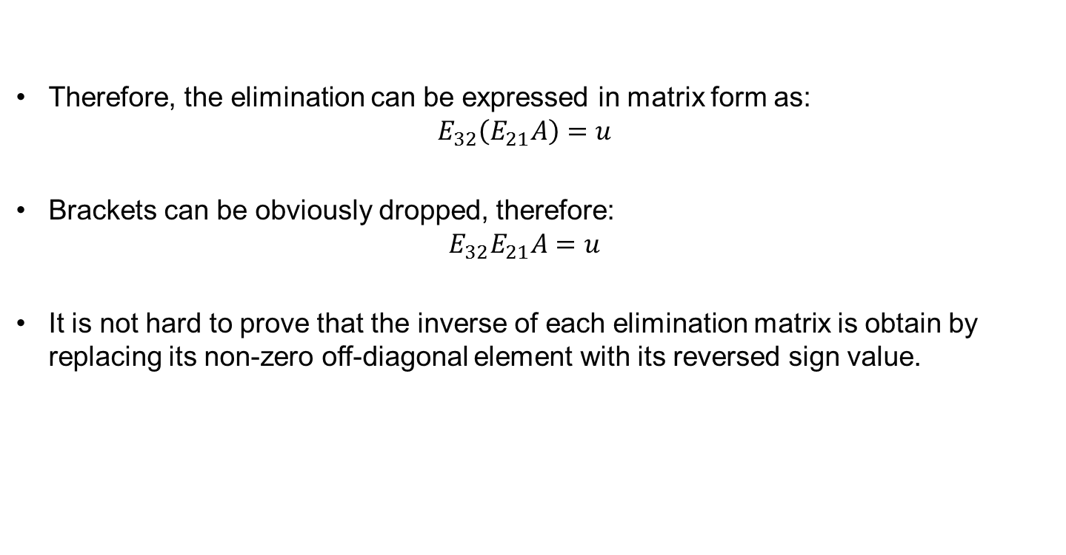
Elimination viewed as matrix multiplication cont.
Therefore, the elimination can be expressed in matrix form as:
$$E_{32}\left(E_{21}A\right)=u$$
Brackets can be obviously dropped, therefore:
$$E_{32}E_{21}A=u$$
It is not hard to prove that the inverse of each elimination matrix is obtain by replacing its non-zero off-diagonal element with its reversed sign value.

Slide 30

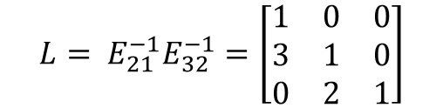
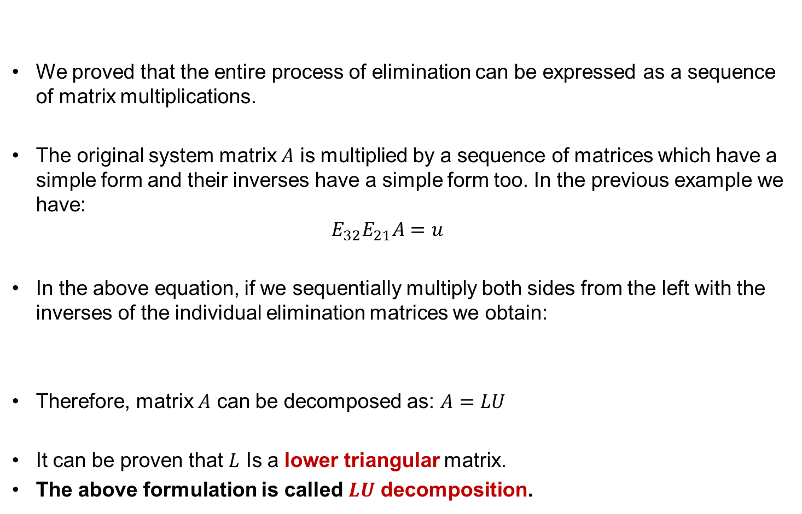
LU Decomposition
We proved that the entire process of elimination can be expressed as a sequence of matrix multiplications.
The original system matrix $A$ is multiplied by a sequence of matrices which have a simple form and their inverses have a simple form too. In the previous example we have:
$$E_{32}E_{21}A=u$$
In the above equation, if we sequentially multiply both sides from the left with the inverses of the individual elimination matrices we obtain:
Therefore, matrix $A$ can be decomposed as: $A=LU$
It can be proven that $L$ Is a lower triangular matrix.
The above formulation is called $LU$ decomposition.

Slide 31
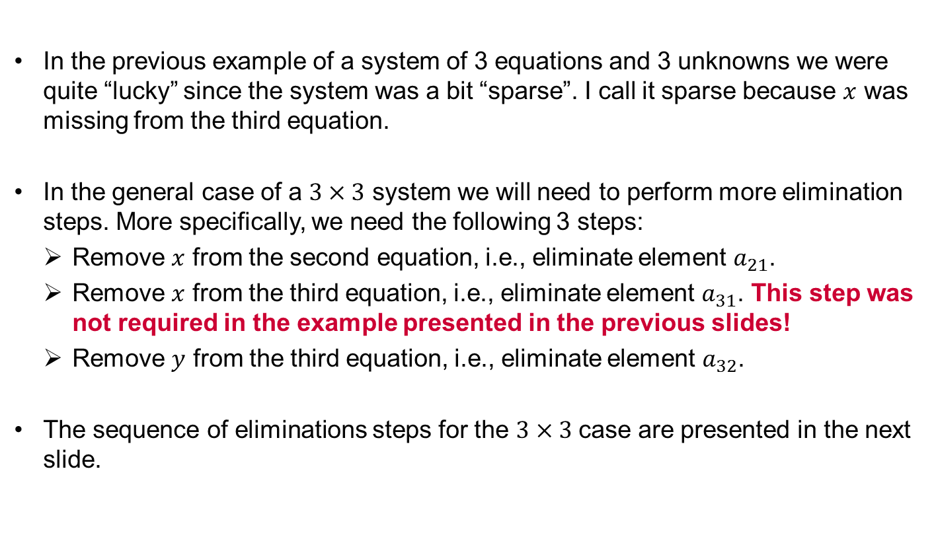
LU Decomposition in the general case
In the previous example of a system of 3 equations and 3 unknowns we were quite “lucky” since the system was a bit “sparse”. I call it sparse because $x$ was missing from the third equation.
In the general case of a $3×3$ system we will need to perform more elimination steps. More specifically, we need the following 3 steps:
Remove $x$ from the second equation, i.e., eliminate element $a_{21}$.
Remove $x$ from the third equation, i.e., eliminate element $a_{31}$. This step was not required in the example presented in the previous slides!
Remove $y$ from the third equation, i.e., eliminate element $a_{32}$.
The sequence of eliminations steps for the $3×3$ case are presented in the next slide.

Slide 32




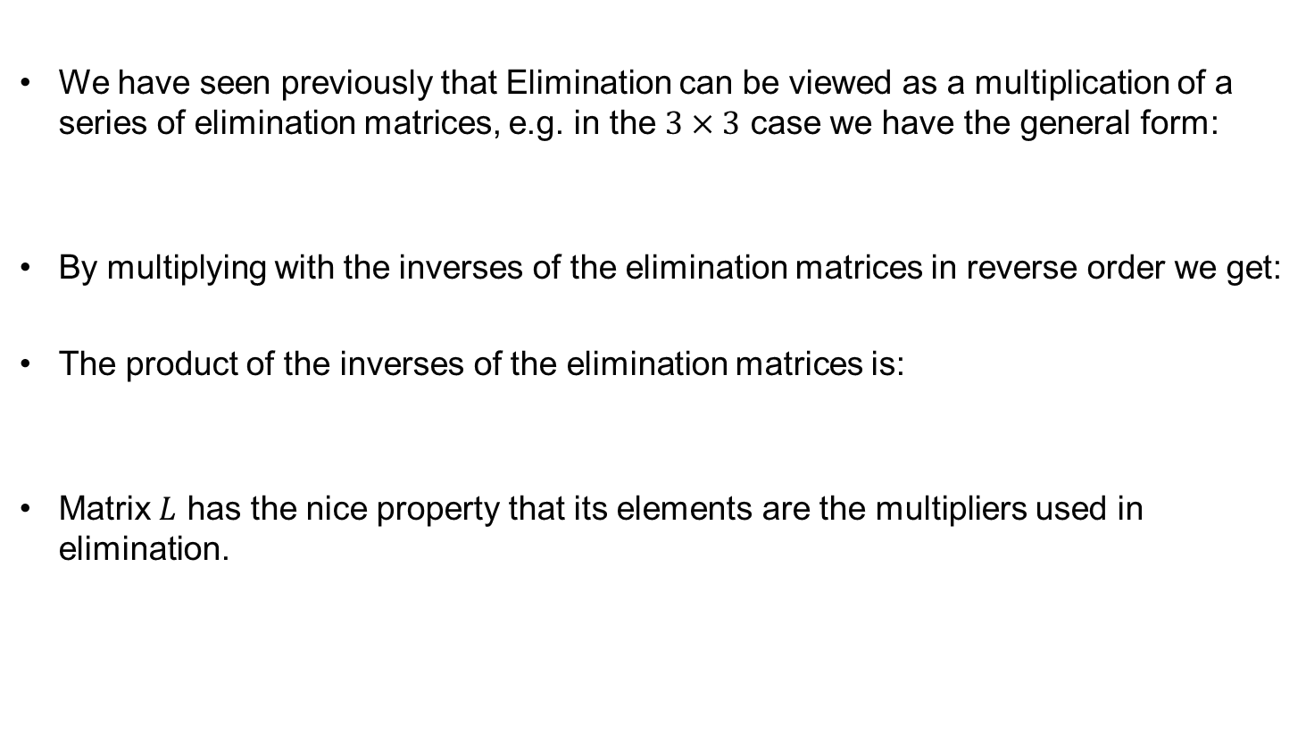
LU Decomposition in the general case
We have seen previously that Elimination can be viewed as a multiplication of a series of elimination matrices, e.g. in the $3×3$ case we have the general form:
By multiplying with the inverses of the elimination matrices in reverse order we get:
The product of the inverses of the elimination matrices is:
Matrix $L$ has the nice property that its elements are the multipliers used in elimination.

Slide 33

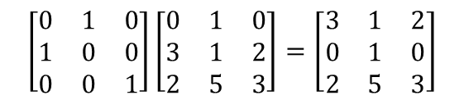
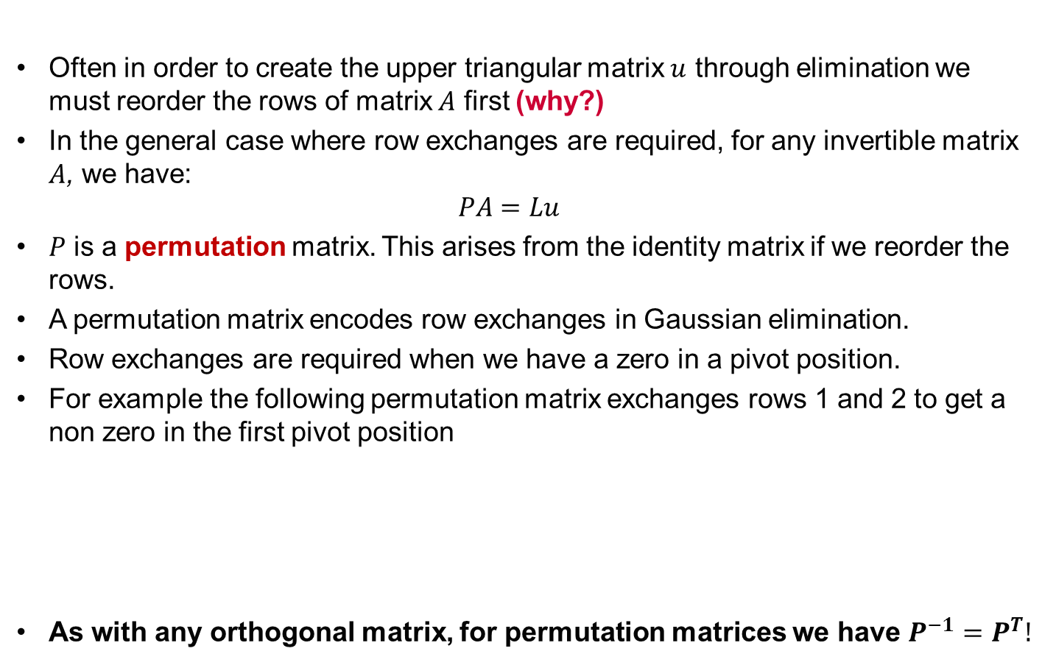
LU Decomposition with row exchanges. Permutation.
Often in order to create the upper triangular matrix $u$ through elimination we must reorder the rows of matrix $A$ first (why?)
In the general case where row exchanges are required, for any invertible matrix $A$, we have:
$$PA=Lu$$
$P$ is a permutation matrix. This arises from the identity matrix if we reorder the rows.
A permutation matrix encodes row exchanges in Gaussian elimination.
Row exchanges are required when we have a zero in a pivot position.
For example the following permutation matrix exchanges rows 1 and 2 to get a non zero in the first pivot position
As with any orthogonal matrix, for permutation matrices we have $P^{−1}=P^{T}!$

Slide 34
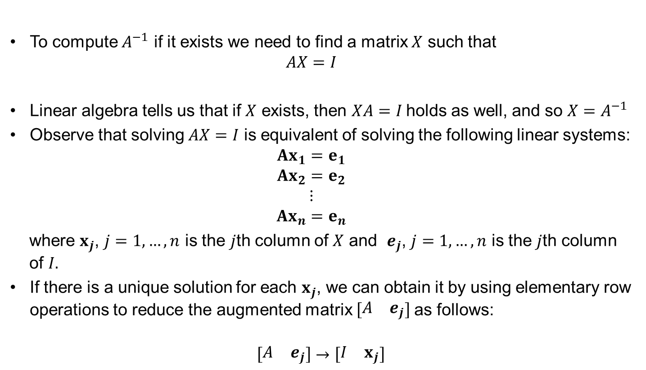
Calculation of the inverse of a matrix using row reduction
To compute $A^{−1}$ if it exists we need to find a matrix $X$ such that
$$AX=I$$
Linear algebra tells us that if $X$ exists, then $XA=I$ holds as well, and so $X=A^{−1}$
Observe that solving $AX=I$ is equivalent of solving the following linear systems:
$$Ax_{1}=e_{1}$$
$$Ax_{2}=e_{2}$$
$$⋮$$
$$Ax_{n}=e_{n}$$
where $x_{j}$, $j=1,…,n$ is the $j$th column of $X$ and $e_{j}$, $j=1,…,n$ is the $j$th column of $I.$
If there is a unique solution for each $x_{j}$, we can obtain it by using elementary row operations to reduce the augmented matrix $\left[\begin{matrix}A & e_{j}\end{matrix}\right]$as follows:
$$\left[\begin{matrix}A & e_{j}\end{matrix}\right]→\left[\begin{matrix}I & x_{j}\end{matrix}\right]$$

Slide 35
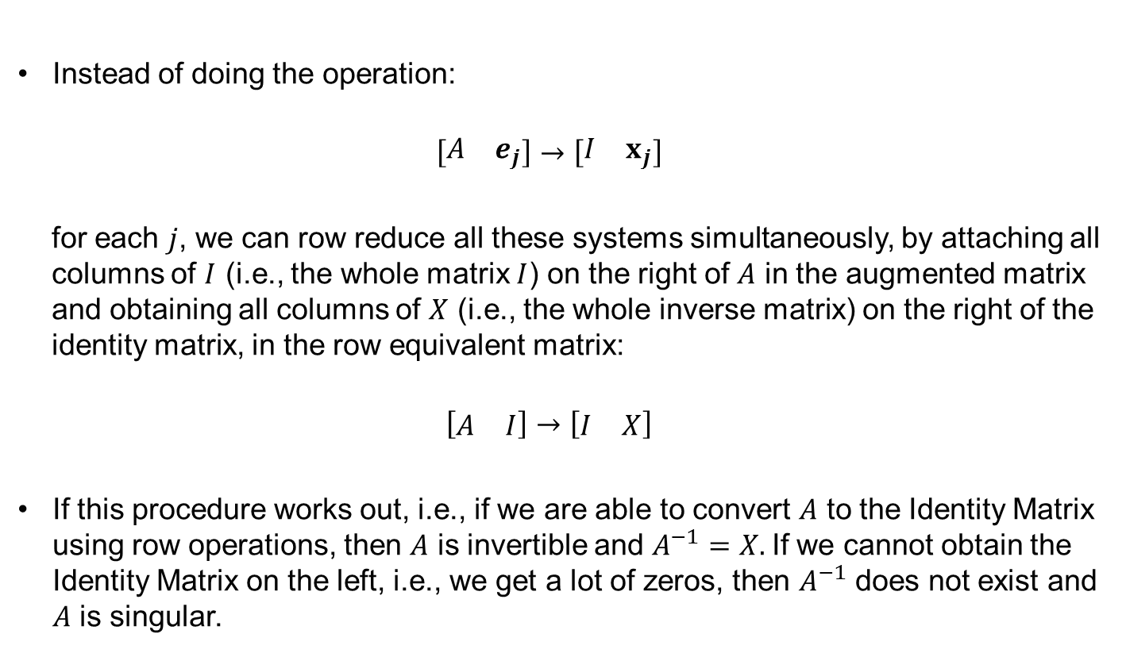
Calculation of the inverse of a matrix using row reduction
Instead of doing the operation:
$$\left[\begin{matrix}A & e_{j}\end{matrix}\right]→\left[\begin{matrix}I & x_{j}\end{matrix}\right]$$
for each $j$, we can row reduce all these systems simultaneously, by attaching all columns of $I$ (i.e., the whole matrix $I$) on the right of $A$ in the augmented matrix and obtaining all columns of $X$ (i.e., the whole inverse matrix) on the right of the identity matrix, in the row equivalent matrix:
$$\left[\begin{matrix}A & I\end{matrix}\right]→\left[\begin{matrix}I & X\end{matrix}\right]$$
If this procedure works out, i.e., if we are able to convert $A$ to the Identity Matrix using row operations, then $A$ is invertible and $A^{−1}=X.$If we cannot obtain the Identity Matrix on the left, i.e., we get a lot of zeros, then $A^{−1}$ does not exist and $A$ is singular.

Slide 36

Calculation of the inverse of a matrix using row reduction. Examples.
Find the inverse of
$$A=\left[\begin{matrix}1 & 2 & 3 \\ 2 & 4 & 5 \\ 3 & 5 & 6\end{matrix}\right]$$
or show that it does not exist.
Find the inverse of
$$B=\left[\begin{matrix}1 & 2 & −1 \\ −2 & 1 & 8 \\ 1 & −2 & −7\end{matrix}\right]$$
or show that it does not exist.

Slide 37
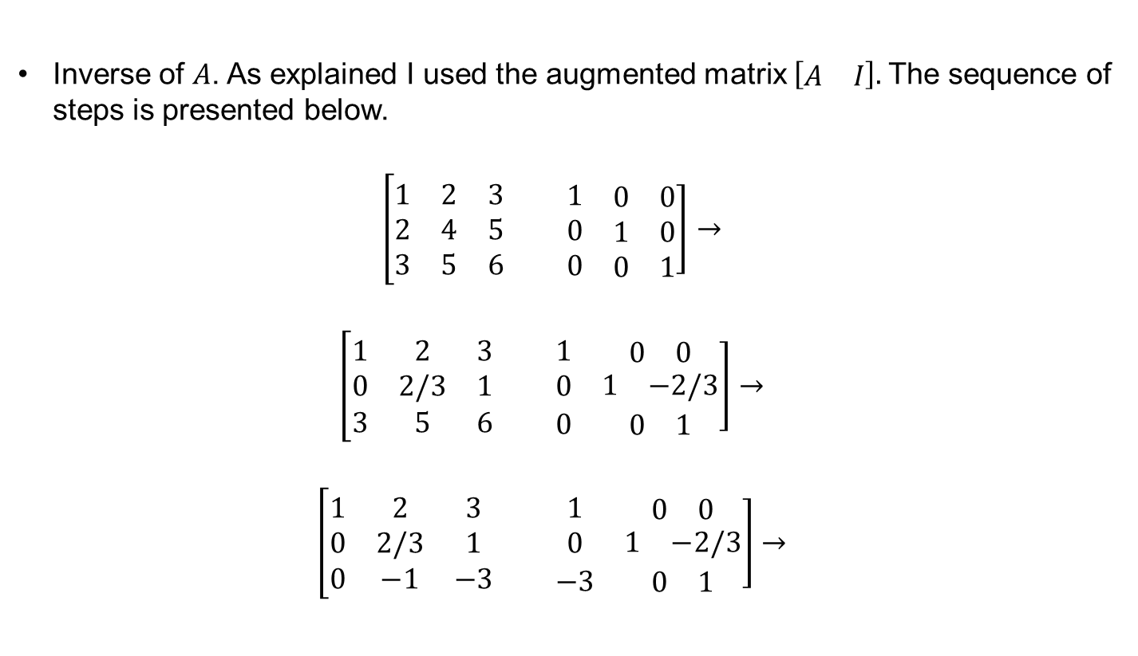
Calculation of the inverse of a matrix using row reduction. Solution.
Inverse of $A$. As explained I used the augmented matrix $\left[\begin{matrix}A & I\end{matrix}\right].$The sequence of steps is presented below.
$$\left[\begin{matrix}1 & 2 & 3 \\ 2 & 4 & 5 \\ 3 & 5 & 6\end{matrix}\right.\left.\begin{matrix} & 1 & \begin{matrix}0 & 0\end{matrix} \\ & 0 & \begin{matrix}1 & 0\end{matrix} \\ & 0 & \begin{matrix}0 & 1\end{matrix}\end{matrix}\right]→$$
$$\left[\begin{matrix}1 & 2 & 3 \\ 0 & 2/3 & 1 \\ 3 & 5 & 6\end{matrix}\right.\left.\begin{matrix} & 1 & \begin{matrix}0 & 0\end{matrix} \\ & 0 & \begin{matrix}1 & −2/3\end{matrix} \\ & 0 & \begin{matrix}0 & 1\end{matrix}\end{matrix}\right]→$$
$$\left[\begin{matrix}1 & 2 & 3 \\ 0 & 2/3 & 1 \\ 0 & −1 & −3\end{matrix}\right.\left.\begin{matrix} & 1 & \begin{matrix}0 & 0\end{matrix} \\ & 0 & \begin{matrix}1 & −2/3\end{matrix} \\ & −3 & \begin{matrix}0 & 1\end{matrix}\end{matrix}\right]→$$

Slide 38
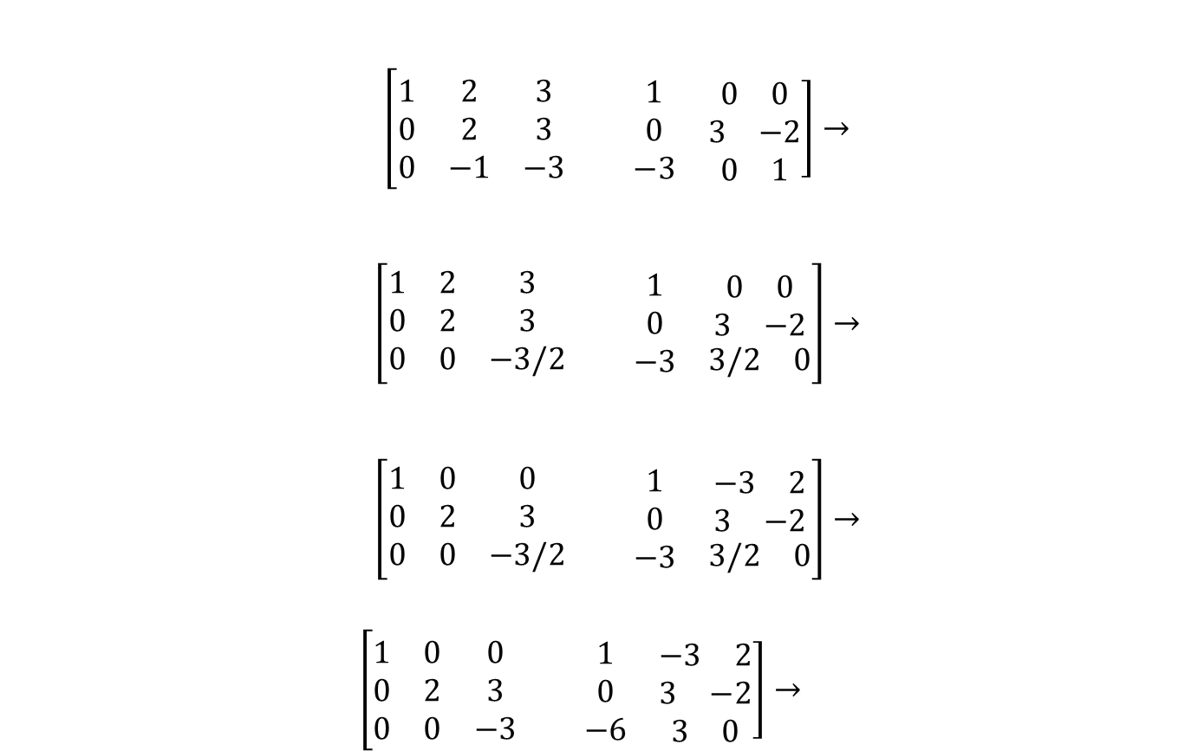
Calculation of the inverse of a matrix using row reduction. Examples.
$\left[\begin{matrix}1 & 2 & 3 \\ 0 & 2 & 3 \\ 0 & −1 & −3\end{matrix}\right.\left.\begin{matrix} & 1 & \begin{matrix}0 & 0\end{matrix} \\ & 0 & \begin{matrix}3 & −2\end{matrix} \\ & −3 & \begin{matrix}0 & 1\end{matrix}\end{matrix}\right]$ $→$
$\left[\begin{matrix}1 & 2 & 3 \\ 0 & 2 & 3 \\ 0 & 0 & −3/2\end{matrix}\right.\left.\begin{matrix} & 1 & \begin{matrix}0 & 0\end{matrix} \\ & 0 & \begin{matrix}3 & −2\end{matrix} \\ & −3 & \begin{matrix}3/2 & 0\end{matrix}\end{matrix}\right]$ $→$
$\left[\begin{matrix}1 & 0 & 0 \\ 0 & 2 & 3 \\ 0 & 0 & −3/2\end{matrix}\right.\left.\begin{matrix} & 1 & \begin{matrix}−3 & 2\end{matrix} \\ & 0 & \begin{matrix}3 & −2\end{matrix} \\ & −3 & \begin{matrix}3/2 & 0\end{matrix}\end{matrix}\right]$ $→$
$$\left[\begin{matrix}1 & 0 & 0 \\ 0 & 2 & 3 \\ 0 & 0 & −3\end{matrix}\right.\left.\begin{matrix} & 1 & \begin{matrix}−3 & 2\end{matrix} \\ & 0 & \begin{matrix}3 & −2\end{matrix} \\ & −6 & \begin{matrix}3 & 0\end{matrix}\end{matrix}\right]→$$

Slide 39
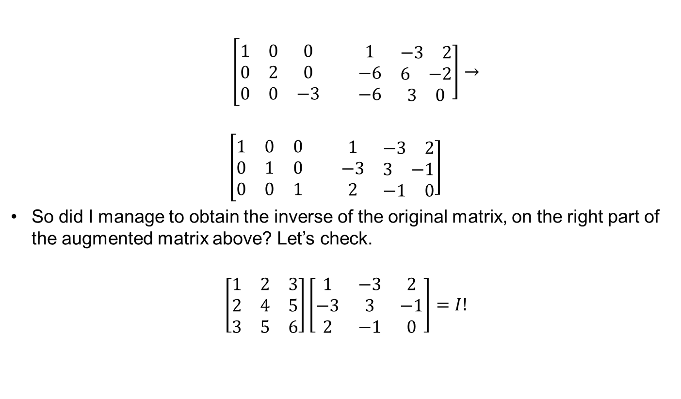
Calculation of the inverse of a matrix using row reduction. Examples.
$\left[\begin{matrix}1 & 0 & 0 \\ 0 & 2 & 0 \\ 0 & 0 & −3\end{matrix}\right.\left.\begin{matrix} & 1 & \begin{matrix}−3 & 2\end{matrix} \\ & −6 & \begin{matrix}6 & −2\end{matrix} \\ & −6 & \begin{matrix}3 & 0\end{matrix}\end{matrix}\right]$ $→$
$$\left[\begin{matrix}1 & 0 & 0 \\ 0 & 1 & 0 \\ 0 & 0 & 1\end{matrix}\right.\left.\begin{matrix} & 1 & \begin{matrix}−3 & 2\end{matrix} \\ & −3 & \begin{matrix}3 & −1\end{matrix} \\ & 2 & \begin{matrix}−1 & 0\end{matrix}\end{matrix}\right]$$
So did I manage to obtain the inverse of the original matrix, on the right part of the augmented matrix above? Let’s check.
$$\left[\begin{matrix}1 & 2 & 3 \\ 2 & 4 & 5 \\ 3 & 5 & 6\end{matrix}\right]\left[\begin{matrix}1 & −3 & 2 \\ −3 & 3 & −1 \\ 2 & −1 & 0\end{matrix}\right]=I!$$

Slide 40
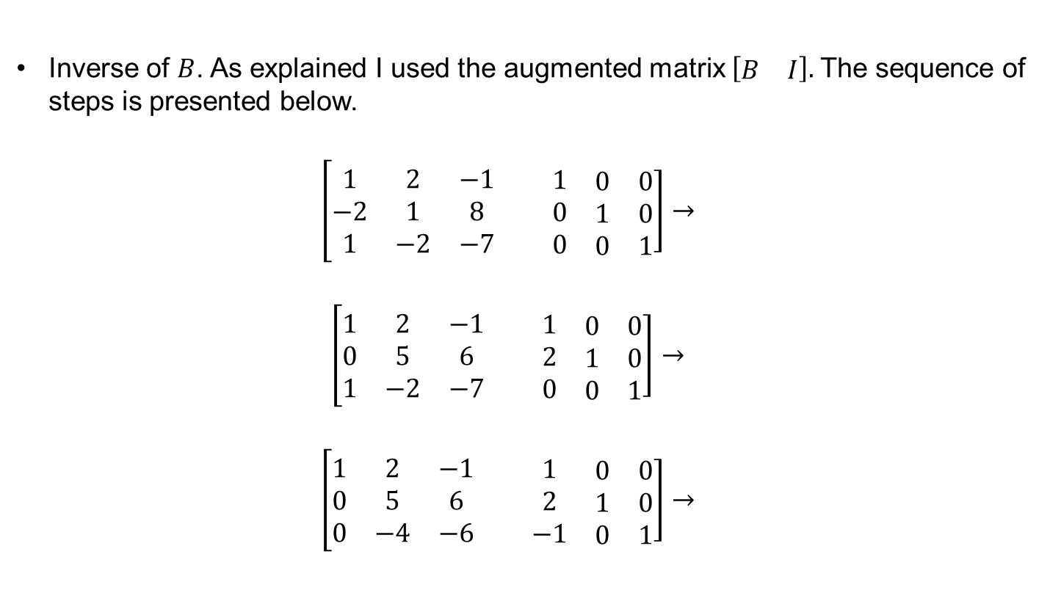
Calculation of the inverse of a matrix using row reduction. Solution.
Inverse of $B$. As explained I used the augmented matrix $\left[\begin{matrix}B & I\end{matrix}\right].$The sequence of steps is presented below.
$$\left[\begin{matrix}1 & 2 & −1 \\ −2 & 1 & 8 \\ 1 & −2 & −7\end{matrix}\right.\left.\begin{matrix} & 1 & \begin{matrix}0 & 0\end{matrix} \\ & 0 & \begin{matrix}1 & 0\end{matrix} \\ & 0 & \begin{matrix}0 & 1\end{matrix}\end{matrix}\right]→$$
$$\left[\begin{matrix}1 & 2 & −1 \\ 0 & 5 & 6 \\ 1 & −2 & −7\end{matrix}\right.\left.\begin{matrix} & 1 & \begin{matrix}0 & 0\end{matrix} \\ & 2 & \begin{matrix}1 & 0\end{matrix} \\ & 0 & \begin{matrix}0 & 1\end{matrix}\end{matrix}\right]→$$
$$\left[\begin{matrix}1 & 2 & −1 \\ 0 & 5 & 6 \\ 0 & −4 & −6\end{matrix}\right.\left.\begin{matrix} & 1 & \begin{matrix}0 & 0\end{matrix} \\ & 2 & \begin{matrix}1 & 0\end{matrix} \\ & −1 & \begin{matrix}0 & 1\end{matrix}\end{matrix}\right]→$$

Slide 41

Calculation of the inverse of a matrix using row reduction. Examples.
$$\left[\begin{matrix}1 & 2 & −1 \\ 0 & 4 & 24/5 \\ 0 & −4 & −6\end{matrix}\right.\left.\begin{matrix} & 1 & \begin{matrix}0 & 0\end{matrix} \\ & 8/5 & \begin{matrix}4/5 & 0\end{matrix} \\ & −1 & \begin{matrix}0 & 1\end{matrix}\end{matrix}\right]→$$
$$\left[\begin{matrix}1 & 2 & −1 \\ 0 & 4 & 24/5 \\ 0 & 0 & −6/5\end{matrix}\right.\left.\begin{matrix} & 1 & \begin{matrix}0 & 0\end{matrix} \\ & 8/5 & \begin{matrix}4/5 & 0\end{matrix} \\ & 3/5 & \begin{matrix}4/5 & 1\end{matrix}\end{matrix}\right]→$$
$$\left[\begin{matrix}1 & 2 & −1 \\ 0 & 1 & 6/5 \\ 0 & 0 & −6/5\end{matrix}\right.\left.\begin{matrix} & 1 & \begin{matrix}0 & 0\end{matrix} \\ & 2/5 & \begin{matrix}1/5 & 0\end{matrix} \\ & 3/5 & \begin{matrix}4/5 & 1\end{matrix}\end{matrix}\right]→$$
$$\left[\begin{matrix}1 & 2 & −1 \\ 0 & 1 & 0 \\ 0 & 0 & −6/5\end{matrix}\right.\left.\begin{matrix} & 1 & \begin{matrix}0 & 0\end{matrix} \\ & 1 & \begin{matrix}1 & 1\end{matrix} \\ & 3/5 & \begin{matrix}4/5 & 1\end{matrix}\end{matrix}\right]→$$

Slide 42

Calculation of the inverse of a matrix using row reduction. Examples.
$$\left[\begin{matrix}1 & 2 & −1 \\ 0 & 1 & 0 \\ 0 & 0 & −6\end{matrix}\right.\left.\begin{matrix} & 1 & \begin{matrix}0 & 0\end{matrix} \\ & 1 & \begin{matrix}1 & 1\end{matrix} \\ & 3 & \begin{matrix}4 & 5\end{matrix}\end{matrix}\right]→$$
$$\left[\begin{matrix}1 & 2 & −1 \\ 0 & 1 & 0 \\ 0 & 0 & 1\end{matrix}\right.\left.\begin{matrix} & 1 & \begin{matrix}0 & 0\end{matrix} \\ & 1 & \begin{matrix}1 & 1\end{matrix} \\ & −1/2 & \begin{matrix}−2/3 & −5/6\end{matrix}\end{matrix}\right]→$$
$$\left[\begin{matrix}1 & 2 & 0 \\ 0 & 1 & 0 \\ 0 & 0 & 1\end{matrix}\right.\left.\begin{matrix} & 1/2 & \begin{matrix}−2/3 & −5/6\end{matrix} \\ & 1 & \begin{matrix}1 & 1\end{matrix} \\ & −1/2 & \begin{matrix}−2/3 & −5/6\end{matrix}\end{matrix}\right]→$$
$$\left[\begin{matrix}1 & 0 & 0 \\ 0 & 1 & 0 \\ 0 & 0 & 1\end{matrix}\right.\left.\begin{matrix} & −3/2 & \begin{matrix}−8/3 & −17/6\end{matrix} \\ & 1 & \begin{matrix}1 & 1\end{matrix} \\ & −1/2 & \begin{matrix}−2/3 & −5/6\end{matrix}\end{matrix}\right]→$$

Slide 43

Calculation of the inverse of a matrix using row reduction. Examples.
So did I manage to obtain the inverse of the original matrix, on the right part of the augmented matrix above? Let’s check.
$$\left[\begin{matrix}1 & 2 & −1 \\ −2 & 1 & 8 \\ 1 & −2 & −7\end{matrix}\right.\left.\begin{matrix} & −3/2 & \begin{matrix}−8/3 & −17/6\end{matrix} \\ & 1 & \begin{matrix}1 & 1\end{matrix} \\ & −1/2 & \begin{matrix}−2/3 & −5/6\end{matrix}\end{matrix}\right]=I!$$

