Slide 1
Maths for Signals and Systems Linear Algebra in Engineering Lectures 4-5, Tuesday 18th October 2016
DR TANIA STATHAKI
READER (ASSOCIATE PROFFESOR) IN SIGNAL PROCESSING IMPERIAL COLLEGE LONDON

Slide 2
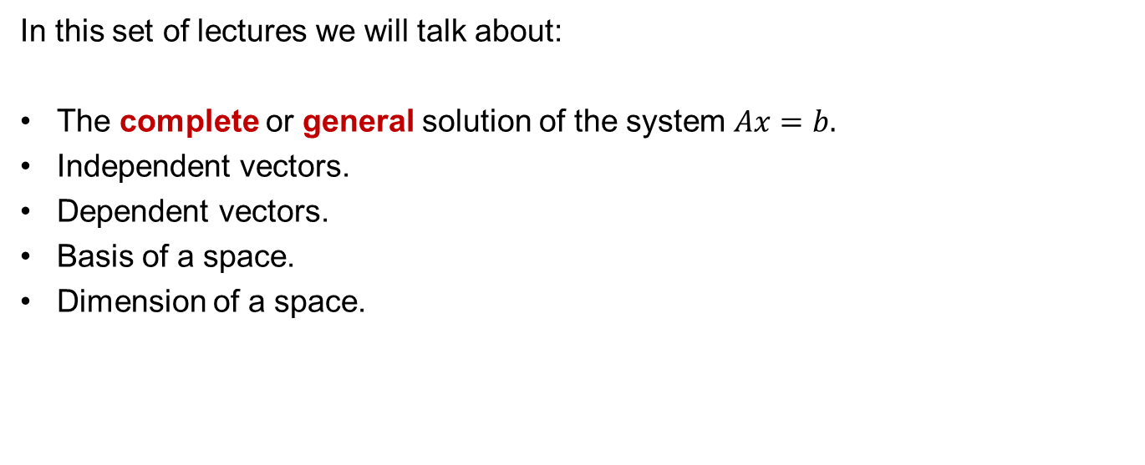
Mathematics for Signals and Systems
In this set of lectures we will talk about:
The complete or general solution of the system $Ax=b.$
Independent vectors.
Dependent vectors.
Basis of a space.
Dimension of a space.

Slide 3
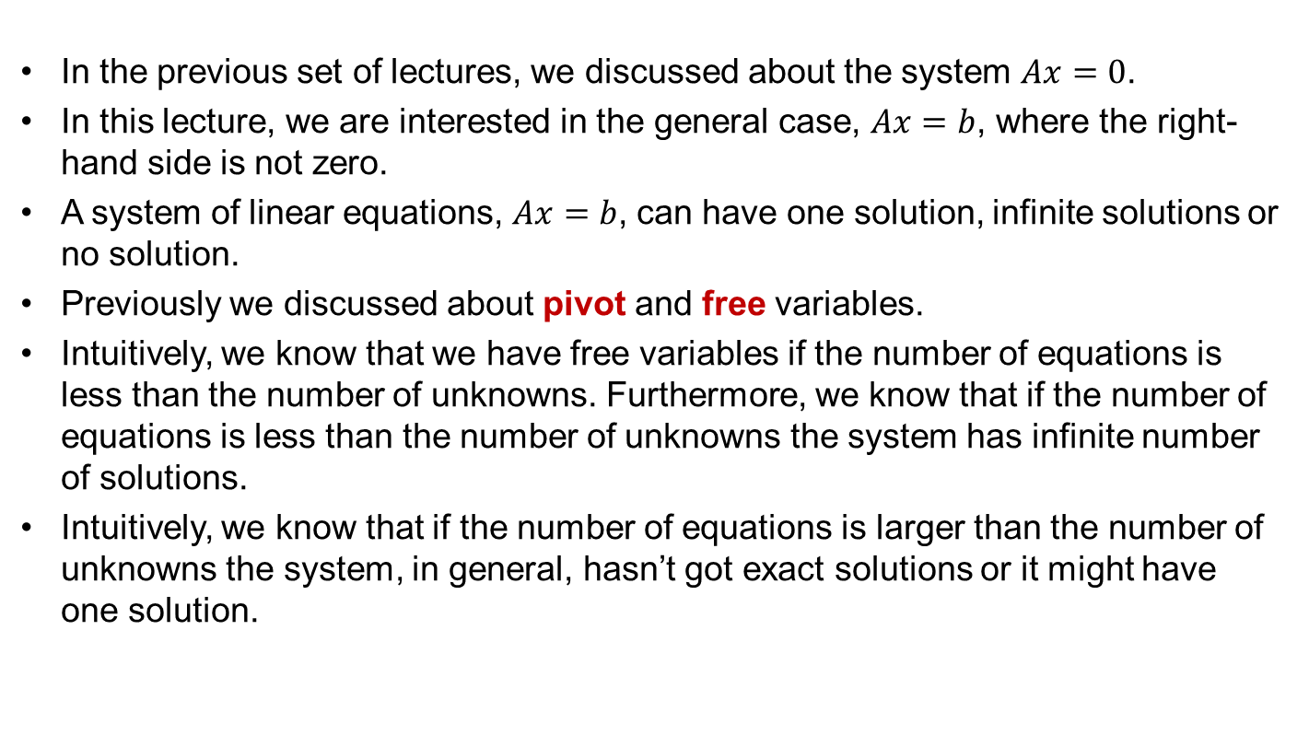
Mathematics for Signals and Systems
In the previous set of lectures, we discussed about the system $Ax=0$.
In this lecture, we are interested in the general case, $Ax=b$, where the right-hand side is not zero.
A system of linear equations, $Ax=b$, can have one solution, infinite solutions or no solution.
Previously we discussed about pivot and free variables.
Intuitively, we know that we have free variables if the number of equations is less than the number of unknowns. Furthermore, we know that if the number of equations is less than the number of unknowns the system has infinite number of solutions.
Intuitively, we know that if the number of equations is larger than the number of unknowns the system, in general, hasn’t got exact solutions or it might have one solution.

Slide 4
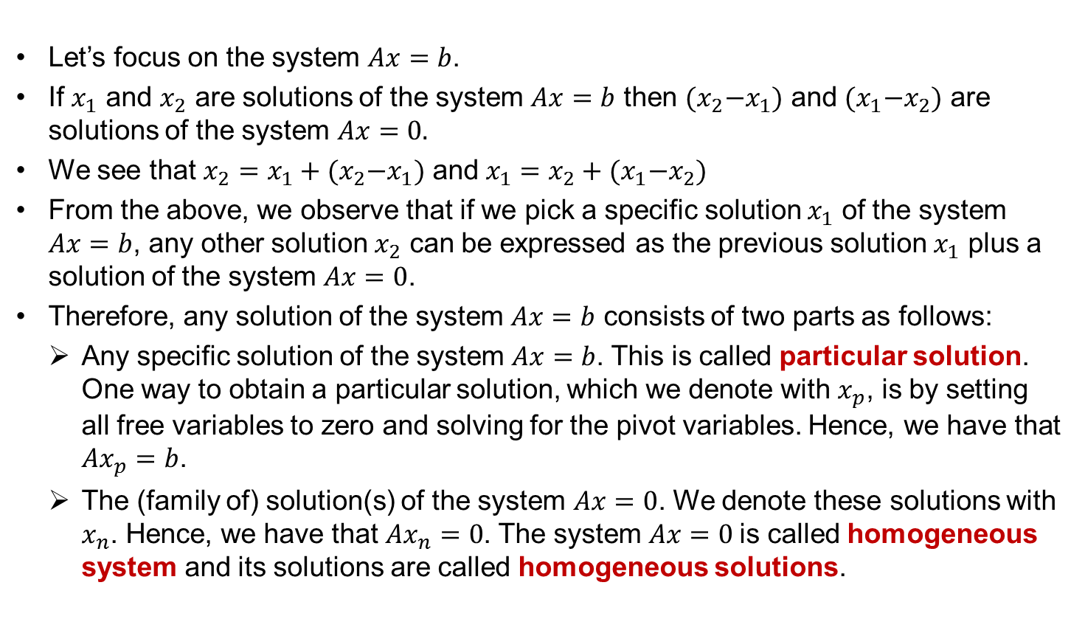
Solution of the general form Ax=b General=Particular+Homogeneous
Let’s focus on the system $Ax=b$.
If $x_{1}$ and $x_{2}$ are solutions of the system $Ax=b$ then ${(x}_{2}−x_{1})$ and ${(x}_{1}−x_{2})$ are solutions of the system $Ax=0.$
We see that $x_{2}=x_{1}+{(x}_{2}−x_{1})$ and $x_{1}=x_{2}+{(x}_{1}−x_{2})$
From the above, we observe that if we pick a specific solution $x_{1}$ of the system $Ax=b$, any other solution $x_{2}$ can be expressed as the previous solution $x_{1}$ plus a solution of the system $Ax=0$.
Therefore, any solution of the system $Ax=b$ consists of two parts as follows:
Any specific solution of the system $Ax=b$. This is called particular solution. One way to obtain a particular solution, which we denote with $x_{p}$, is by setting all free variables to zero and solving for the pivot variables. Hence, we have that $Ax_{p}=b$.
The (family of) solution(s) of the system $Ax=0$. We denote these solutions with $x_{n}$. Hence, we have that $Ax_{n}=0$. The system $Ax=0$is called homogeneous system and its solutions are called homogeneous solutions.

Slide 5

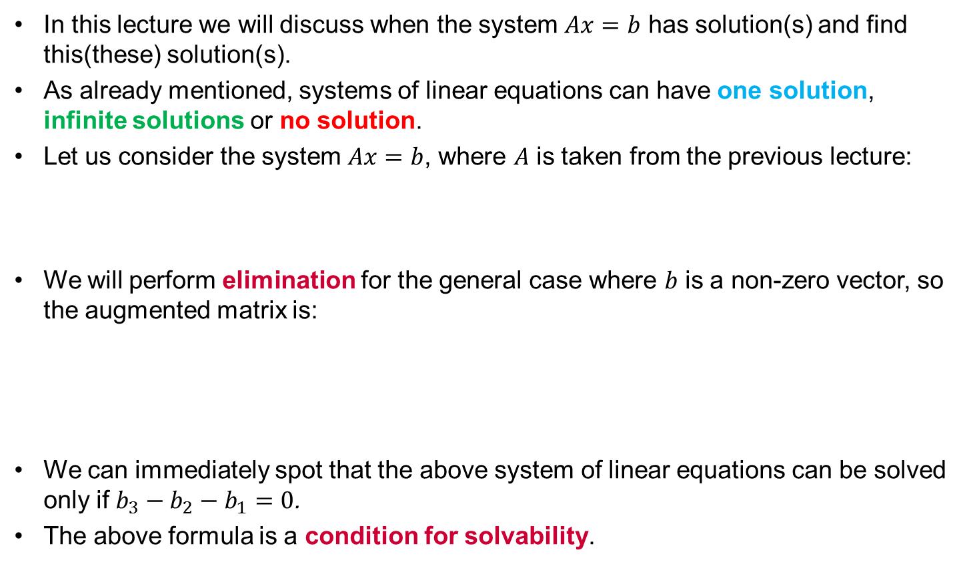


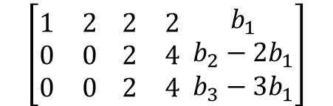
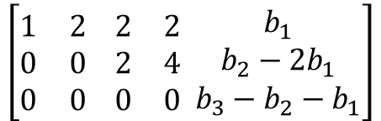
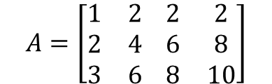

Solution of the general form Ax=b
In this lecture we will discuss when the system $Ax=b$ has solution(s) and find this(these) solution(s).
As already mentioned, systems of linear equations can have one solution, infinite solutions or no solution.
Let us consider the system $Ax=b$, where $A$ is taken from the previous lecture:
We will perform elimination for the general case where $b$ is a non-zero vector, so the augmented matrix is:
We can immediately spot that the above system of linear equations can be solved only if $b_{3}−b_{2}−b_{1}=0$.
The above formula is a condition for solvability.
$$A=\left[\begin{matrix}1 & 2 \\ 2 & 4 \\ 3 & 6\end{matrix} \begin{matrix}2 & 2 \\ 6 & 8 \\ 8 & 10\end{matrix}\right]$$
$$\left[\begin{matrix}1 & 2 \\ 2 & 4 \\ 3 & 6\end{matrix} \begin{matrix}2 & 2 \\ 6 & 8 \\ 8 & 10\end{matrix} \begin{matrix}b_{1} \\ b_{2} \\ b_{3}\end{matrix}\right]$$
$$\left[\begin{matrix}1 & 2 \\ 0 & 0 \\ 0 & 0\end{matrix} \begin{matrix}2 & 2 \\ 2 & 4 \\ 2 & 4\end{matrix} \begin{matrix}b_{1} \\ b_{2}−{2b}_{1} \\ b_{3}−3b_{1}\end{matrix}\right]$$
$$\left[\begin{matrix}1 & 2 \\ 0 & 0 \\ 0 & 0\end{matrix} \begin{matrix}2 & 2 \\ 2 & 4 \\ 0 & 0\end{matrix} \begin{matrix}b_{1} \\ b_{2}−{2b}_{1} \\ b_{3}−b_{2}−b_{1}\end{matrix}\right]$$
$$\left[2\right]−2\left[1\right]$$
$$\left[2\right]−3\left[1\right]$$
$$\left[3\right]−\left[2\right]$$

Slide 6
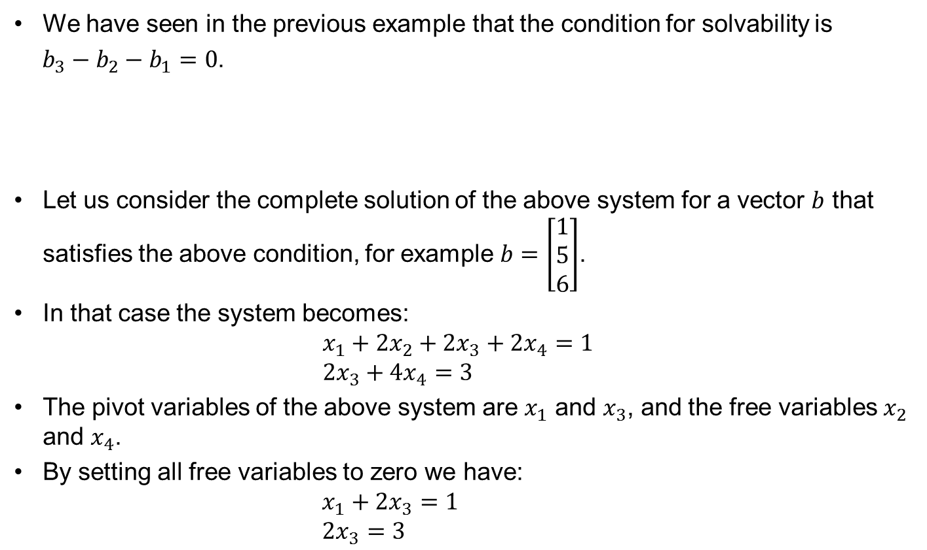
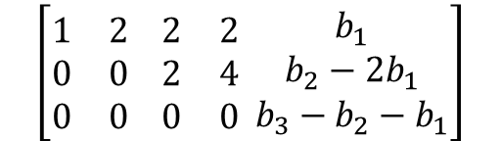
Solution of the general form Ax=b. Particular Solution.
We have seen in the previous example that the condition for solvability is
$b_{3}−b_{2}−b_{1}=0$.
Let us consider the complete solution of the above system for a vector $b$ that satisfies the above condition, for example $b=\left[\begin{matrix}1 \\ 5 \\ 6\end{matrix}\right]$.
In that case the system becomes:
$$x_{1}+2x_{2}+2x_{3}+{2x}_{4}=1$$
$$2x_{3}+{4x}_{4}=3$$
The pivot variables of the above system are $x_{1}$ and $x_{3}$, and the free variables $x_{2}$ and $x_{4}$.
By setting all free variables to zero we have:
$$x_{1}+2x_{3}=1$$
$$2x_{3}=3$$
$$\left[\begin{matrix}1 & 2 \\ 0 & 0 \\ 0 & 0\end{matrix} \begin{matrix}2 & 2 \\ 2 & 4 \\ 0 & 0\end{matrix} \begin{matrix}b_{1} \\ b_{2}−{2b}_{1} \\ b_{3}−b_{2}−b_{1}\end{matrix}\right]$$

Slide 7
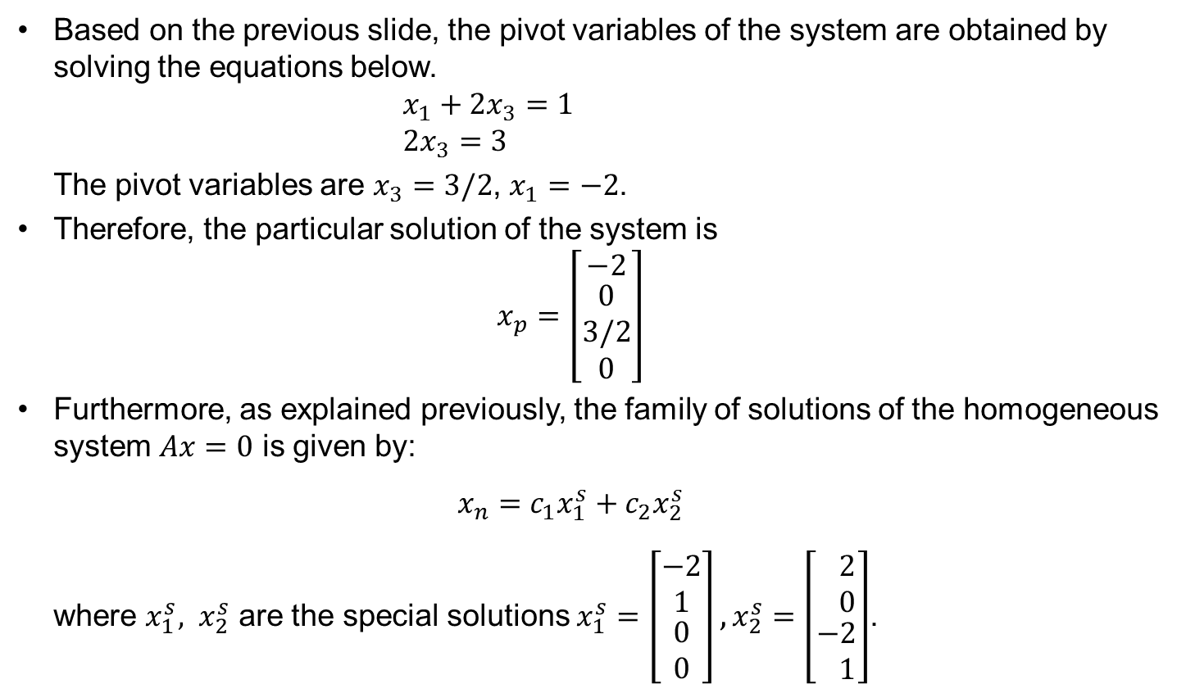
Particular and Homogeneous Solutions cont.
Based on the previous slide, the pivot variables of the system are obtained by solving the equations below.
$$x_{1}+2x_{3}=1$$
$$2x_{3}=3$$
The pivot variables are $x_{3}=3/2$, $x_{1}=−2$.
Therefore, the particular solution of the system is
$$x_{p}=\left[\begin{matrix}−2 \\ \begin{aligned}0 \\ 3/2 \\ 0\end{aligned}\end{matrix}\right]$$
Furthermore, as explained previously, the family of solutions of the homogeneous system $Ax=0$ is given by:
$${x_{n}=c_{1}x}_{1}^{s}+c_{2}x_{2}^{s}$$
where $x_{1}^{s}, x_{2}^{s}$ are the special solutions $x_{1}^{s}=\left[\begin{matrix}\begin{matrix}−2 \\ 1\end{matrix} \\ \begin{matrix}0 \\ 0\end{matrix}\end{matrix}\right], x_{2}^{s}=\left[\begin{aligned}\begin{matrix} 2 \\ 0\end{matrix} \\ −2 \\ 1\end{aligned}\right]$.

Slide 8


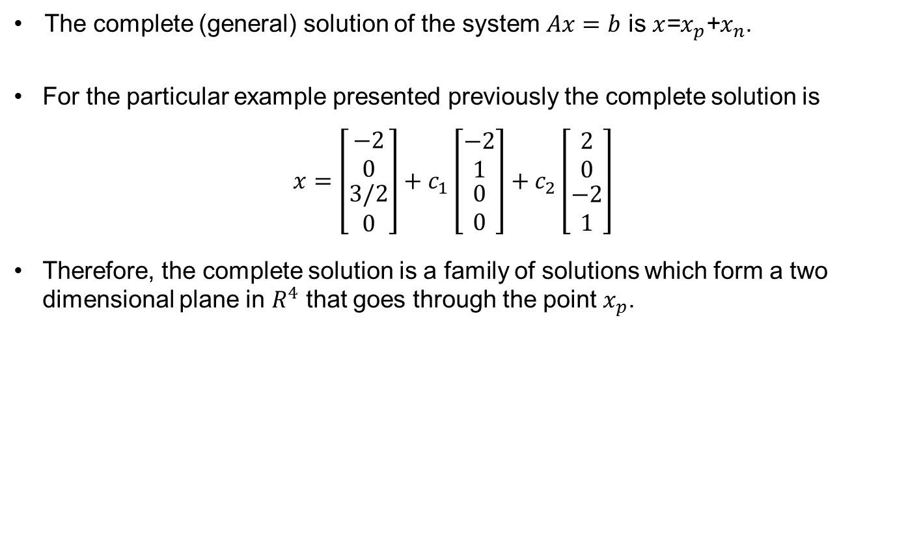





Particular and Homogeneous Solutions cont.
The complete (general) solution of the system $Ax=b$ is $x$=$x_{p}$+$x_{n}$.
For the particular example presented previously the complete solution is
$$x=\left[\begin{aligned}\begin{matrix}−2 \\ 0\end{matrix} \\ 3/2 \\ 0\end{aligned}\right]+c_{1}\left[\begin{aligned}\begin{matrix}−2 \\ 1\end{matrix} \\ 0 \\ 0\end{aligned}\right]+c_{2}\left[\begin{aligned}\begin{matrix}2 \\ 0\end{matrix} \\ −2 \\ 1\end{aligned}\right]$$
Therefore, the complete solution is a family of solutions which form a two dimensional plane in $R^{4}$ that goes through the point $x_{p}$.
$$x_{3}$$
$$x_{4}$$
$$x_{n}$$
$$x_{p}$$
$$x$$
$$x_{1}$$
$$x_{2}$$

Slide 9
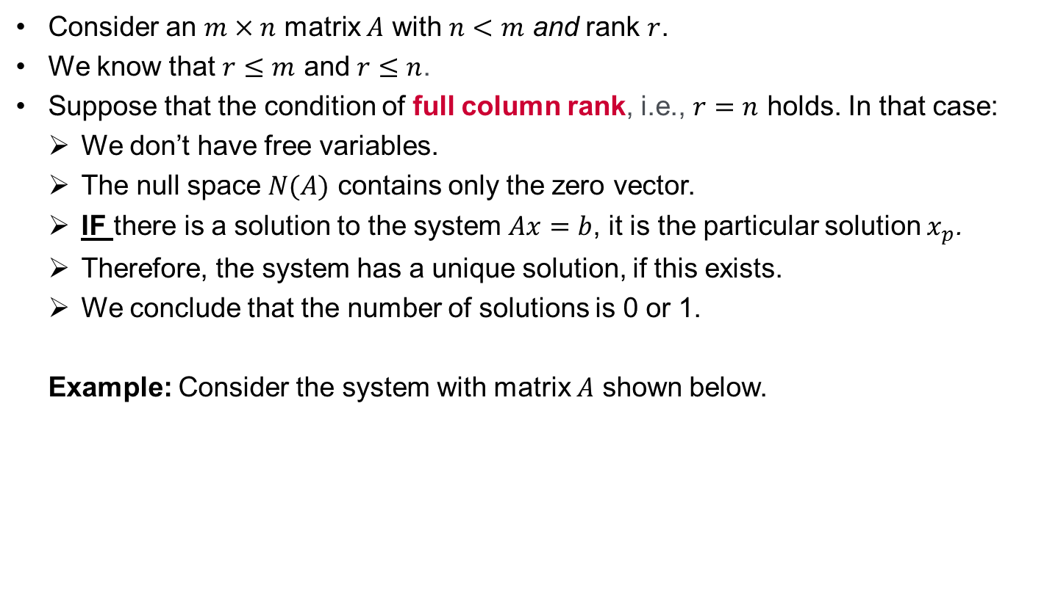




Solution of the general form Ax=b. More rows than columns.
Consider an $m×n$ matrix $A$ with $n<m$ and rank $r$.
We know that $r≤m$ and $r≤n$.
Suppose that the condition of full column rank, i.e., $r=n$ holds. In that case:
We don’t have free variables.
The null space $N(A)$ contains only the zero vector.
IF there is a solution to the system $Ax=b$, it is the particular solution $x_{p}$.
Therefore, the system has a unique solution, if this exists.
We conclude that the number of solutions is 0 or 1.
Example: Consider the system with matrix $A$ shown below.
$$\left[\begin{aligned}\begin{matrix}1 & 3 \\ 2 & 1 \\ 6 & 1\end{matrix} \\ \begin{matrix}5 & 1\end{matrix}\end{aligned}\right]\underset{→}{elimin.}\left[\begin{aligned}\begin{matrix}1 & 0 \\ 0 & 1 \\ 0 & 0\end{matrix} \\ \begin{matrix}0 & 0\end{matrix}\end{aligned}\right]$$
rank = 2
there aren’t any free variables
the null space is the zero vector
there is a unique solution to $Ax=b$ only when $b$ is a linear combination of the columns of $A$
this unique solution is the particular solution $x_{p}$
$$A$$
$$R$$

Slide 10
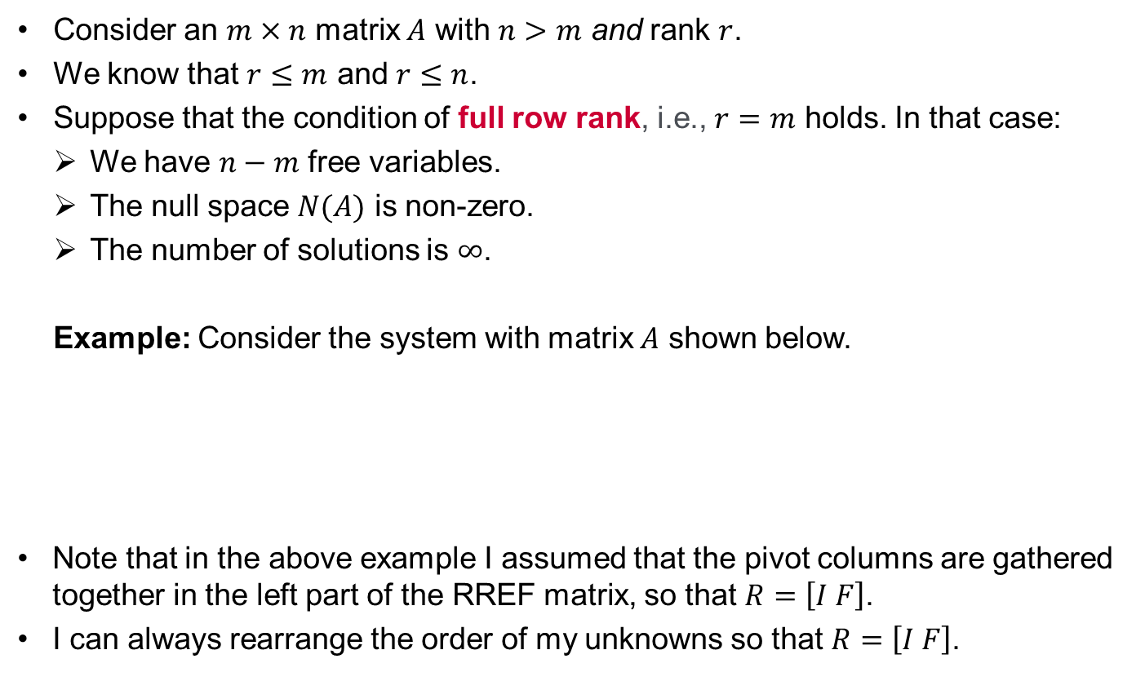



Solution of the general form Ax=b. More columns than rows.
Consider an $m×n$ matrix $A$ with $n>m$ and rank $r$.
We know that $r≤m$ and $r≤n$.
Suppose that the condition of full row rank, i.e., $r=m$ holds. In that case:
We have $n−m$ free variables.
The null space $N(A)$ is non-zero.
The number of solutions is $∞$.
Example: Consider the system with matrix $A$ shown below.
Note that in the above example I assumed that the pivot columns are gathered together in the left part of the RREF matrix, so that $R=\left[I F\right]$.
I can always rearrange the order of my unknowns so that $R=\left[I F\right]$.
$$\left[\begin{matrix}1 & 4 & 6 \\ 3 & 1 & 1\end{matrix} \begin{matrix}5 \\ 1\end{matrix}\right]\underset{→}{elimin.}\left[\begin{matrix}1 & 0 & f_{12} \\ 0 & 1 & f_{21}\end{matrix} \begin{matrix}f_{12} \\ f_{22}\end{matrix}\right]$$
rank = 2
there are 2 free variables
the null space is non-zero
there are infinite number of solutions
$$A$$
$$R$$

Slide 11
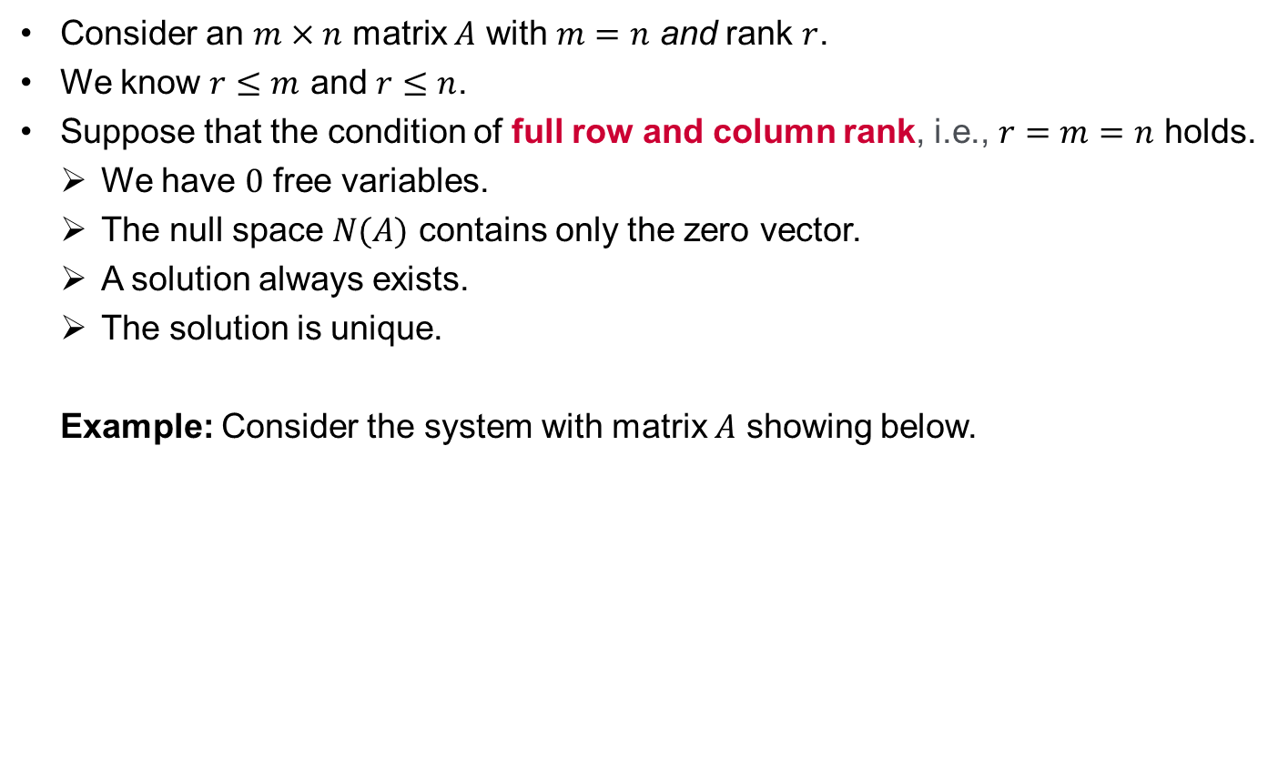




Solution of the general form Ax=b. Same rows and columns.
Consider an $m×n$ matrix $A$ with $m=n$ and rank $r$.
We know $r≤m$ and $r≤n$.
Suppose that the condition of full row and column rank, i.e., $r=m=n$ holds.
We have $0$ free variables.
The null space $N(A)$ contains only the zero vector.
A solution always exists.
The solution is unique.
Example: Consider the system with matrix $A$ showing below.
$$\left[\begin{matrix}1 & 2 \\ 3 & 1\end{matrix}\right]\underset{→}{elimin.}\left[\begin{matrix}1 & 0 \\ 0 & 1\end{matrix}\right]$$
rank = 2
there are 0 free variables
the null space is the zero vector
$A$ is invertible and the corresponding
echelon matrix $R$is the identity matrix
there is always a unique solution
$$A$$
$$R$$

Slide 12
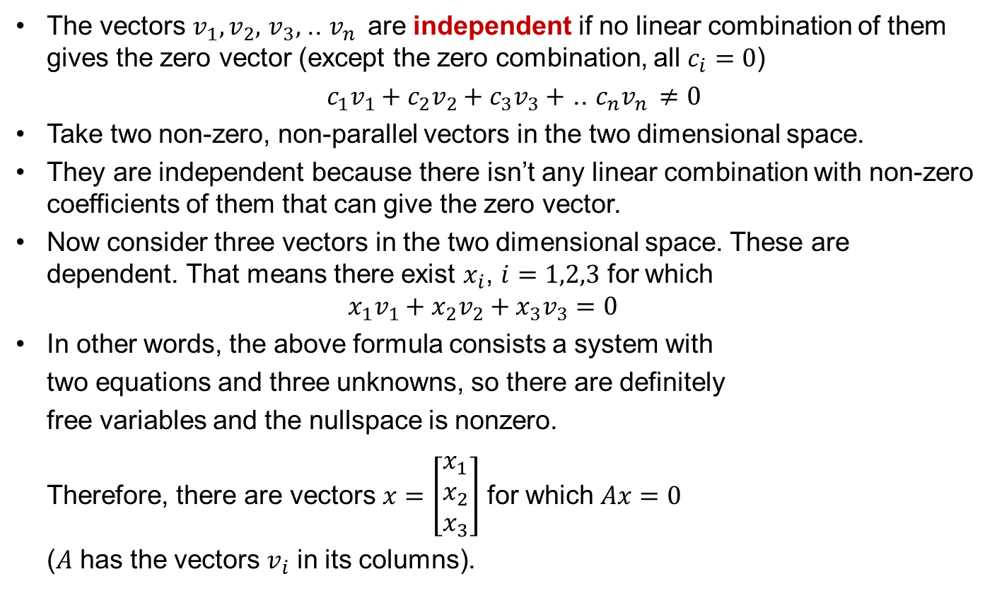



Linear Independence
The vectors $v_{1},v_{2},$ $v_{3},$ .. $v_{n }$ are independent if no linear combination of them gives the zero vector (except the zero combination, all $c_{i}=0$)
$c_{1}v_{1}+c_{2}v_{2}+c_{3}v_{3}+$ .. $c_{n}v_{n }≠0$
Take two non-zero, non-parallel vectors in the two dimensional space.
They are independent because there isn’t any linear combination with non-zero coefficients of them that can give the zero vector.
Now consider three vectors in the two dimensional space. These are dependent. That means there exist $x_{i}$, $i=1,2,3$ for which
$$x_{1}v_{1}+x_{2}v_{2}+x_{3}v_{3}=0$$
In other words, the above formula consists a system with
two equations and three unknowns, so there are definitely
free variables and the nullspace is nonzero.
Therefore, there are vectors $x=\left[\begin{matrix}x_{1} \\ x_{2} \\ x_{3}\end{matrix}\right]$ for which $Ax=0$
($A$ has the vectors $v_{i}$ in its columns).
$$v_{2}$$
$$v_{1}$$
$$v_{3}$$

Slide 13
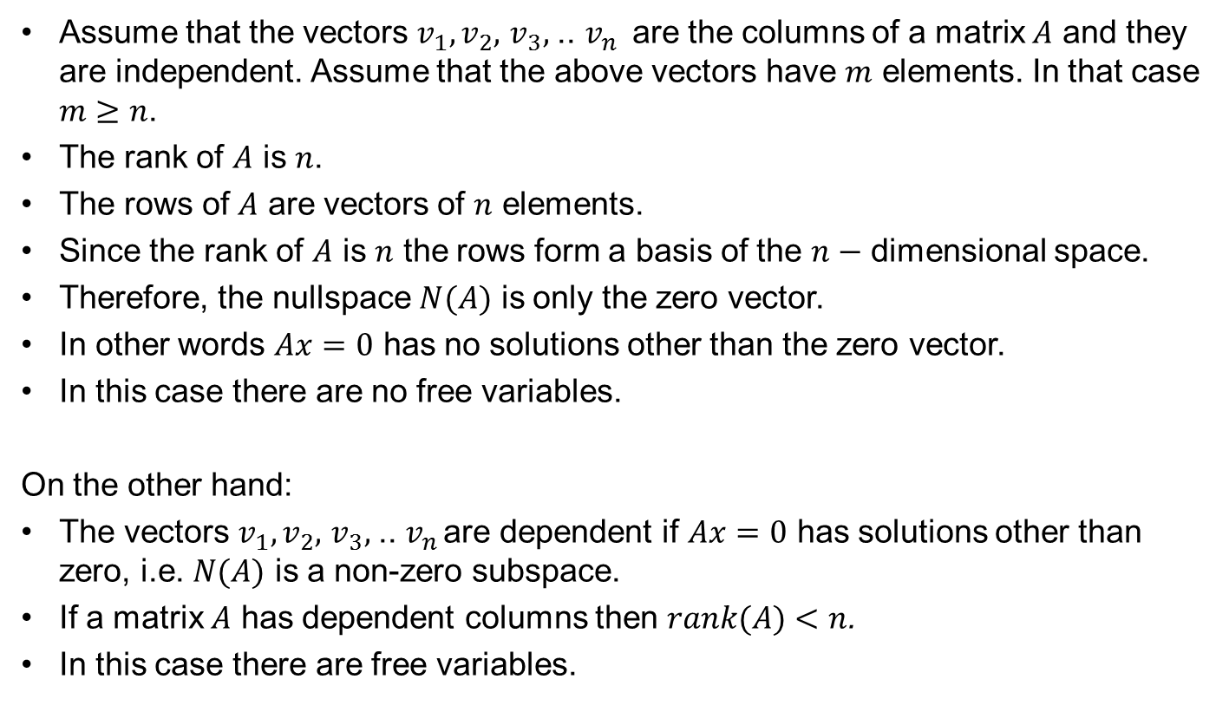
Linear Independence of Column Vectors
Assume that the vectors $v_{1},v_{2},$ $v_{3},$ .. $v_{n }$ are the columns of a matrix $A$ and they are independent. Assume that the above vectors have $m$ elements. In that case $m≥n$.
The rank of $A$ is $n$.
The rows of $A$ are vectors of $n$ elements.
Since the rank of $A$ is $n$ the rows form a basis of the $n−$ dimensional space.
Therefore, the nullspace $N(A)$ is only the zero vector.
In other words $Ax=0$ has no solutions other than the zero vector.
In this case there are no free variables.
On the other hand:
The vectors $v_{1},v_{2},$ $v_{3},$ .. $v_{n }$are dependent if $Ax=0$ has solutions other than zero, i.e. $N(A)$ is a non-zero subspace.
If a matrix $A$ has dependent columns then $rank(A)<n$.
In this case there are free variables.

Slide 14
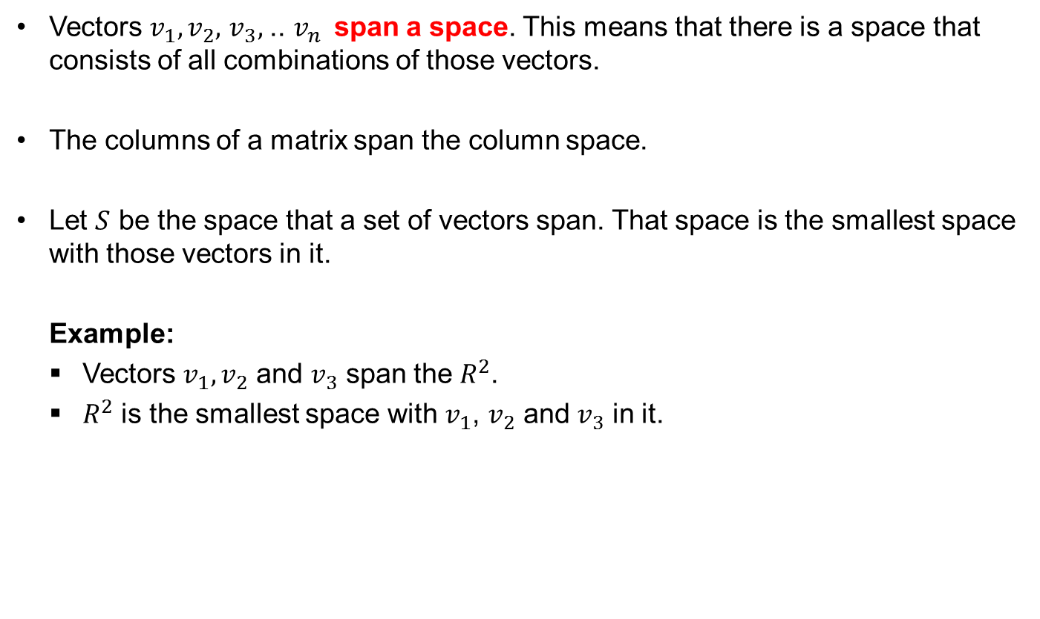



Span
Vectors $v_{1},v_{2},$ $v_{3},$ .. $v_{n }$ span a space. This means that there is a space that consists of all combinations of those vectors.
The columns of a matrix span the column space.
Let $S$ be the space that a set of vectors span. That space is the smallest space with those vectors in it.
Example:
Vectors $v_{1},v_{2}$ and $v_{3}$ span the $R^{2}$.
$R^{2}$ is the smallest space with $v_{1}$, $v_{2}$ and $v_{3}$ in it.
$$v_{2}$$
$$v_{1}$$
$$v_{3}$$

Slide 15
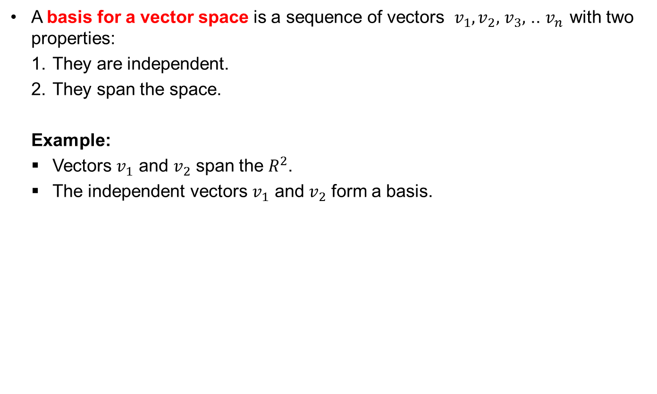


Basis
A basis for a vector space is a sequence of vectors $v_{1},v_{2},$ $v_{3},$ .. $v_{n }$with two properties:
They are independent.
They span the space.
Example:
Vectors $v_{1}$ and $v_{2}$ span the $R^{2}$.
The independent vectors $v_{1}$ and $v_{2}$ form a basis.
$$v_{2}$$
$$v_{1}$$

Slide 16
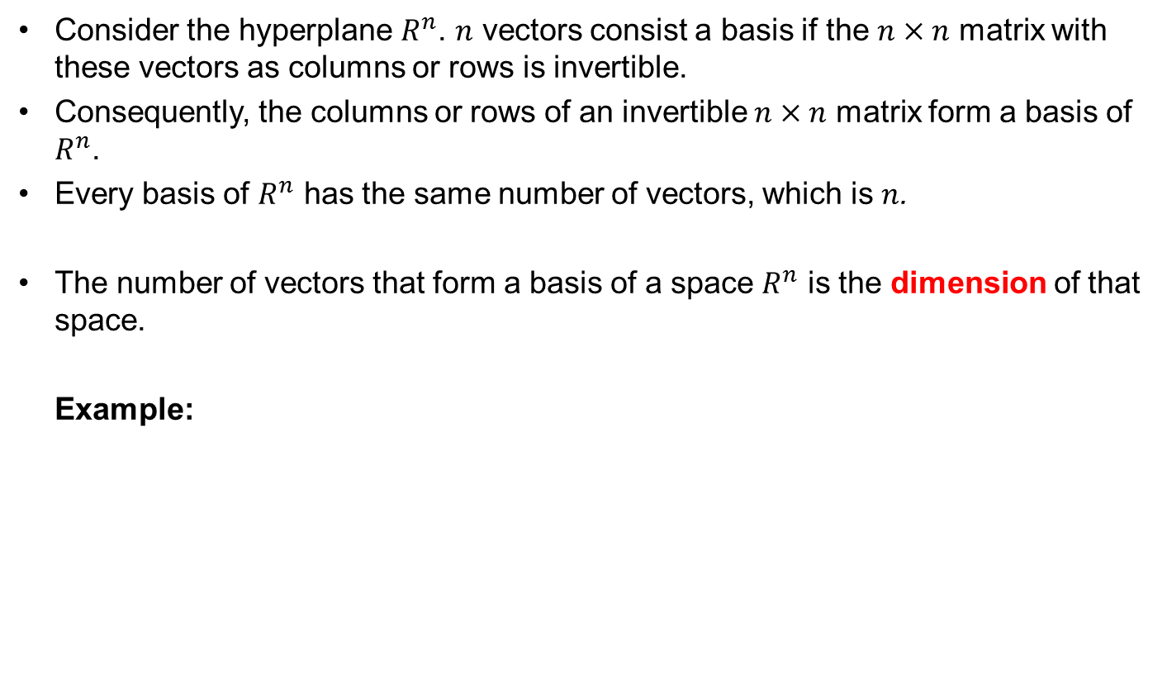
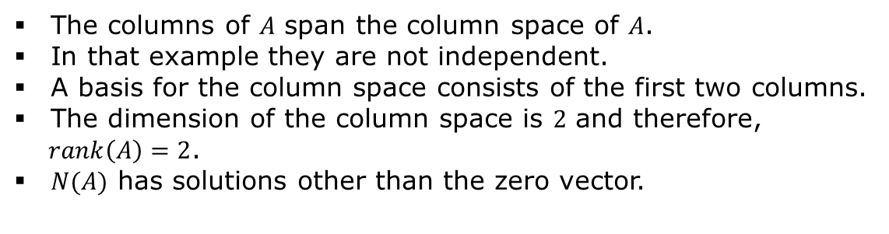

Basis cont.
Consider the hyperplane $R^{n}$. $n$ vectors consist a basis if the $n×n$ matrix with these vectors as columns or rows is invertible.
Consequently, the columns or rows of an invertible $n×n$ matrix form a basis of $R^{n}$.
Every basis of $R^{n}$ has the same number of vectors, which is $n$.
The number of vectors that form a basis of a space $R^{n}$ is the dimension of that space.
Example:
$$A=\left[\begin{aligned}\begin{matrix}1 \\ 1 \end{matrix} \\ 1 \end{aligned}\begin{aligned}\begin{matrix}2 \\ 1 \end{matrix} \\ 2 \end{aligned}\begin{aligned}\begin{matrix}3 \\ 2 \end{matrix} \\ 3 \end{aligned}\begin{aligned}\begin{matrix} 1 \\ 1\end{matrix} \\ 1\end{aligned}\right]$$
The columns of $A$ span the column space of $A$.
In that example they are not independent.
A basis for the column space consists of the first two columns.
The dimension of the column space is $2$ and therefore,
$rank\left(A\right)=2$.
$N(A)$ has solutions other than the zero vector.

Slide 17
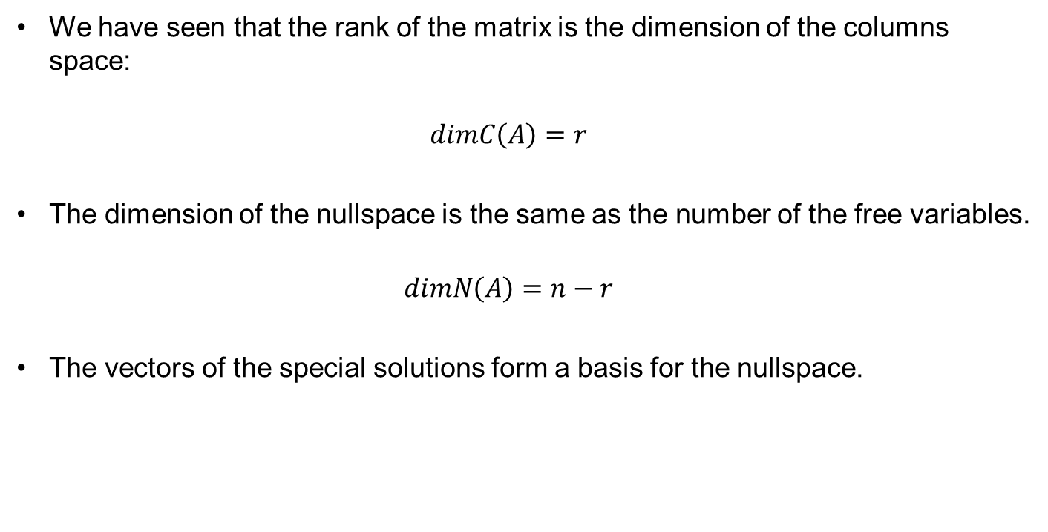
Basis cont.
We have seen that the rank of the matrix is the dimension of the columns space:
$$dimC\left(A\right)=r$$
The dimension of the nullspace is the same as the number of the free variables.
$$dimN\left(A\right)=n−r$$
The vectors of the special solutions form a basis for the nullspace.

Slide 18
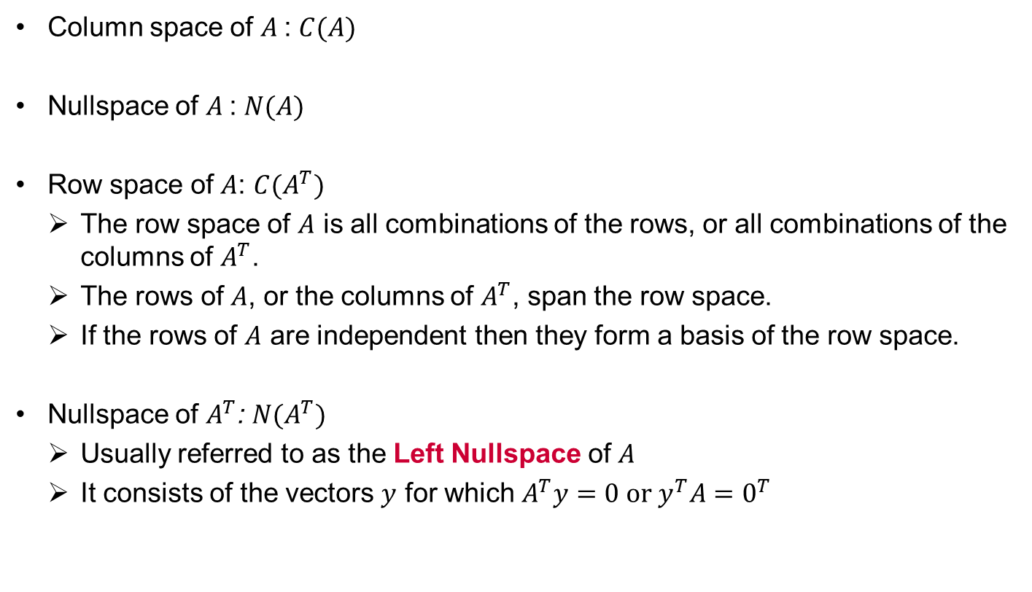
The Four Fundamental Subspaces: Column Space, Row Space, Nullspace, Left Nullspace
Column space of $A$: $C(A)$
Nullspace of $A$: $N(A)$
Row space of $A$: ${C(A}^{T})$
The row space of $A$ is all combinations of the rows, or all combinations of the columns of $A^{T}$.
The rows of $A$, or the columns of $A^{T}$, span the row space.
If the rows of $A$ are independent then they form a basis of the row space.
Nullspace of $A^{T}$: ${N(A}^{T})$
Usually referred to as the Left Nullspace of $A$
It consists of the vectors $y$ for which $A^{T}y=0 or{ y}^{T}A=0^{T}$

Slide 19
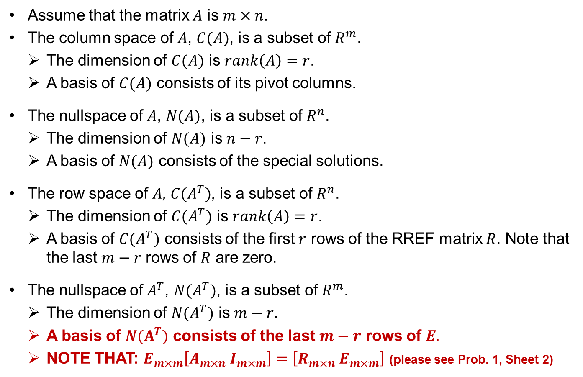
Dimensionality of the Four Fundamental Subspaces
Assume that the matrix $A$ is $m×n$.
The column space of $A$, $C(A)$, is a subset of $R^{m}$.
The dimension of $C(A)$ is $rank\left(A\right)=r$.
A basis of $C(A)$ consists of its pivot columns.
The nullspace of $A$, $N(A)$, is a subset of $R^{n}$.
The dimension of $N(A)$ is $n−r$.
A basis of $N(A)$ consists of the special solutions.
The row space of $A,$ ${C(A}^{T})$, is a subset of $R^{n}$.
The dimension of $C(A^{T})$ is $rank\left(A\right)=r$.
A basis of ${C(A}^{T})$ consists of the first $r$ rows of the RREF matrix $R$. Note that the last $m−r$ rows of $R$ are zero.
The nullspace of $A^{T}$, ${N(A}^{T})$, is a subset of $R^{m}$.
The dimension of ${N(A}^{T})$ is $m−r$.
A basis of ${N(A}^{T})$ consists of the last $m−r$ rows of $E.$
NOTE THAT: $E_{m×m}\left[A_{m×n} I_{m×m}\right]=\left[R_{m×n} E_{m×m}\right]$ (please see Prob. 1, Sheet 2)

