Slide 1
Maths for Signals and Systems
Linear Algebra in Engineering
Some problems by Gilbert Strang

Slide 2
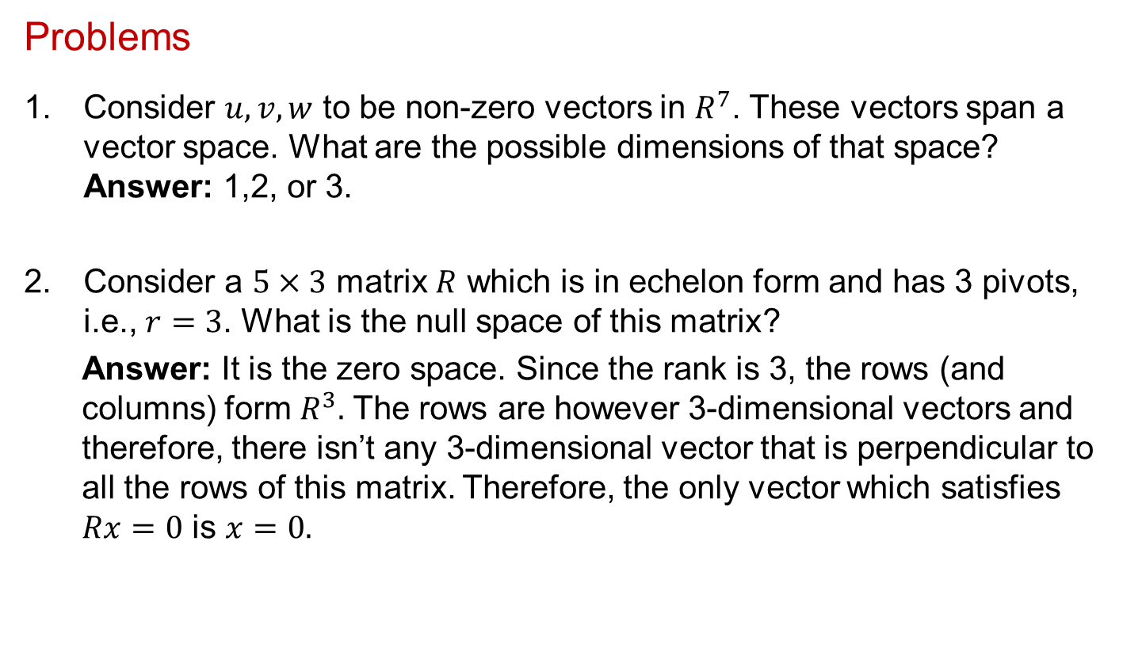
Mathematics for Signals and Systems
Problems
Consider $u,v,w$ to be non-zero vectors in $R^{7}$. These vectors span a vector space. What are the possible dimensions of that space? Answer: 1,2, or 3.
Consider a $5×3$ matrix $R$ which is in echelon form and has 3 pivots, i.e., $r=3$. What is the null space of this matrix?
Answer: It is the zero space. Since the rank is 3, the rows (and columns) form $R^{3}.$ The rows are however 3-dimensional vectors and therefore, there isn’t any 3-dimensional vector that is perpendicular to all the rows of this matrix. Therefore, the only vector which satisfies $Rx=0$ is $x=0.$

Slide 3
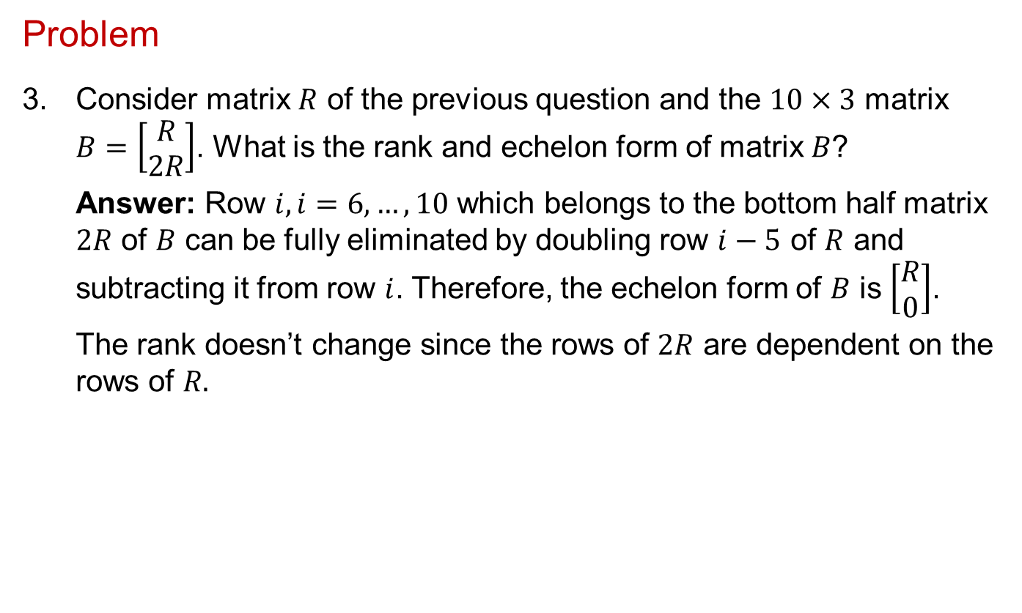
Mathematics for Signals and Systems
Problem
3. Consider matrix $R$ of the previous question and the $10×3$ matrix $B=\left[\begin{matrix}R \\ 2R\end{matrix}\right]$. What is the rank and echelon form of matrix $B$?
Answer: Row $i, i=6,…,10$ which belongs to the bottom half matrix $2R$ of $B$ can be fully eliminated by doubling row $i−5$ of $R$ and subtracting it from row $i$. Therefore, the echelon form of $B$ is $\left[\begin{matrix}R \\ 0\end{matrix}\right]$.
The rank doesn’t change since the rows of $2R$ are dependent on the rows of $R.$

Slide 4
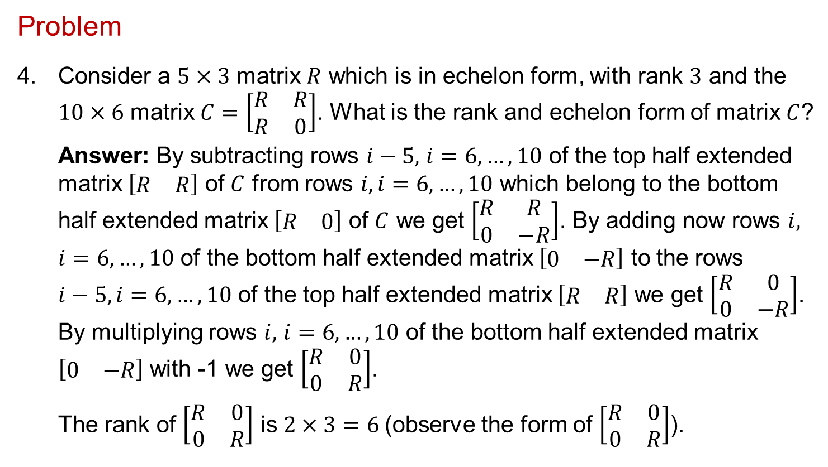
Mathematics for Signals and Systems
Problem
4. Consider a $5×3$ matrix $R$ which is in echelon form, with rank $3$ and the $10×6$ matrix $C=\left[\begin{matrix}R & R \\ R & 0\end{matrix}\right]$. What is the rank and echelon form of matrix $C$?
Answer: By subtracting rows $i−5,$ $i=6,…,10$ of the top half extended matrix $\left[\begin{matrix}R & R\end{matrix}\right]$ of $C$ from rows $i, i=6,…,10$ which belong to the bottom half extended matrix $\left[\begin{matrix}R & 0\end{matrix}\right]$ of $C$ we get $\left[\begin{matrix}R & R \\ 0 & −R\end{matrix}\right]$. By adding now rows $i,$ $i=6,…,10$ of the bottom half extended matrix $\left[\begin{matrix}0 & −R\end{matrix}\right]$ to the rows $i−5, i=6,…,10$ of the top half extended matrix $\left[\begin{matrix}R & R\end{matrix}\right]$ we get $\left[\begin{matrix}R & 0 \\ 0 & −R\end{matrix}\right]$. By multiplying rows $i,$ $i=6,…,10$ of the bottom half extended matrix $\left[\begin{matrix}0 & −R\end{matrix}\right]$ with -1 we get $\left[\begin{matrix}R & 0 \\ 0 & R\end{matrix}\right]$.
The rank of $\left[\begin{matrix}R & 0 \\ 0 & R\end{matrix}\right]$ is $2×3=6$(observe the form of $\left[\begin{matrix}R & 0 \\ 0 & R\end{matrix}\right]$).

Slide 5
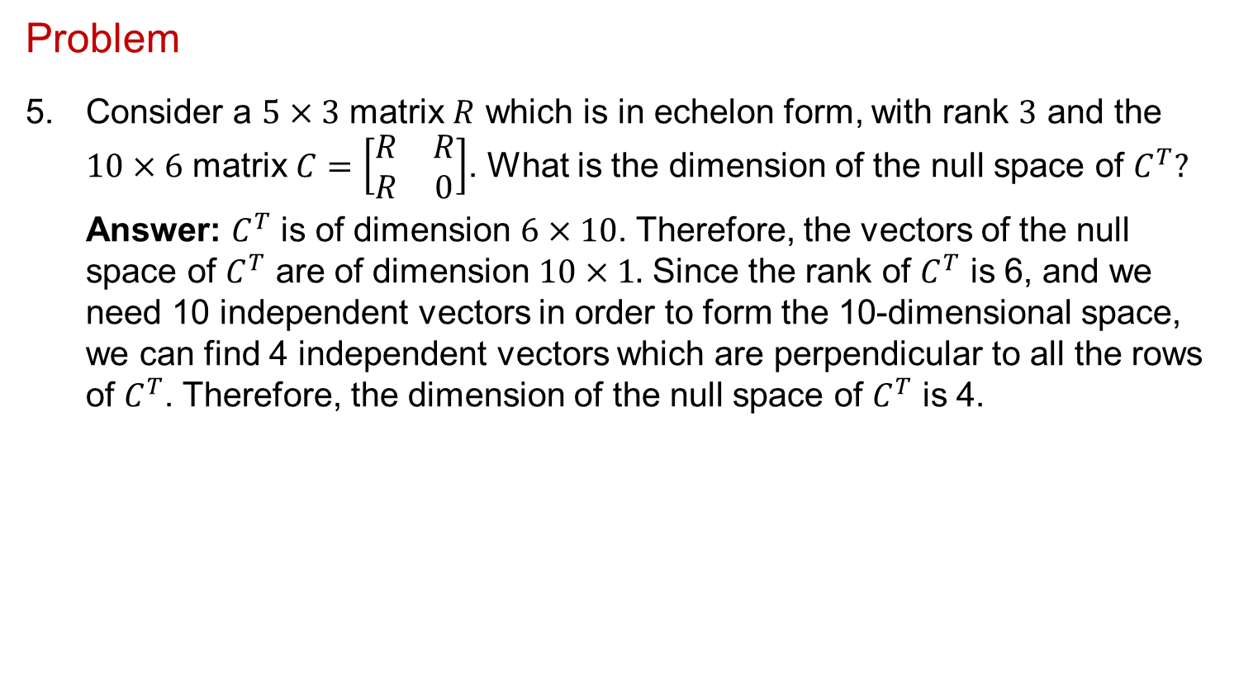
Mathematics for Signals and Systems
Problem
5. Consider a $5×3$ matrix $R$ which is in echelon form, with rank $3$ and the $10×6$ matrix $C=\left[\begin{matrix}R & R \\ R & 0\end{matrix}\right]$. What is the dimension of the null space of $C^{T}?$
Answer: $C^{T}$ is of dimension $6×10$. Therefore, the vectors of the null space of $C^{T}$ are of dimension $10×1.$ Since the rank of $C^{T}$ is 6, and we need 10 independent vectors in order to form the 10-dimensional space, we can find 4 independent vectors which are perpendicular to all the rows of $C^{T}$. Therefore, the dimension of the null space of $C^{T}$ is 4.

Slide 6
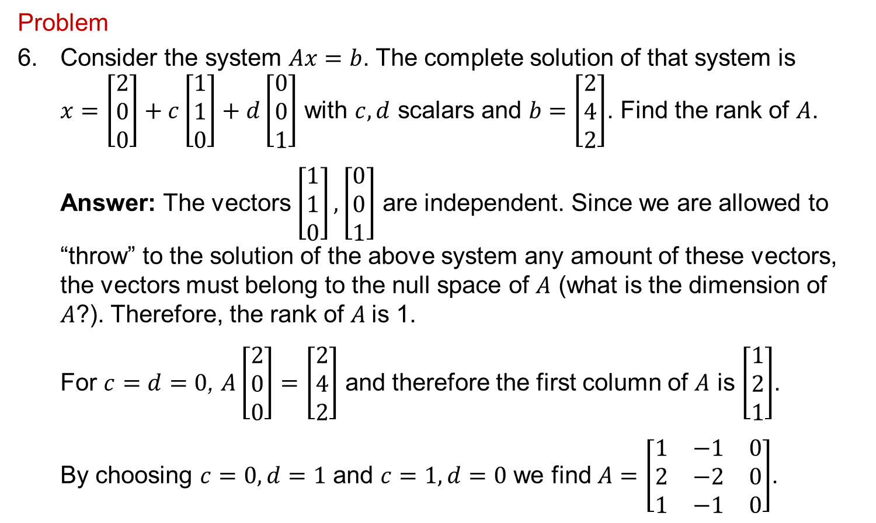
Mathematics for Signals and Systems
Problem
6. Consider the system $Ax=b$. The complete solution of that system is $x=\left[\begin{matrix}2 \\ 0 \\ 0\end{matrix}\right]+c\left[\begin{matrix}1 \\ 1 \\ 0\end{matrix}\right]+d\left[\begin{matrix}0 \\ 0 \\ 1\end{matrix}\right]$ with $c,d$ scalars and $b=\left[\begin{matrix}2 \\ 4 \\ 2\end{matrix}\right]$. Find the rank of $A$.
Answer: The vectors $\left[\begin{matrix}1 \\ 1 \\ 0\end{matrix}\right],\left[\begin{matrix}0 \\ 0 \\ 1\end{matrix}\right]$ are independent. Since we are allowed to “throw” to the solution of the above system any amount of these vectors, the vectors must belong to the null space of $A$ (what is the dimension of $A$?). Therefore, the rank of $A$is 1.
For $c=d=0$, $A\left[\begin{matrix}2 \\ 0 \\ 0\end{matrix}\right]=\left[\begin{matrix}2 \\ 4 \\ 2\end{matrix}\right]$ and therefore the first column of $A$ is $\left[\begin{matrix}1 \\ 2 \\ 1\end{matrix}\right]$.
By choosing $c=0,d=1$ and $c=1,d=0$ we find $A=\left[\begin{matrix}1 & −1 & 0 \\ 2 & −2 & 0 \\ 1 & −1 & 0\end{matrix}\right]$.

Slide 7
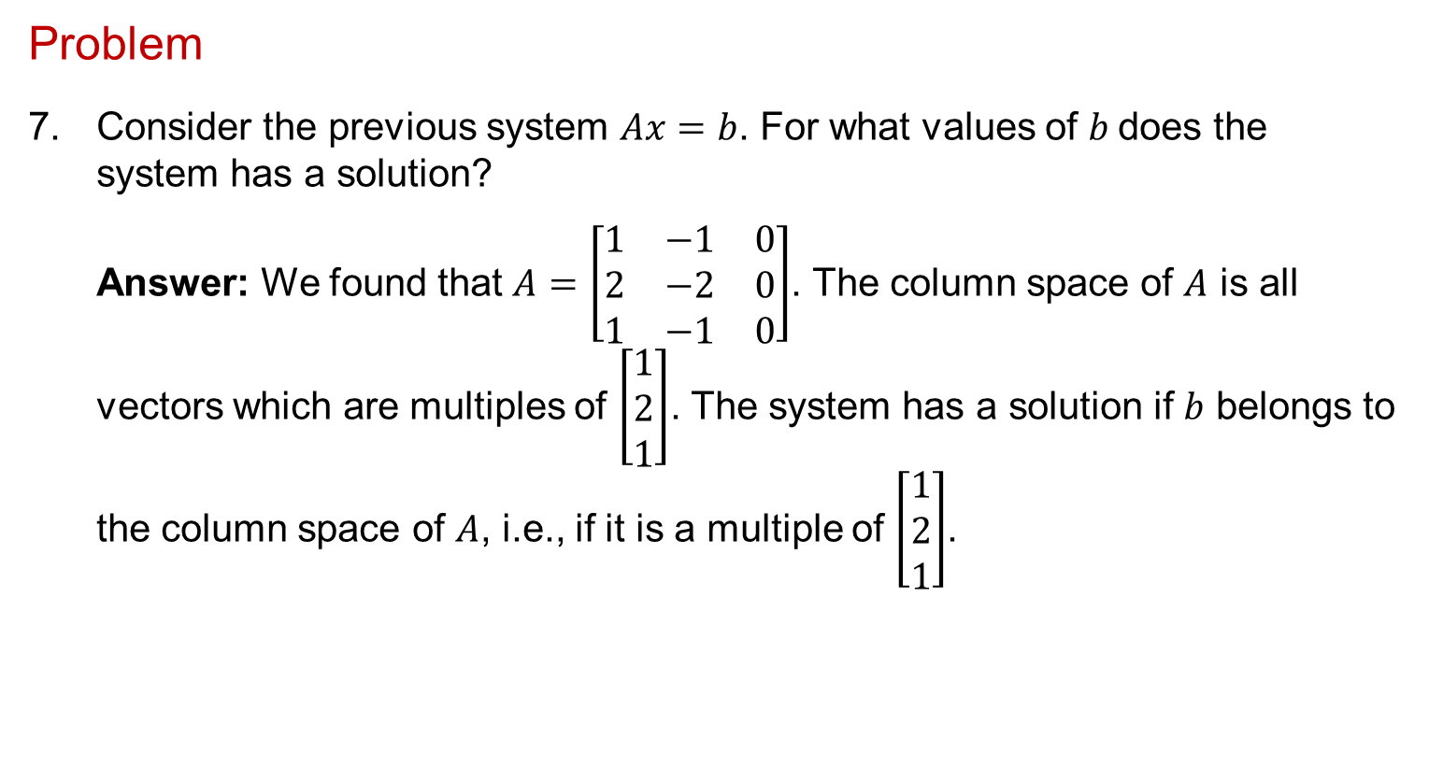
Mathematics for Signals and Systems
Problem
7. Consider the previous system $Ax=b$. For what values of $b$does the system has a solution?
Answer: We found that $A=\left[\begin{matrix}1 & −1 & 0 \\ 2 & −2 & 0 \\ 1 & −1 & 0\end{matrix}\right]$. The column space of $A$ is all vectors which are multiples of $\left[\begin{matrix}1 \\ 2 \\ 1\end{matrix}\right]$. The system has a solution if $b$ belongs to the column space of $A$, i.e., if it is a multiple of $\left[\begin{matrix}1 \\ 2 \\ 1\end{matrix}\right]$.

Slide 8
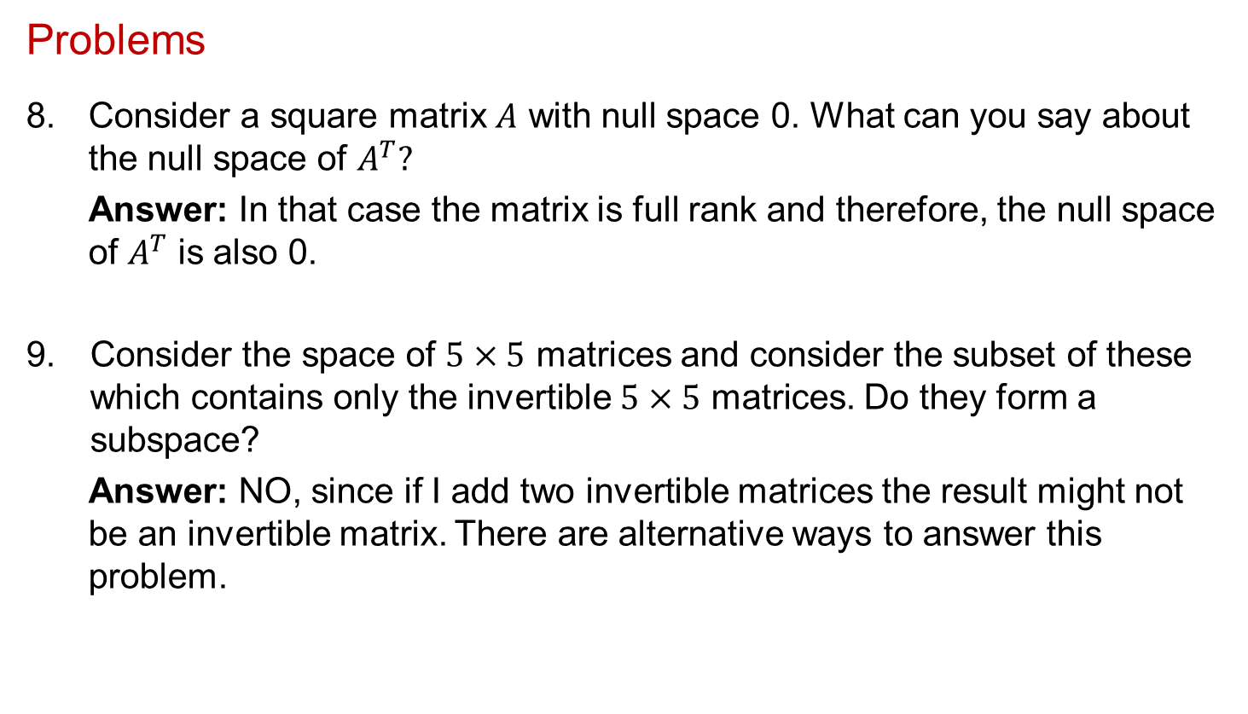
Mathematics for Signals and Systems
Problems
8. Consider a square matrix $A$ with null space 0. What can you say about the null space of $A^{T}?$
Answer: In that case the matrix is full rank and therefore, the null space of $A^{T}$ is also 0.
Consider the space of $5×5$ matrices and consider the subset of these which contains only the invertible $5×5$ matrices. Do they form a subspace?
Answer: NO, since if I add two invertible matrices the result might not be an invertible matrix. There are alternative ways to answer this problem.

Slide 9
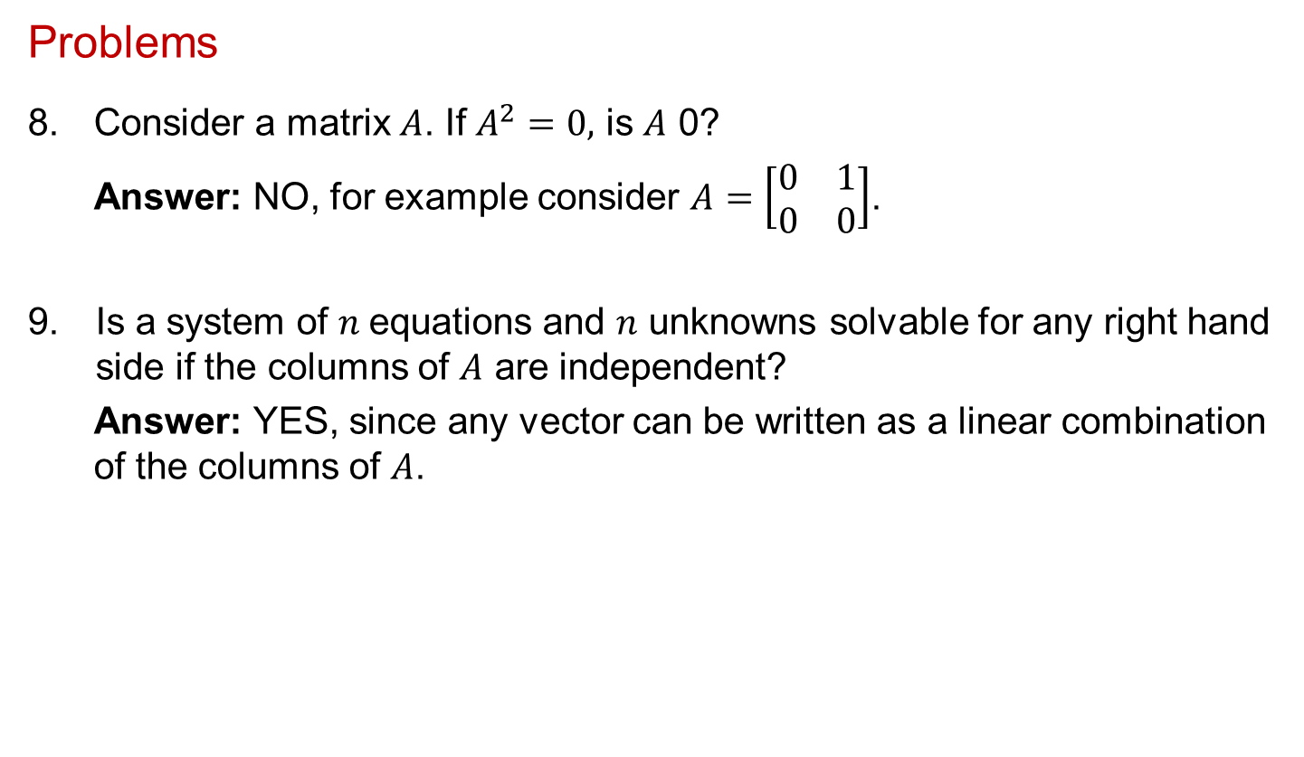
Mathematics for Signals and Systems
Problems
8. Consider a matrix $A$. If $A^{2}=0,$ is $A$ 0?
Answer: NO, for example consider $A=\left[\begin{matrix}0 & 1 \\ 0 & 0\end{matrix}\right]$.
Is a system of $n$equations and $n$ unknowns solvable for any right hand side if the columns of $A$ are independent?
Answer: YES, since any vector can be written as a linear combination of the columns of $A$.

Slide 10
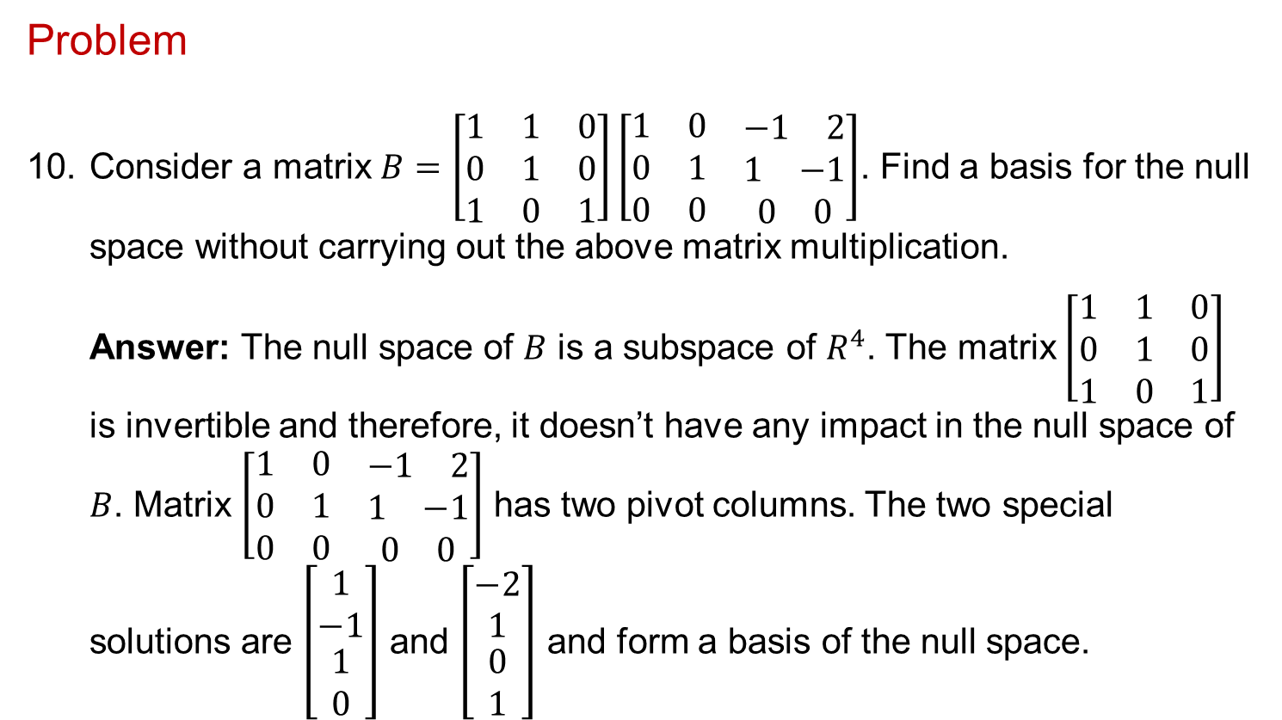
Mathematics for Signals and Systems
Problem
10. Consider a matrix $B=\left[\begin{matrix}1 & 1 & 0 \\ 0 & 1 & 0 \\ 1 & 0 & 1\end{matrix}\right]\left[\begin{matrix}1 & 0 & \begin{matrix}−1 & 2\end{matrix} \\ 0 & 1 & \begin{matrix}1 & −1\end{matrix} \\ 0 & 0 & \begin{matrix}0 & 0\end{matrix}\end{matrix}\right]$. Find a basis for the null space without carrying out the above matrix multiplication.
Answer: The null space of $B$ is a subspace of $R^{4}$. The matrix $\left[\begin{matrix}1 & 1 & 0 \\ 0 & 1 & 0 \\ 1 & 0 & 1\end{matrix}\right]$ is invertible and therefore, it doesn’t have any impact in the null space of $B$. Matrix $\left[\begin{matrix}1 & 0 & \begin{matrix}−1 & 2\end{matrix} \\ 0 & 1 & \begin{matrix}1 & −1\end{matrix} \\ 0 & 0 & \begin{matrix}0 & 0\end{matrix}\end{matrix}\right]$ has two pivot columns. The two special solutions are $\left[\begin{matrix}1 \\ −1 \\ \begin{matrix}1 \\ 0\end{matrix}\end{matrix}\right]$ and $\left[\begin{matrix}−2 \\ 1 \\ \begin{matrix}0 \\ 1\end{matrix}\end{matrix}\right]$ and form a basis of the null space.

Slide 11
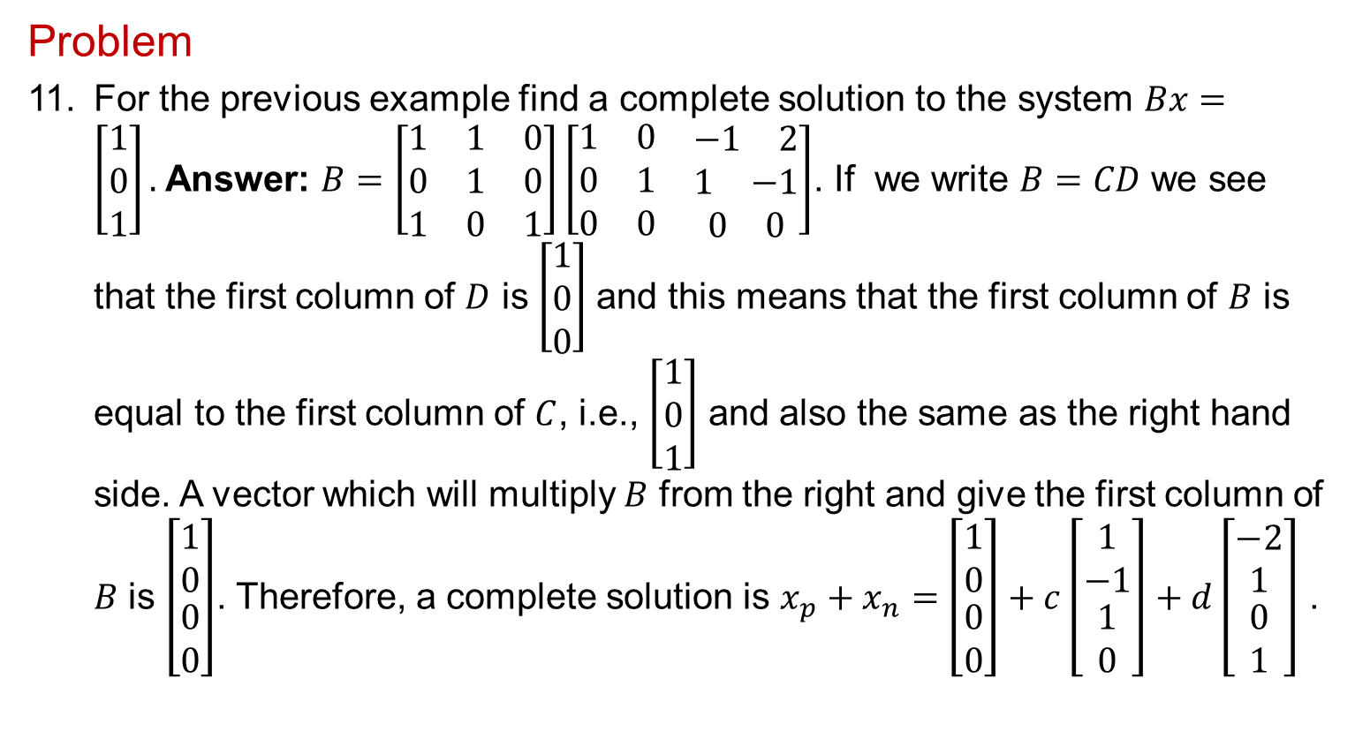
Mathematics for Signals and Systems
Problem
11. For the previous example find a complete solution to the system $Bx=\left[\begin{matrix}1 \\ 0 \\ 1\end{matrix}\right].$Answer: $B=\left[\begin{matrix}1 & 1 & 0 \\ 0 & 1 & 0 \\ 1 & 0 & 1\end{matrix}\right]\left[\begin{matrix}1 & 0 & \begin{matrix}−1 & 2\end{matrix} \\ 0 & 1 & \begin{matrix}1 & −1\end{matrix} \\ 0 & 0 & \begin{matrix}0 & 0\end{matrix}\end{matrix}\right]$. If we write $B=CD$ we see that the first column of $D$ is $\left[\begin{matrix}1 \\ 0 \\ 0\end{matrix}\right]$and this means that the first column of $B$ is equal to the first column of $C$, i.e., $\left[\begin{matrix}1 \\ 0 \\ 1\end{matrix}\right]$ and also the same as the right hand side. A vector which will multiply $B$ from the right and give the first column of $B$ is $\left[\begin{matrix}1 \\ 0 \\ \begin{matrix}0 \\ 0\end{matrix}\end{matrix}\right]$. Therefore, a complete solution is $x_{p}+x_{n}=$ $\left[\begin{matrix}1 \\ 0 \\ \begin{matrix}0 \\ 0\end{matrix}\end{matrix}\right]+c\left[\begin{matrix}1 \\ −1 \\ \begin{matrix}1 \\ 0\end{matrix}\end{matrix}\right]+d\left[\begin{matrix}−2 \\ 1 \\ \begin{matrix}0 \\ 1\end{matrix}\end{matrix}\right]$ .

Slide 12
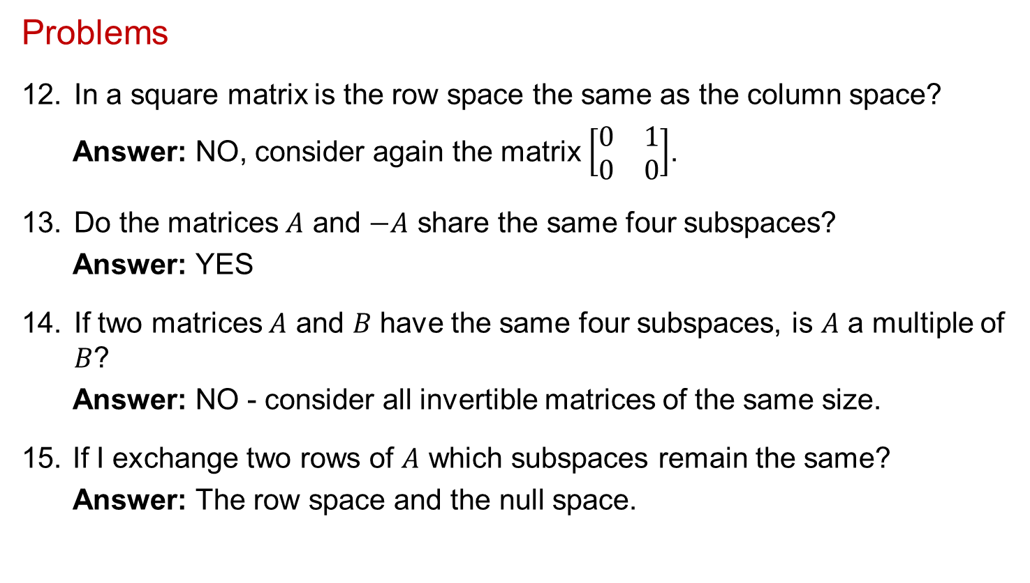
Mathematics for Signals and Systems
Problems
In a square matrix is the row space the same as the column space?
Answer: NO, consider again the matrix $\left[\begin{matrix}0 & 1 \\ 0 & 0\end{matrix}\right]$.
Do the matrices $A$ and $−A$ share the same four subspaces?
Answer: YES
If two matrices $A$ and $B$ have the same four subspaces, is $A$ a multiple of $B$?
Answer: NO - consider all invertible matrices of the same size.
15. If I exchange two rows of $A$ which subspaces remain the same?
Answer: The row space and the null space.

