Slide 1
Digital Image Processing Introduction to Image Processing
DR TANIA STATHAKI
READER (ASSOCIATE PROFESSOR) IN SIGNAL PROCESSING IMPERIAL COLLEGE LONDON

Slide 2
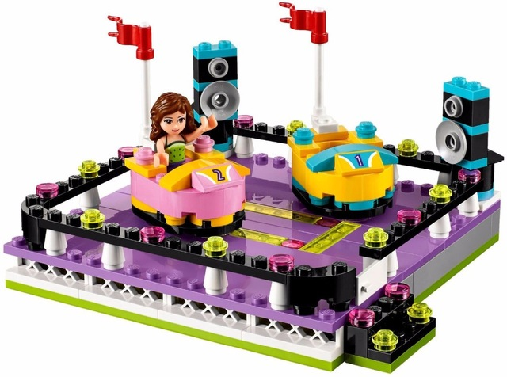
Logistics of the course
Welcome to the Digital Image Processing course.
This course is very important to students who are interested in taking any course related to Computer Vision and Machine learning and it is also related to Pattern Recognition and Artificial Intelligence.
Image Processing algorithms constitute the
building blocks of most Computer Vision
and Machine learning algorithms.
Duration: 20 lectures
Assessment: 100% exam
Textbook:
R. C. Gonzalez, R. E. Woods, Digital Image Processing, Addison Wesley.
There are many editions of the above book, any of them is good.

Slide 3
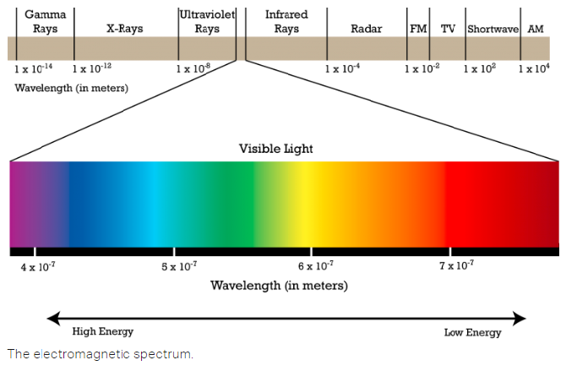
What is a digital image?
We are mostly familiar with images that we can see with our eyes. These are the images we take with our cameras. They form a very small part of the spectrum!

Slide 4
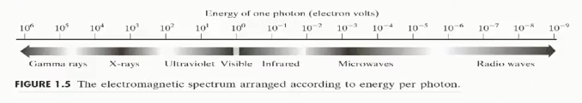
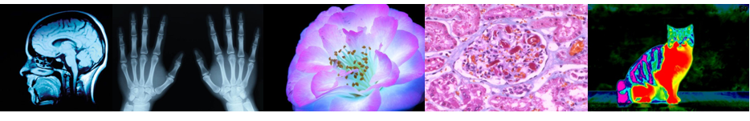
What is a digital image cont?
Images can be captured from other parts of the spectrum. For example:
Gamma images
X ray images
Ultra violet images
Optical-microscopy (light-microscopy) images
Infrared images
Satellite images
Thermal images

Slide 5
What is Image Processing?
Image Processing refers to a huge collection of mathematical techniques which aim at analysing digital images in order to achieve various goals.
The mathematics involved in Image Processing are mainly discrete mathematics since we are dealing with digital images. They could be:
Multi-dimensional filters
Probabilities and statistics
System analysis algorithms
Others
Image Processing topics include:
Image modelling
Image restoration, enhancement, reconstruction
Image compression
Analysis, detection, recognition, understanding

Slide 6
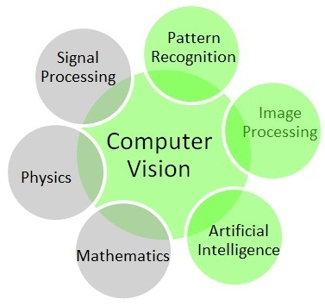
Image Processing and Computer Vision: what is the difference?
Image Processing refers to a lower level (modelling/signal analysis/noise removal) of processing of an image signal compared to Computer Vision.
For example:
Finding good mathematical features to describe a human silhouette is image processing.
Using the features which describe a human silhouette as part of a system that detects humans in an image is computer vision.
Computer Vision refers to any type
of science that attempts to make a digital
computer carry human vision tasks.
It is a bigger and less well-defined
area compared to Image Processing.
The two areas overlap.

Slide 7

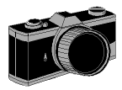


Image acquisition
An image is a projection of a 3D scene into a 2D projection plane.
An image can be defined as a function of two variables $(x,y)$ as $f\left(x,y\right): R^{2}→R$, where for each position $(x,y)$ in the projection plane, $f\left(x,y\right)$ defines the light intensity at this point.

Slide 8
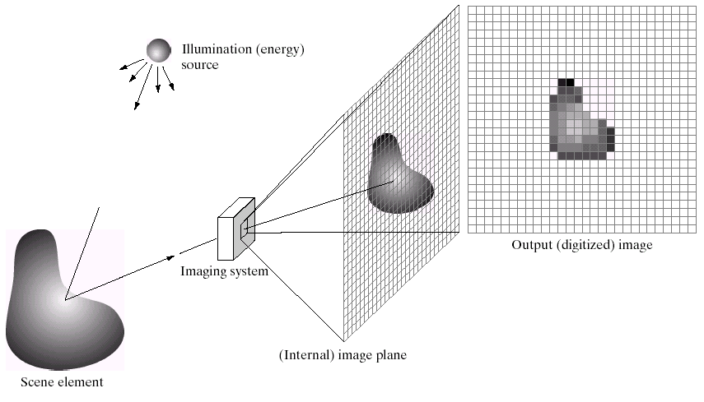
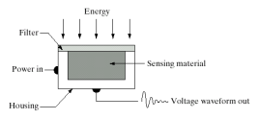

Image acquisition cont.
pixel$=$picture element
quantization and sampling
image sensors

Slide 9
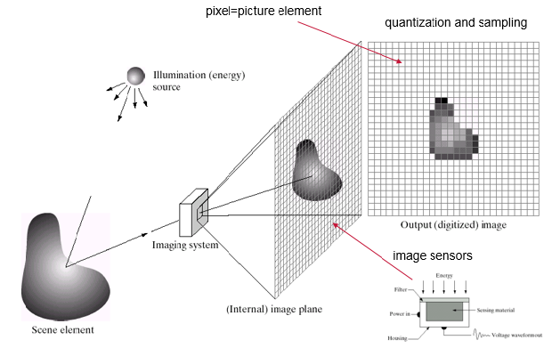
From analogue to digital
sample and quantize
digital storage (disk)
imaging
system
digital computer
display
object
capture (CCD or CMOS sensor)
digitize
store
process

Slide 10
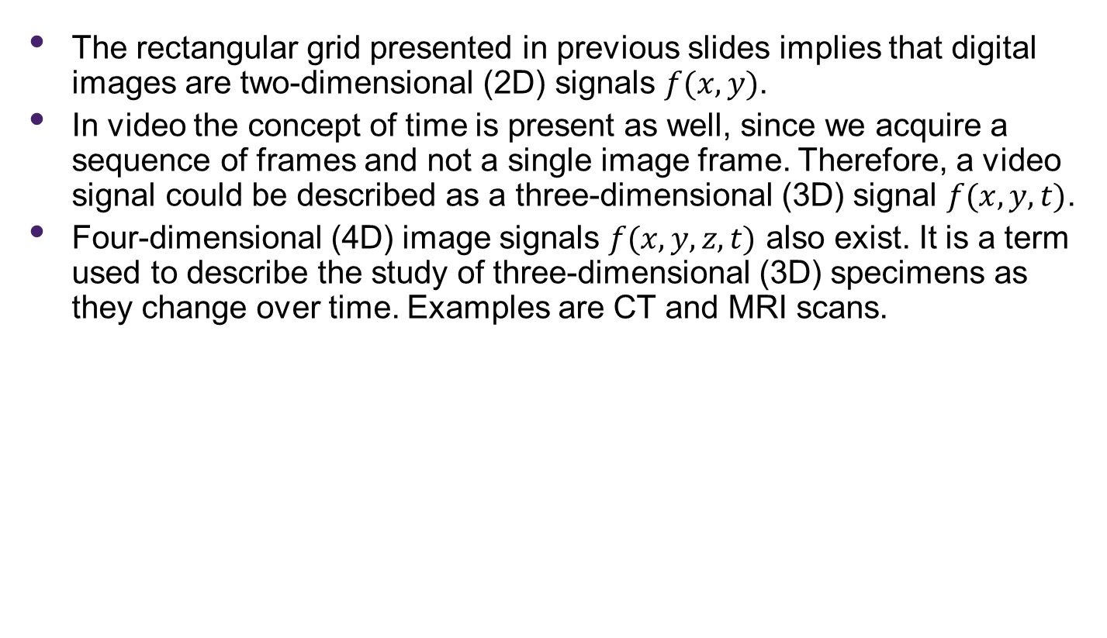
Image as a function
The rectangular grid presented in previous slides implies that digital images are two-dimensional (2D) signals $f(x,y)$.
In video the concept of time is present as well, since we acquire a sequence of frames and not a single image frame. Therefore, a video signal could be described as a three-dimensional (3D) signal $f(x,y,t)$.
Four-dimensional (4D) image signals $f(x,y,z,t)$ also exist. It is a term used to describe the study of three-dimensional (3D) specimens as they change over time. Examples are CT and MRI scans.

Slide 11
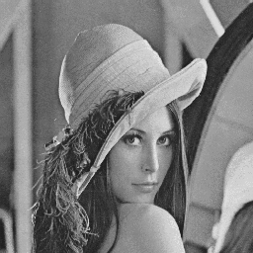

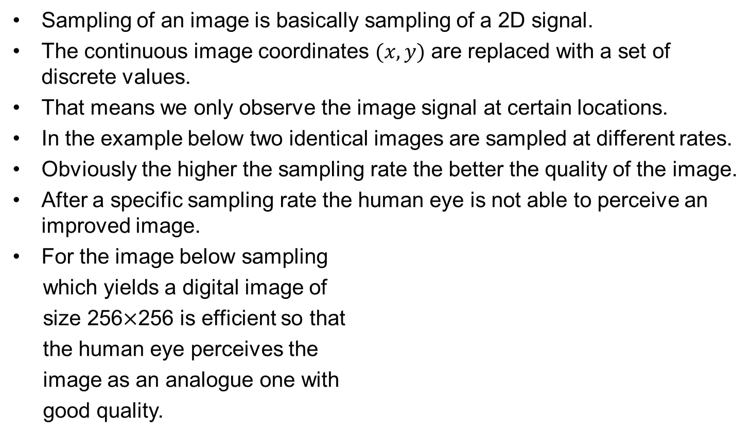


2D Sampling: From analogue images to digital images (pixels)
Sampling of an image is basically sampling of a 2D signal.
The continuous image coordinates $(x,y)$ are replaced with a set of discrete values.
That means we only observe the image signal at certain locations.
In the example below two identical images are sampled at different rates.
Obviously the higher the sampling rate the better the quality of the image.
After a specific sampling rate the human eye is not able to perceive an improved image.
For the image below sampling
which yields a digital image of
size 256$×$256 is efficient so that
the human eye perceives the
image as an analogue one with
good quality.
256$×$256
64$×$64

Slide 12

Quantisation: From continuous image signal to discrete image signal
Quantisation of an image is basically discretization of the image signal $f(x,y)$ (discretization of the image amplitude).
After sampling and quantization both pixel coordinates $(x,y)$ and image values $f(x,y)$ are represented with binary numbers.
Below you see an image quantised in two levels (binary).
For images of the so called gray level
type where $f(x,y)$ is a scalar and
represents all shades of the gray
colour, ranging from the absolute
black (0) to the absolute white (255),
we normally use 256 gray levels
for $f(x,y)$.
The value of $f(x,y)$ is called the
intensity of the image.
0
255
255
0
0
0
0
255
0
0
0
0
255
0
0
0
0
255
0
0
0
255
255
255
0

Slide 13
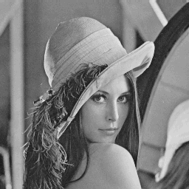
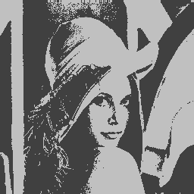



Quantisation cont.
Obviously the more quantisation levels we assign to digital images the better their quality.
The term quality gives rooms for discussion. When can we say that an image is of good quality?
Image processing scientists use various mathematical metrics to asses the quality of in image. We will come across with some of them later.
256$×$256 256 levels
256$×$256 32 levels
256$×$256 2 levels

Slide 14
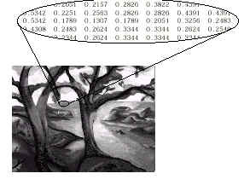
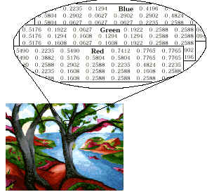
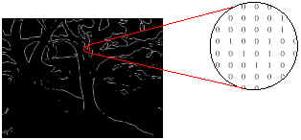
Image intensity: gray level images/colour images/binary images

Slide 15



This course
Part I: Image Transforms
Image transforms are used extensively in Image Processing.
Very often the transform of an image gives a lot more insight into the properties of an image compared to the original spatial representation of the image.
Fourier Transform for images is very popular.
Other transforms are popular as well, as for example, the Discrete Cosine Transform (JPEG standard).
Fourier Transform
Amplitude Phase
Original Image

Slide 16
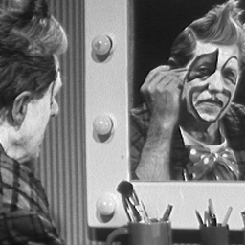
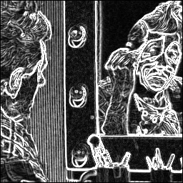
This course
Part II: Image Enhancement
Image enhancement refers to a collection of algorithms which aim at improving the quality of a digitally stored image using mathematical techniques.
It is quite easy, for example, to make an image lighter or darker, or to increase or decrease its contrast.
We often want to extract certain features from an image, as for example, its edges (see figure below right.)
Original Image
High Pass Filtering

Slide 17

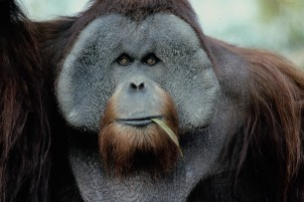
This course
Part III: Image Restoration
Image Restoration is the operation of taking a corrupt/noisy image and estimating the clean, original image.
Corruption may come in many forms such as motion blur, noise and camera mis-focus.
Image restoration is performed by reversing the process that blurred the image using system identification techniques.
Image Enhancement and Image Restoration have similar goals but different approaches.
Distorted Image
Restored Image

Slide 18
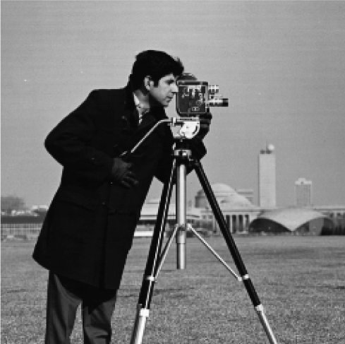

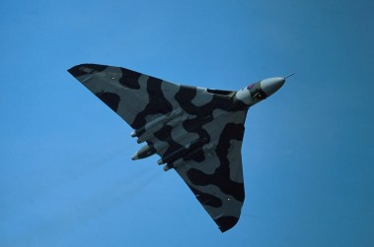

Distortion due to Camera Misfocus
Original image
Distorted image

Slide 19

Distortion due to object motion
Camera lens

Slide 20
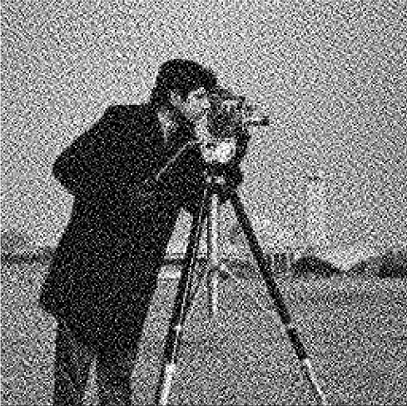
Distortion due to random noise
Original image
Distorted image

Slide 21
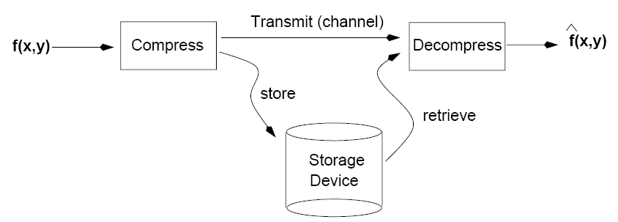
This course
Part IV: Image Compression
The goal of image compression is to reduce the amount of data required to represent a digital image.
Image compression aims at reducing the cost for storage or transmission of images.
An advanced mage compression algorithm may take advantage of the human visual system and the redundancies within particular image data to provide superior results compared to generic compression methods.
It is hard to imagine life without compression since you take for granted the fact that there are billions of images available on line.

Slide 22
Applications of Image Processing
Medicine
Cultural heritage
Environment
Astronomy
Security
Defense
Surveillance

Slide 23
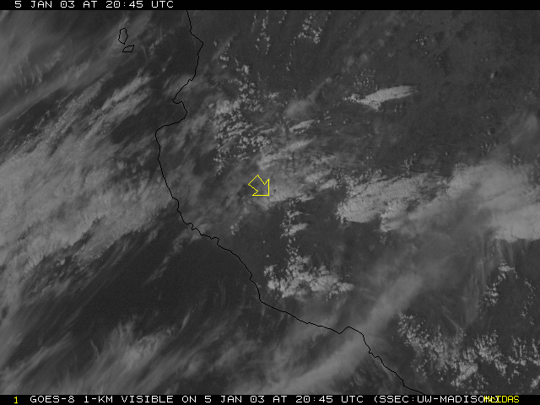
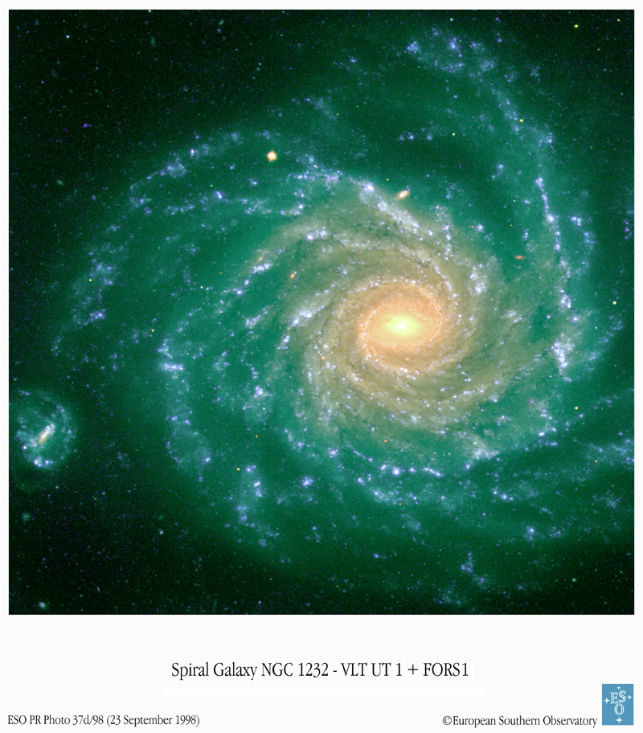
Satellite/astronomical images: examples

Slide 24
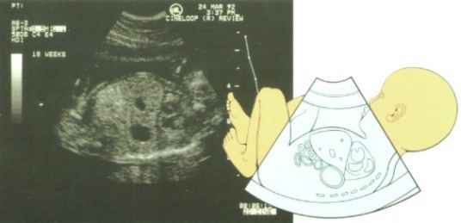
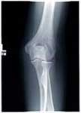
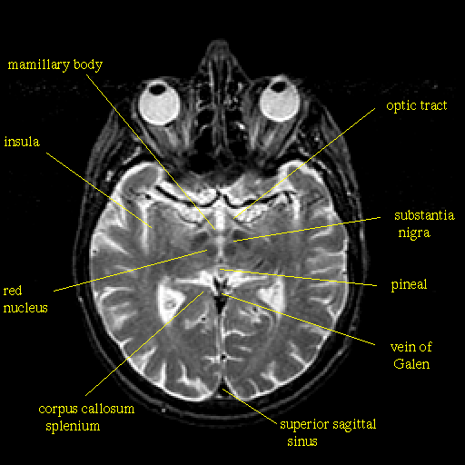
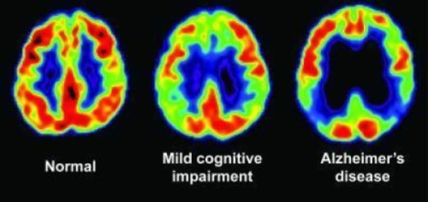
Medical images: examples

