Slide 1
Digital Image Procesing Discrete CosineTrasform (DCT) in Image Processing
DR TANIA STATHAKI
READER (ASSOCIATE PROFFESOR) IN SIGNAL PROCESSING IMPERIAL COLLEGE LONDON

Slide 2
1-D Discrete Cosine Transform

Slide 3
1-D Inverse Discrete Cosine Transform (IDCT)

Slide 4
1-D Basis Functions N=8

Slide 5
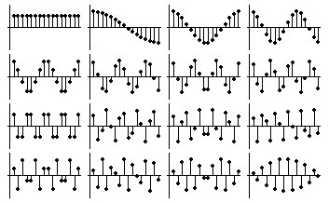
1-D Basis Functions N=16

Slide 6
Example: 1D signal

Slide 8
2-D Discrete Cosine Transform (IDCT)

Slide 9
Advantages of the Discrete Cosine Transform
Notice that the DCT is a real transform.
The DCT has excellent energy compaction properties.
There are fast algorithms to compute the DCT similar to the FFT.

Slide 10
2-D Basis Functions N=4

Slide 11
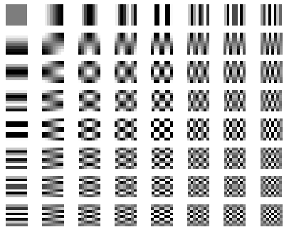
2-D Basis Functions N=8

Slide 12
Separability of DCT

Slide 13
Example: 2D signal

Slide 14
Example: 8x8 Block DCT

Slide 15
Example: Energy Compaction

Slide 16
Experiment that demonstrates the superiority of DCT in terms of energy compaction
Experiment

Slide 17
Relation between DCT and DFT
Define

Slide 18
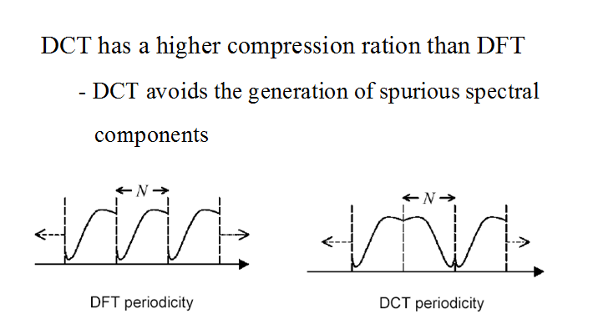
Relation between DCT and DFT

Slide 19
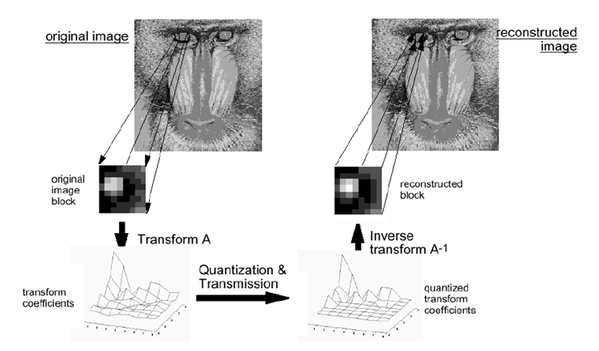
Using DCT for Image Compression

