Slide 1



Sensing the physical world: Sparse Sampling meets Strang-Fix and Baron de Prony
Pier Luigi Dragotti Imperial College London
August 23, 2016¹
¹This research is supported by European Research Council ERC, project 277800 (RecoSamp)

Slide 2
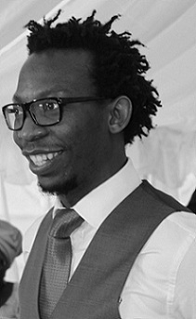
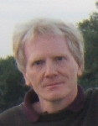
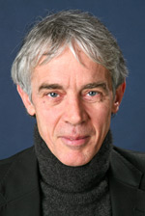
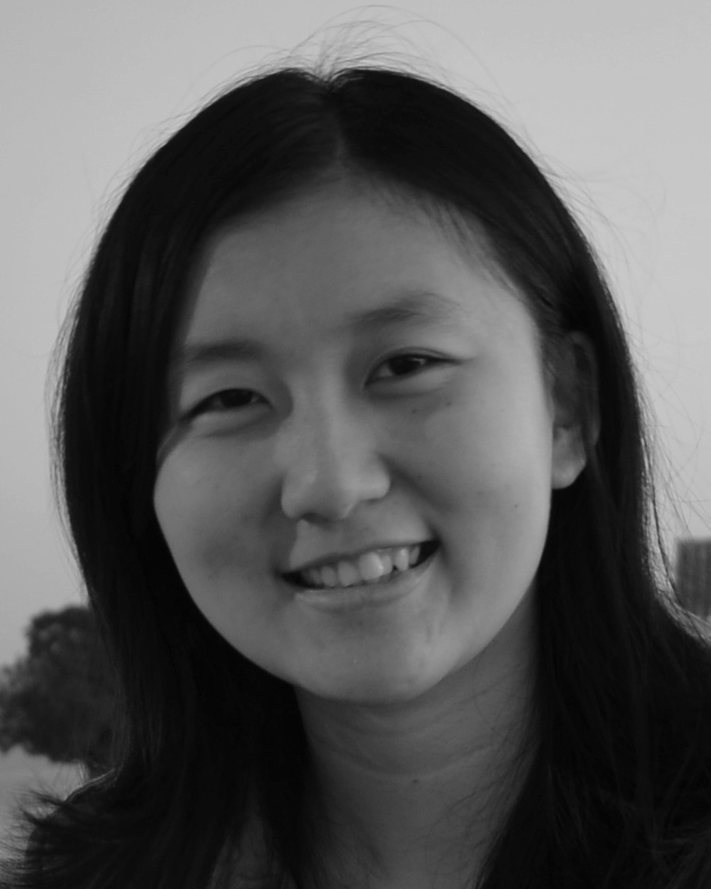
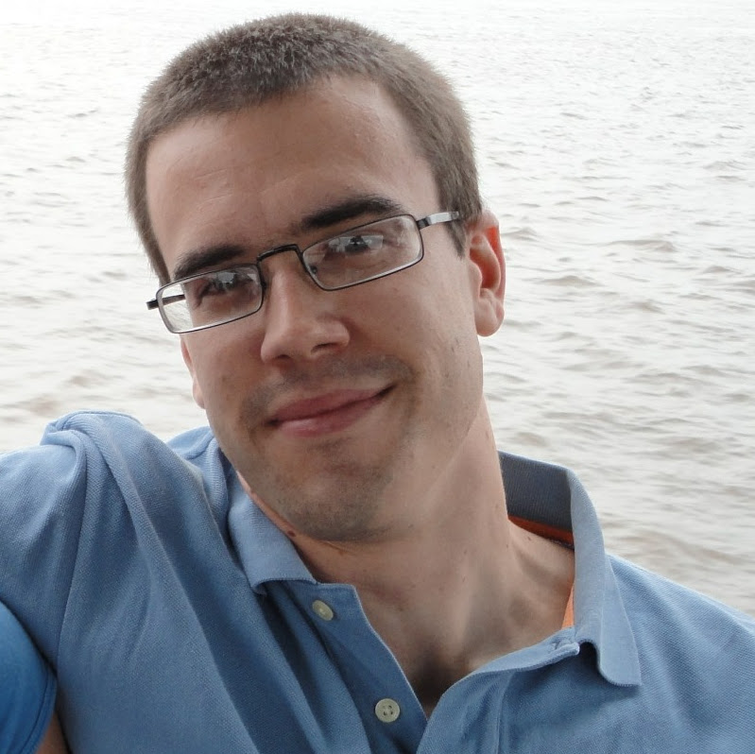
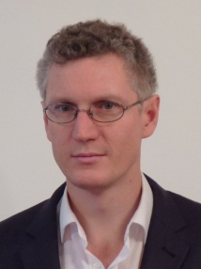
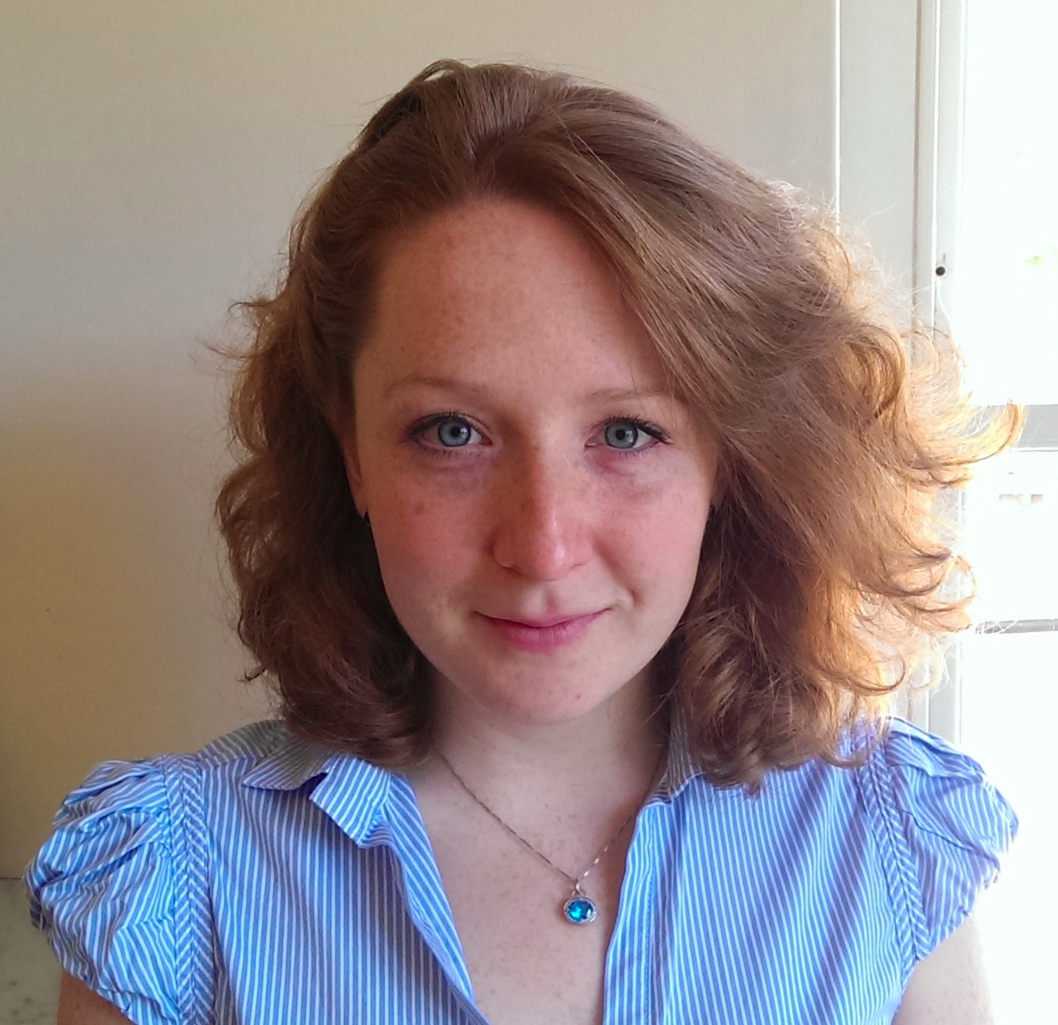
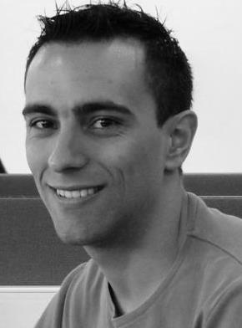
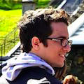
Special Thank to Collaborators and Students

Slide 3
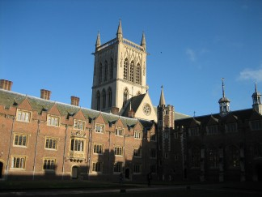

A few Interesting Applications: Digital Imaging
Real Scene
Digital Image
The real scene is analogue and is turned into a digital image by the camera
Can we overcome the limitation of the camera and, given the pixels, obtain a sharper image with arbitrary resolution?
Sparsity: Edges and contours can be modelled using a small number of parameters

Slide 4
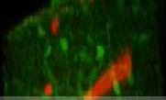
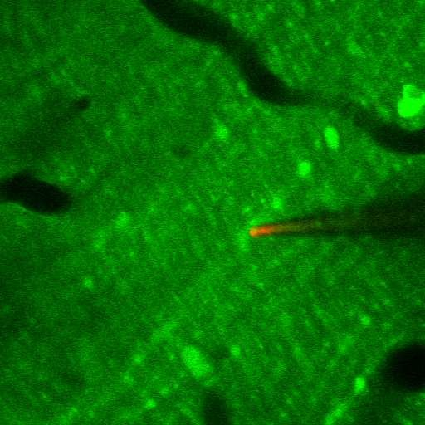
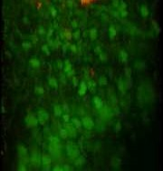
Application: Neuroscience
Goal: Understanding how information processing occurs in neural circuits.
0.4
0.35
0.3
0.25
0.2
0.15
0.1
0.05
0
Fluorescence signal
35
40
45
Time (s)
50
55
60
Brain activity is analogue and it is observed with digital two-photon microscopes
Neurones communicate through pulses called Action Potentials (AP)
The problem of reconstructing the activity of a neurone is sparse when the shape of the AP is approximately known.

Slide 5
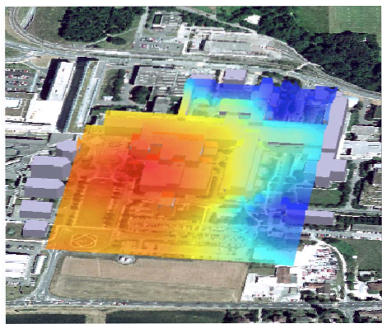
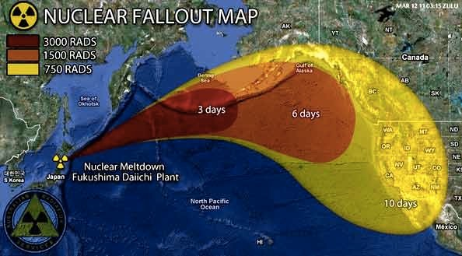
Application: Estimation of Diffusion Fields
Can we localise diffusion sources or acoustic sources using sensor networks?
Application:
1.Monitor dispersion in factories producing bio-chemicals 2.Check whether your government is lying ;-)
The diffusion field is analogue, spatio-temporal sensor measurements are digital

Slide 6
Problem Statement
What do all these problems have in common?
The world is analogue, computation is digital
The source is continuous in time and/or space, measurements are discrete (e.g., pixels in a camera, sensors measurements)
The data formation process is well understood and involves deterministic smoothing functions normally known a priori (e.g., point spread function in a camera, the diffusion kernel for diffusion fields)
Strong priors on the source to be estimated
Our Approach
From the samples, using the knowledge of the observation process, estimate proper integral measurements of the source (e.g., estimate the Fourier transform at specific frequencies)
Given the integral measurements (e.g., partial Fourier transform), solve the inverse/reconstruction problem using proper sparsity priors

Slide 7
The Sampling Problem

Slide 8
Outline
Goal 1: to map the samples to partial Fourier information about x (t)
Sample Formation Process (Sampling kernels)
Reproduction of exponentials and generalised Strang-Fix conditions
Goal 2: from partial knowledge of x (t) to x (t)
Analogue sparsity: Signals with Finite Rate of Innovation (FRI)
Prony’s Methods and Structured Least-Squares Methods
Exact results and performance analysis
Applications
Neuroscience
Sensor Networks and Diffusion Fields
Single Image Super-Resolution

Slide 9
The Sampling Kernel

Slide 10
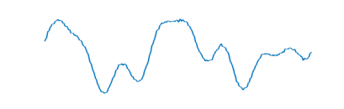
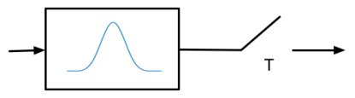
The Data Formation Process

Slide 11
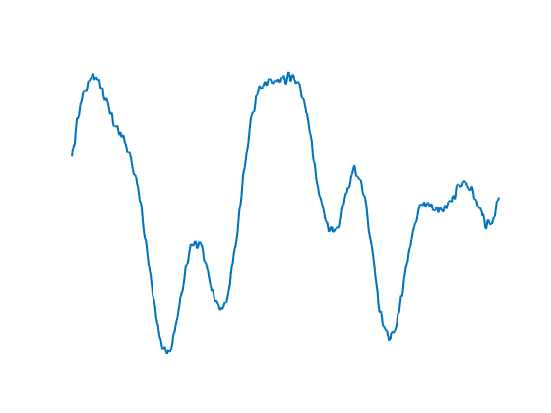
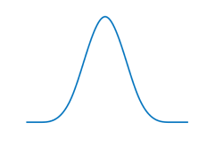

The Data Formation Process

Slide 12
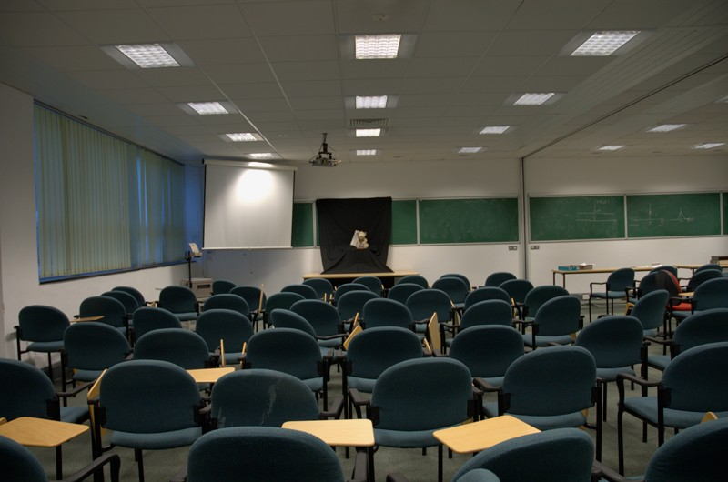
The Sampling Kernel
1
Line spread function
0
−6
−4 −2
0 2 4
Pixels (perpendicular)
6
(a)Original (2014 × 3039)
(b) Point Spread function

Slide 13
From Samples to Signals
Our first goal is to map the discrete sample to some information of the continuous-time signal (e.g. Fourier transform)
Key Insight: Use the knowledge of the acquisition process to map the discrete samples to some information about x (t)

Slide 14
From Samples to Signals

Slide 15
Exponential Reproducing Functions

Slide 16
Exponential Reproducing Functions

Slide 17
From Samples to Signals

Slide 18
Approximation of Exponentials

Slide 19
Generalized Strang-Fix Conditions

Slide 20
Approximate Strang-Fix
Strang-Fix conditions are not restrictive
Any low-pass or band-pass filter approximately satisfies them.
Gaussian
E-spline
1
0.5
0
−3π −2π −π 0 π
ω [rad·s⁻¹ ]
2π 3π
π
3π/2
2π
5π/2

Slide 21
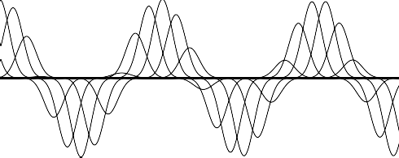
Reproduction of Exponentials (exact)
φ(t) is an E-spline

Slide 22
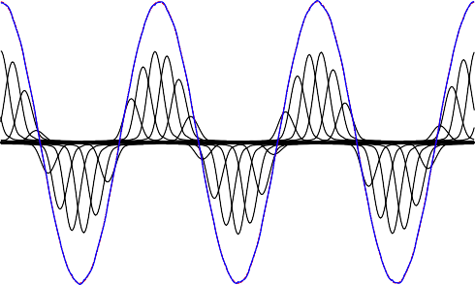
Approximate Strang-Fix
φ(t) from a real camera

Slide 23
Strang-Fix and the Acquisition Devices
We want the coefficients c_{m,n} that give as a good approximation of exponentials:
Some acquisition devices can do that exactly
Others can do it only approximately
Either cases we know how to find the best c_{m,n}
If you can design your own device make sure it satisfies the above
equation exactly

Slide 24
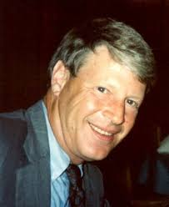
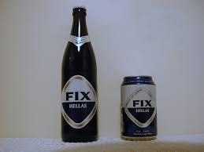
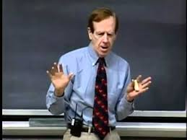
Strang-Fix and Generalized Strang-Fix Conditions
G. Strang G. Fix

Slide 25
Strang-Fix and Generalized Strang-Fix Conditions
Approximate Strang-Fix [UriguenBluD:TSP13]

Slide 26
From Samples to Signals

Slide 27
Signals with Finite Rate of Innovation

Slide 28
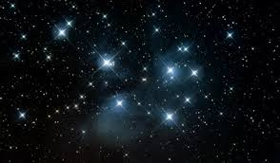
Sampling the ‘Starry Sky above me’
Essential information in a starry sky: location and intensity of the stars
K stars → 2K parameters

Slide 29
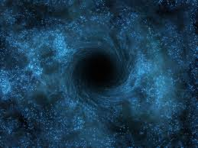
Sampling the ‘Starry Sky above me’
Stars
Black hole
Imagine using black holes to ‘switch off’ each star until the output is zero.
The location of the black holes corresponds to that of the stars.
This second problem is easier than the first one if we operate in frequency domain

Slide 30
Sampling the ‘Starry Sky above me’

Slide 31
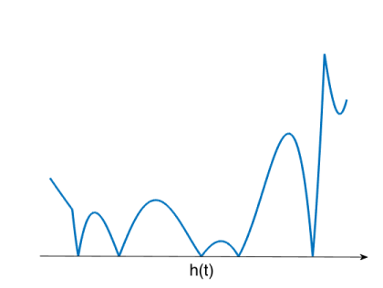
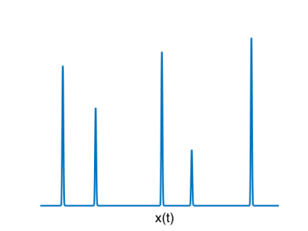
Annihilation of the Starry Sky
We want:
It is sufficient to have where are the K locations of the stars

Slide 32
Annihilation of the Starry Sky
We want:
It is sufficient to have where are the K locations of the stars
Assume with
If h(t) is a polynomial its coefficients are found in frequency domain by solving
This is a linear problem when is known at 2K evenly spaced frequencies

Slide 33
Sampling Streams of Diracs

Slide 34
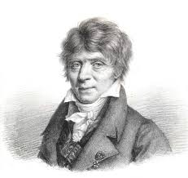
Prony’s Method

Slide 35
Overview of Prony’s Method

Slide 36
Overview of Prony’s Method

Slide 37
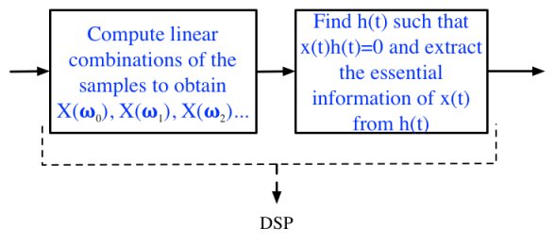


Sparse Sampling Overview

Slide 38
Sampling Streams of Diracs: Numerical Example

Slide 39
Stream of Decaying Exponentials
5
4
3
2
1
0
y(t)
5
4
3
2
1
0
0.06
yn
zn
0.04
0.02
0
0.5
t [s]
(a) Input signal, x(t)
1
0
0 0.5 1 1.5
0
0.5
t [s]
(c) Reconstructed signal
1
t [s]
(b) Filtered and sampled signal

Slide 40

Sampling 2-D domains
The curve is uniquely specified by a finite number of parameters which
are found through annihilation of the samples [PanBD:TIP14].

Slide 41
Performance Bounds in Sparse Sampling
The elusive trade-off between noise and resolution
Note: Image courtesy of Martin Vetterli

Slide 42
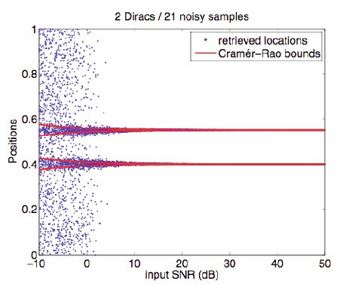
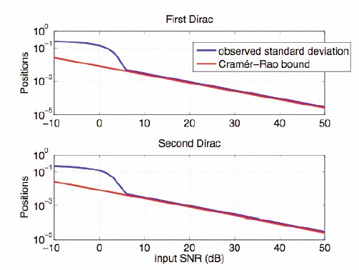
Performance Bounds in Sparse Sampling
Samples are corrupted by additive noise.
This is a parametric estimation problem.
Unbiased algorithms have a covariance matrix lower bounded by CRB.
The proposed algorithm reaches CRB down to SNR of 5dB.

Slide 43
Performance Bounds in Sparse Sampling
Phase-transition
The ‘cut-off’ SNR can be predicted precisely [Wei-Dragotti-15]

Slide 44
Subspace Swap: One Dirac
Note: L = P + 1

Slide 45

Subspace Swap: Two Diracs

Slide 46
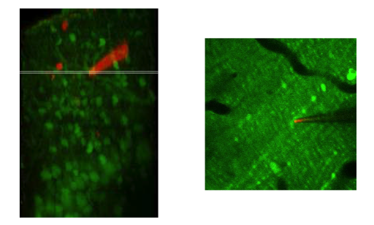
Sparse Sampling and Neuroscience
[OnativiaSD:13, ReynoldsSD:16]

Slide 47
Sparse Sampling and Neuroscience

Slide 48
Sparse Sampling and Neuroscience

Slide 49
Sparse Sampling and Neuroscience
The algorithm outperforms
state-of-the art methods
Can operate in real-time simultaneously on 80 streams
Increase in resolution by factor 3

Slide 50
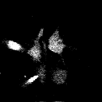

Segmentation and Calcium Transient Detection
[ReynoldsSD:16]

Slide 51
Estimating Temperature Fields with Sensor Networks
[MurrayBruceD:TSP15]

Slide 52
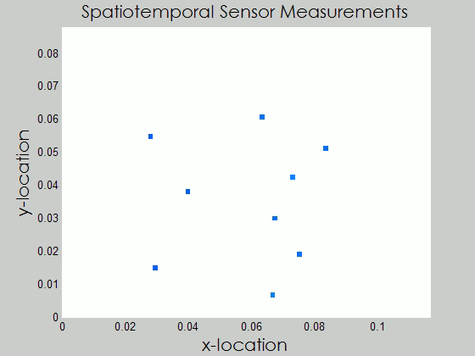
Estimating Temperature Fields with Sensor Networks

Slide 53
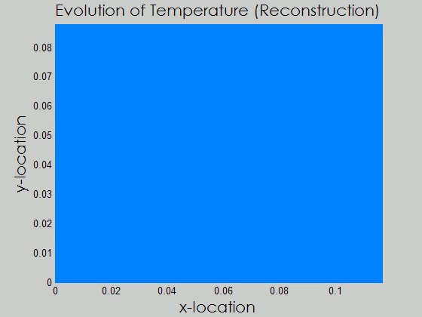
Estimating Temperature Fields with Sensor Networks

Slide 54
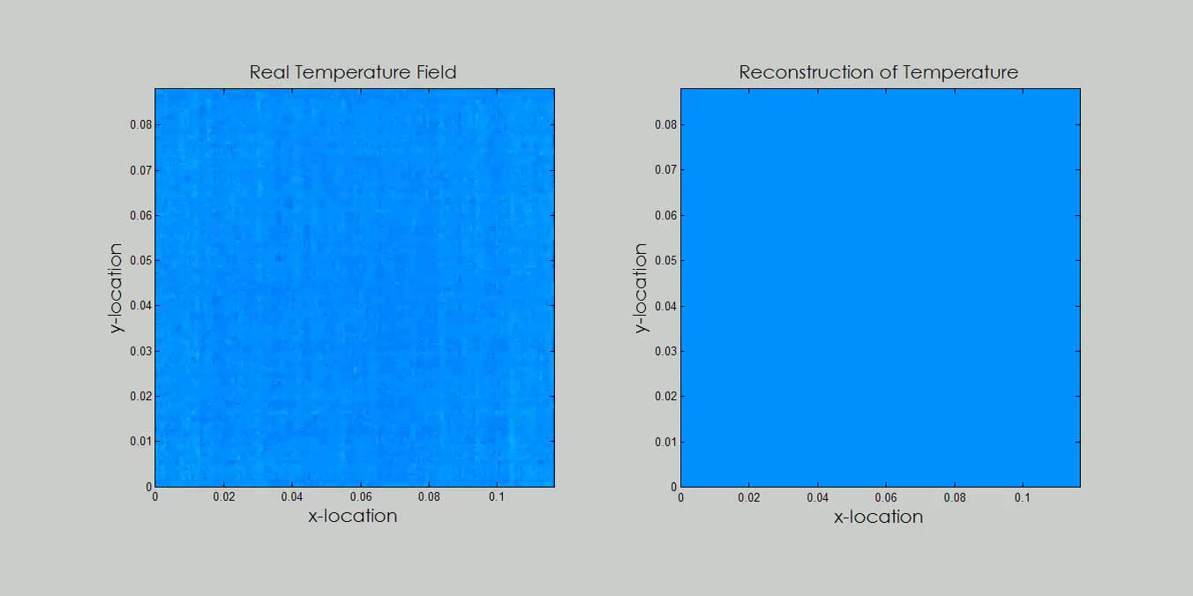
Estimating Temperature Fields with Sensor Networks

Slide 55
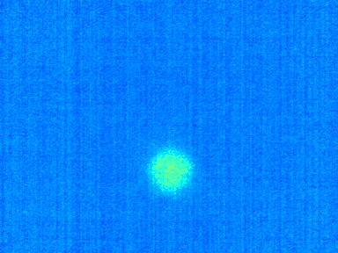
Localisation of Diffusion Sources: Real Data
Initial Thermal Map
0.08
0.07
0.06
0.05
^{x}2
0.04
0.1
4
0.03
0.08
Activation Time
3
0.02
x2
0.06
2
0.01
0.04
0.02
1
0
0
0 0.02 0.04 0.06 0.08 0.1
0
2
0
0.02 0.04 0.06 0.08
^{x}1
0.1
x1
4 6 8 10 12
Independent Trial Index
14 16 18 20

Slide 56
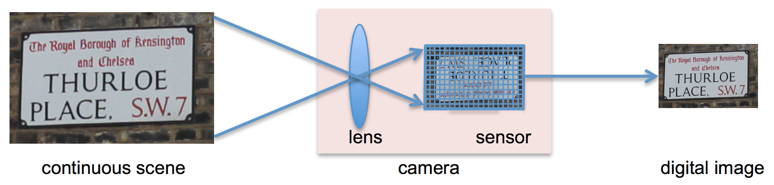
FRESH: FRI-based Single-Image Super-Resolution
Algorithm capable of increasing the resolution of digital images up to 4X.
Based on applying FRI-based Sampling Theory along several directions of the image
The upsampled images are merged using wavelet theory
Accurately retrieve fine details lost during the acquisition process.
[WeiD:TIP16]

Slide 57
FRESH: FRI-based Single-Image Super-Resolution

Slide 58
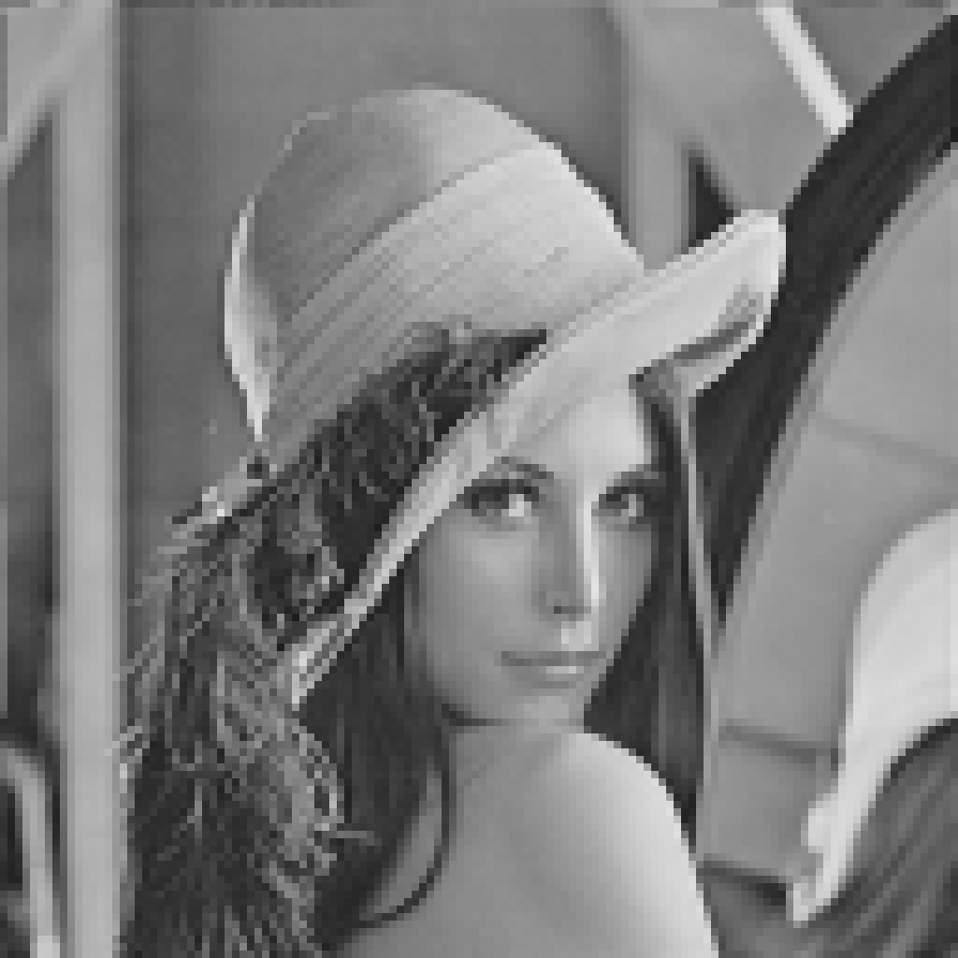
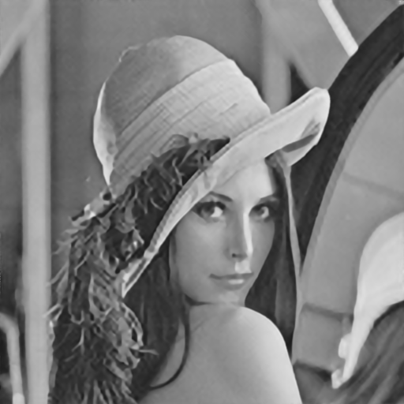
FRESH Results: Lena
Low-res input
128x128 pixels
Final result
512x512 pixels

Slide 59
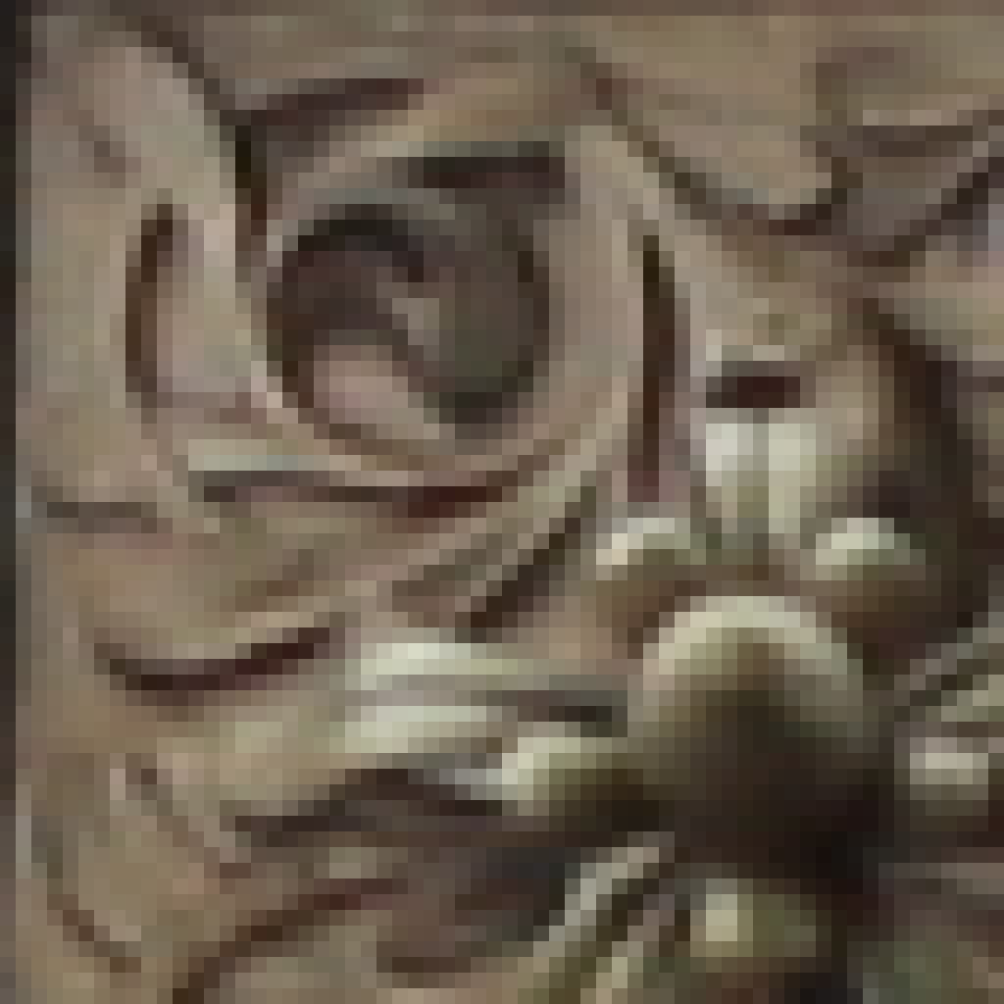
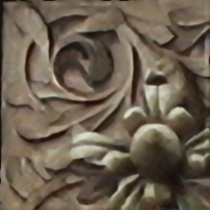
FRESH Results: Real Data
Low-res input
64 x64 pixels
Final result
256x256 pixels

Slide 60
Conclusions
Sparse Sampling:
New framework that allows the sampling and reconstruction of continuous-time non-bandlimited signals.
Use the knowledge of the acquisition process to map discrete measurements to specific integral measurements
Key Insights:
No need to discretize the input signals (use the mathematics of Hilbert and shift-invariant spaces)
Non-convex reconstruction algorithms (i.e., structured least-squares methods) often superior to other methods
Be creative with the notion of sparsity!
Carve the right solution for the problem at hand: discrete/continuous, convex/non-convex, noise/no-noise
Outlook: This is the era of inverse problem! Be prepared to witness and contribute to surprising new results and applications!

Slide 61
References
On sampling
J. Uriguen, T. Blu, and P.L. Dragotti ‘FRI Sampling with Arbitrary Kernels’, IEEE Trans. on Signal Processing, November 2013
T. Blu, P.L. Dragotti, M. Vetterli, P. Marziliano and L. Coulot ‘Sparse Sampling of Signal Innovations: Theory, Algorithms and Performance Bounds,’ IEEE Signal Processing Magazine, vol. 25(2), pp. 31-40, March 2008
P.L. Dragotti, M. Vetterli and T. Blu, ‘Sampling Moments and Reconstructing Signals of Finite Rate of Innovation: Shannon meets Strang-Fix’, IEEE Trans. on Signal Processing, vol.55 (5), pp.1741-1757, May 2007.
H. Pan, T. Blu, and P.L. Dragotti, ‘Sampling Curves with Finite Rate of Innovation’ IEEE Trans. on Signal Processing, January 2014.
X. Wei and P.L. Dragotti, Guaranteed Performance in the FRI setting, IEEE Signal Processing Letters, 2015

Slide 62
References (cont’d)
On Single-Image Image Super-Resolution
X. Wei and P.L. Dragotti, FRESH -FRI-based single image super-resolution algorithm, IEEE Trans on Image Processing, Vol.25(8), pp. 3723-3735, August 2016.
On Calcium Transient Detection
Jon Onativia, Simon R. Schultz, and Pier Luigi Dragotti, A Finite Rate of Innovation algorithm for fast and accurate spike detection from two-photon calcium imaging, Journal of Neural Engineering, August 2013.
S. Reynolds, C.S. Copeland, S. Schultz and P.L. Dragotti, An Extension of the FRI framework for Calcium Transient Detection, International Symposium on BioMedical Imaging, (ISBI), Prague, Czech Republic, April 2016.
On Diffusion Fields and Sensor Networks
John Murray-Bruce and Pier Luigi Dragotti, Estimating localized sources of diffusion fields using spatiotemporal sensor measurements, IEEE Trans. on Signal Processing, June 2015.

