Slide 1



Sensing the real world: Sparse Sampling meets Strang-Fix and Baron de Prony
Pier Luigi Dragotti Imperial College London
December 16, 2016¹
¹This research is supported by European Research Council ERC, project 277800 (RecoSamp)

Slide 2
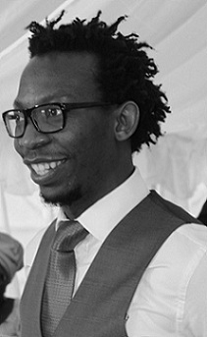
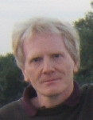
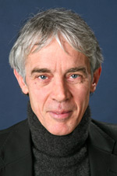
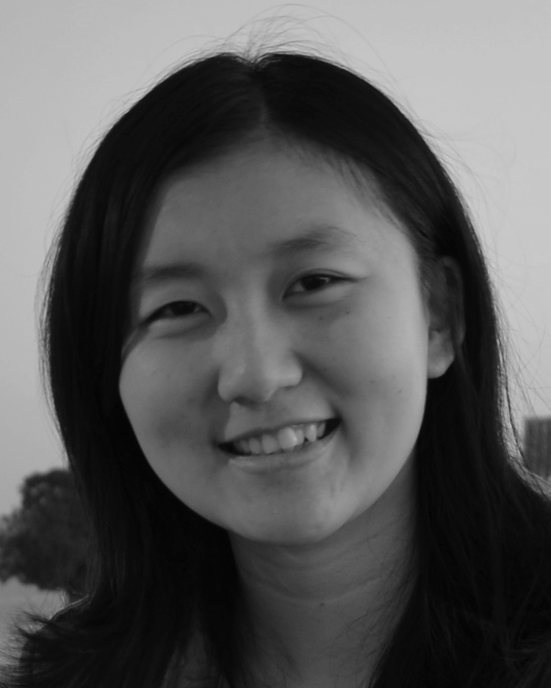
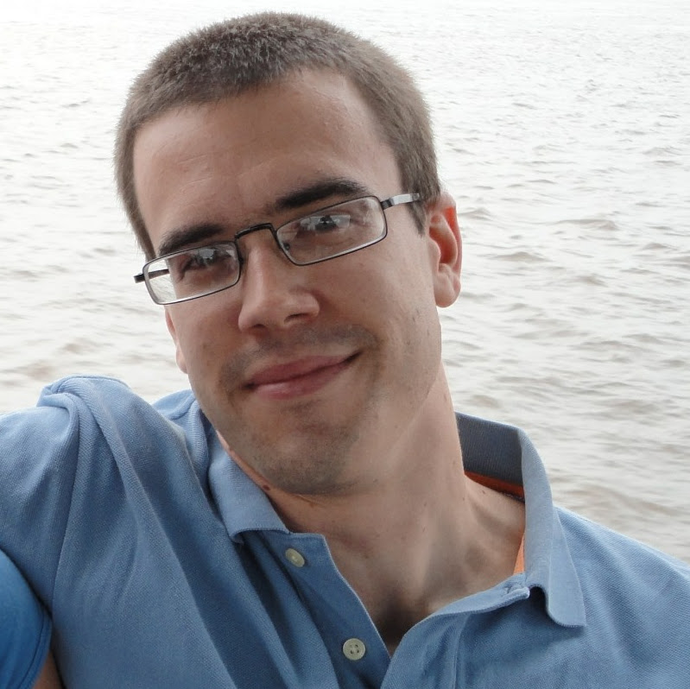
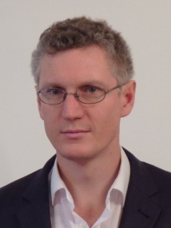
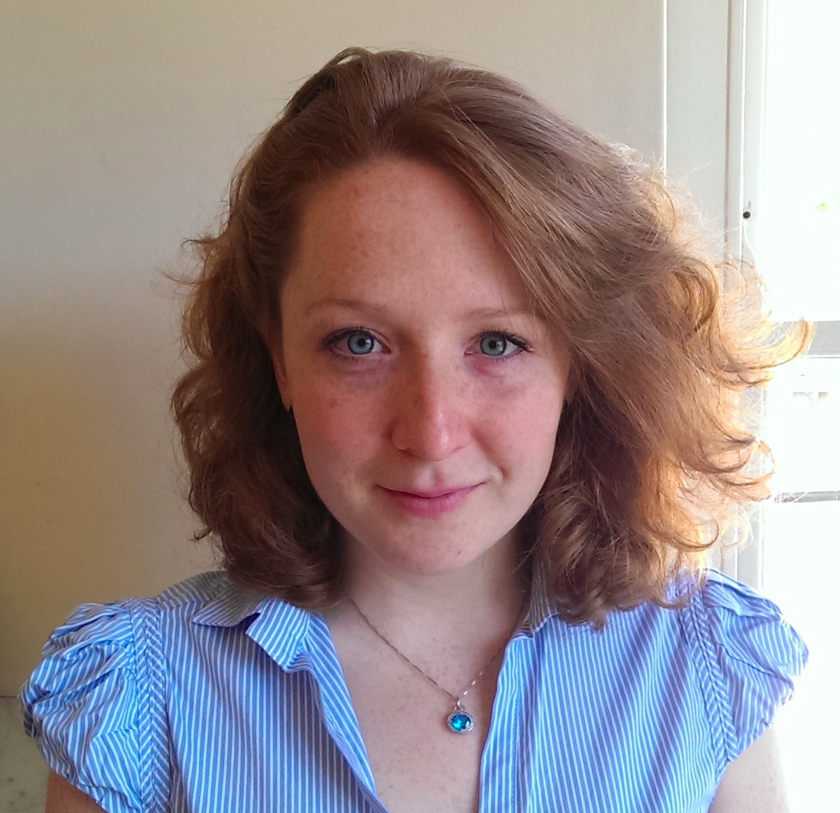
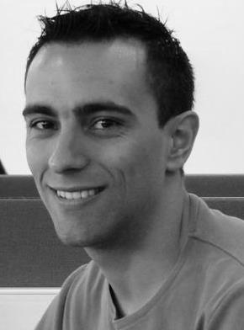
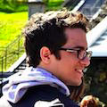
Special Thanks to Collaborators and Students

Slide 3
The Sampling Problem

Slide 4
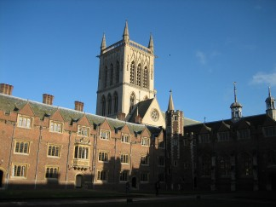

A few Interesting Applications: Digital Imaging
Real Scene
Digital Image
The real scene is analogue and is turned into a digital image by the camera
Can we overcome the limitation of the camera and, given the pixels, obtain a sharper image with arbitrary resolution?
Sparsity: Edges and contours can be modelled using a small number of parameters

Slide 5
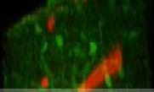
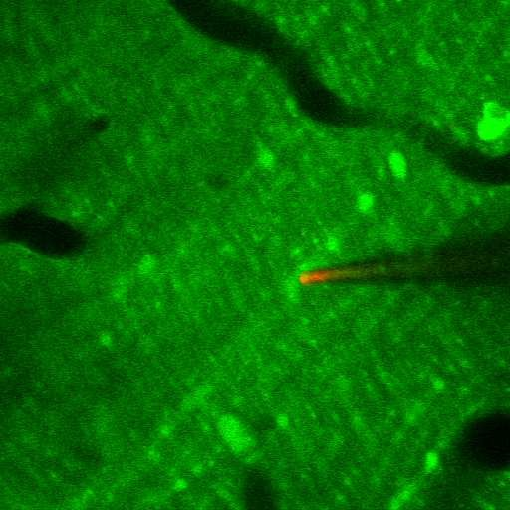
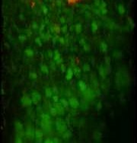
Application: Neuroscience
Goal: Understanding how information processing occurs in neural circuits.
0.4
0.35
0.3
0.25
0.2
0.15
0.1
0.05
0
35
40
45
Time (s)
50
55
60
Brain activity is analogue and it is observed with digital two-photon microscopes
Neurones communicate through pulses called Action Potentials (AP)
The problem of reconstructing the activity of a neurone is sparse when the shape of the AP is approximately known.

Slide 6
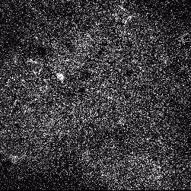
Application: Neuroscience
This is a multidimensional problem that requires simultaneously segmentation, denoising and time-resolution enhancement.
Note: Video from Simon Peron, Jeremy Freeman, Vijay Iyer, Karel Svoboda (2014); Calcium imaging data from vibrissal S1 neurons in adult mice performing a pole localization task.

Slide 7
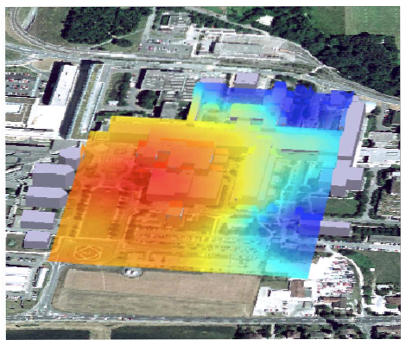
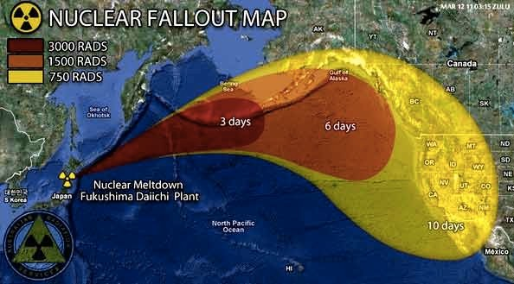
Application: Estimation of Diffusion Fields
Can we localise diffusion sources or acoustic sources using sensor networks?
Application:
1.Monitor dispersion in factories producing bio-chemicals 2.Check whether your government is lying ;-)
The diffusion field is analogue, spatio-temporal sensor measurements are digital

Slide 8
Problem Statement
What do all these problems have in common?
The world is analogue, computation is digital
The source is continuous in time and/or space, measurements are discrete (e.g., pixels in a camera, sensors measurements)
The data formation process is well understood and involves deterministic smoothing functions normally known a priori (e.g., point spread function in a camera, the diffusion kernel for diffusion fields)
Strong priors on the source to be estimated
Our Approach
From the samples, using the knowledge of the observation process, estimate proper integral measurements of the source (e.g., estimate the Fourier transform at specific frequencies)
Given the integral measurements (e.g., partial Fourier transform), solve the inverse/reconstruction problem using proper sparsity priors

Slide 9
Outline
Goal 1: to map the samples to partial Fourier information about x (t)
Sample Formation Process (Sampling kernels)
Reproduction of exponentials and generalised Strang-Fix conditions
Goal 2: from partial knowledge of x (t) to x (t)
Analogue sparsity: Signals with Finite Rate of Innovation (FRI)
Prony’s Methods and Structured Least-Squares Methods
Exact results and performance analysis
Applications
Neuroscience
Single Image Super-Resolution
Sensor Networks and Diffusion Fields

Slide 10
The Sampling Kernel

Slide 11
From Samples to Signals

Slide 12
From Samples to Signals

Slide 13
Exponential Reproducing Functions

Slide 14
Exponential Reproducing Functions

Slide 15
Approximation of Exponentials

Slide 16
Generalized Strang-Fix Conditions

Slide 17
Approximate Strang-Fix
Strang-Fix conditions are not restrictive
Any low-pass or band-pass filter approximately satisfies them.
Gaussian
E-spline
1
0.5
0
−3π −2π −π 0 π
ω [rad·s⁻¹ ]
2π 3π
π
3π/2
2π
5π/2

Slide 18
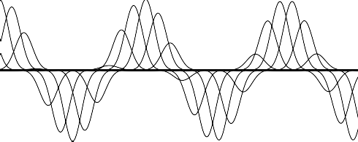
Reproduction of Exponentials (exact)
φ(t) is an E-spline

Slide 19
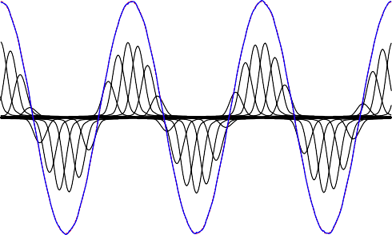
Approximate Strang-Fix
φ(t) from a real camera

Slide 20
Strang-Fix and the Acquisition Devices
We want the coefficients c_{m,n} that give as a good approximation of exponentials:
Some acquisition devices can do that exactly
Others can do it only approximately
Either cases we know how to find the best c_{m,n}
If you can design your own device make sure it satisfies the above
equation exactly

Slide 21
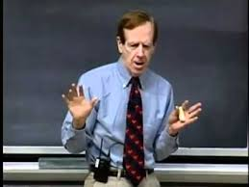
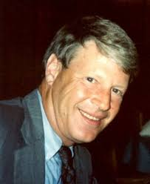
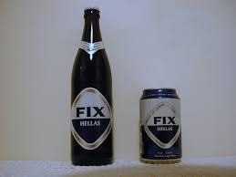
Strang-Fix and Generalized Strang-Fix Conditions
Original Strang-Fix conditions [Strang-Fix:71]
G. Strang G. Fix
Approximate and Generalized Strang-Fix [UriguenBluD:TSP13]

Slide 22
From Samples to Signals

Slide 23
Signals with Finite Rate of Innovation

Slide 24
Sampling Streams of Diracs

Slide 25
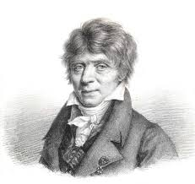
Prony’s Method

Slide 26
Overview of Prony’s Method

Slide 27
Overview of Prony’s Method

Slide 28
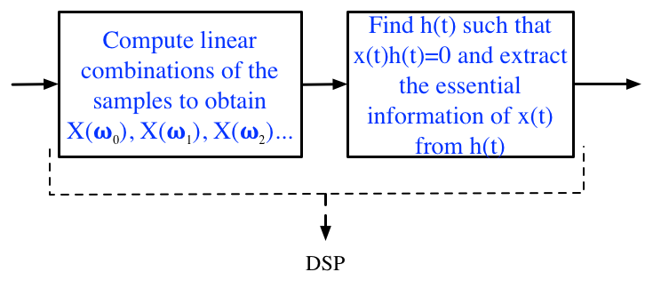
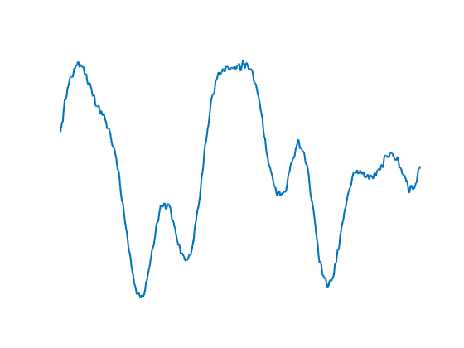
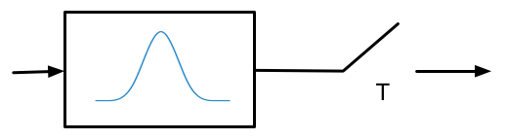
Sparse Sampling Overview

Slide 29
Sampling Streams of Diracs: Numerical Example

Slide 30
Stream of Decaying Exponentials
5
4
3
2
1
0
y(t)
5
4
3
2
1
0
0.06
yn
zn
0.04
0.02
0
0.5
t [s]
(a) Input signal, x(t)
1
0
0 0.5 1 1.5
0
0.5
t [s]
(c) Reconstructed signal
1
t [s]
(b) Filtered and sampled signal

Slide 31

Sampling 2-D domains
The curve is uniquely specified by a finite number of parameters which
are found through annihilation of the samples [PanBD:TIP14].

Slide 32
Performance Bounds in Sparse Sampling
The elusive trade-off between noise and resolution
Note: Image courtesy of Martin Vetterli

Slide 33
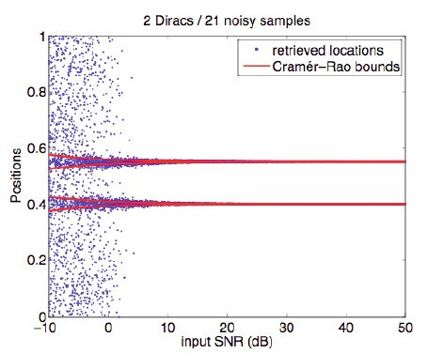
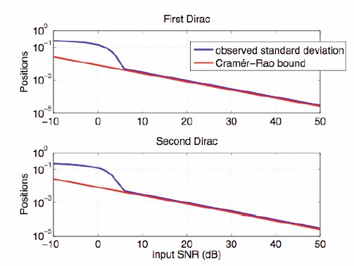
Performance Bounds in Sparse Sampling
Samples are corrupted by additive noise.
This is a parametric estimation problem.
Unbiased algorithms have a covariance matrix lower bounded by CRB.
The proposed algorithm reaches CRB down to SNR of 5dB.

Slide 34
Performance Bounds in Sparse Sampling
Phase-transition
The ‘cut-off’ SNR can be predicted precisely [Wei-Dragotti-15]

Slide 35
Phase Transition: Subspace Swap

Slide 36
Subspace Swap: One Dirac
Note: L = P + 1

Slide 37

Subspace Swap: Two Diracs

Slide 38
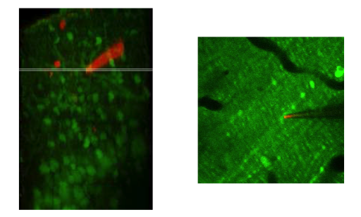
Sparse Sampling and Neuroscience
[OnativiaSD:13, ReynoldsSD:16]

Slide 39
Sparse Sampling and Neuroscience
Signal Model: Stream of decaying exponentials

Slide 40
Sparse Sampling and Neuroscience

Slide 41
Sparse Sampling and Neuroscience
The algorithm outperforms
state-of-the art methods
Can operate in real-time simultaneously on 80 streams
Increase in resolution by factor 3

Slide 42
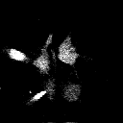

Segmentation and Calcium Transient Detection
[ReynoldsSD:16]

Slide 43
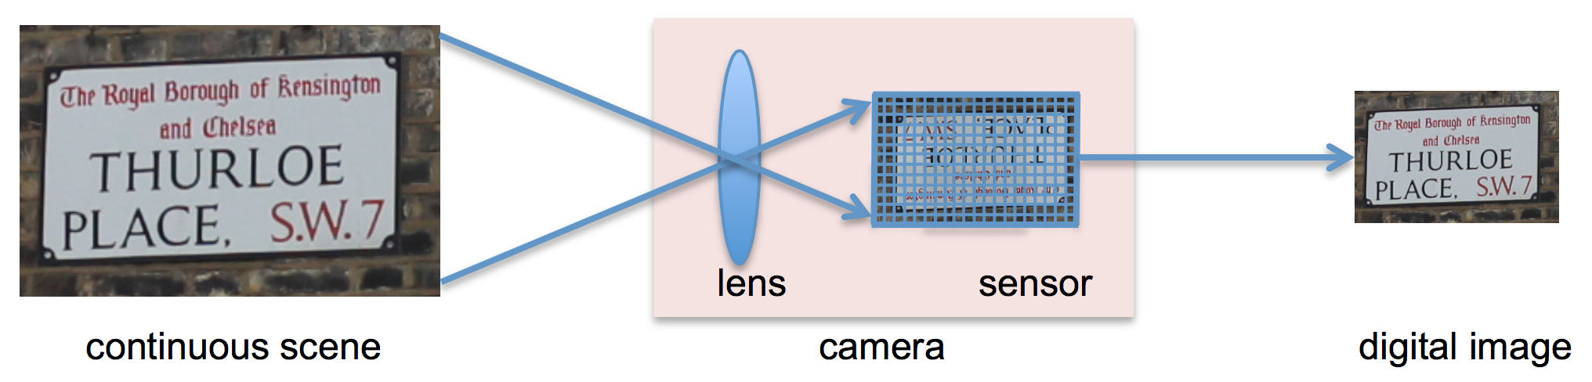
FRESH: FRI-based Single-Image Super-Resolution
Algorithm capable of increasing the resolution of digital images up to 4X.
Based on applying FRI-based sampling theory along several directions of the image
The upsampled images are merged using wavelet theory
Accurately retrieve fine details lost during the acquisition process.
[WeiD:TIP16]

Slide 44
FRESH: FRI-based Single-Image Super-Resolution
Key Insights:
  Rows and column of images are piecewise smooth signals
  Smooth part approximated with the wavelet low-pass coefficients
  Fine details recovered with FRI sampling methods.

Slide 45
FRESH: FRI-based Single-Image Super-Resolution

Slide 46
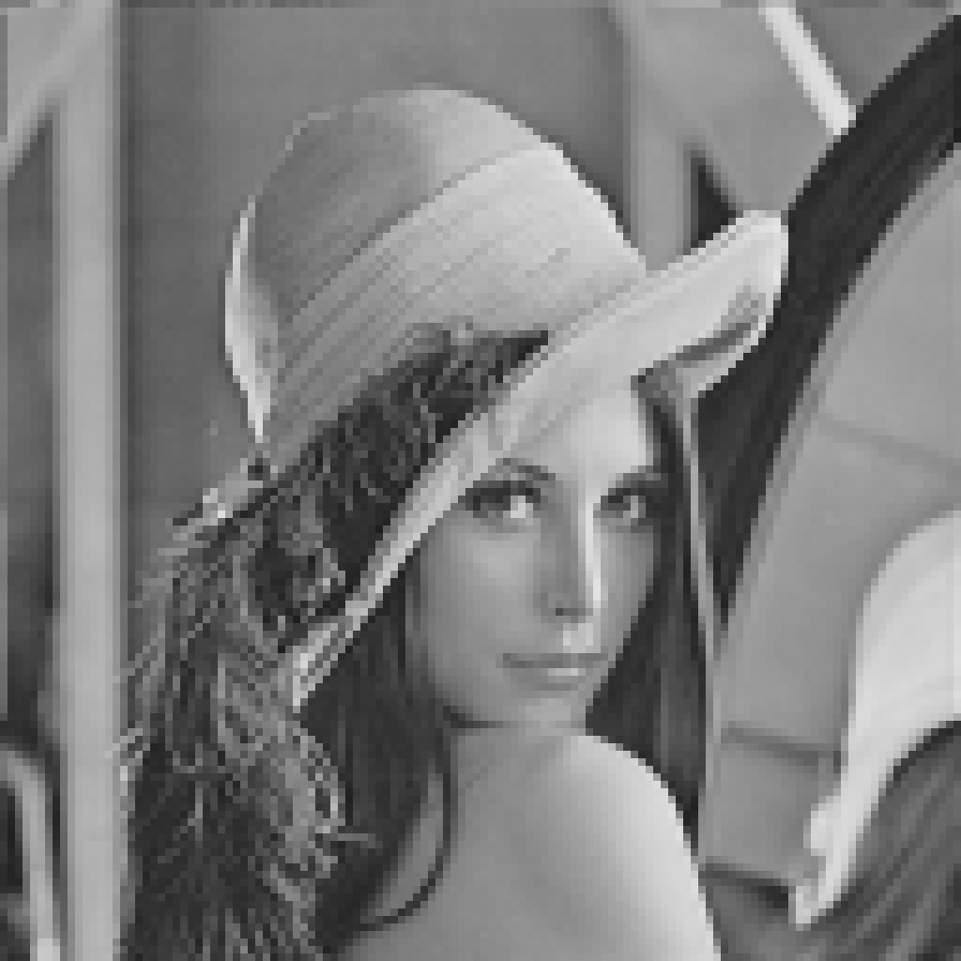

FRESH Results: Lena
Low-res input
128x128 pixels
Final result
512x512 pixels

Slide 47
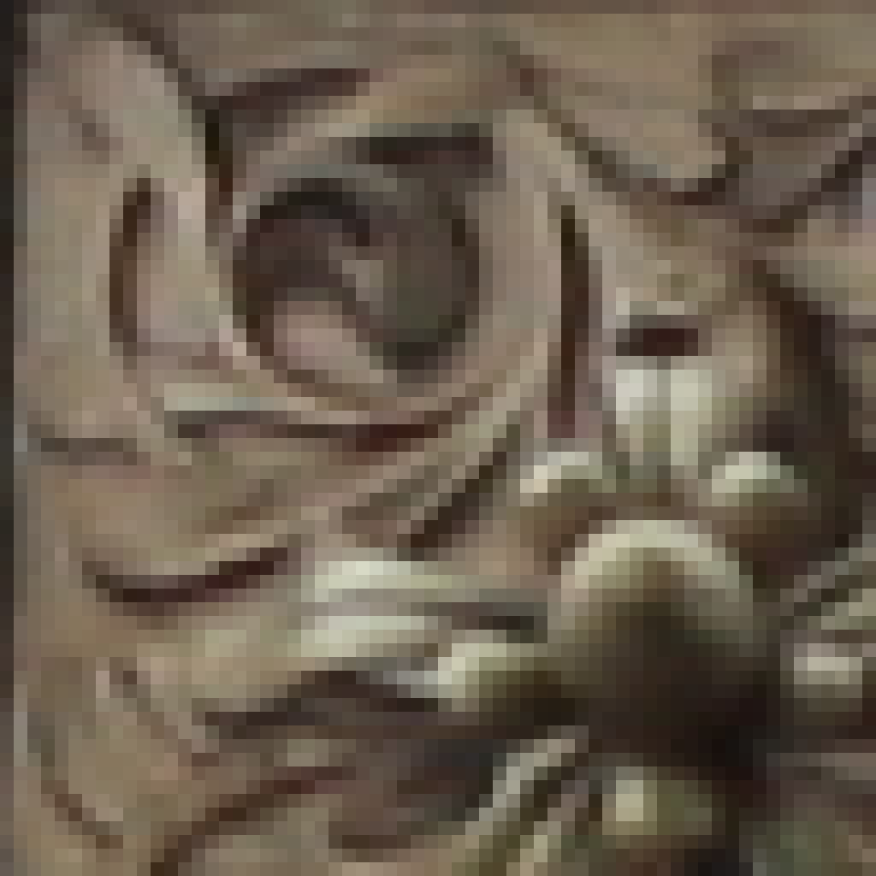
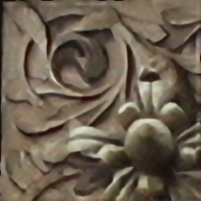
FRESH Results: Real Data
Low-res input
64 x64 pixels
Final result
256x256 pixels

Slide 48
Estimating Temperature Fields with Sensor Networks
[MurrayBruceD:TSP15]

Slide 49
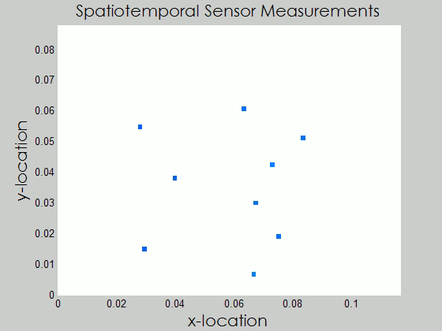
Estimating Temperature Fields with Sensor Networks

Slide 50
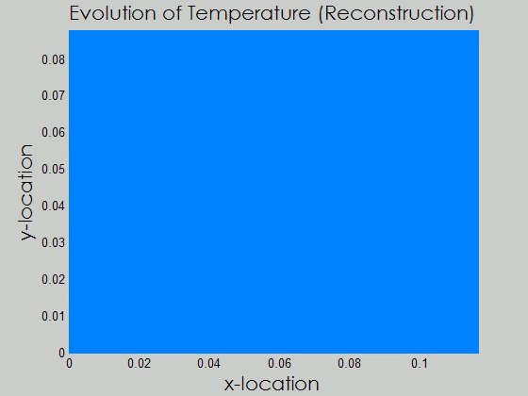
Estimating Temperature Fields with Sensor Networks

Slide 51
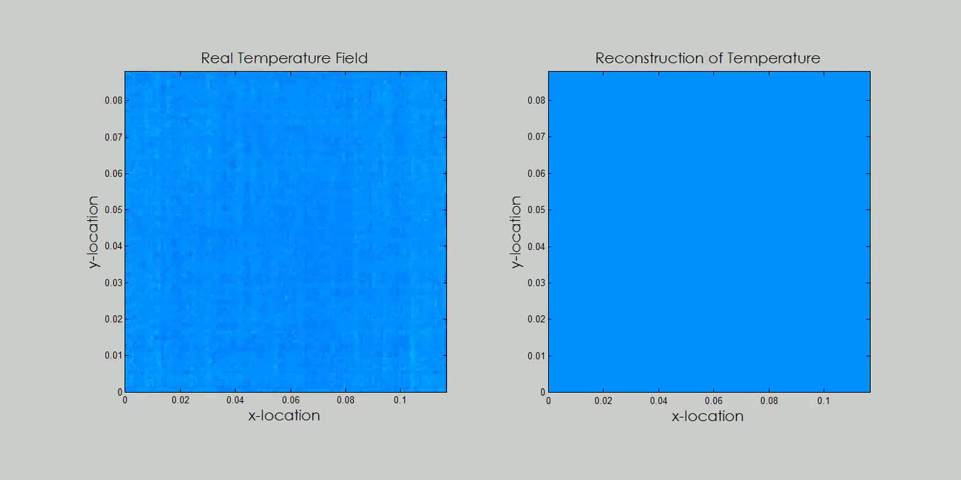
Estimating Temperature Fields with Sensor Networks

Slide 52
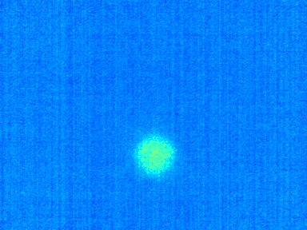
Localisation of Diffusion Sources: Real Data
Initial Thermal Map
0.08
0.07
0.06
0.05
^{x}2
0.04
0.1
4
0.03
0.08
Activation Time
3
0.02
x2
0.06
2
0.01
0.04
0.02
1
0
0
0 0.02 0.04 0.06 0.08 0.1
0
2
0
0.02 0.04 0.06 0.08
^{x}1
0.1
x1
4 6 8 10 12
Independent Trial Index
14 16 18 20

Slide 53
Conclusions
Sparse Sampling:
New framework that allows the sampling and reconstruction of continuous-time non-bandlimited signals.
Use the knowledge of the acquisition process to map discrete measurements to specific integral measurements
Key Insights:
No need to discretize the input signals (use the mathematics of Hilbert and shift-invariant spaces)
Non-convex reconstruction algorithms (i.e., structured least-squares methods) often superior to other methods
Be creative with the notion of sparsity!
Carve the right solution for the problem at hand: discrete/continuous, convex/non-convex, noise/no-noise
Outlook: This is the era of inverse problem! Be prepared to witness and contribute to surprising new results and applications!

Slide 54
References
On sampling
J. Uriguen, T. Blu, and P.L. Dragotti ‘FRI Sampling with Arbitrary Kernels’, IEEE Trans. on Signal Processing, November 2013
T. Blu, P.L. Dragotti, M. Vetterli, P. Marziliano and L. Coulot ‘Sparse Sampling of Signal Innovations: Theory, Algorithms and Performance Bounds,’ IEEE Signal Processing Magazine, vol. 25(2), pp. 31-40, March 2008
P.L. Dragotti, M. Vetterli and T. Blu, ‘Sampling Moments and Reconstructing Signals of Finite Rate of Innovation: Shannon meets Strang-Fix’, IEEE Trans. on Signal Processing, vol.55 (5), pp.1741-1757, May 2007.
H. Pan, T. Blu, and P.L. Dragotti, ‘Sampling Curves with Finite Rate of Innovation’ IEEE Trans. on Signal Processing, January 2014.
X. Wei and P.L. Dragotti, Guaranteed Performance in the FRI setting, IEEE Signal Processing Letters, 2015

Slide 55
References (cont’d)
On Single-Image Image Super-Resolution
X. Wei and P.L. Dragotti, FRESH -FRI-based single image super-resolution algorithm, IEEE Trans on Image Processing, Vol.25(8), pp. 3723-3735, August 2016.
On Calcium Transient Detection
Jon Onativia, Simon R. Schultz, and Pier Luigi Dragotti, A Finite Rate of Innovation algorithm for fast and accurate spike detection from two-photon calcium imaging, Journal of Neural Engineering, August 2013.
S. Reynolds, C.S. Copeland, S. Schultz and P.L. Dragotti, An Extension of the FRI framework for Calcium Transient Detection, International Symposium on BioMedical Imaging, (ISBI), Prague, Czech Republic, April 2016.
On Diffusion Fields and Sensor Networks
John Murray-Bruce and Pier Luigi Dragotti, Estimating localized sources of diffusion fields using spatiotemporal sensor measurements, IEEE Trans. on Signal Processing, June 2015.

Slide 56
Approximation of Exponentials - Proof

Slide 57
Approximation of Exponentials - Proof

